Slide 1

O-Pitblast – Overview

Slide 2
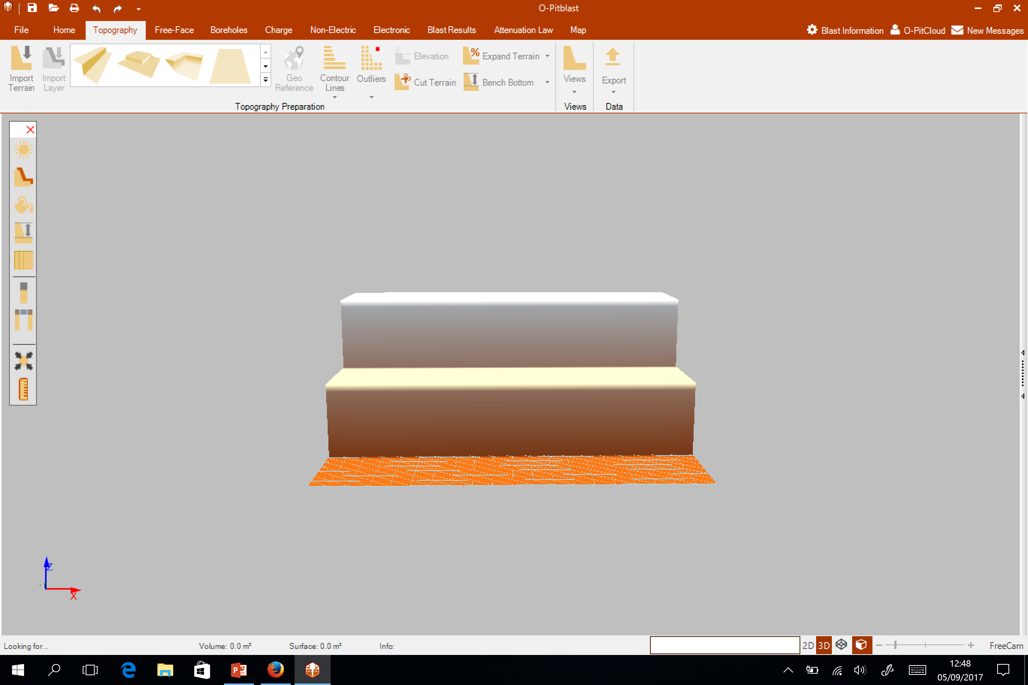
O-Pitblast - Overview

Slide 3
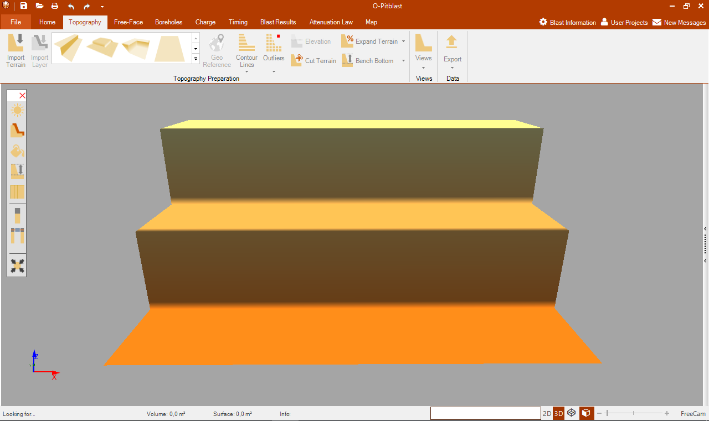

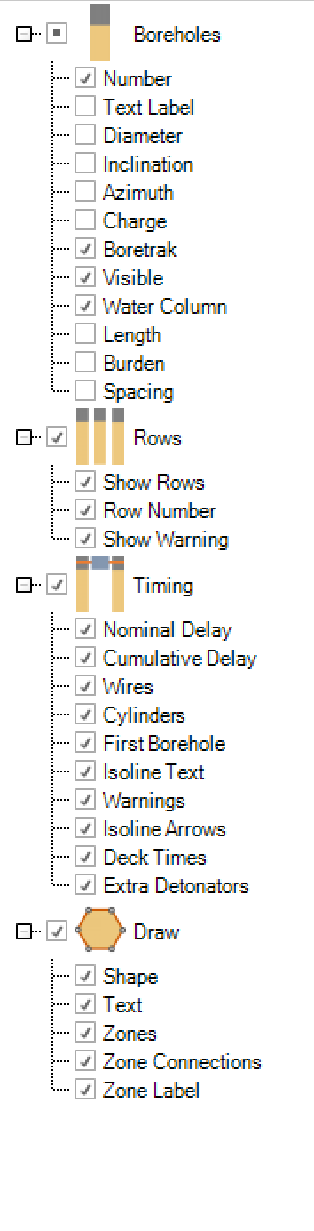
O-Pitblast - Overview
Quick Access Toolbar
General Control Bar
Toolbox
Viewing Options Bar
Status Bar

Slide 4
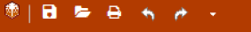
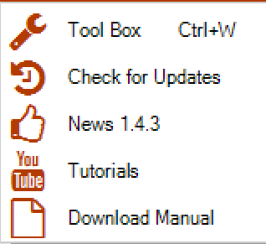
O-Pitblast - Overview
Quick Access Toolbar
Toolbox and Check for Updates
Re-do
Undo
Print Report
Open
Save

Slide 5
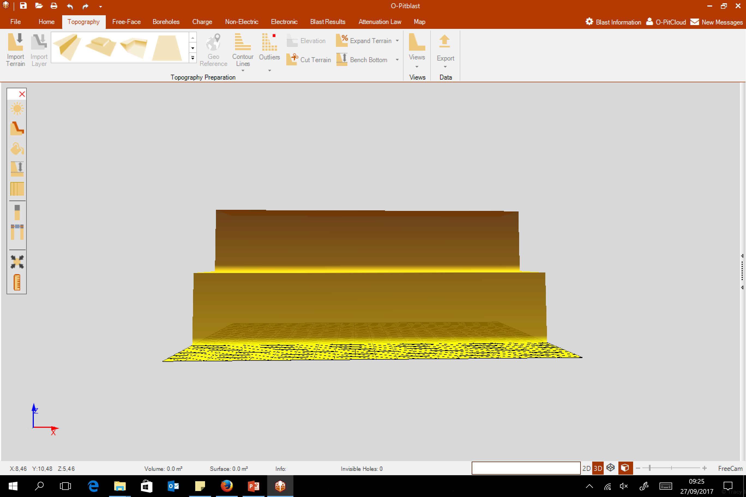
O-Pitblast - Overview
Status Bar
Status info
Surface and Volume
Coordinates
Status
View Options
Zoom Control
Selection Info
Interface

Slide 6
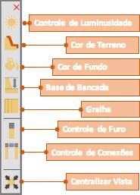

O-Pitblast - Overview
Lightning Control
Terrain Color
Sky Color
Bench Bottom
Grid
Hole Control
Timing Control
Centralize View
Ruller
Toolbox

Slide 7
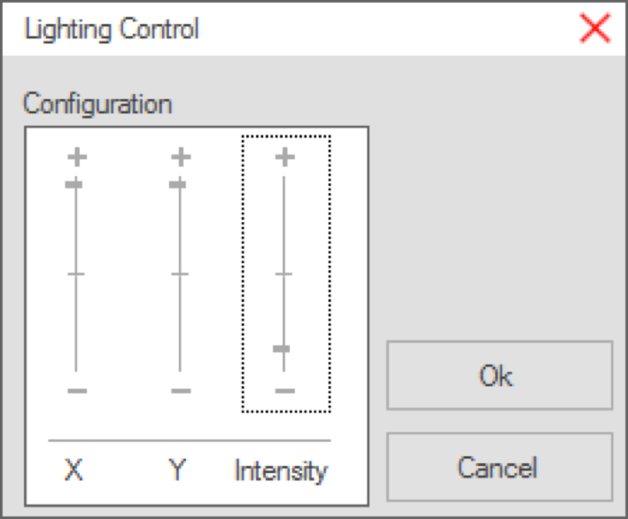
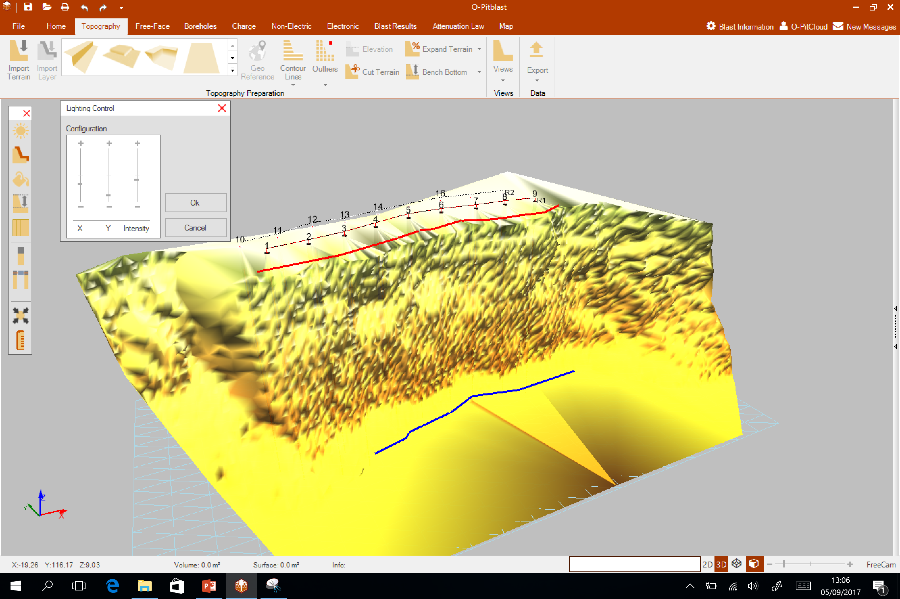
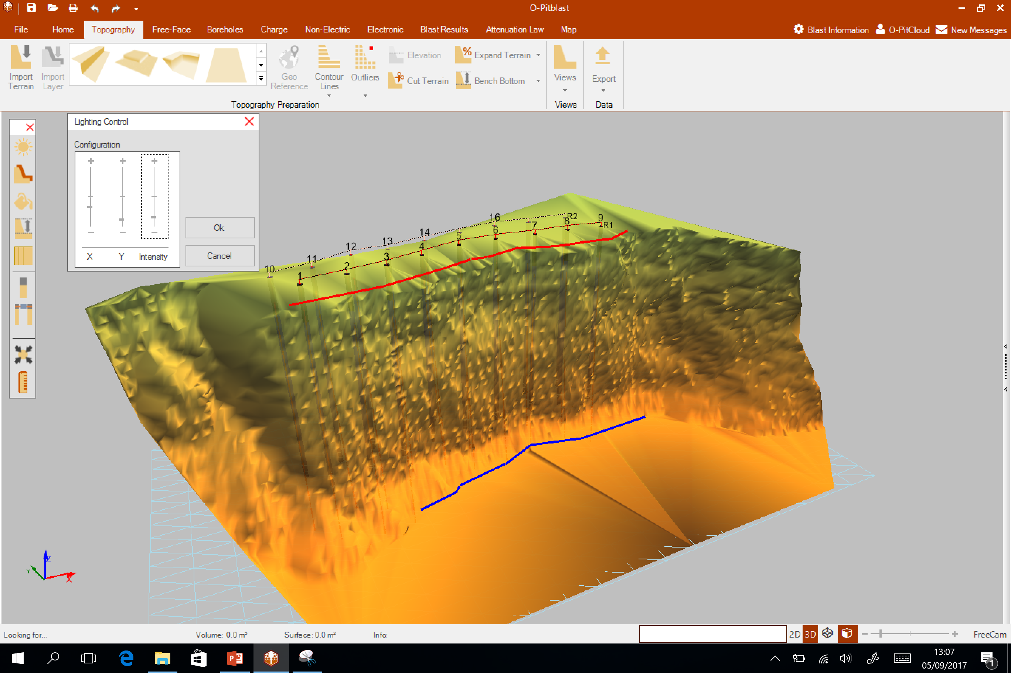
O-Pitblast - Overview
Lightning Control
Terrain Color
Sky Color
Bench Bottom
Grid
Hole Control
Timing Control
Centralize View
Ruller
Ruller
Toolbox

Slide 8
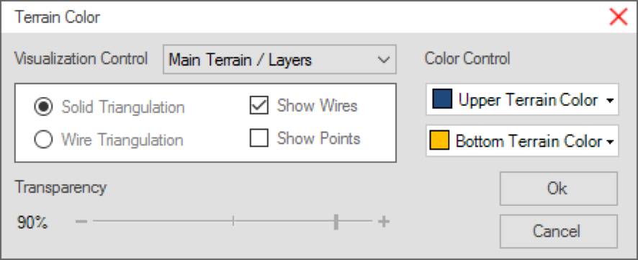
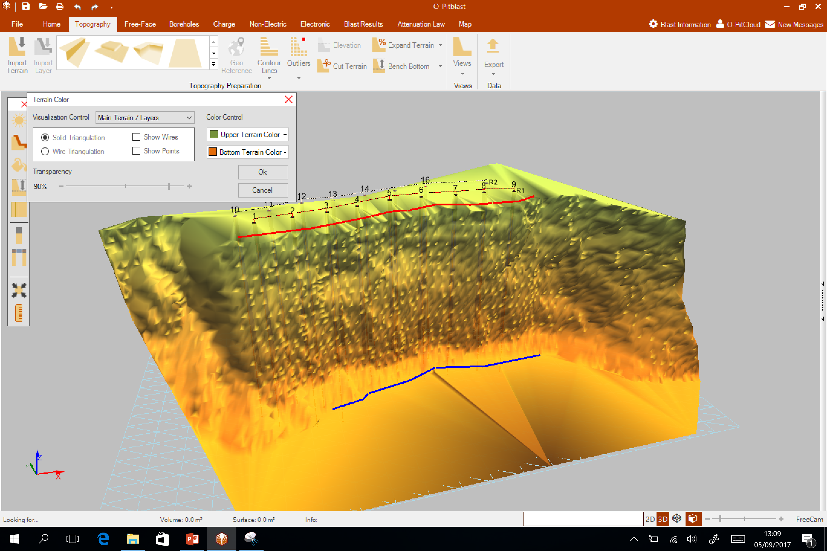
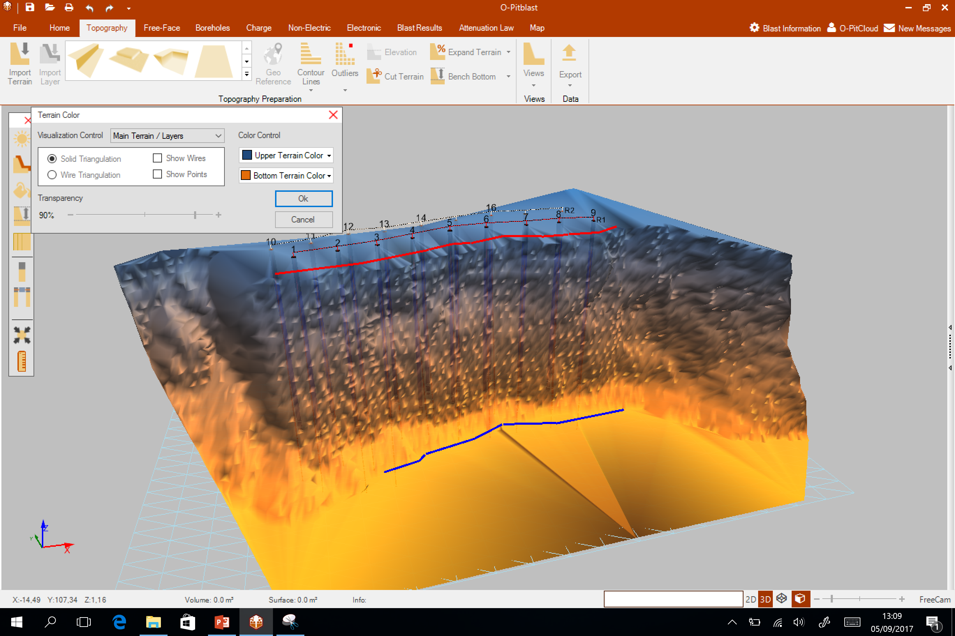
O-Pitblast - Overview
Lightning Control
Lightning Control
Terrain Color
Terrain Color
Sky Color
Sky Color
Bench Bottom
Bench Bottom
Grid
Grid
Hole Control
Hole Control
Timing Control
Timing Control
Centralize View
Centralize View
Ruller
Ruller

Slide 9
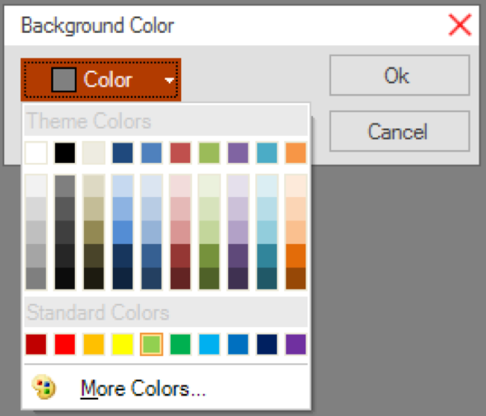
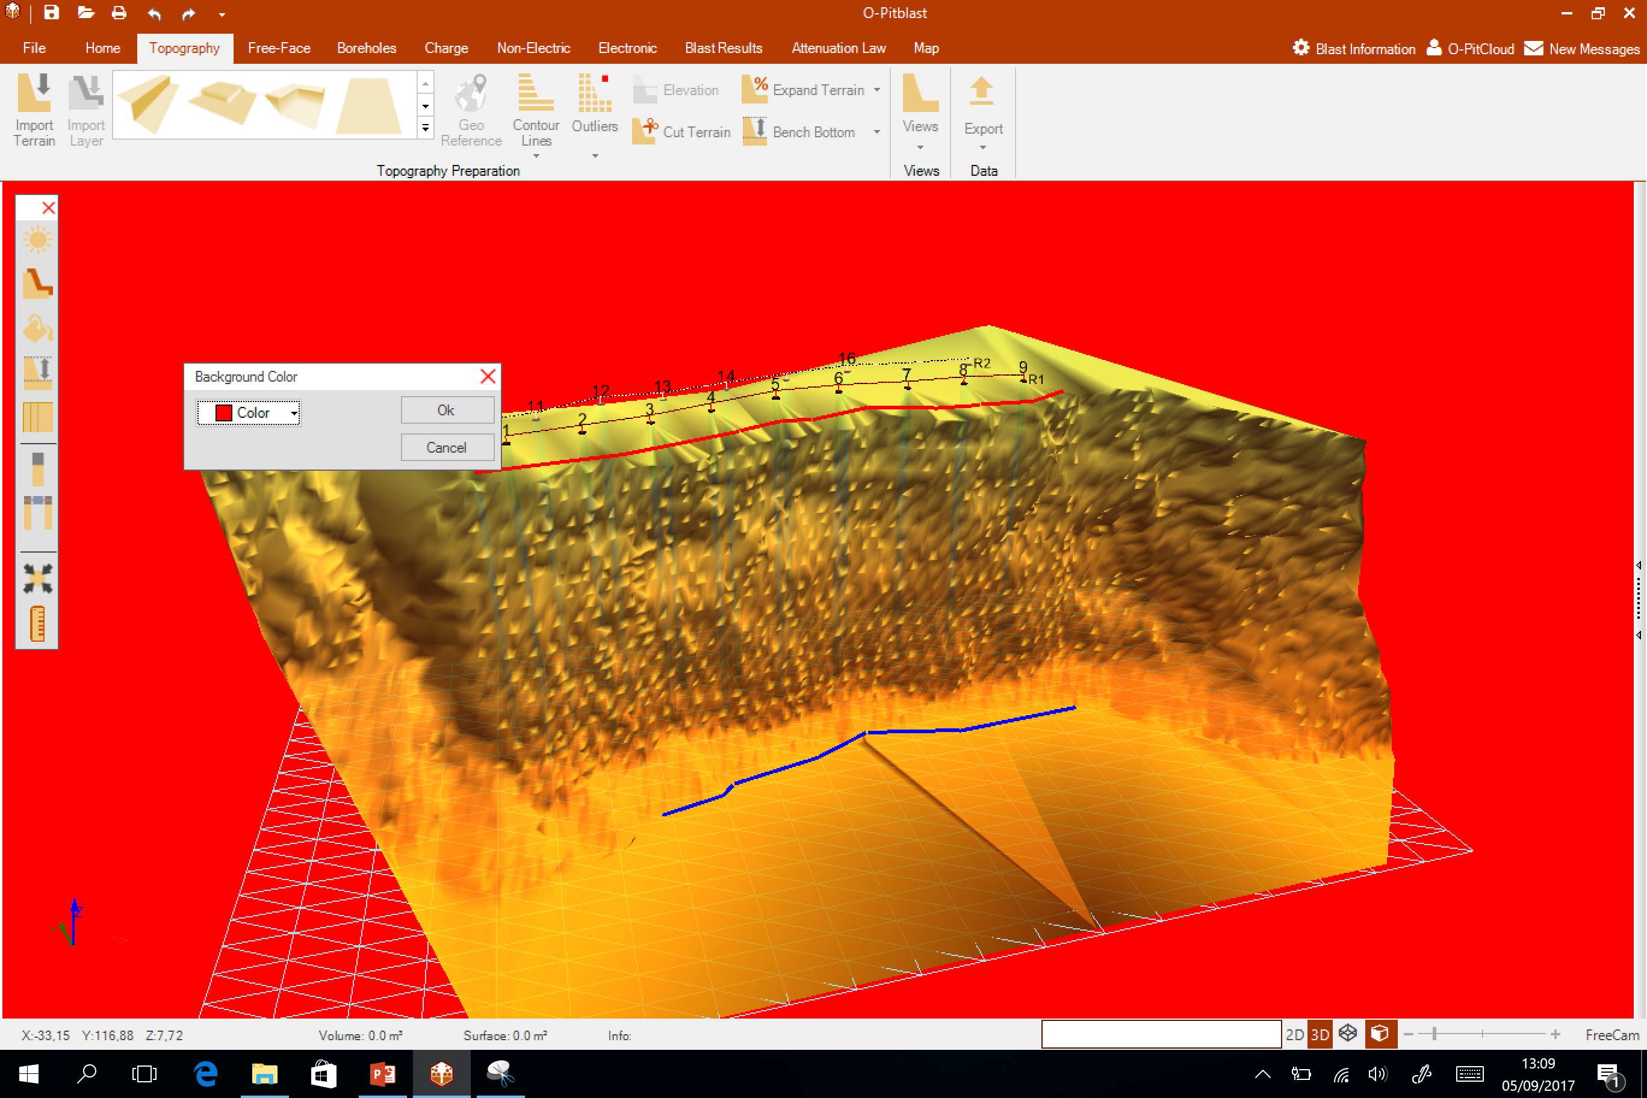
O-Pitblast - Overview
Lightning Control
Terrain Color
Sky Color
Bench Bottom
Grid
Hole Control
Timing Control
Centralize View
Ruller

Slide 10
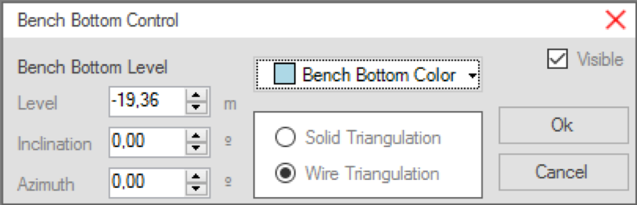
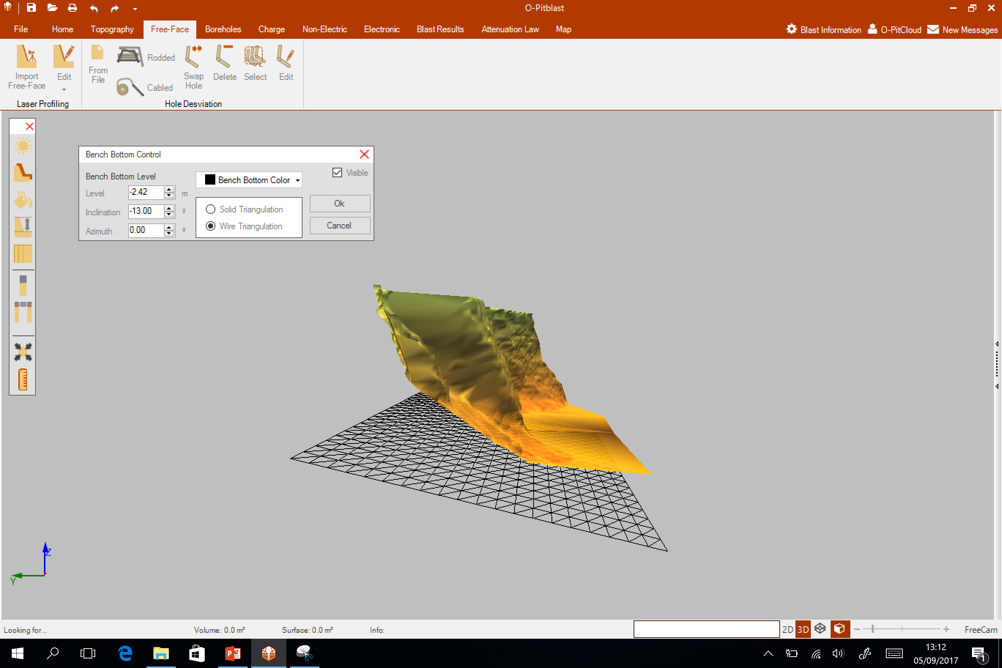
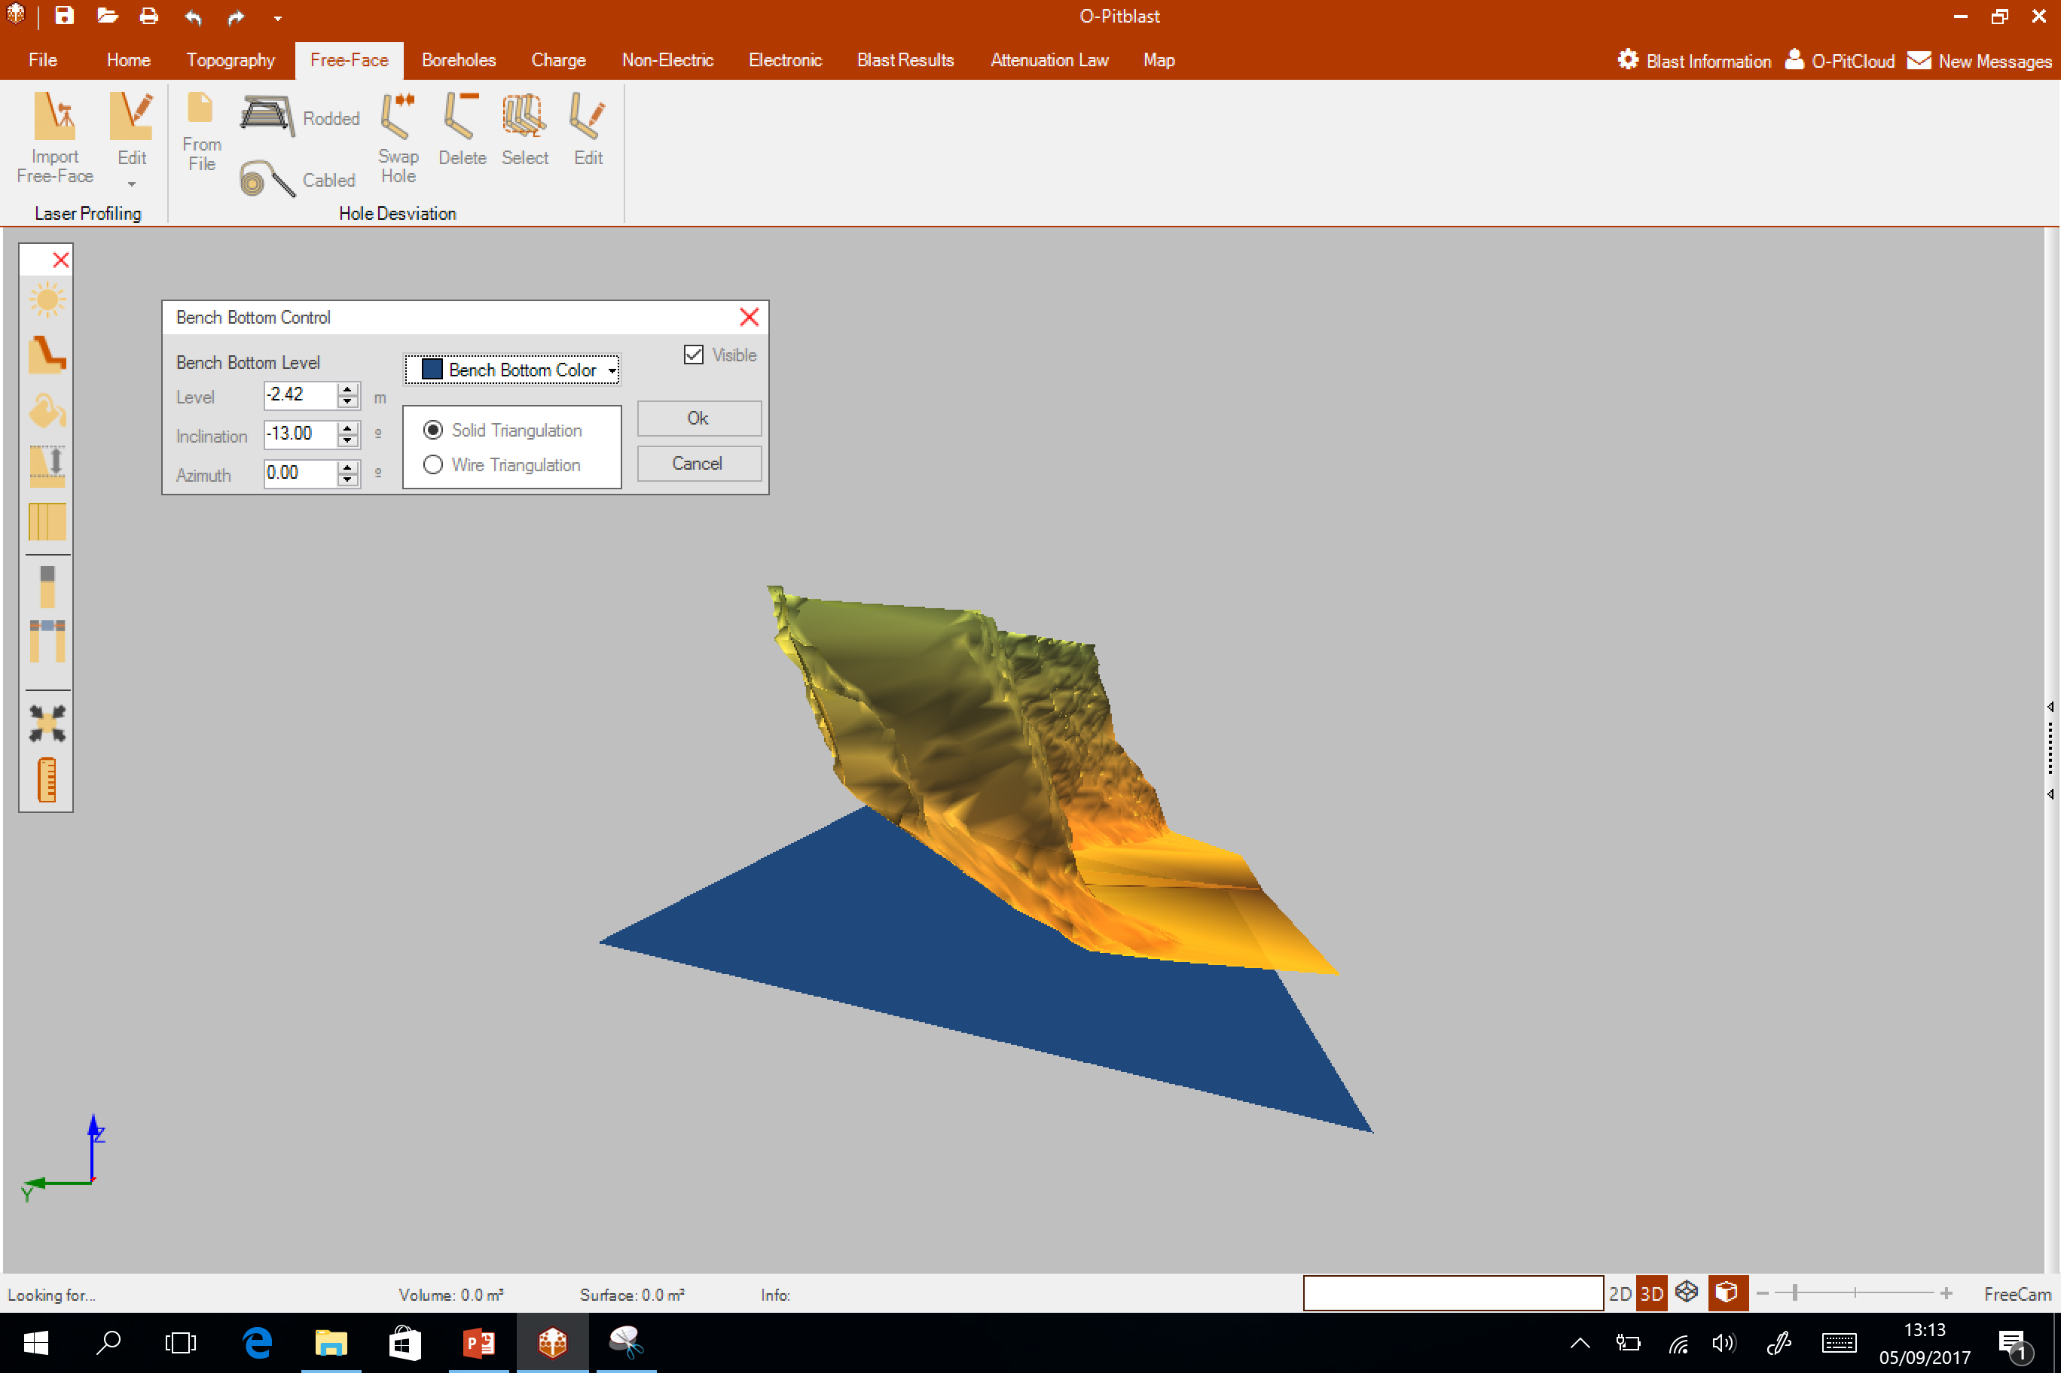
O-Pitblast - Overview
Lightning Control
Lightning Control
Terrain Color
Terrain Color
Sky Color
Sky Color
Bench Bottom
Bench Bottom
Grid
Grid
Hole Control
Hole Control
Timing Control
Timing Control
Centralize View
Centralize View
Ruller

Slide 11
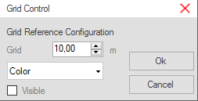
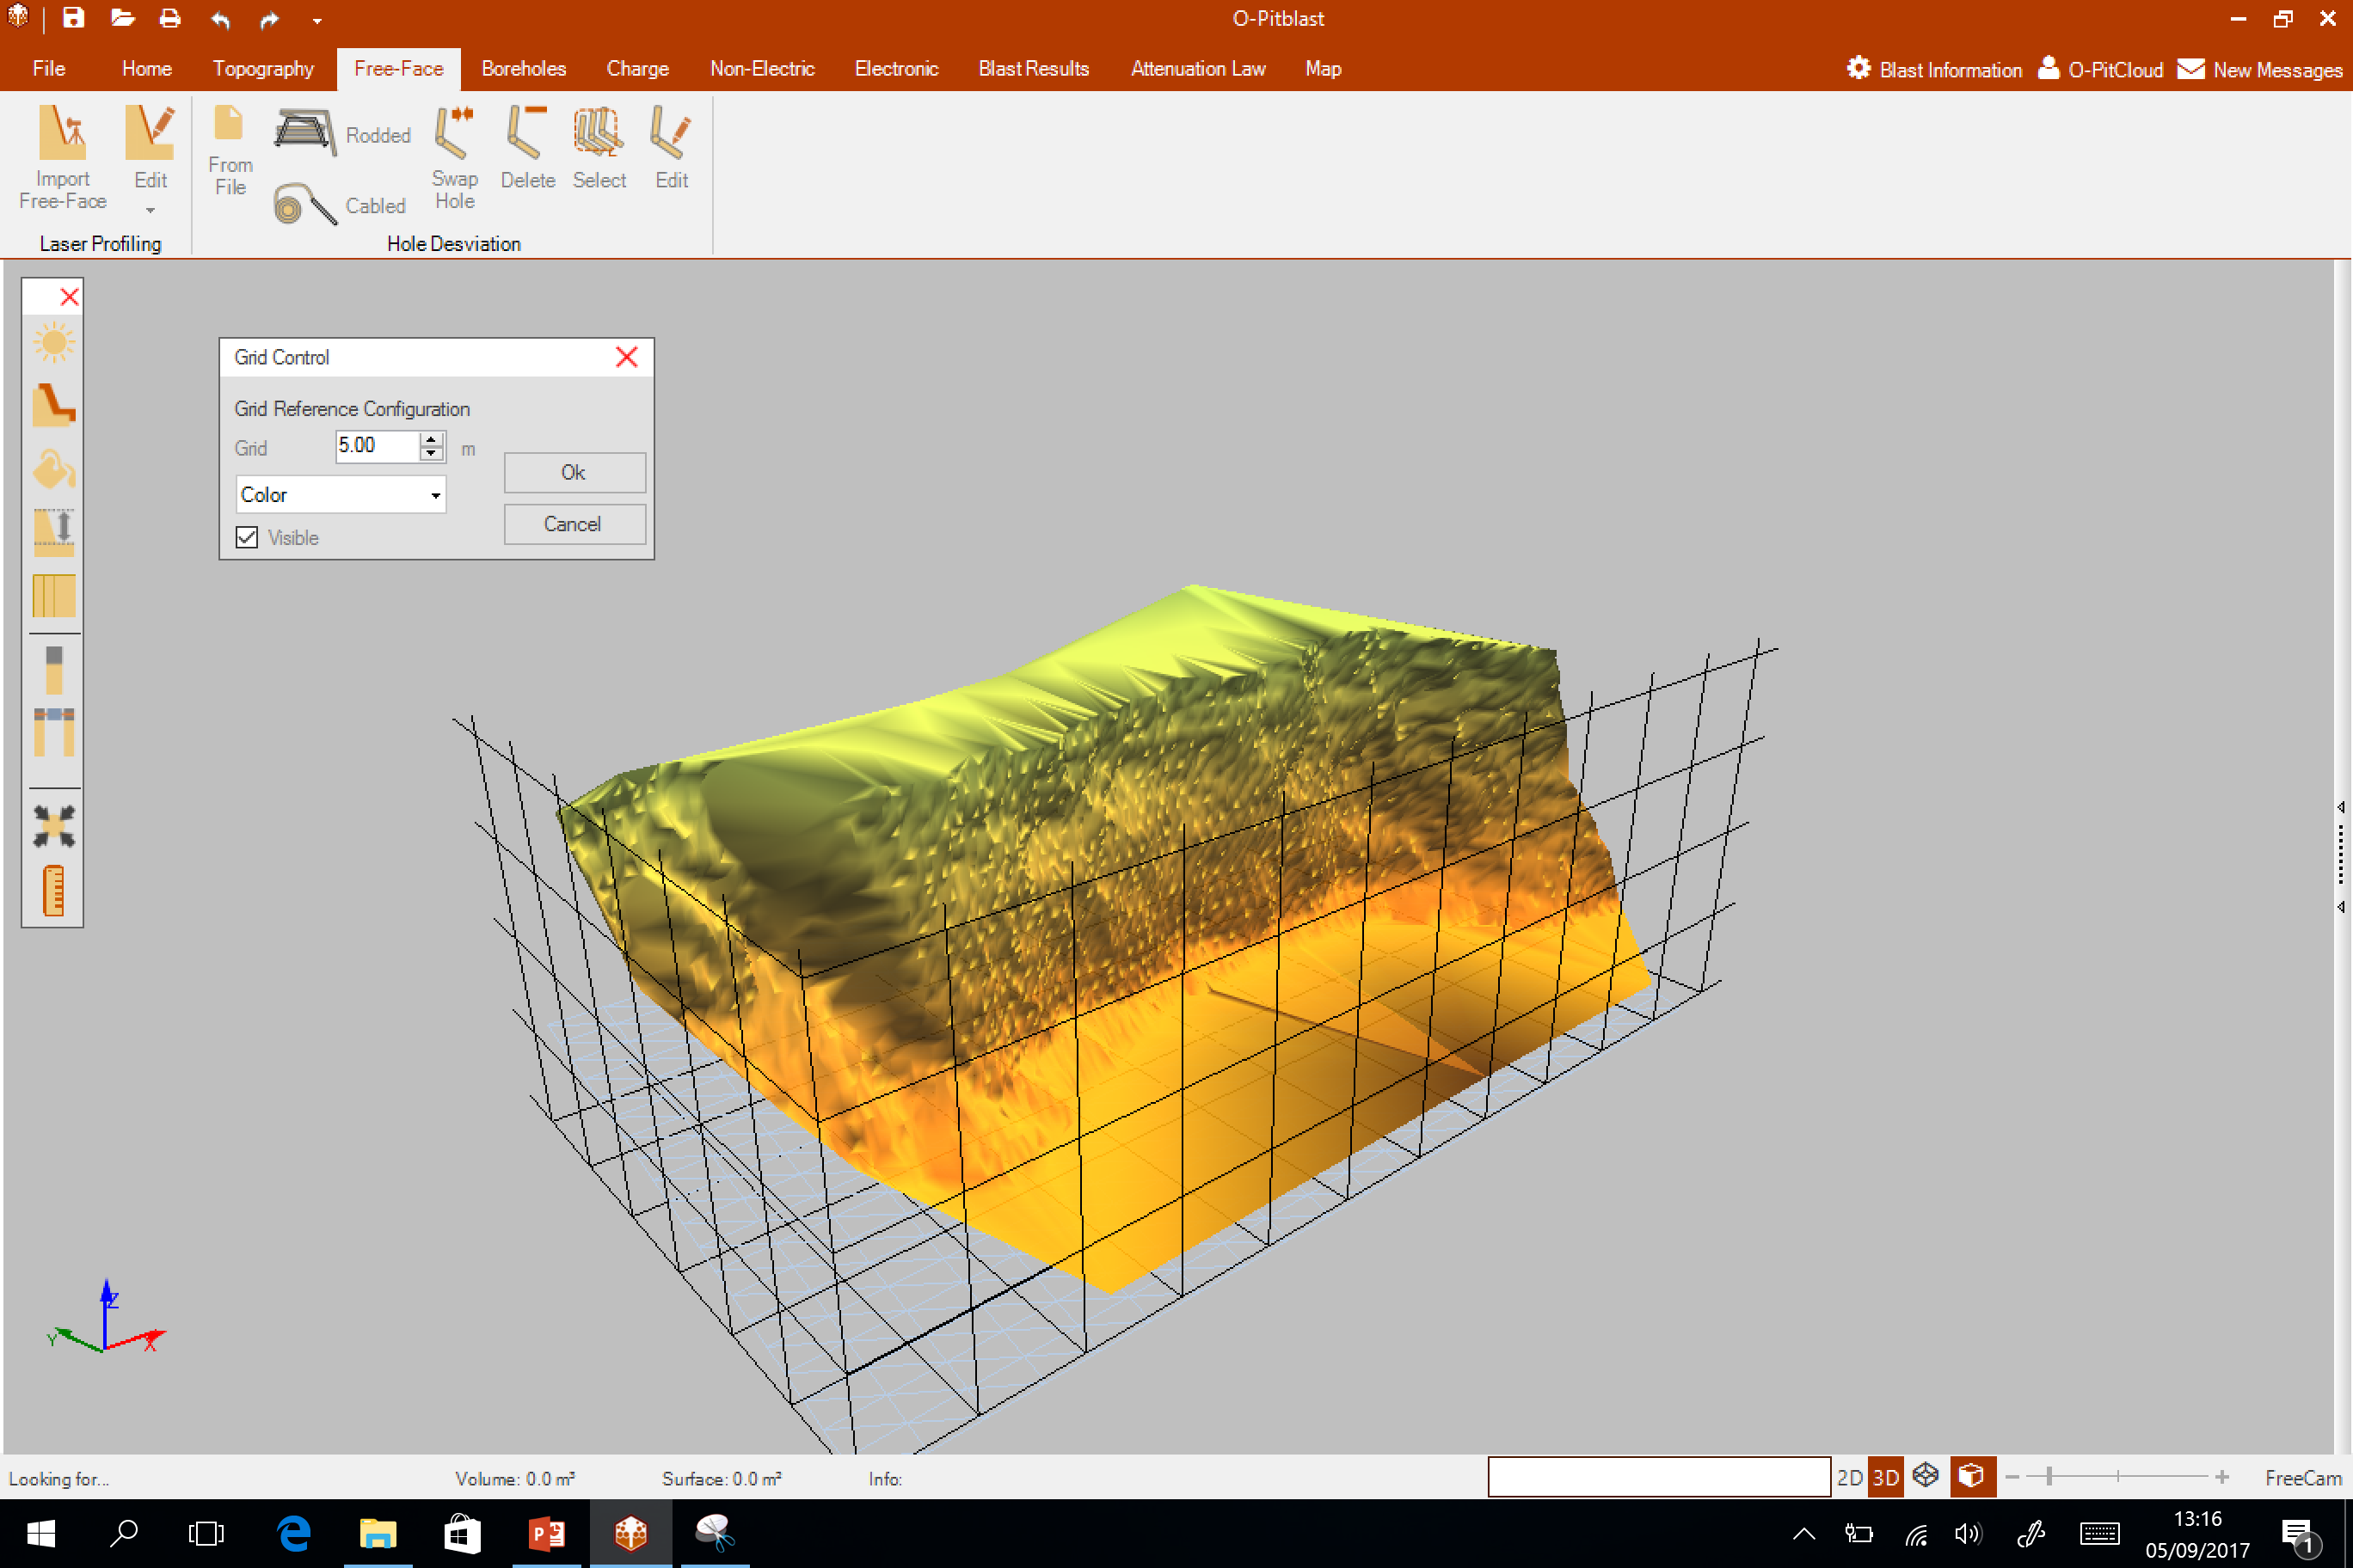
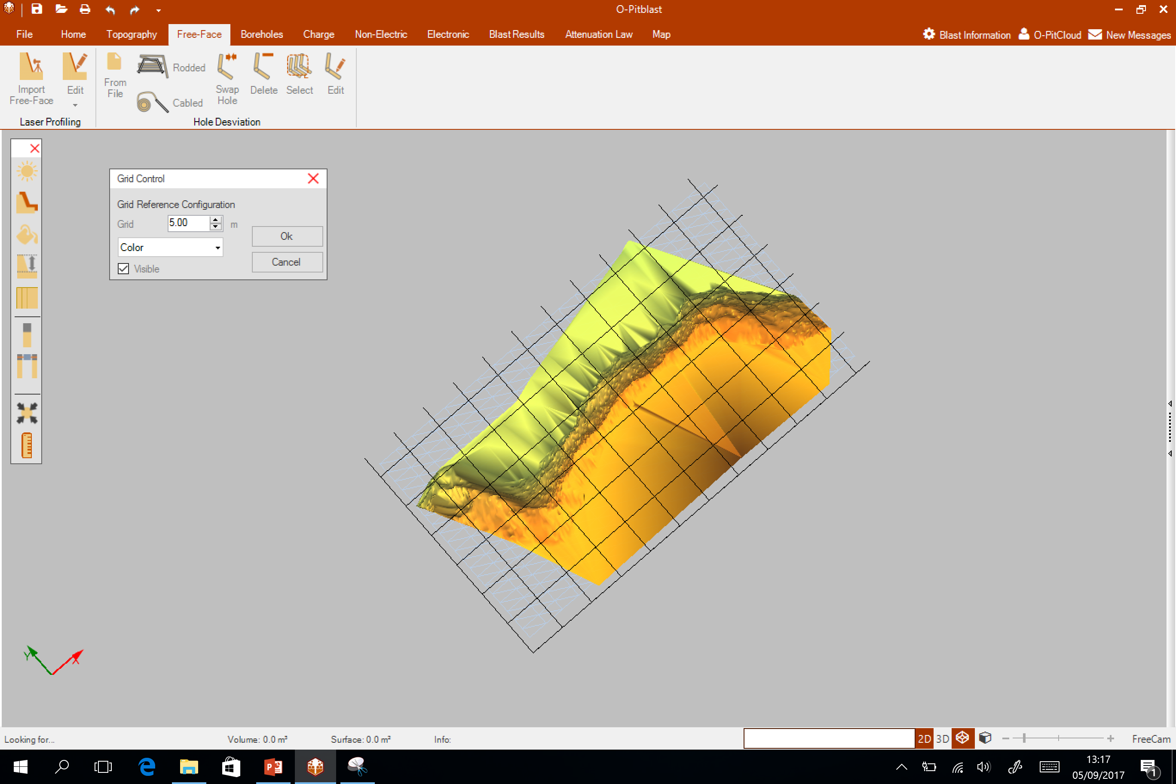
O-Pitblast - Overview
Lightning Control
Lightning Control
Terrain Color
Terrain Color
Sky Color
Sky Color
Bench Bottom
Bench Bottom
Grid
Grid
Hole Control
Hole Control
Timing Control
Timing Control
Centralize View
Centralize View
Ruller

Slide 12
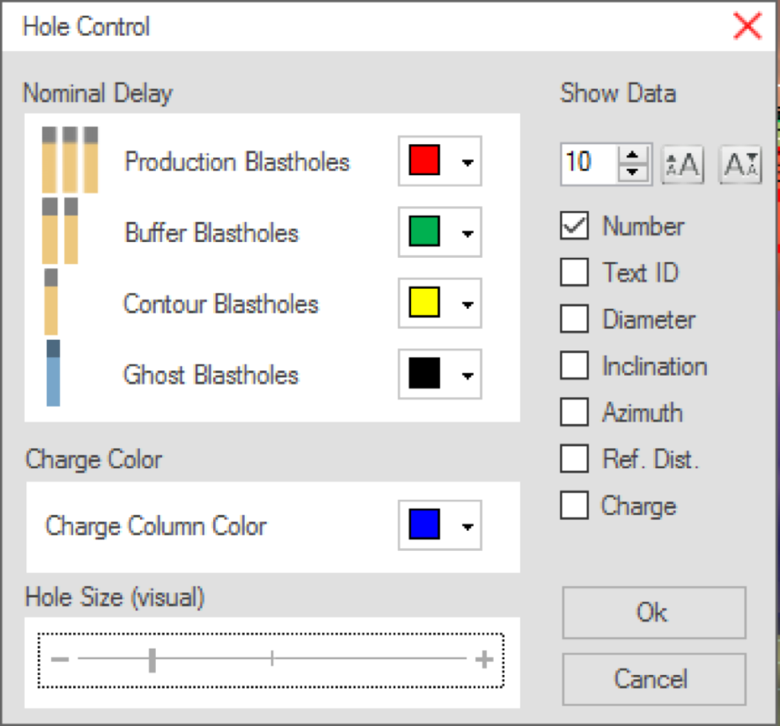
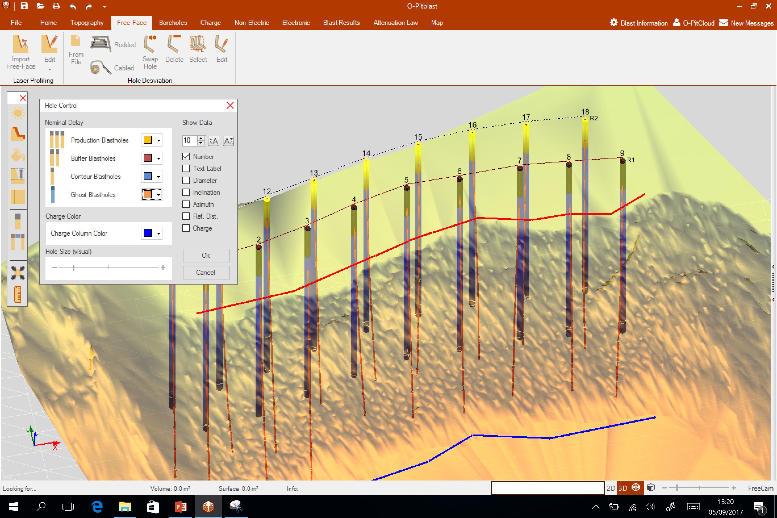
O-Pitblast - Overview
Lightning Control
Lightning Control
Terrain Color
Terrain Color
Sky Color
Sky Color
Bench Bottom
Bench Bottom
Grid
Grid
Hole Control
Hole Control
Timing Control
Timing Control
Centralize View
Centralize View
Ruller

Slide 13
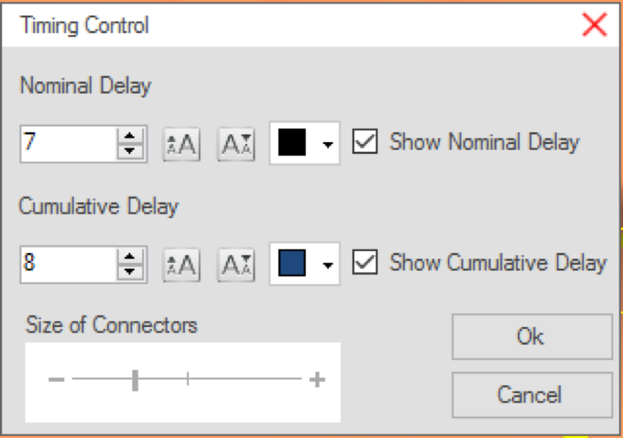
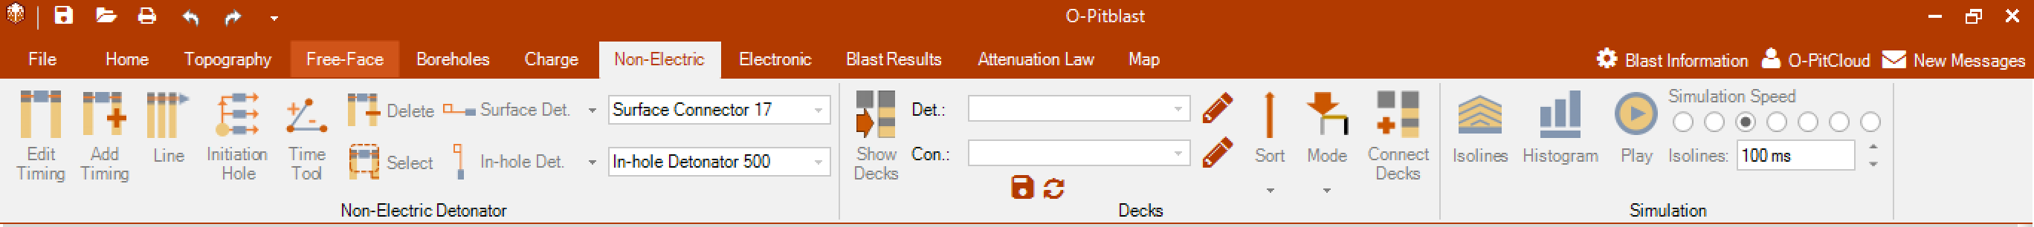
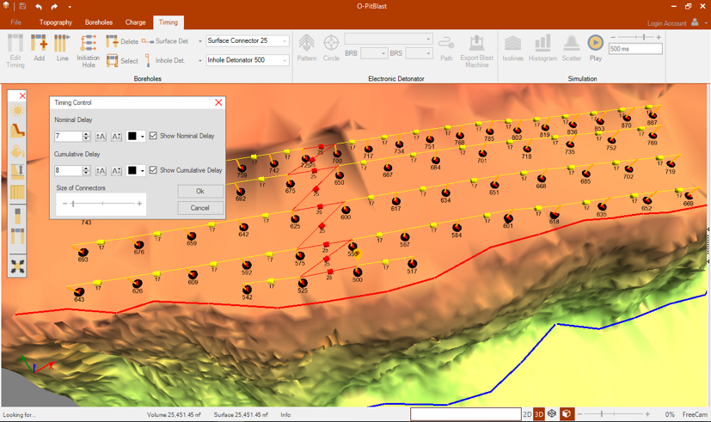
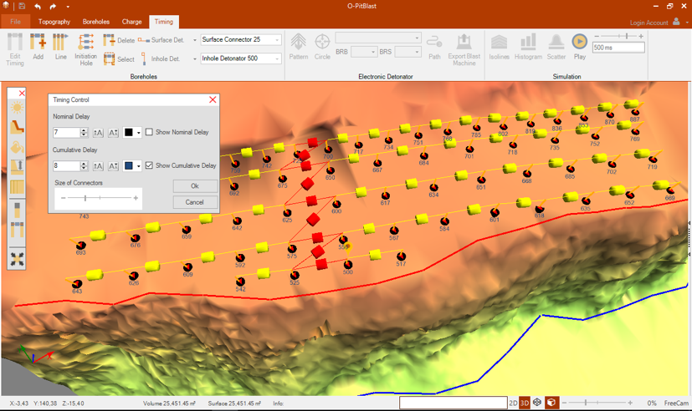
O-Pitblast - Overview
Lightning Control
Terrain Color
Sky Color
Bench Bottom
Grid
Hole Control
Timing Control
Centralize View
Ruller

Slide 14
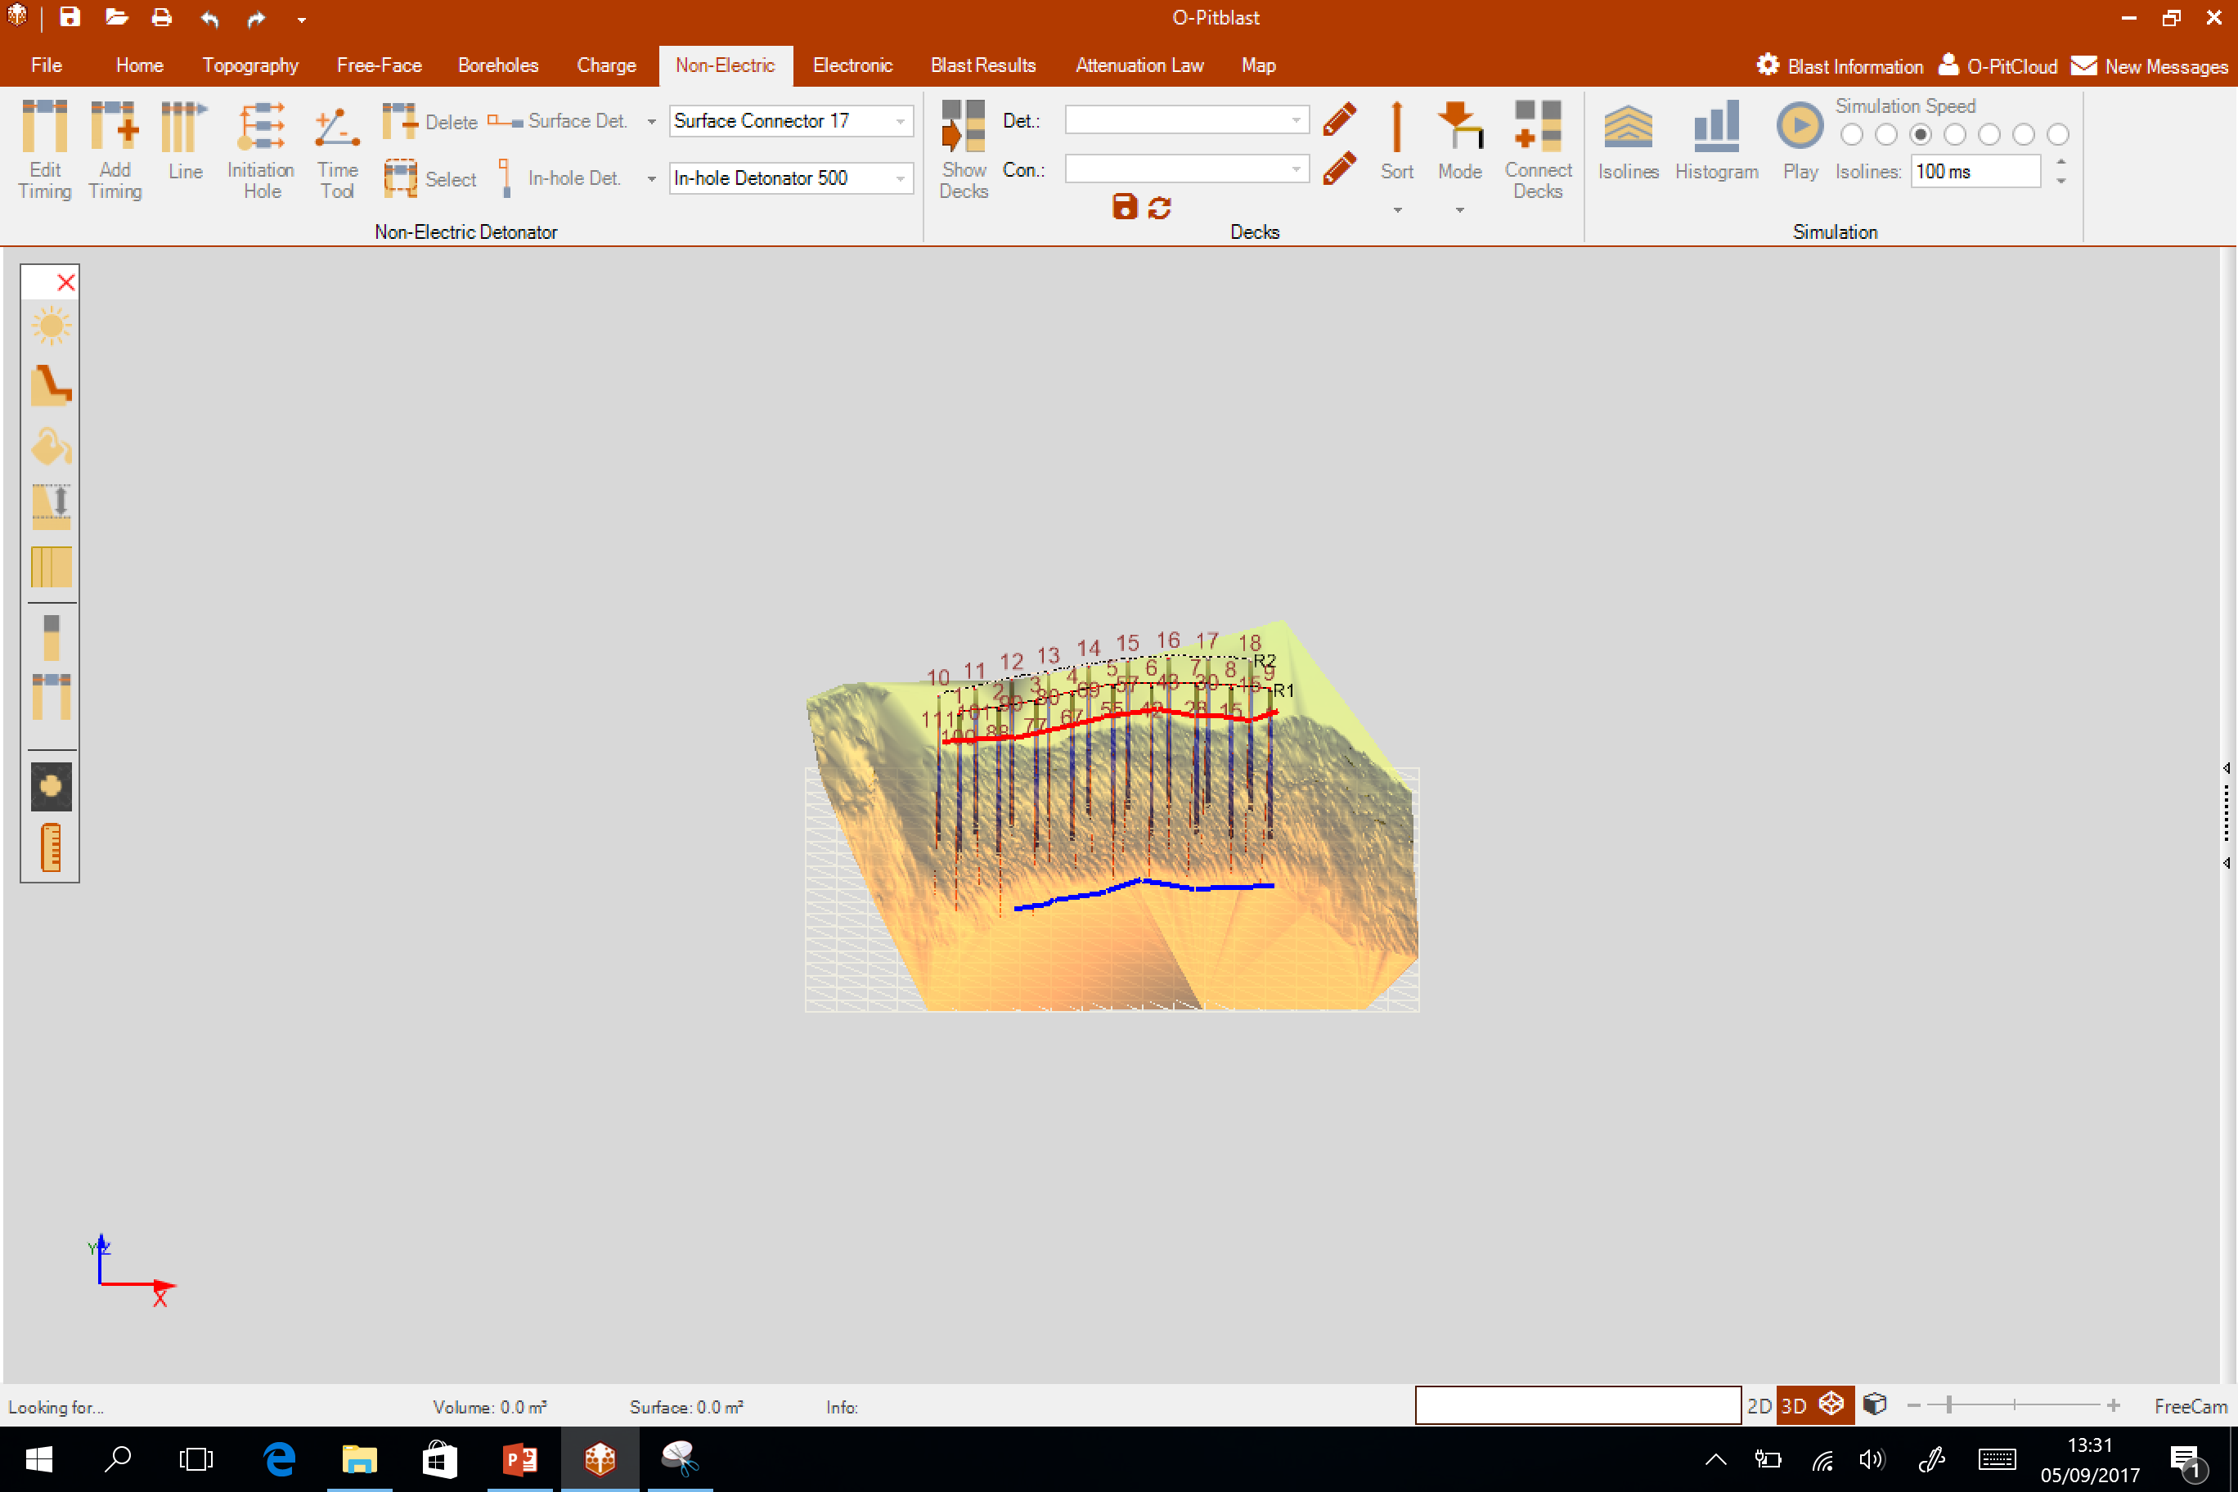
O-Pitblast - Overview
Lightning Control
Terrain Color
Sky Color
Bench Bottom
Grid
Hole Control
Timing Control
Centralize View
Ruller

Slide 15
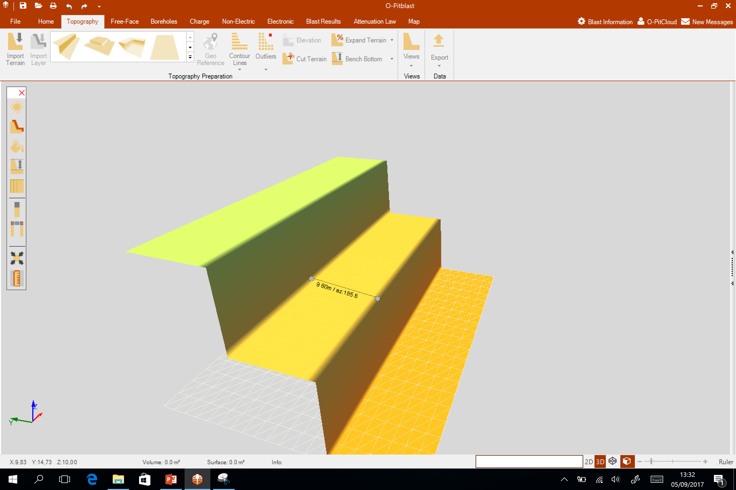
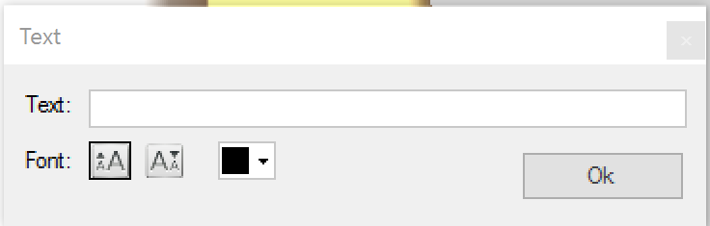

O-Pitblast - Overview
Lightning Control
Terrain Color
Sky Color
Bench Bottom
Grid
Hole Control
Timing Control
Centralize View
Ruller

Slide 16
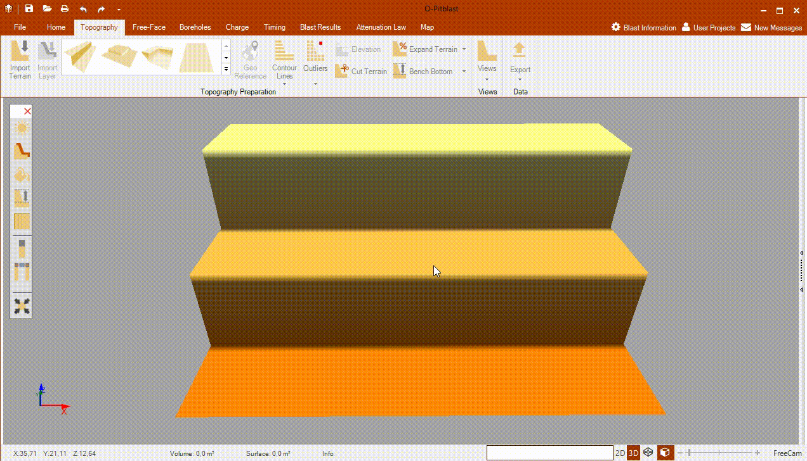

O-Pitblast - Overview
To do it faster: A +
To do it slower: Z +

Slide 17
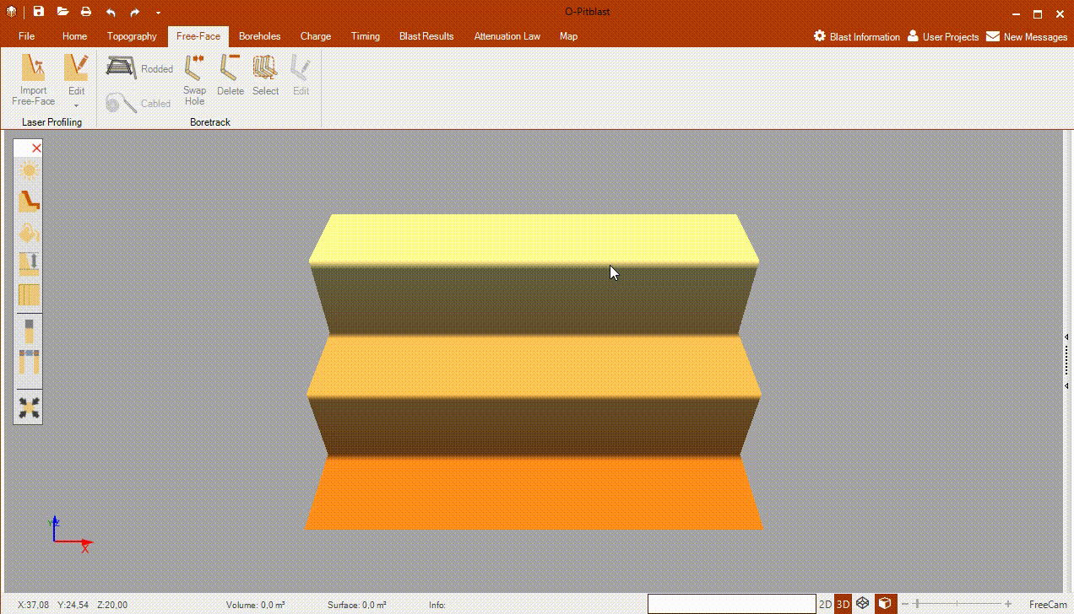

O-Pitblast - Overview
Ctrl +

Slide 18
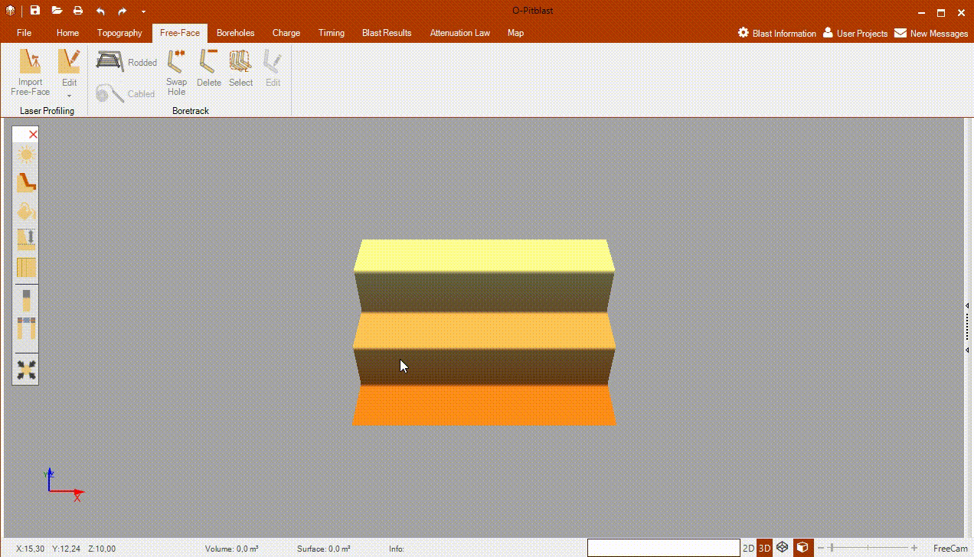
O-Pitblast - Overview

Slide 19
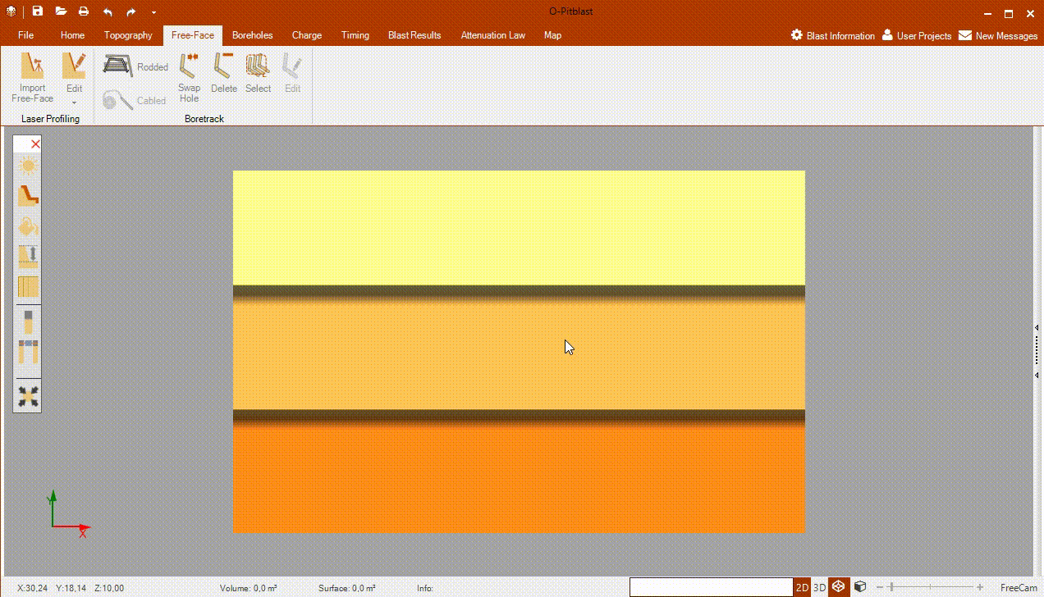
O-Pitblast - Overview

Slide 20
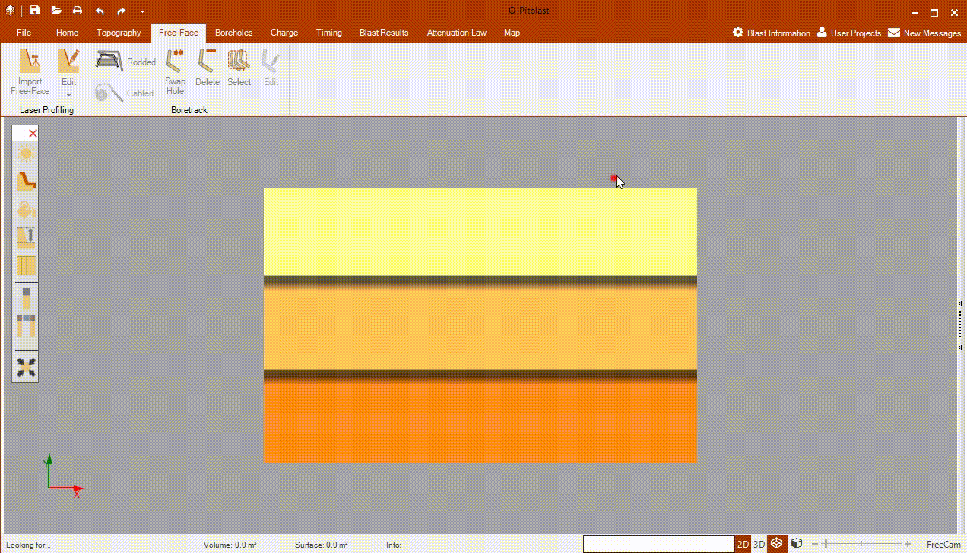
O-Pitblast - Overview
Ctrl +

Slide 21
Technical Support
Phone: +351 918 558 879
E-mail: support@o-pitblast.com

