Slide 1

Installing O-Pitblast – Blast Design Platform

Slide 2
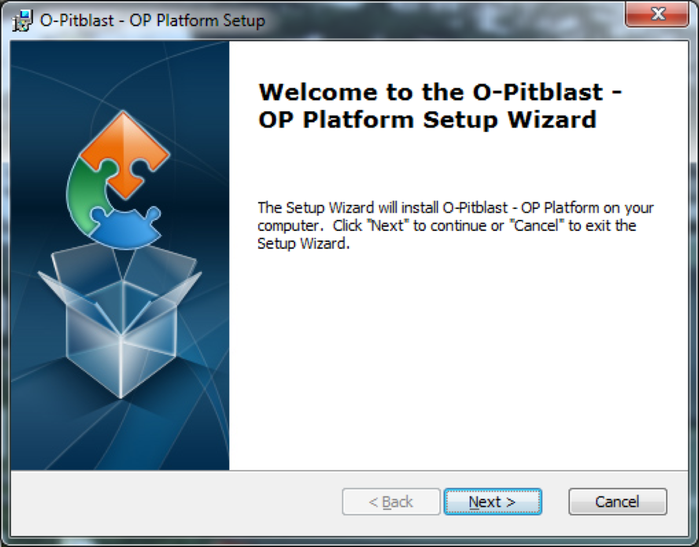
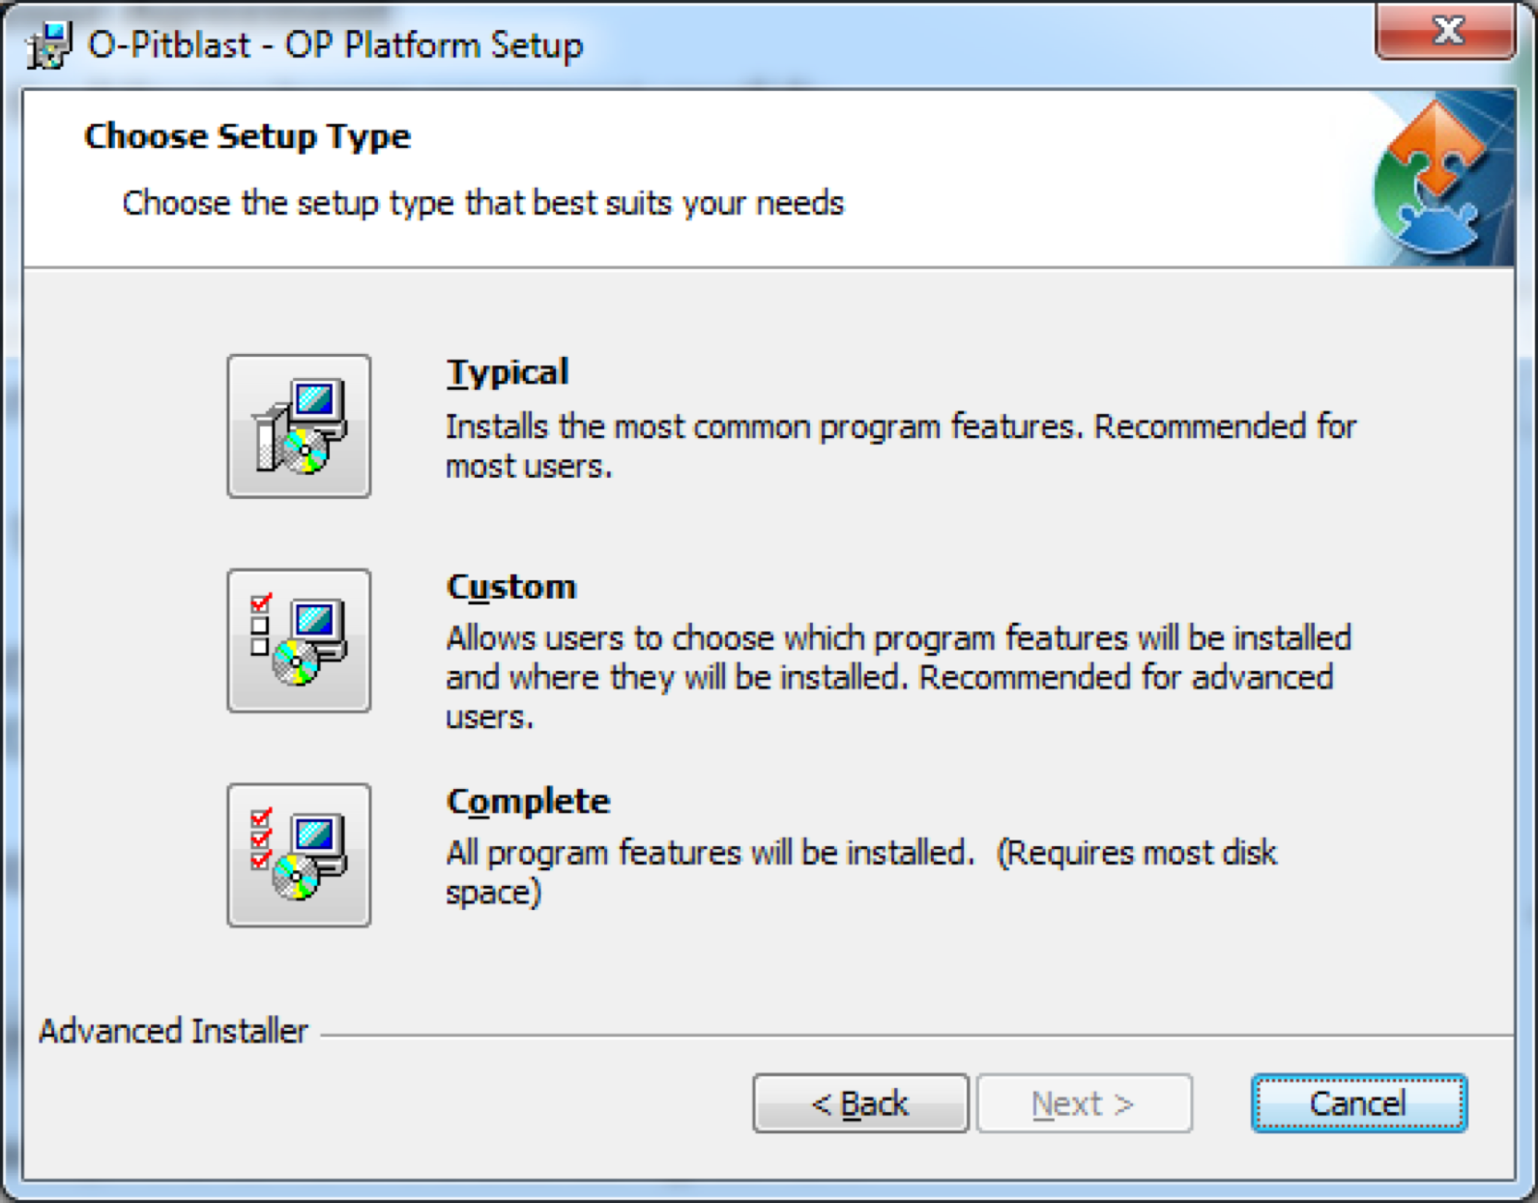

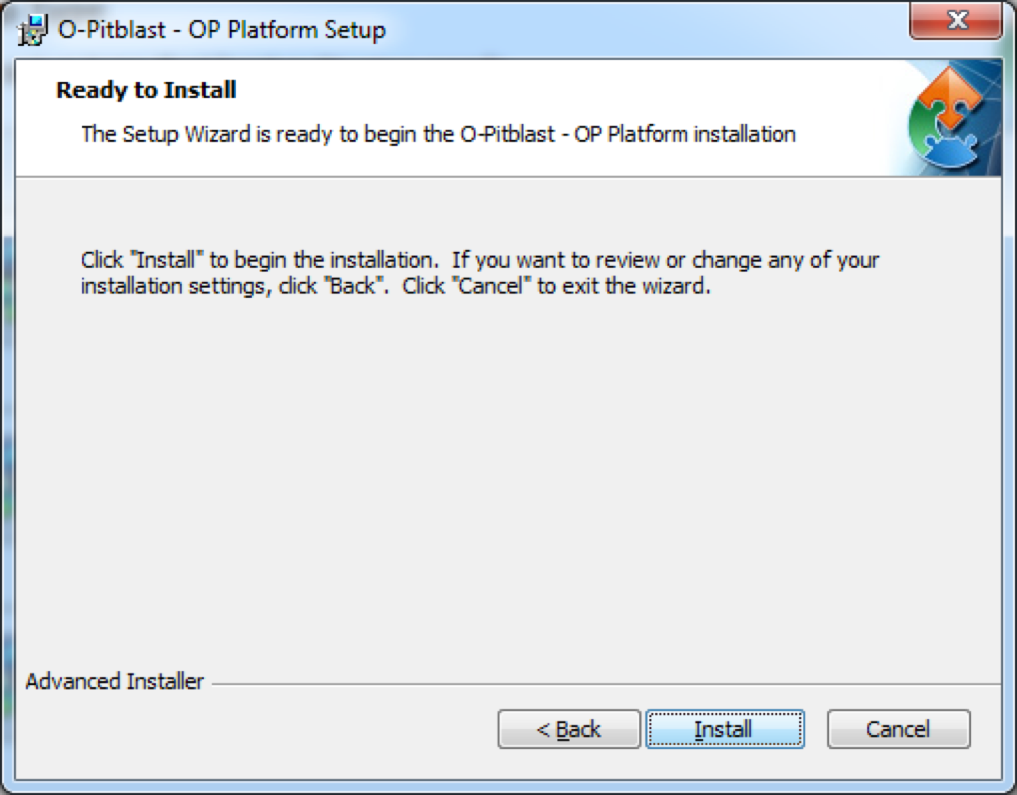
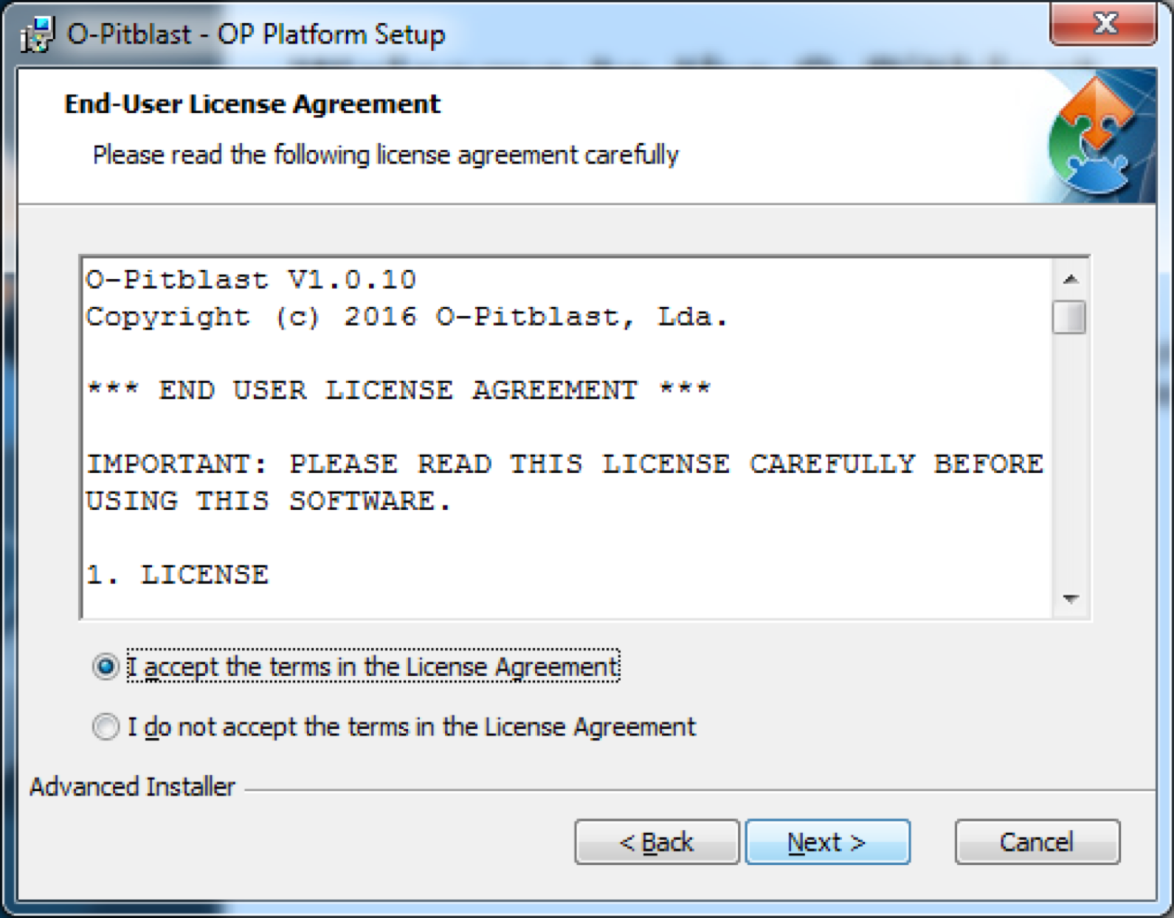
Installing O-Pitblast
O-Pitblast Install.exe

Slide 3
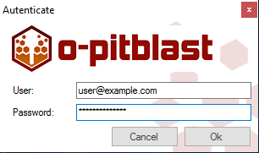

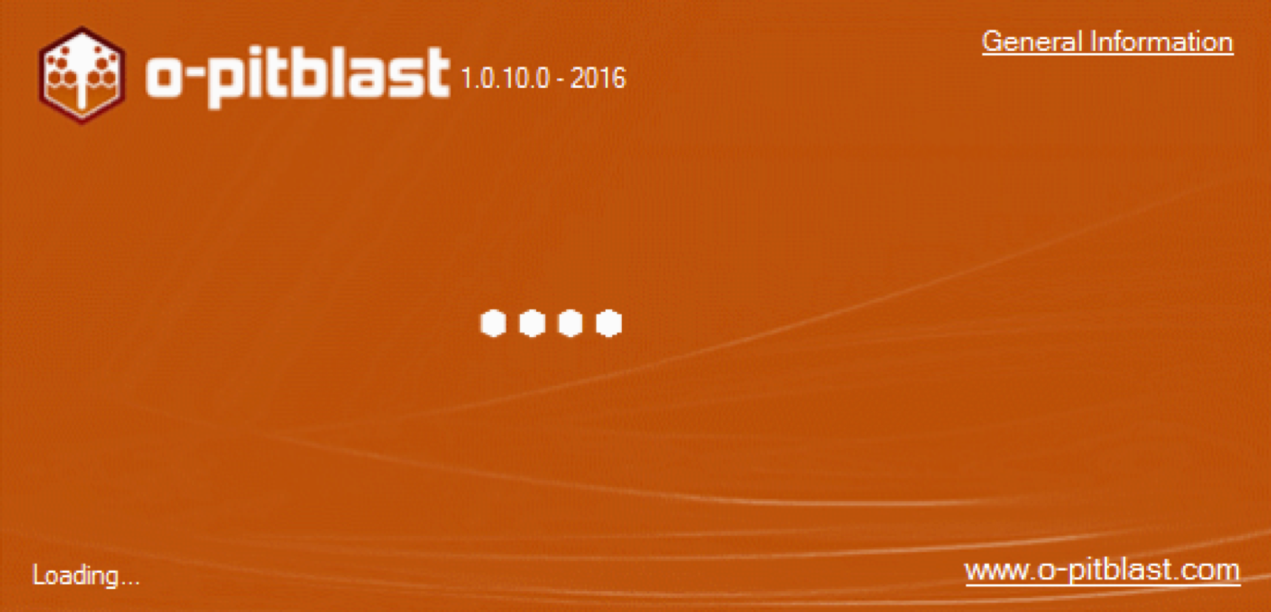
Installing O-Pitblast

Slide 4
Installing O-Pitblast

Slide 5
Technical Support
Phone: +351 918 558 879
E-mail: support@o-pitblast.com

