Slide 1

O-Pitblast – Topography

Slide 2
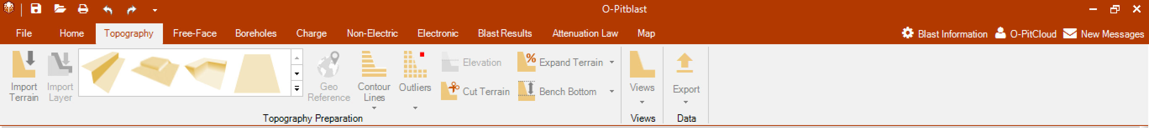
O-Pitblast – Topography Module

Slide 3

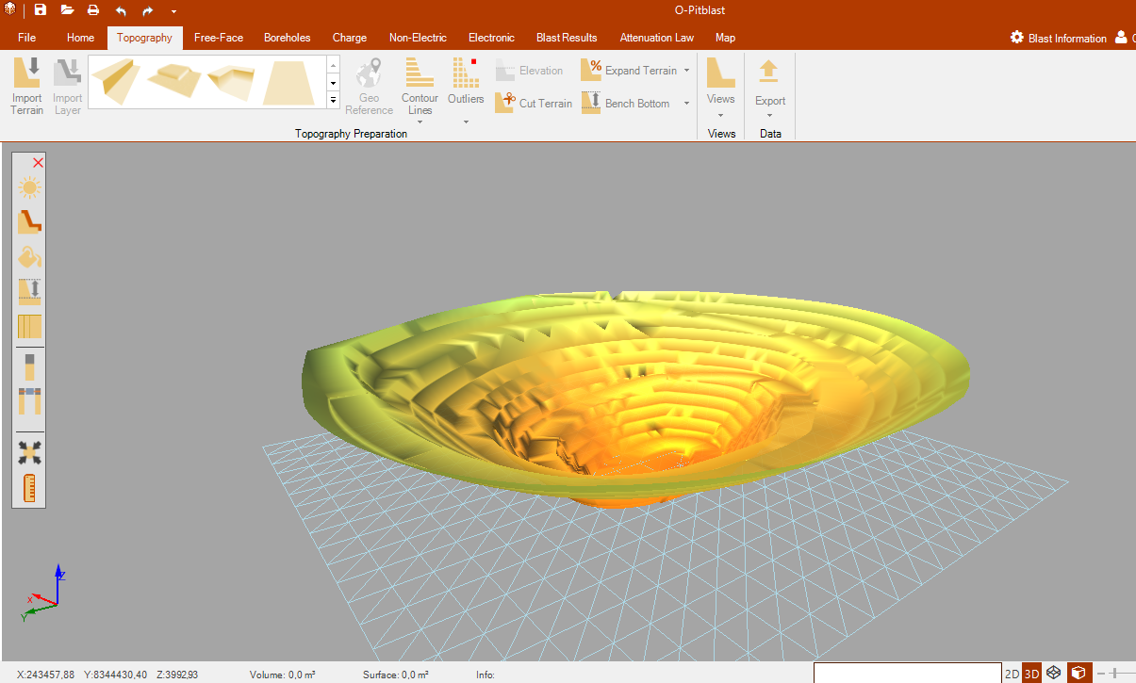
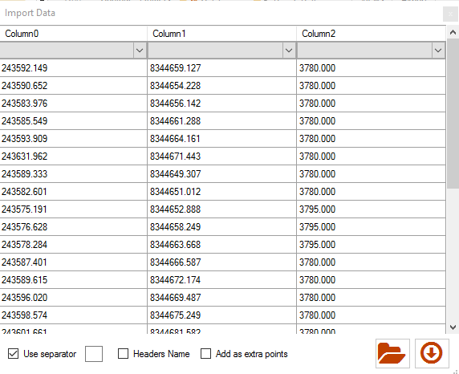
O-Pitblast – Topography Module
Import Terrain

Slide 4
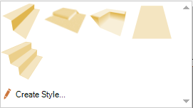
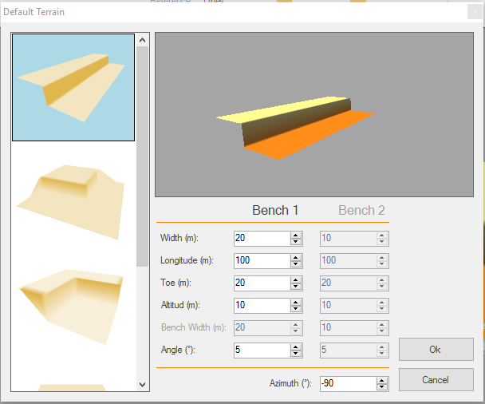
O-Pitblast – Topography Module

Slide 5
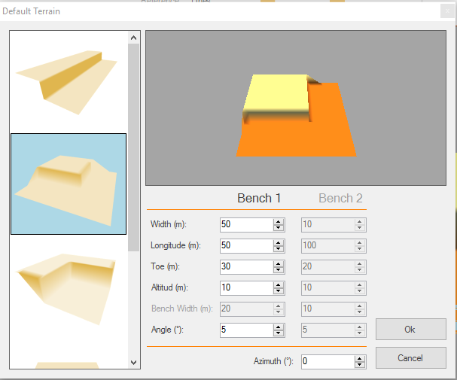
O-Pitblast – Topography Module

Slide 6
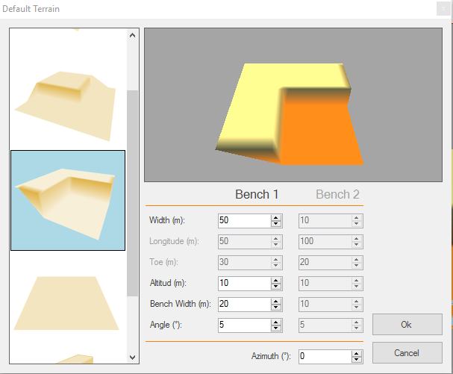
O-Pitblast – Topography Module

Slide 7
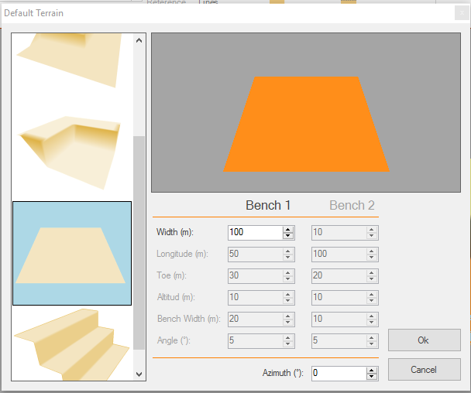
O-Pitblast – Topography Module

Slide 8
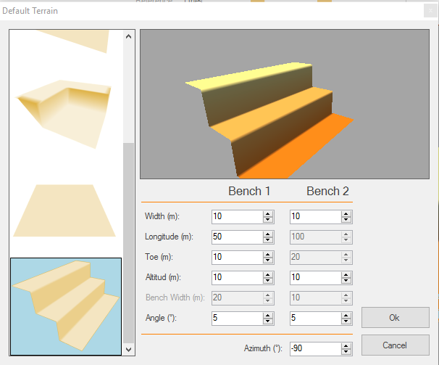
O-Pitblast – Topography Module

Slide 9

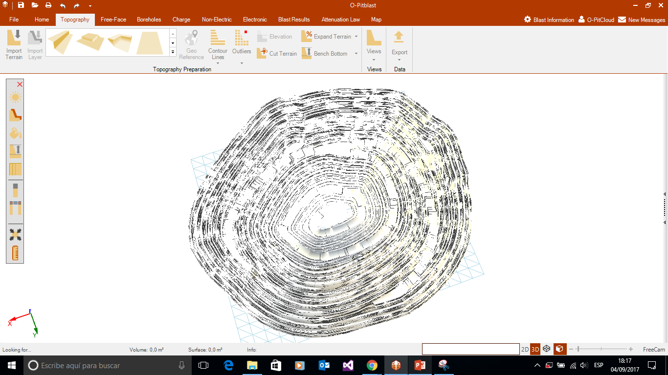
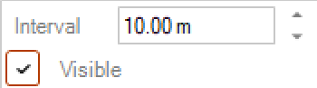
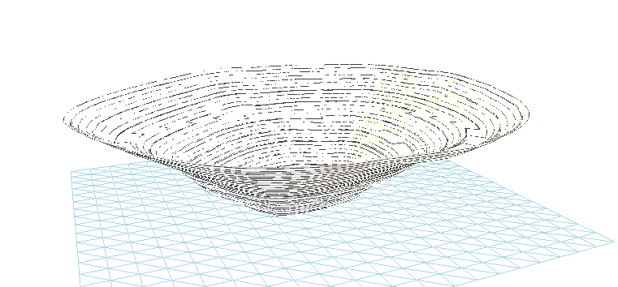
O-Pitblast – Topography Module
Contour Lines

Slide 10
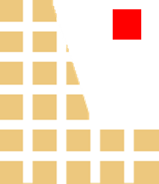
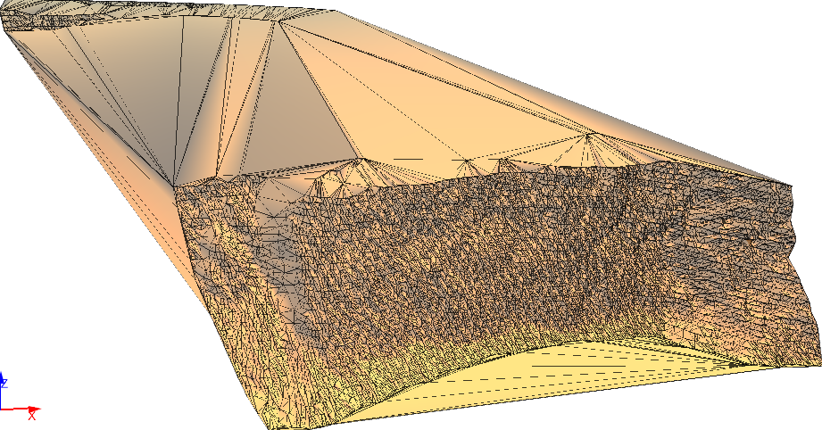
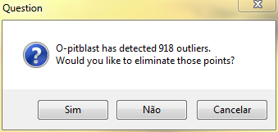
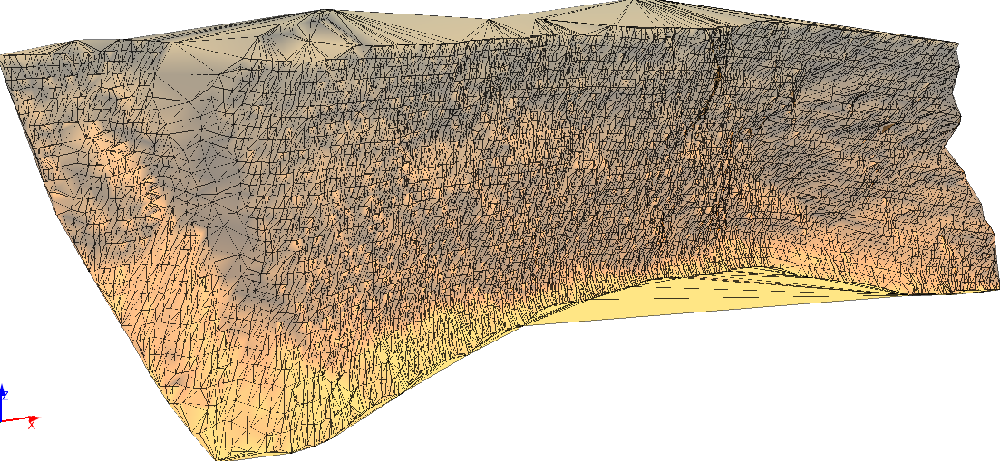
O-Pitblast – Topography Module
Outliers

Slide 11

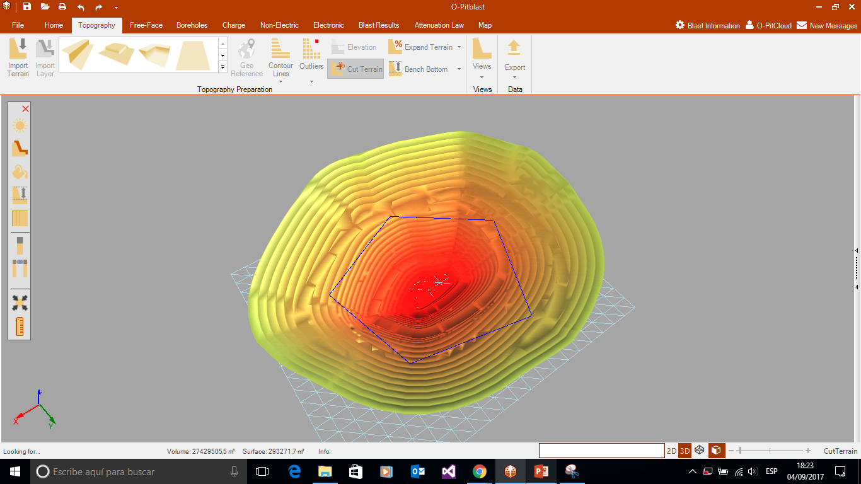
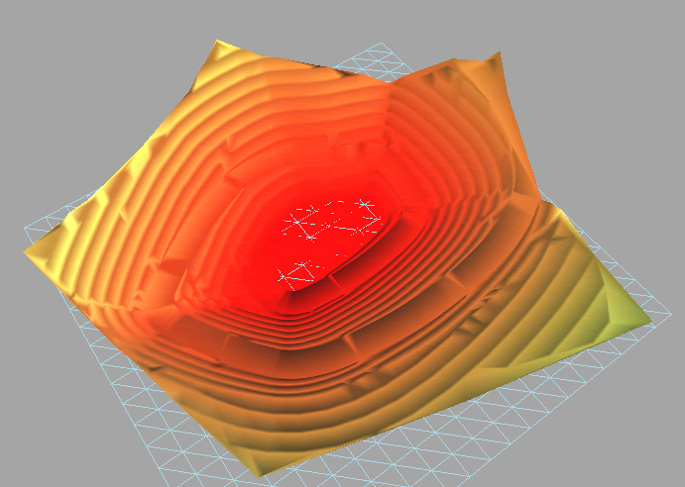
O-Pitblast – Topography Module
Select Polygon
Cut Terrain
Press “Enter”

Slide 12
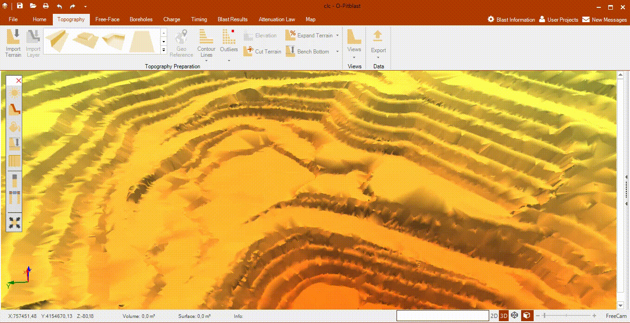
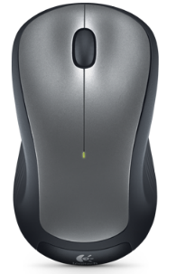
O-Pitblast – Topography Module
Cut Terrain
+ Enter

Slide 13

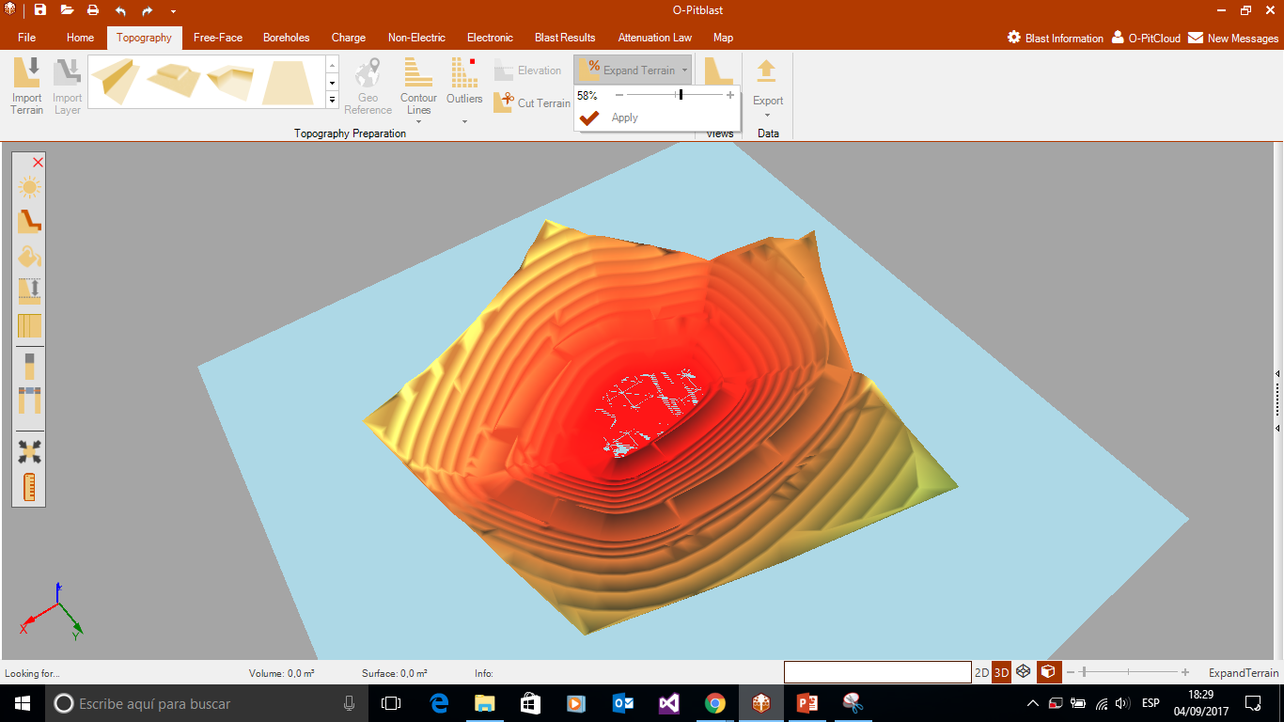
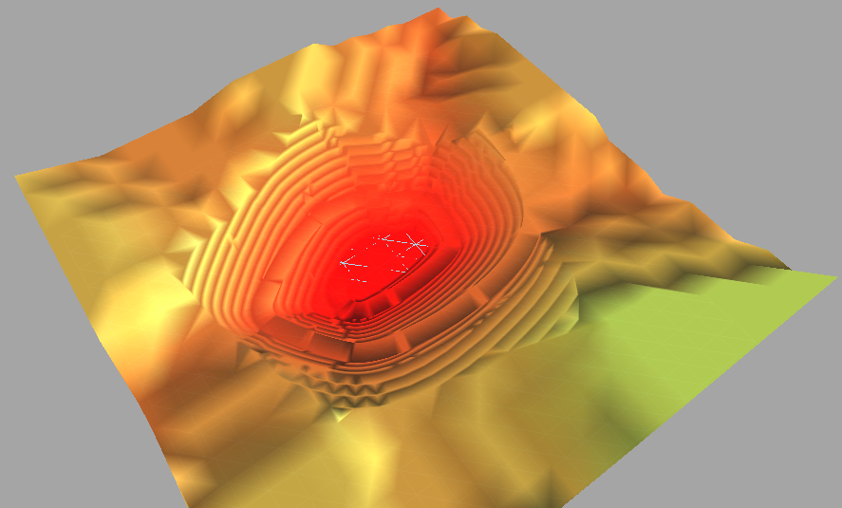
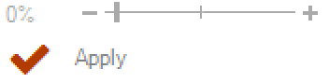
O-Pitblast – Topography Module
Select Expansion %
Expand Terrain
Press “Apply”

Slide 14
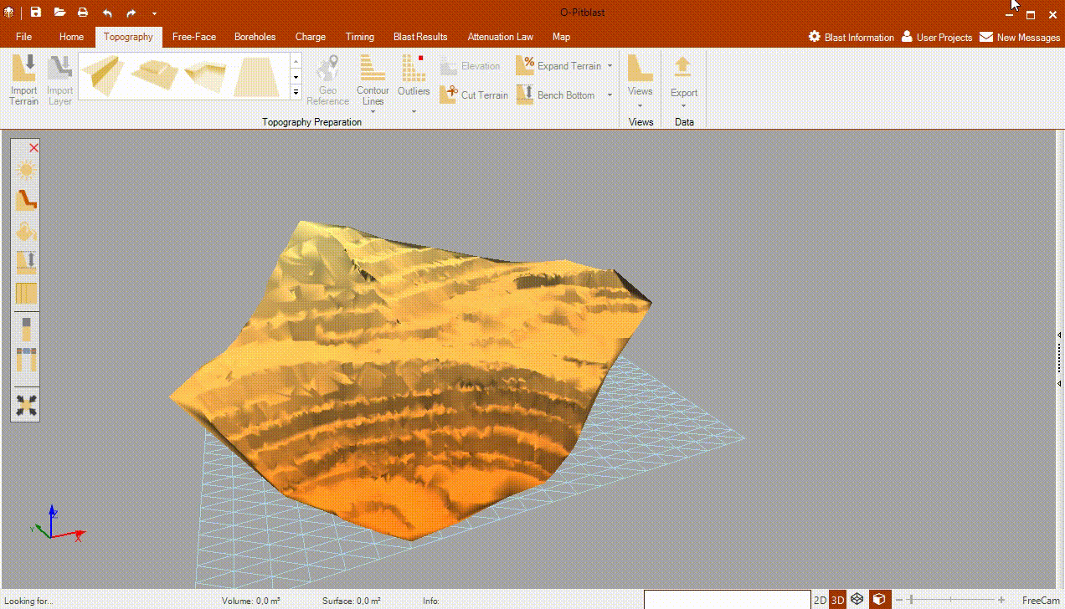
O-Pitblast – Topography Module
Expand Terrain

Slide 15

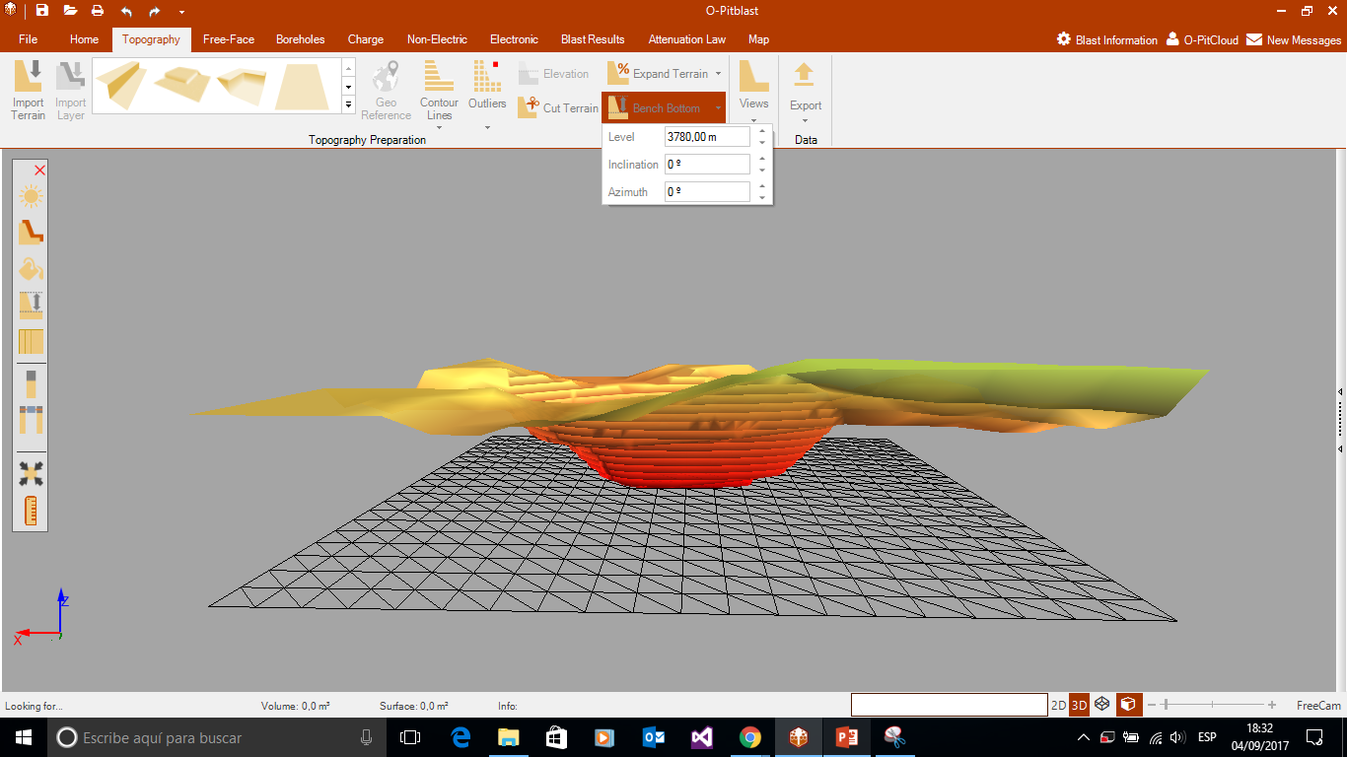
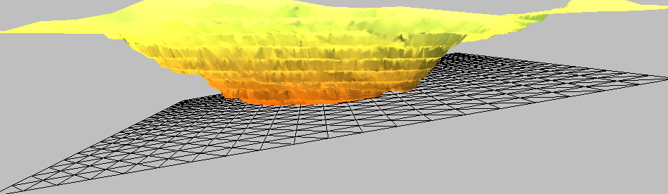
O-Pitblast – Topography Module
Adjust Bench Bottom
Select Bech-High Level, Inclination and Azimuth

Slide 16
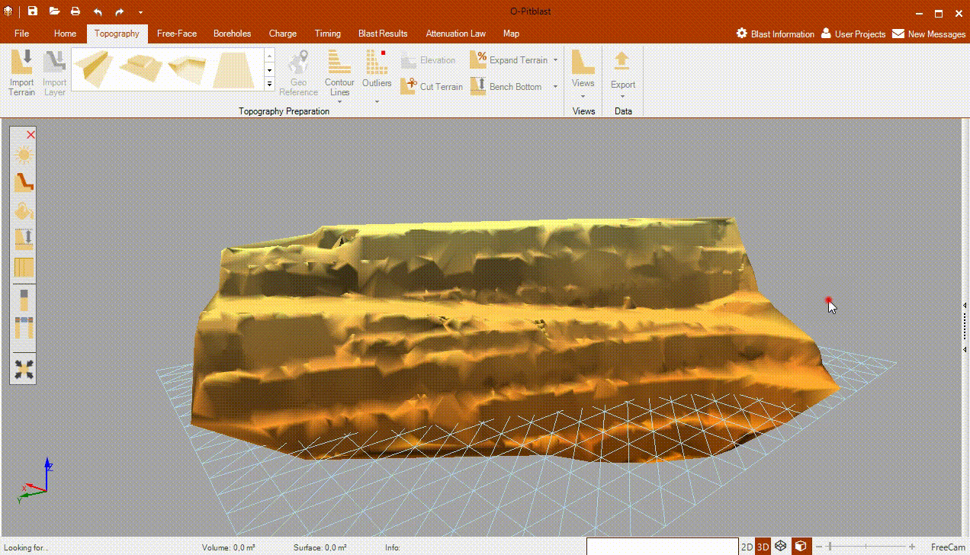
O-Pitblast – Topography Module
Adjust Bench Bottom

Slide 17


O-Pitblast – Topography Module
General View
Free Face View
Crest/Toe View
Terrain Points View
Isolines View

Slide 18
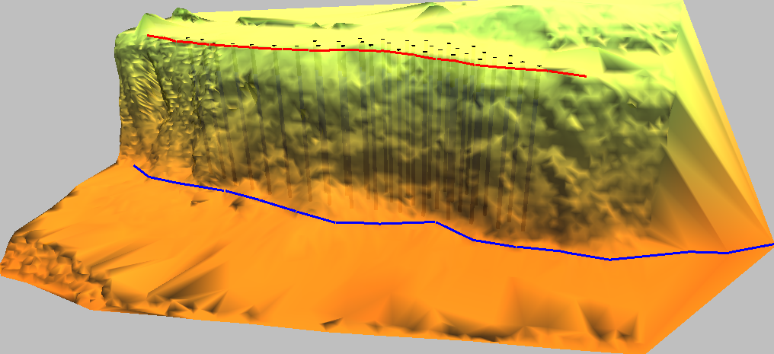
O-Pitblast – Topography Module
General View
Free Face View
Crest/Toe View
Terrain Points View
Isolines View

Slide 19
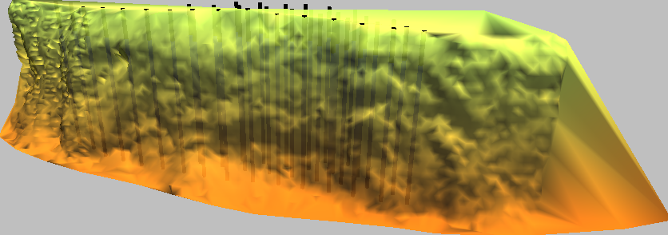
O-Pitblast – Topography Module
General View
Free Face View
Crest/Toe View
Terrain Points View
Isolines View

Slide 20
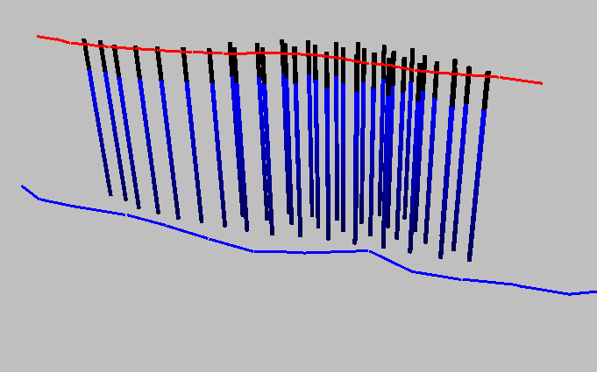
O-Pitblast – Topography Module
General View
Free Face View
Crest/Toe View
Terrain Points View
Isolines View

Slide 21
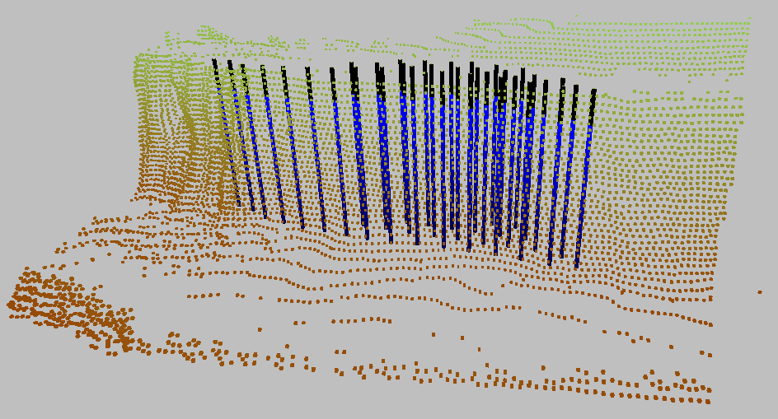
O-Pitblast – Topography Module
General View
Free Face View
Crest/Toe View
Terrain Points View
Isolines View

Slide 22
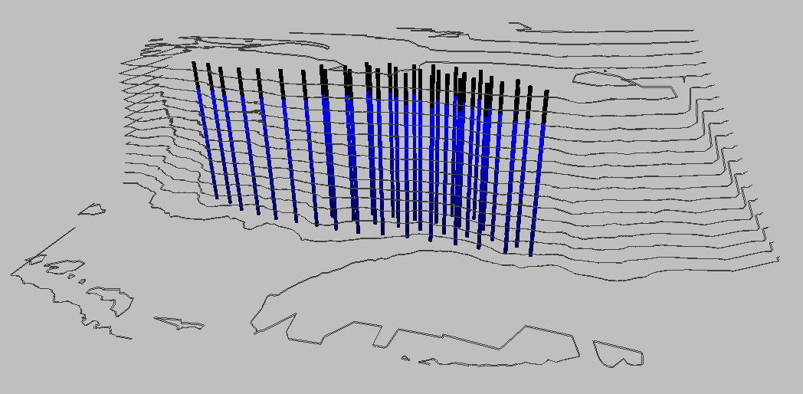
O-Pitblast – Topography Module
General View
Free Face View
Crest/Toe View
Terrain Points View
Isolines View

Slide 23
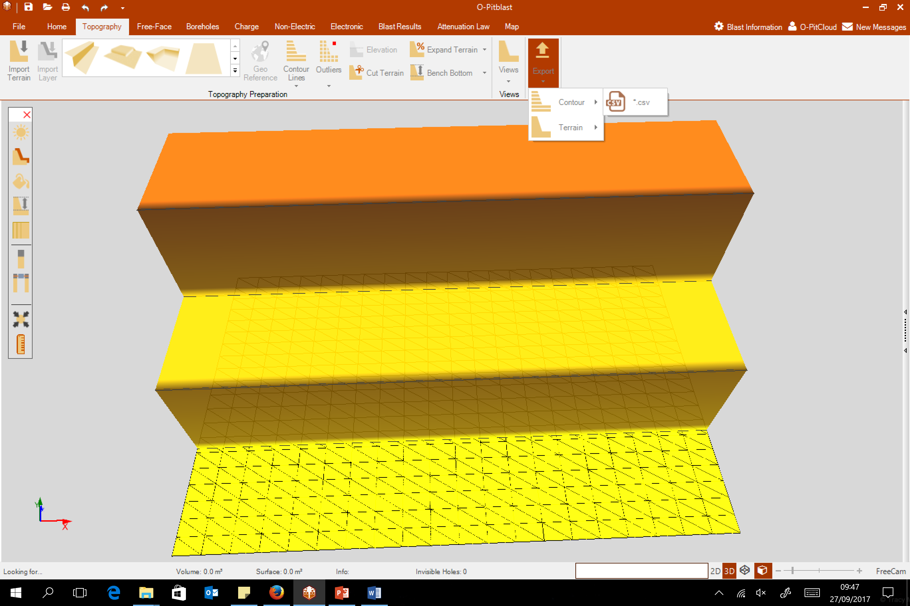
O-Pitblast – Topography Module
Countour or terrain files (.csv)

Slide 24
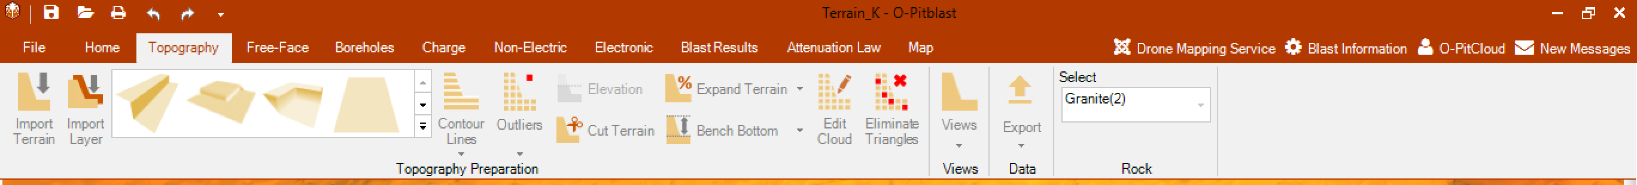
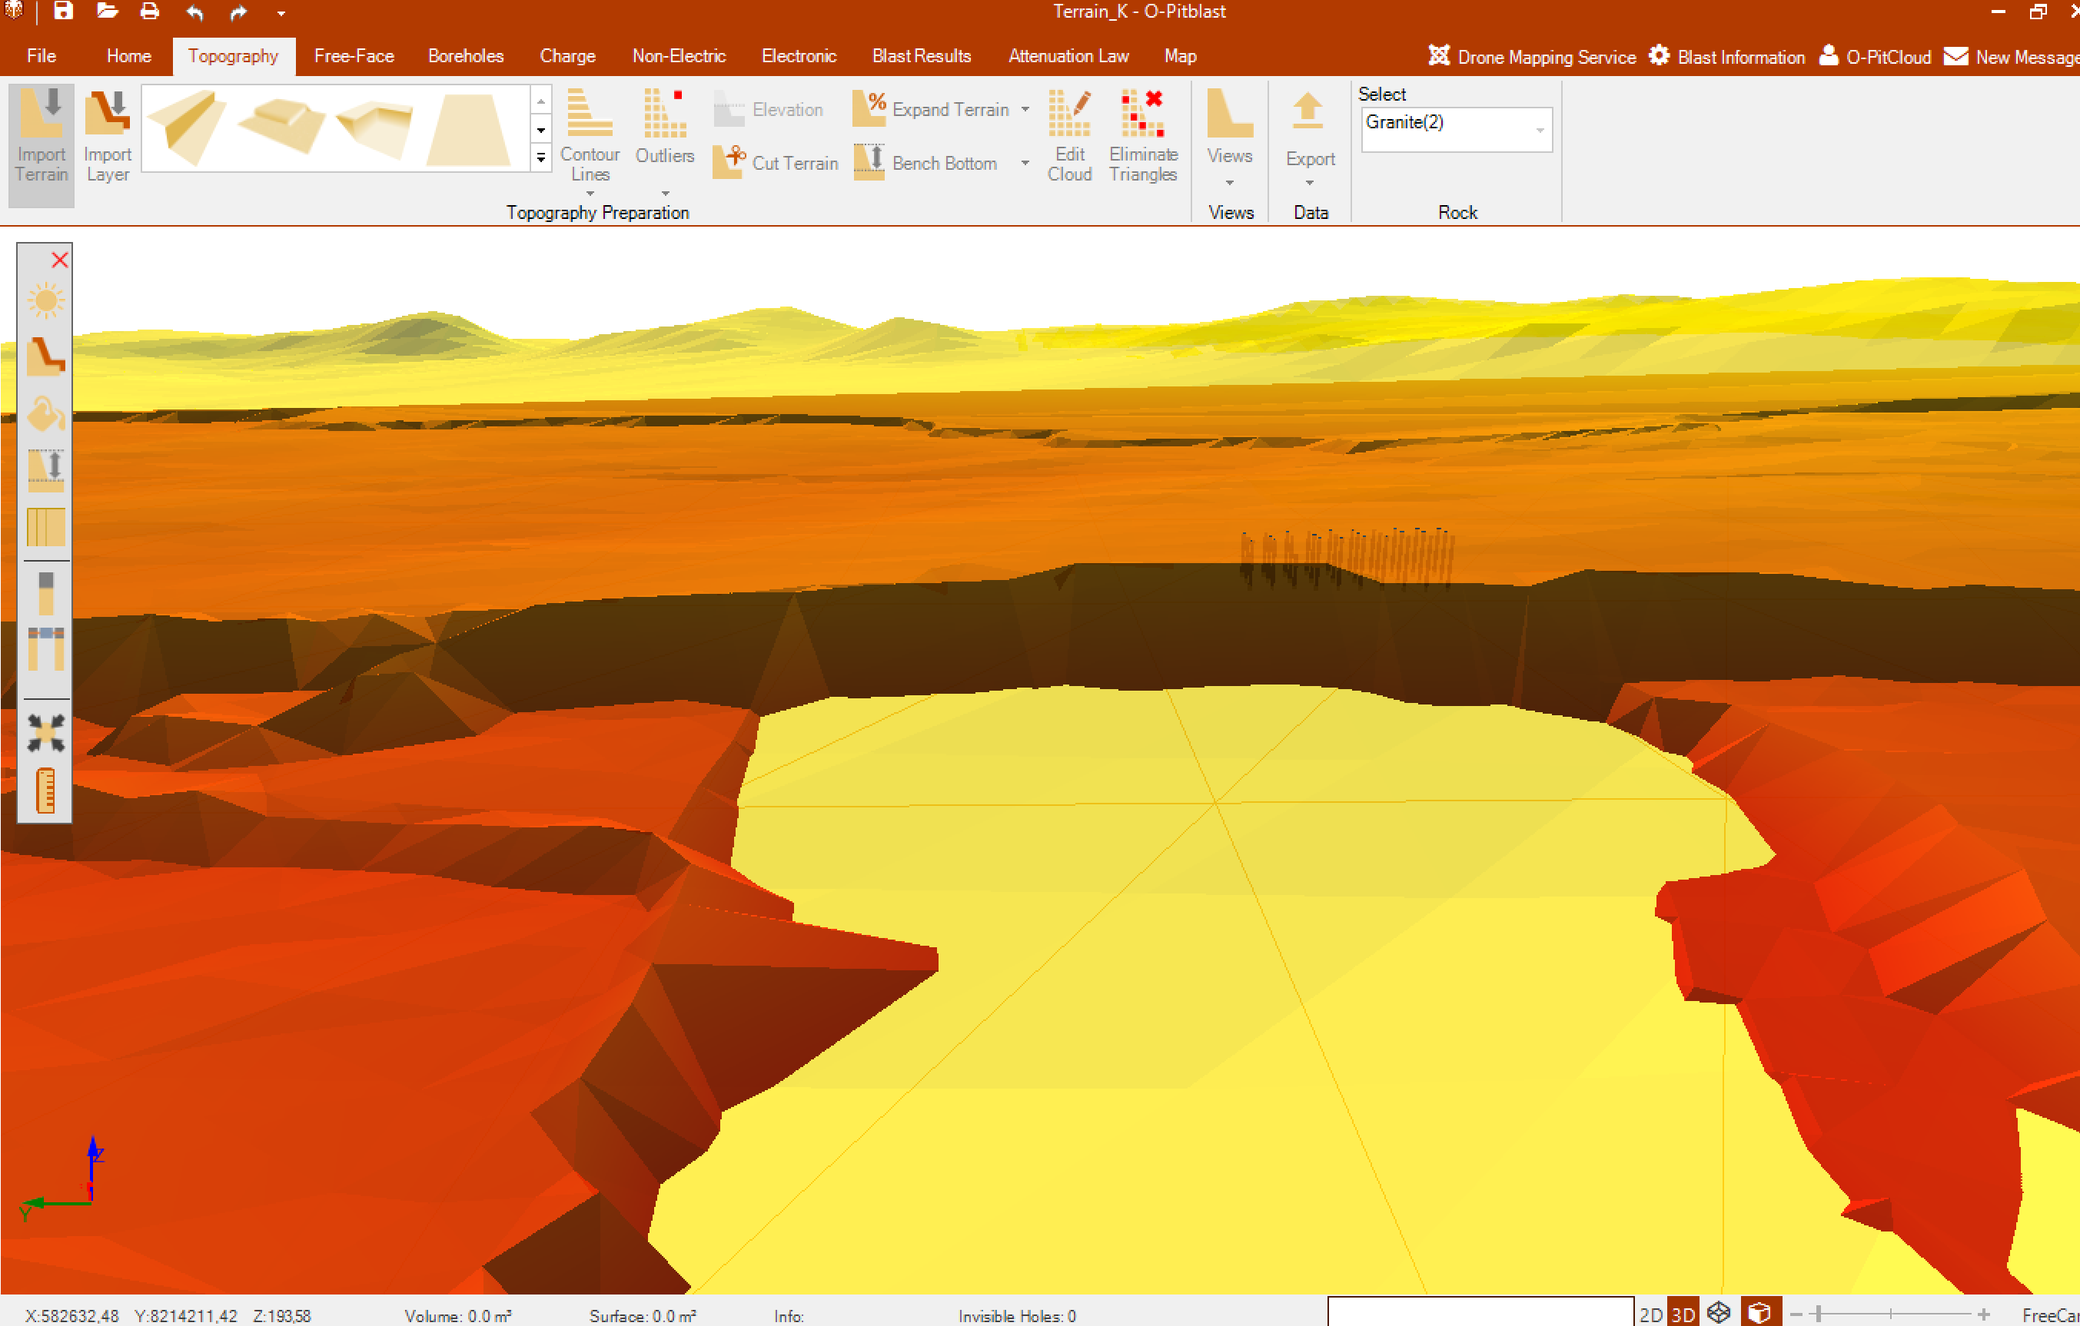
O-Pitblast – Topography Module
Import layer (same steps as import terrain)
Choose your Topography type of rock.
Main Terrain
(Orange)
Layer 1 (yellow)

Slide 25
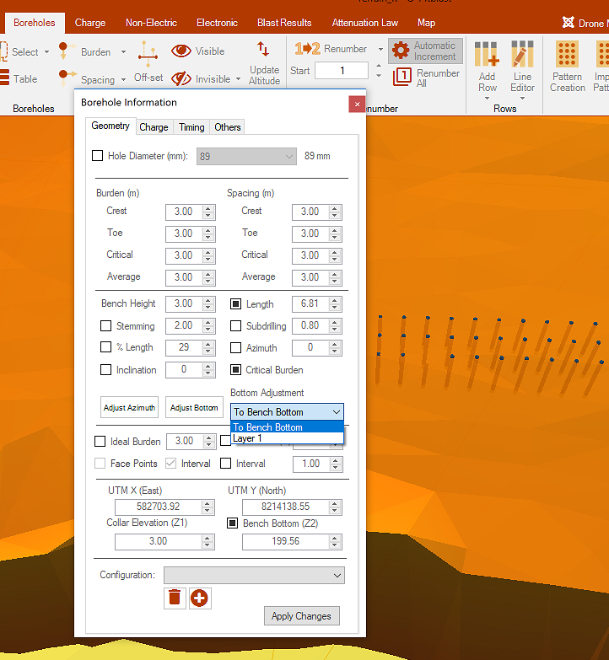
O-Pitblast – Topography Module
Import layer
NOTE: You can adjsut your boreholes until the LAYER that you want, or until bench bottom, like usual (see Borehole Module)

Slide 26
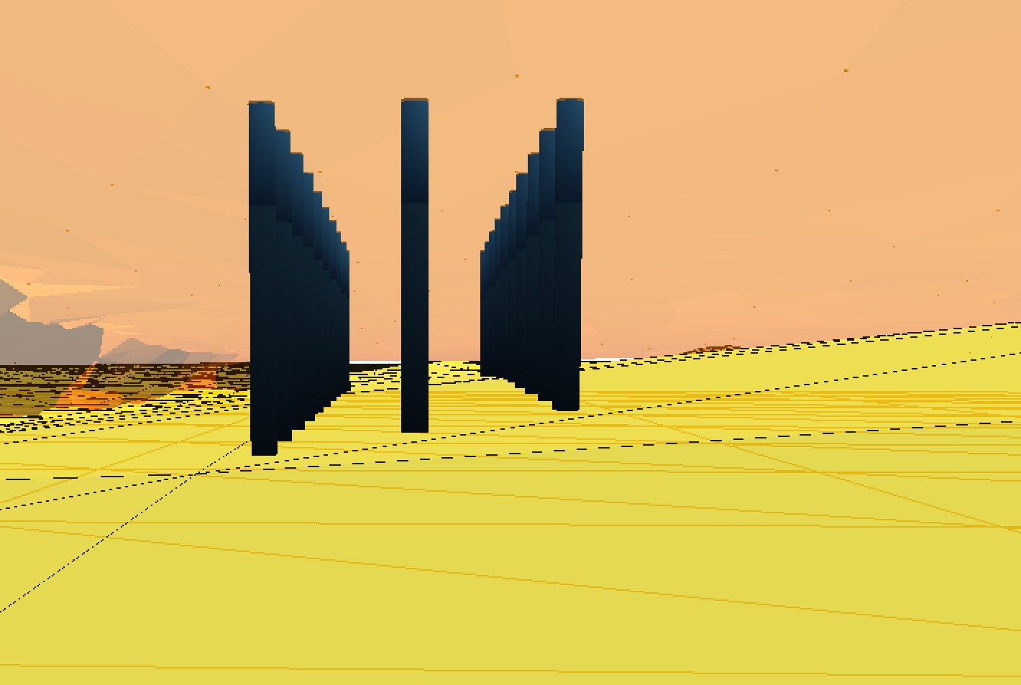
O-Pitblast – Topography Module
Import layer
Holes adjusted until Layer 1

Slide 27
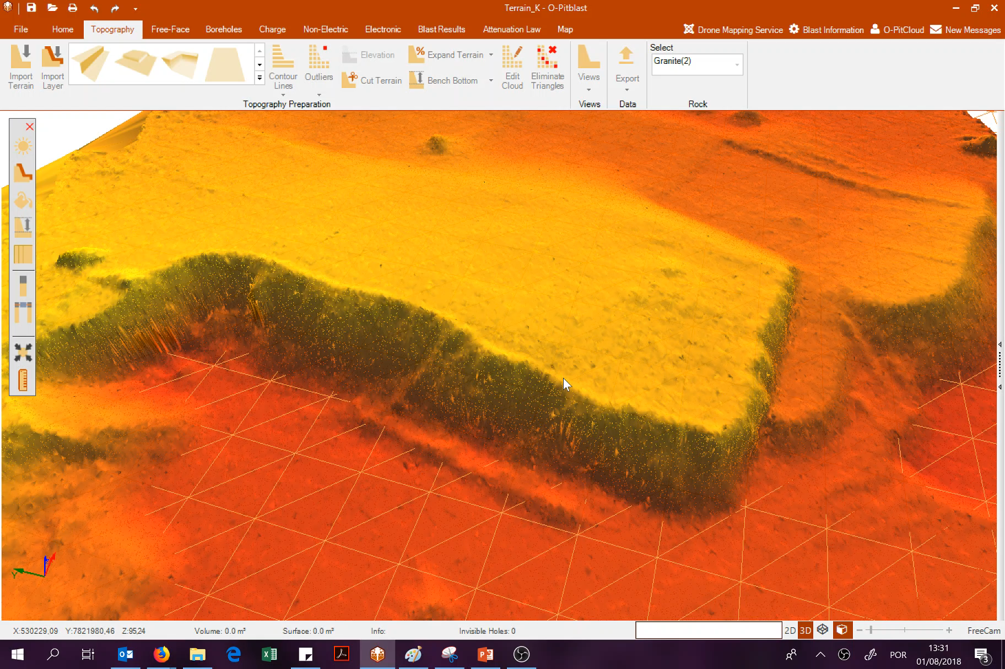
O-Pitblast – Topography Module
Delete your cloud points

Slide 28
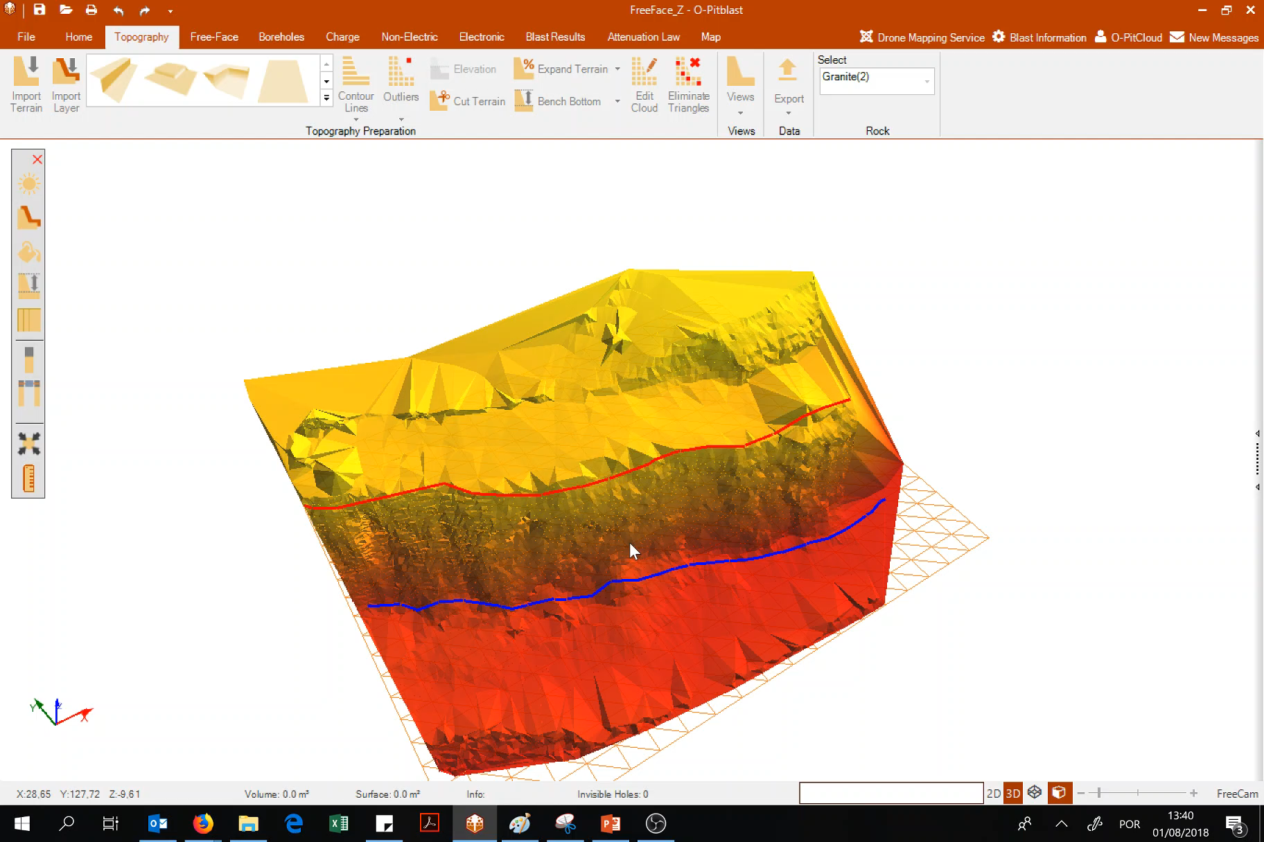
O-Pitblast – Topography Module
Delete your triangulation

Slide 29
Technical Support
Phone: +351 918 558 879
E-mail: support@o-pitblast.com

