Slide 1

O-Pitblast – Free Face Module

Slide 2

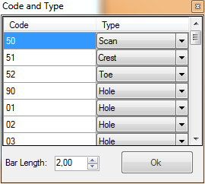
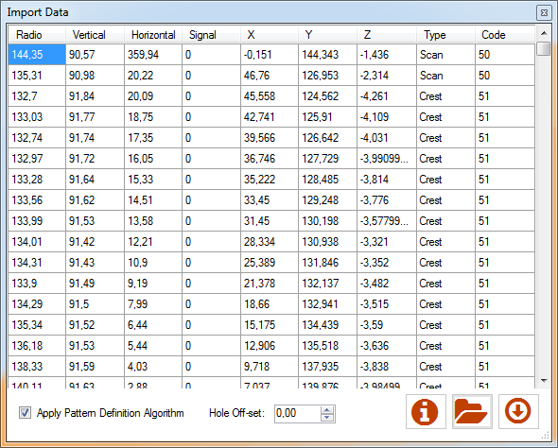
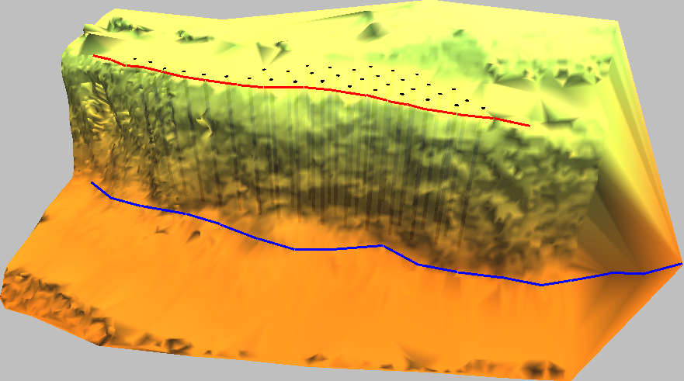
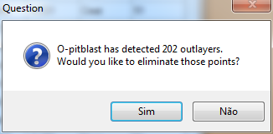
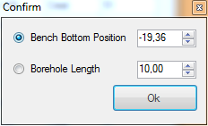
O-Pitblast – Free Face Module
Import Free Face

Slide 3
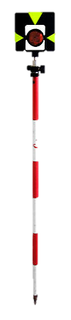
O-Pitblast – Free Face Module
Import Free Face

Slide 4
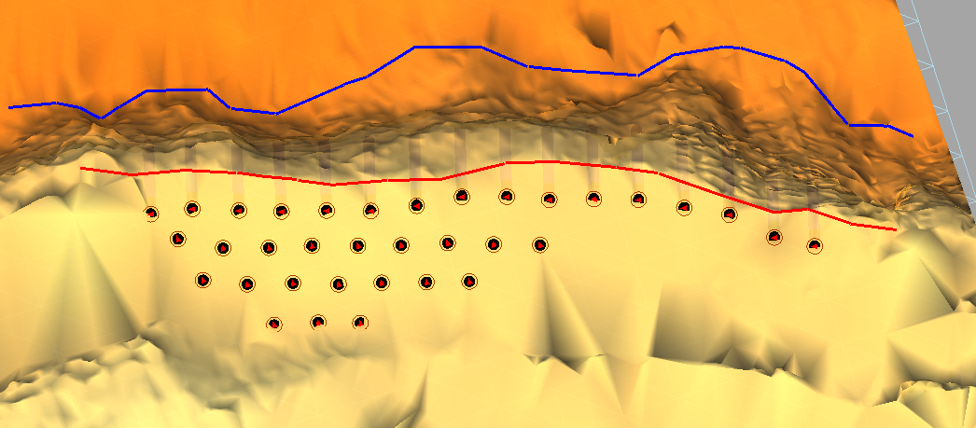
O-Pitblast – Free Face Module
Import Free Face

Slide 5
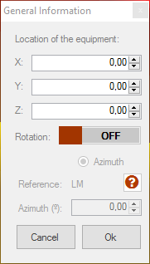
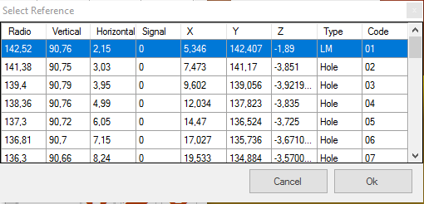
O-Pitblast – Free Face Module
Import Free Face

Slide 6
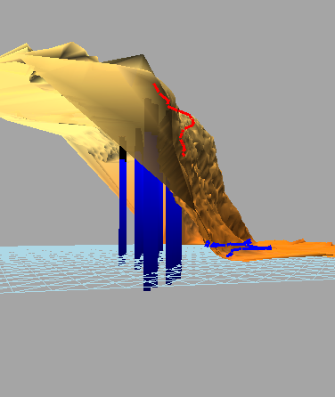
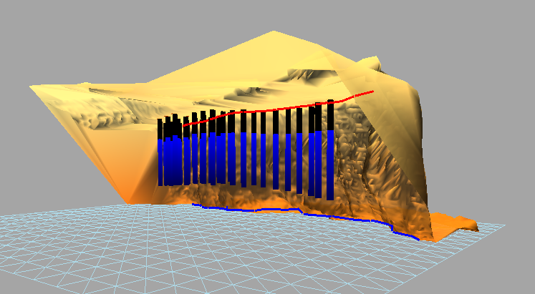
O-Pitblast – Free Face Module
Import Free Face

Slide 7

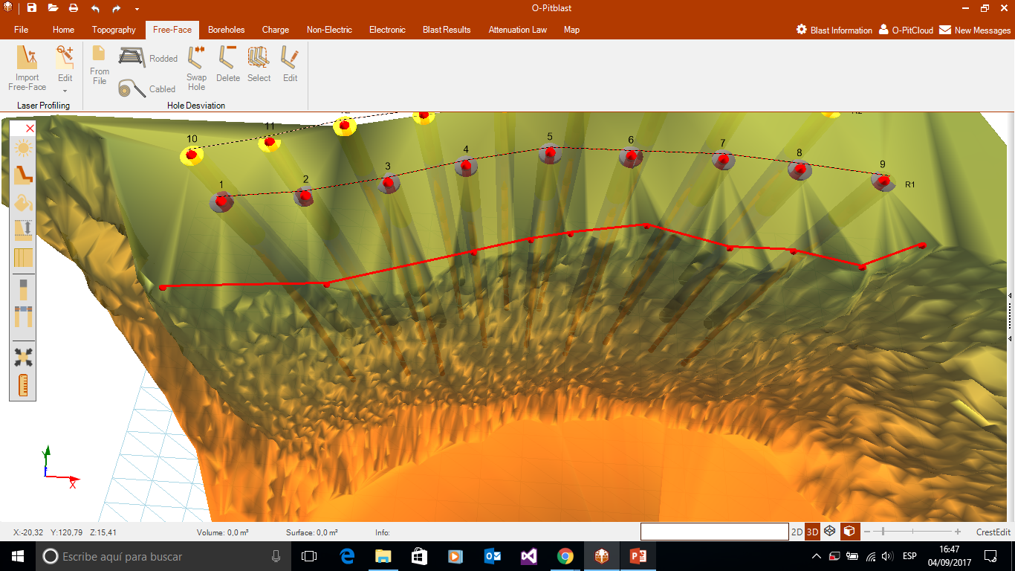

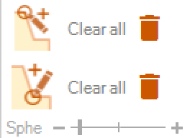
O-Pitblast – Free Face Module
Edit Crest

Slide 8
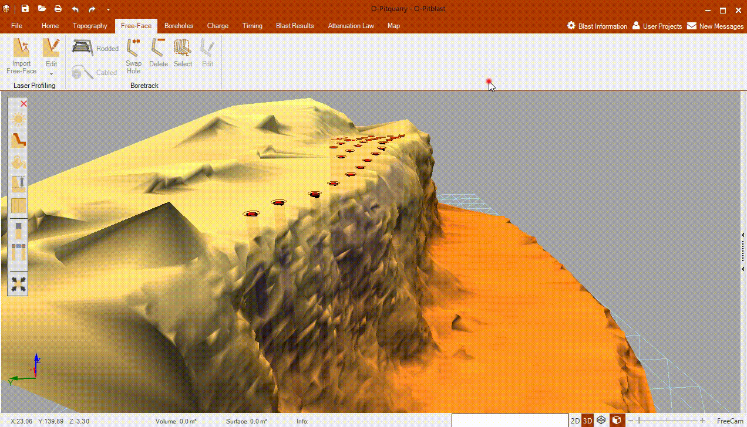

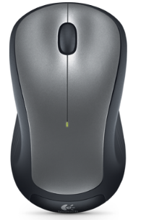
O-Pitblast – Free Face Module
Edit Crest
= Create Points
= Delete Points
Drag +
= Move Terrain

Slide 9
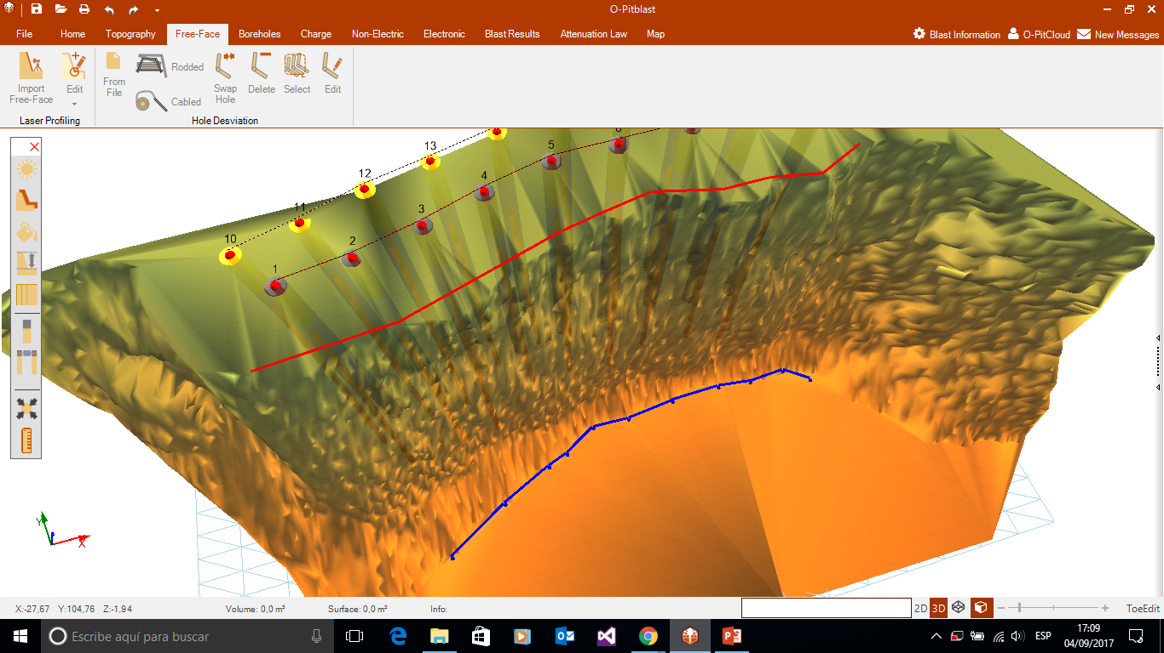

O-Pitblast – Free Face Module
Edit Toe

Slide 10
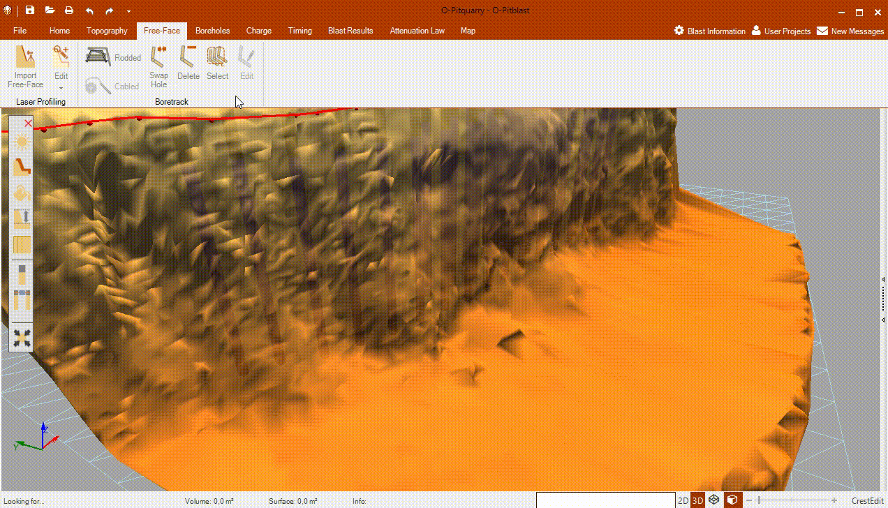
O-Pitblast – Free Face Module
Edit Toe
= Create Points
= Delete Points
Drag +
= Move Terrain

Slide 11
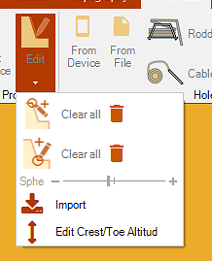
O-Pitblast – Free Face Module
Import from file your crest/toe
Change crest/toe altitud

Slide 12
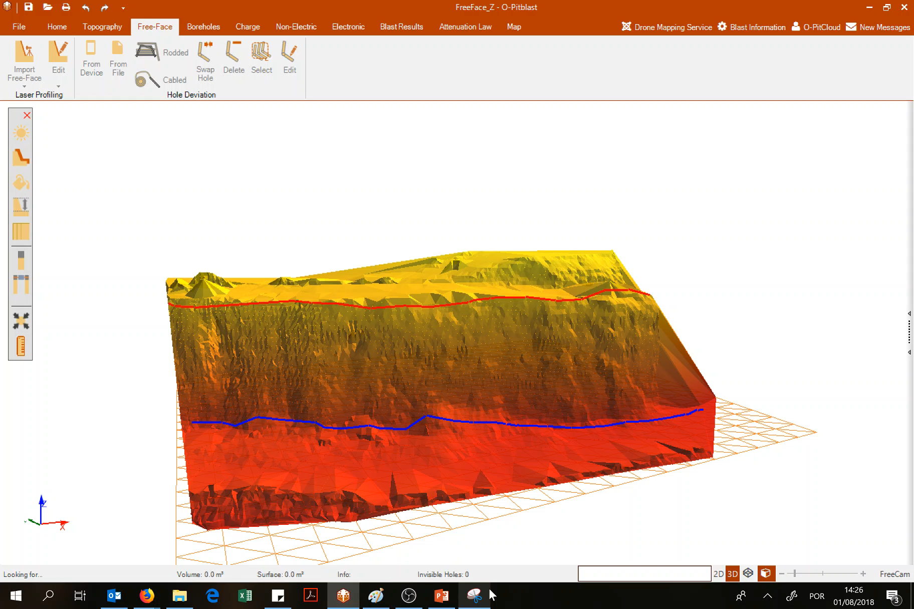
O-Pitblast – Free Face Module

Slide 13
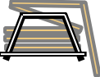
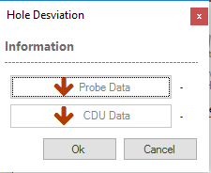
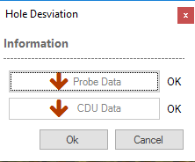
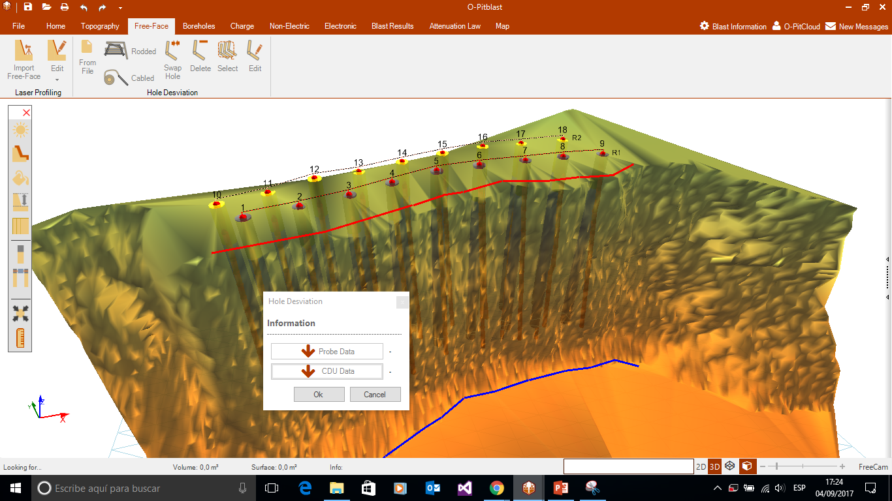
O-Pitblast – Free Face Module
Rodded Boretrak

Slide 14
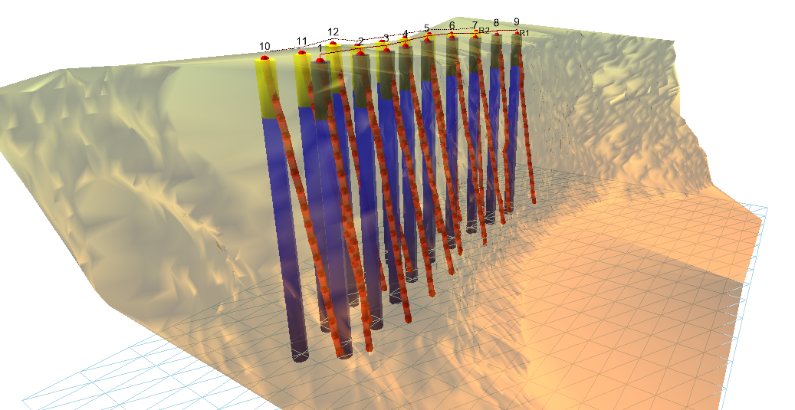
O-Pitblast – Free Face Module
Rodded Boretrak

Slide 15
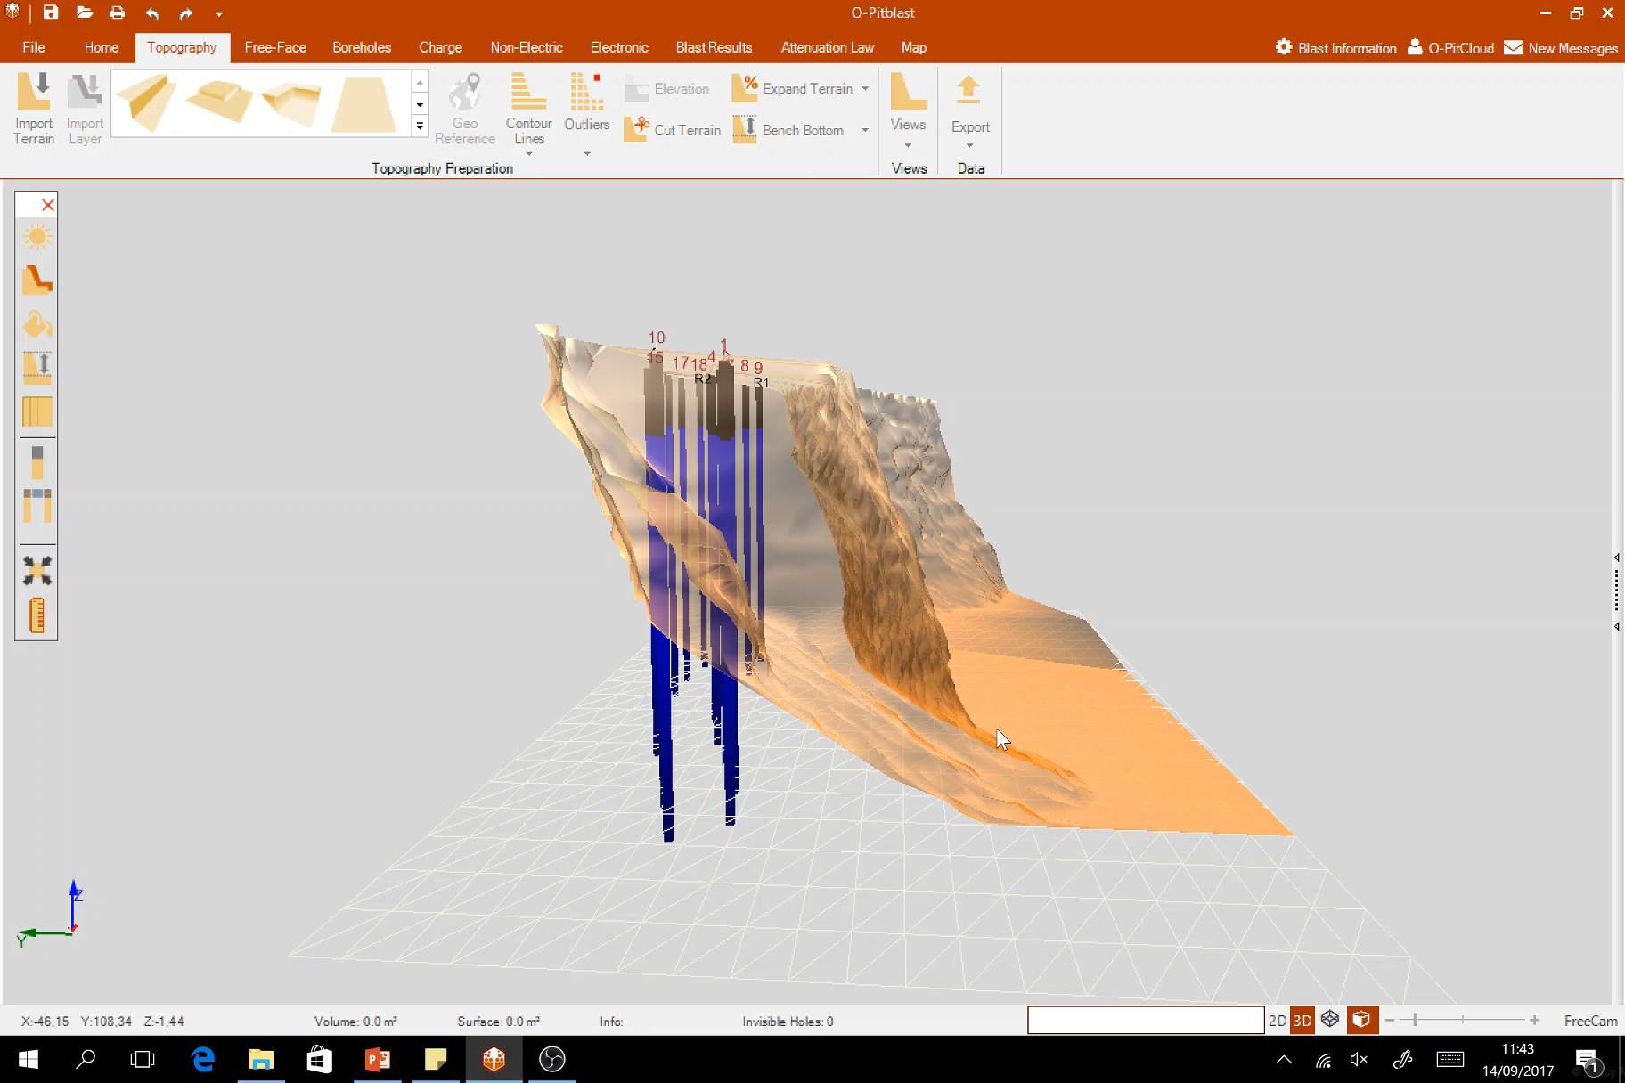
O-Pitblast – Free Face Module
Rodded Boretrak

Slide 16
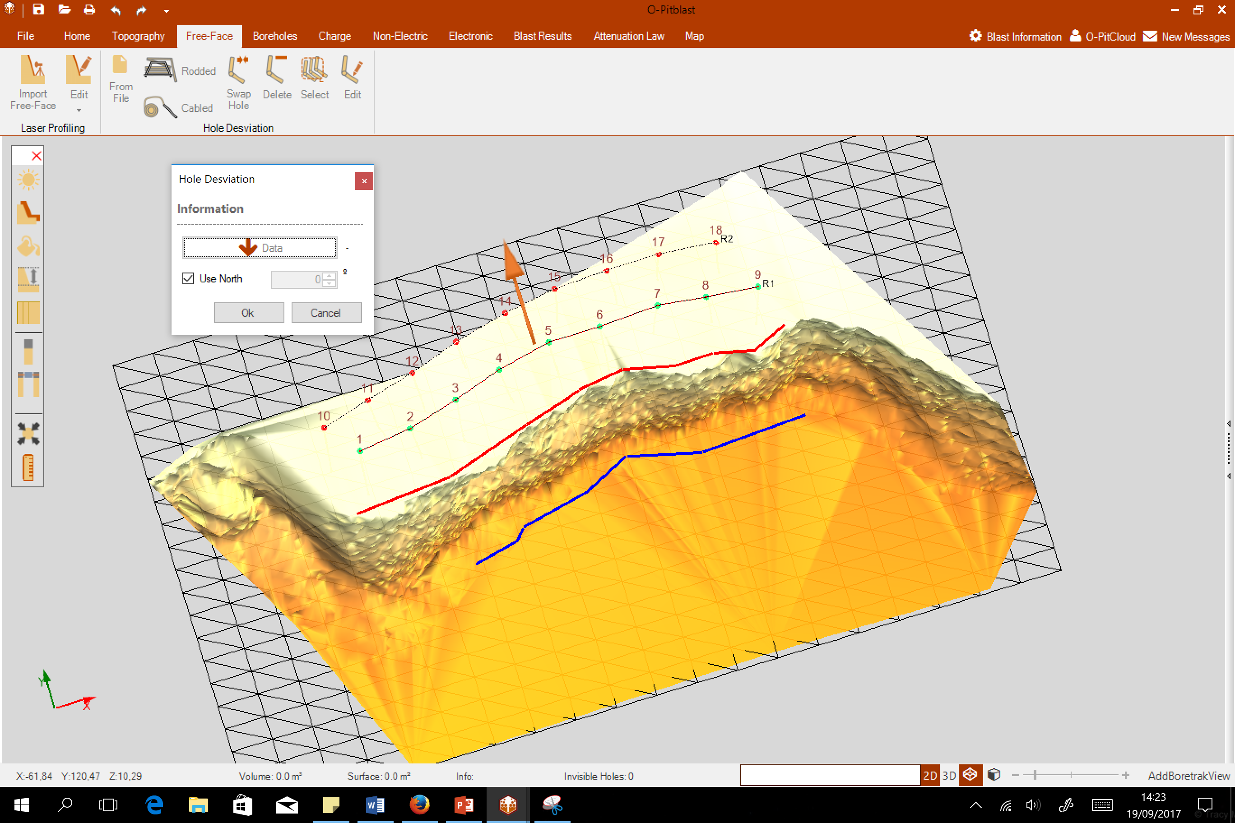
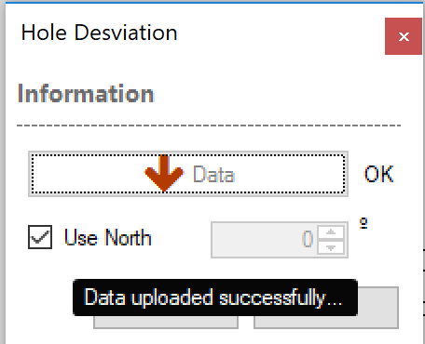

O-Pitblast – Free Face Module
Cabled

Slide 17
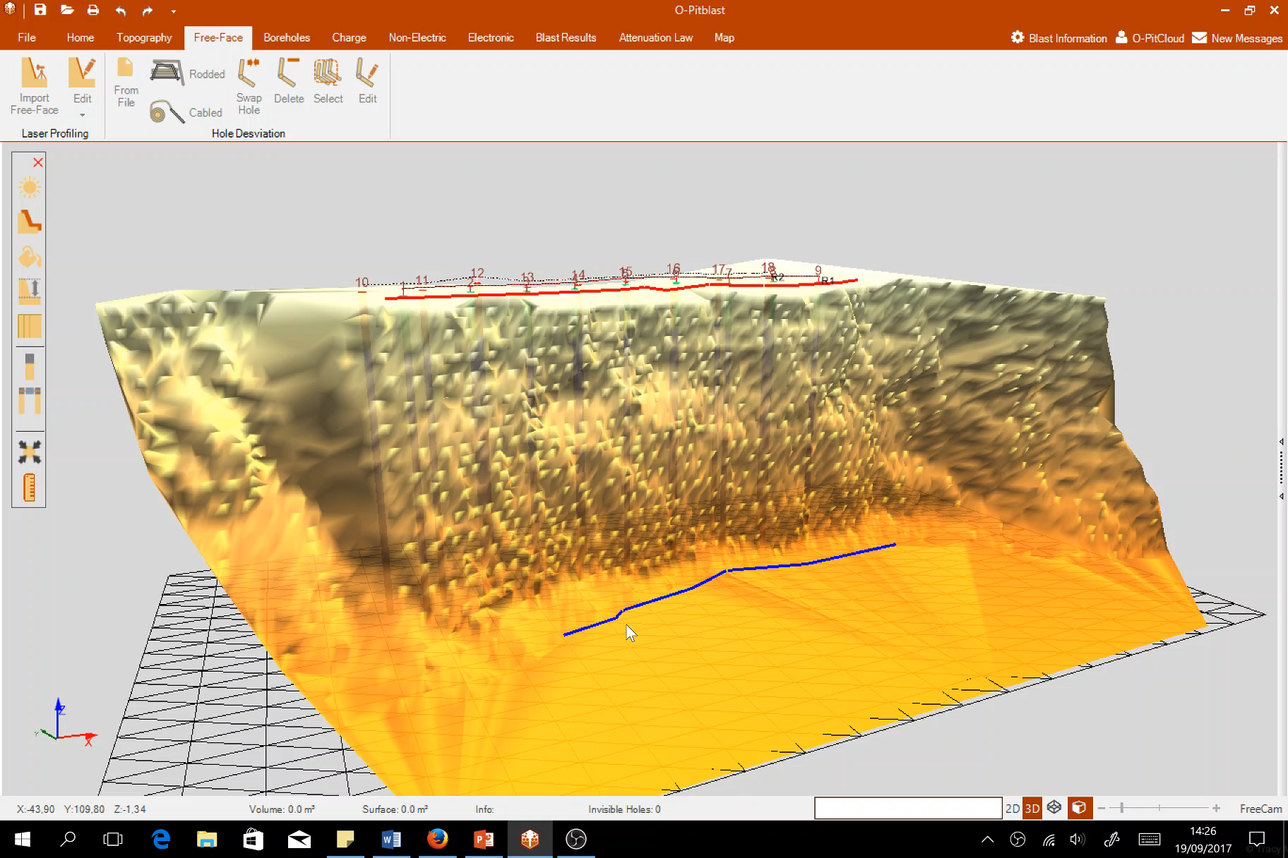
O-Pitblast – Free Face Module
Cabled

Slide 18
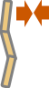
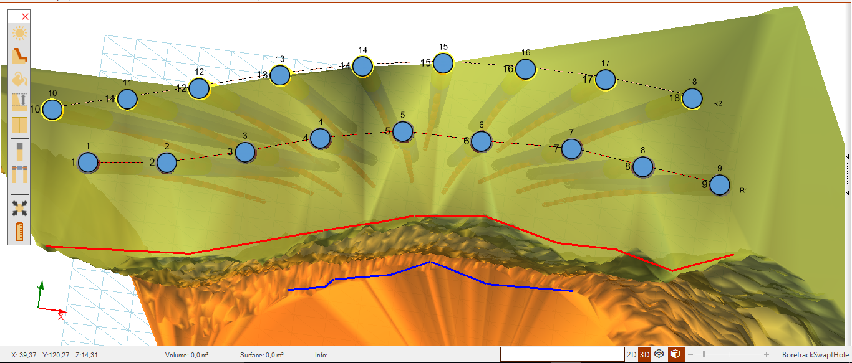

O-Pitblast – Free Face Module
Swap Hole

Slide 19
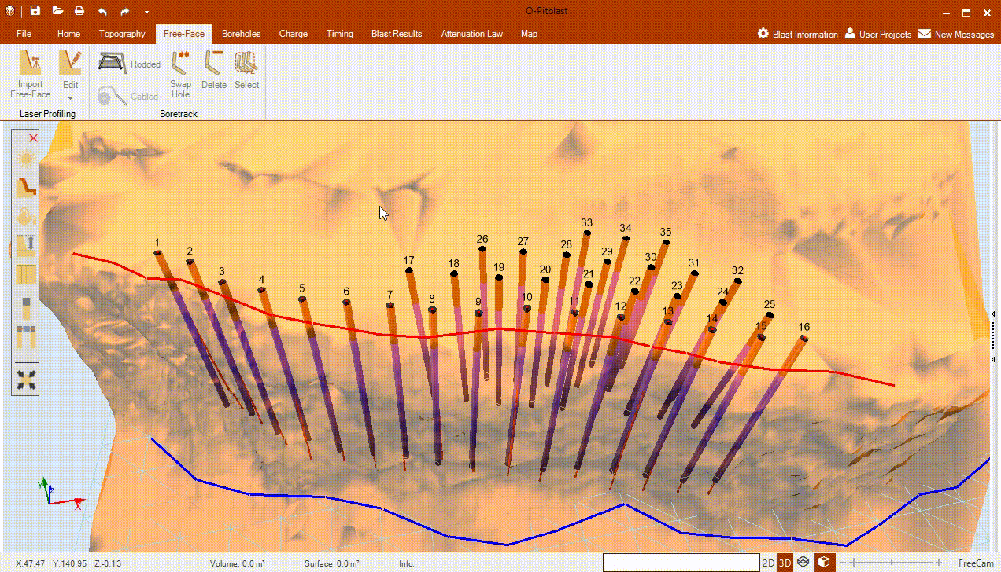
O-Pitblast – Free Face Module
Swap Hole

Slide 20
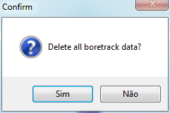

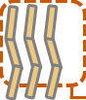
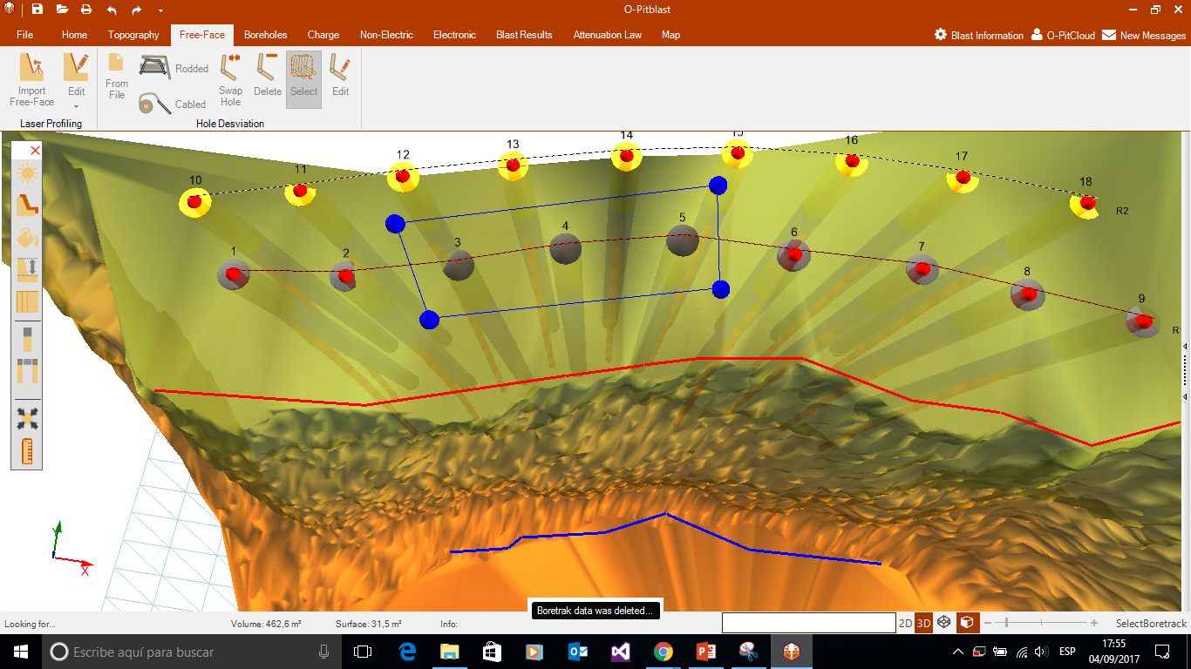
O-Pitblast – Free Face Module
Delete Boretrak

Slide 21
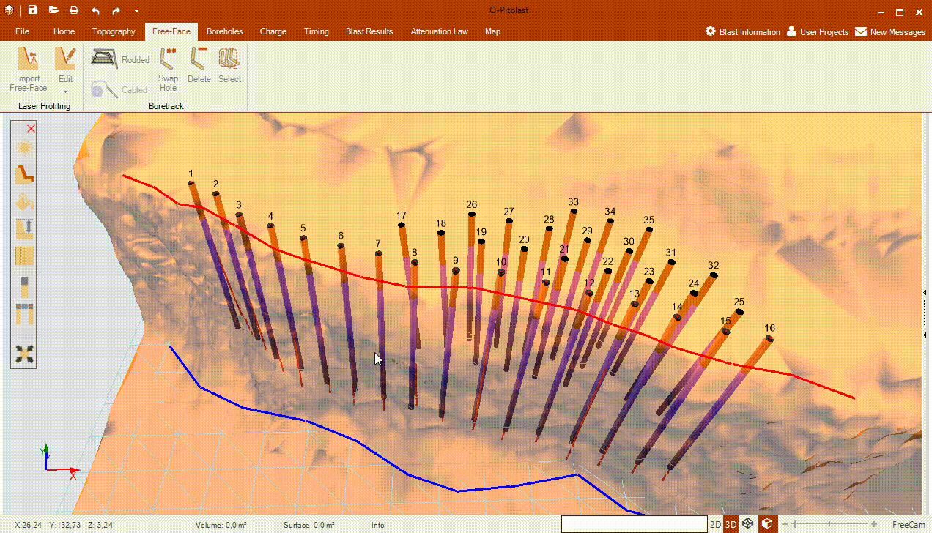
O-Pitblast – Free Face Module
Delete Boretrak

Slide 22

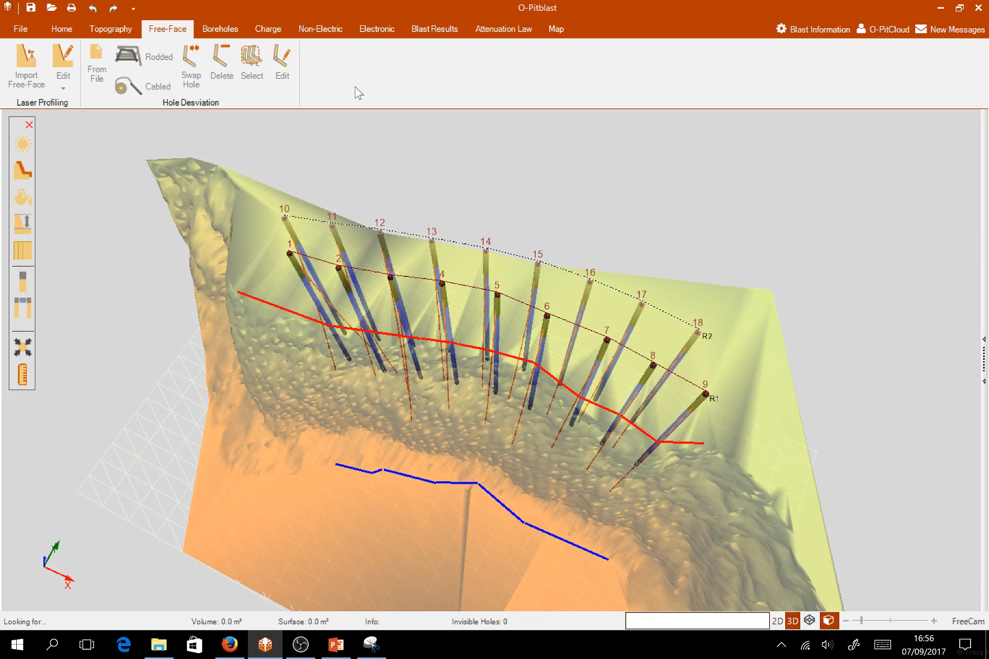
O-Pitblast – Free Face Module
Edit

Slide 23
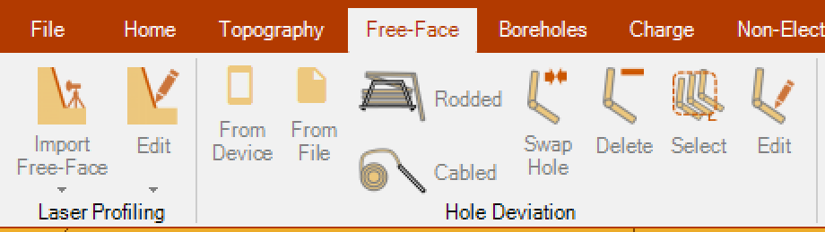
O-Pitblast – Free Face Module
Import your Borehole deviation information directly from device

Slide 24
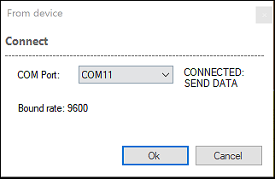
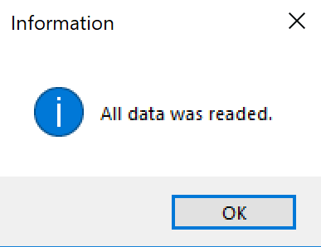
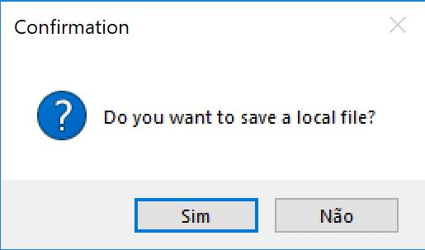
O-Pitblast – Free Face Module
Connect your device to computer, then choose your COM PORT.
After the connection is made send the data.

Slide 25
O-Pitblast – Free Face Module
Also, O-Pibtlast ask you if you want to save a local file from your device.
Then the process is the same expained on the rodded and cabled.

Slide 26
Technical Support
Phone: +351 918 558 879
E-mail: support@o-pitblast.com

