Slide 1
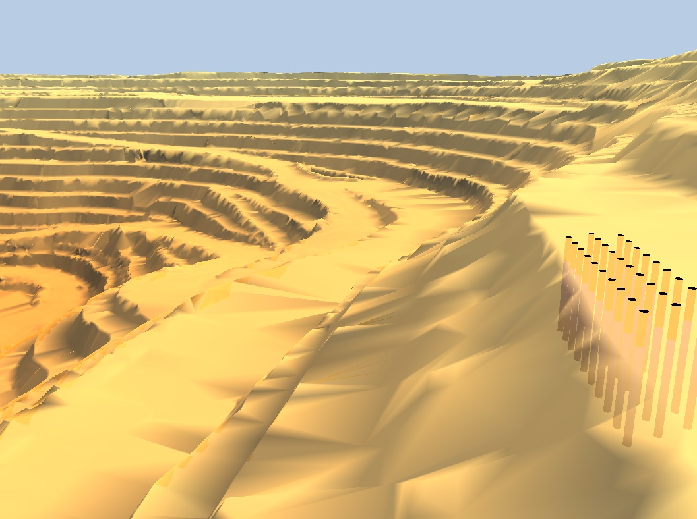

O-Pitblast – Borehole Module

Slide 2
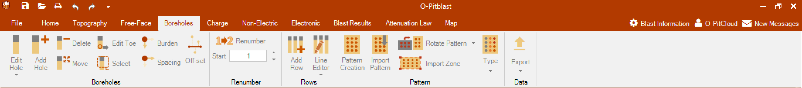

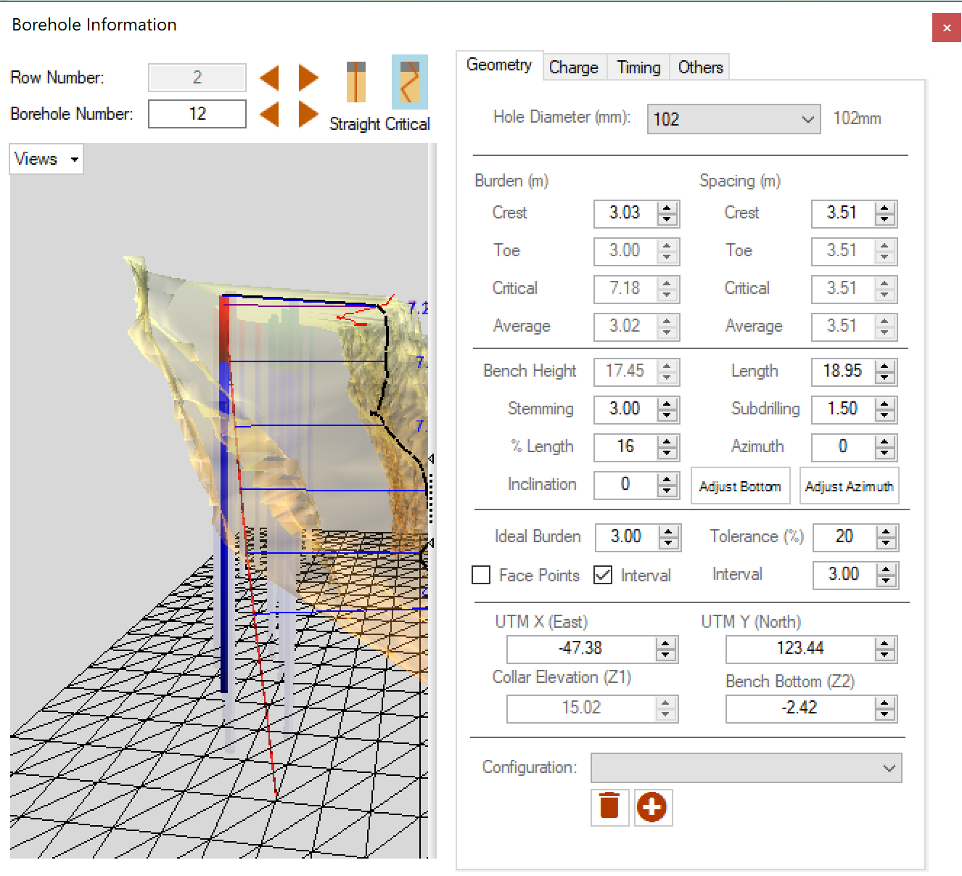
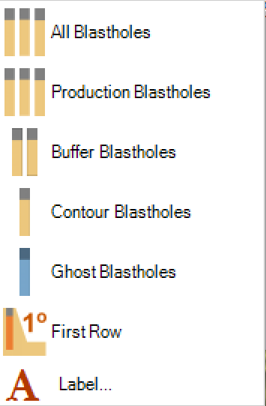
O-Pitblast – Boreholes Module
Edit Hole

Slide 3
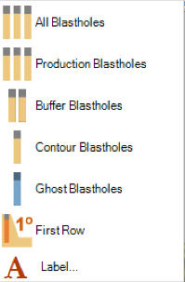
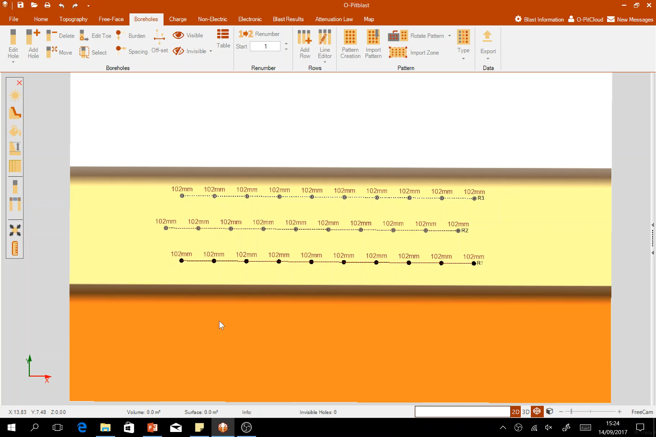
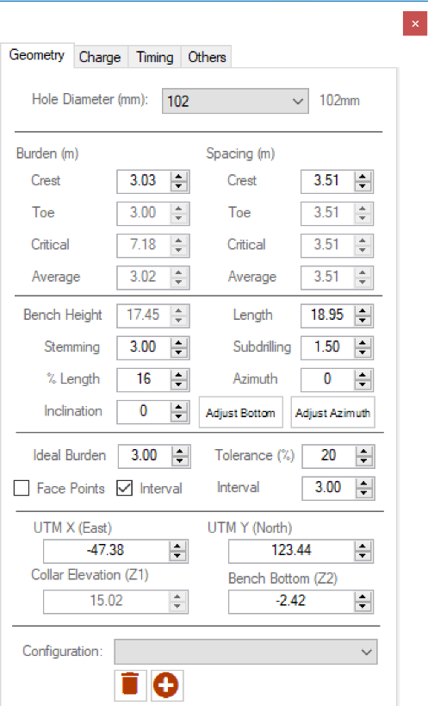
O-Pitblast – Boreholes Module
Edit Hole

Slide 4
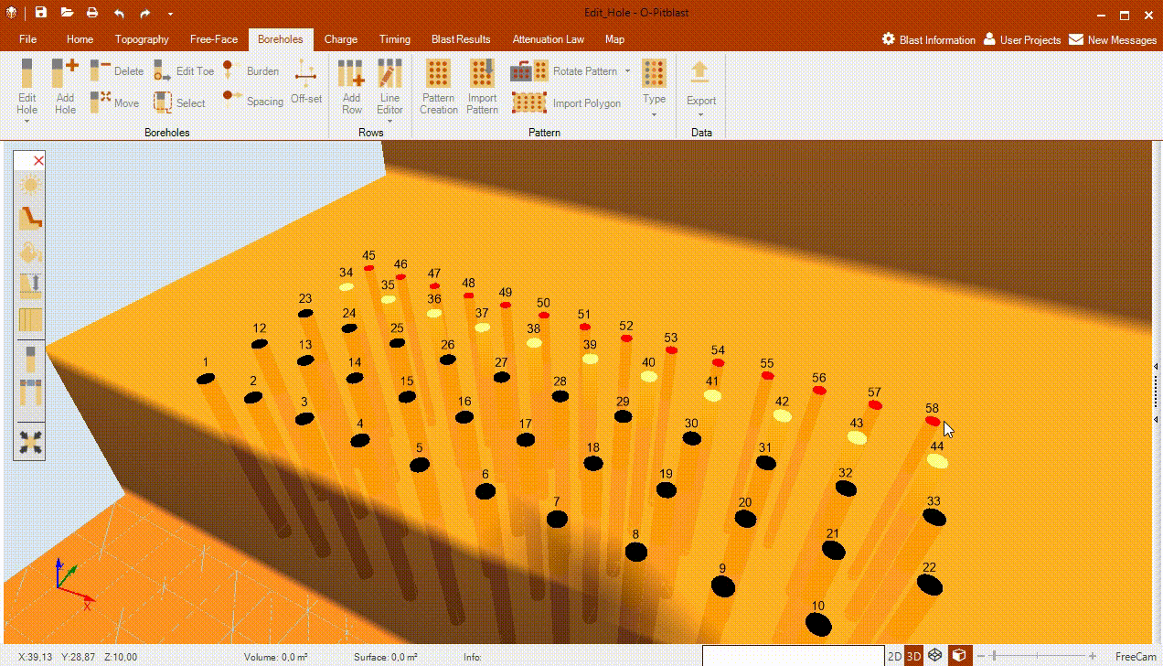
O-Pitblast – Boreholes Module
Edit Hole

Slide 5
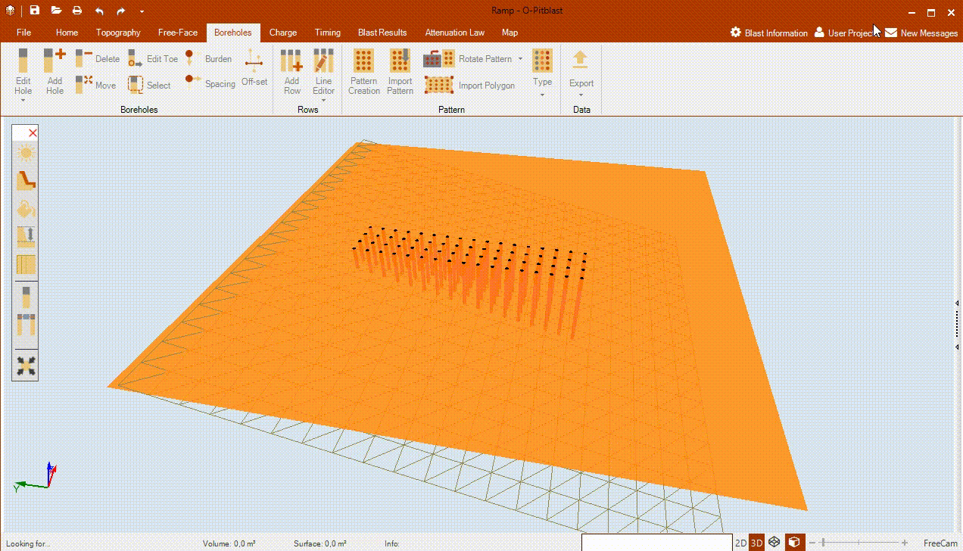
O-Pitblast – Boreholes Module
*.Ramp
Edit Hole

Slide 6
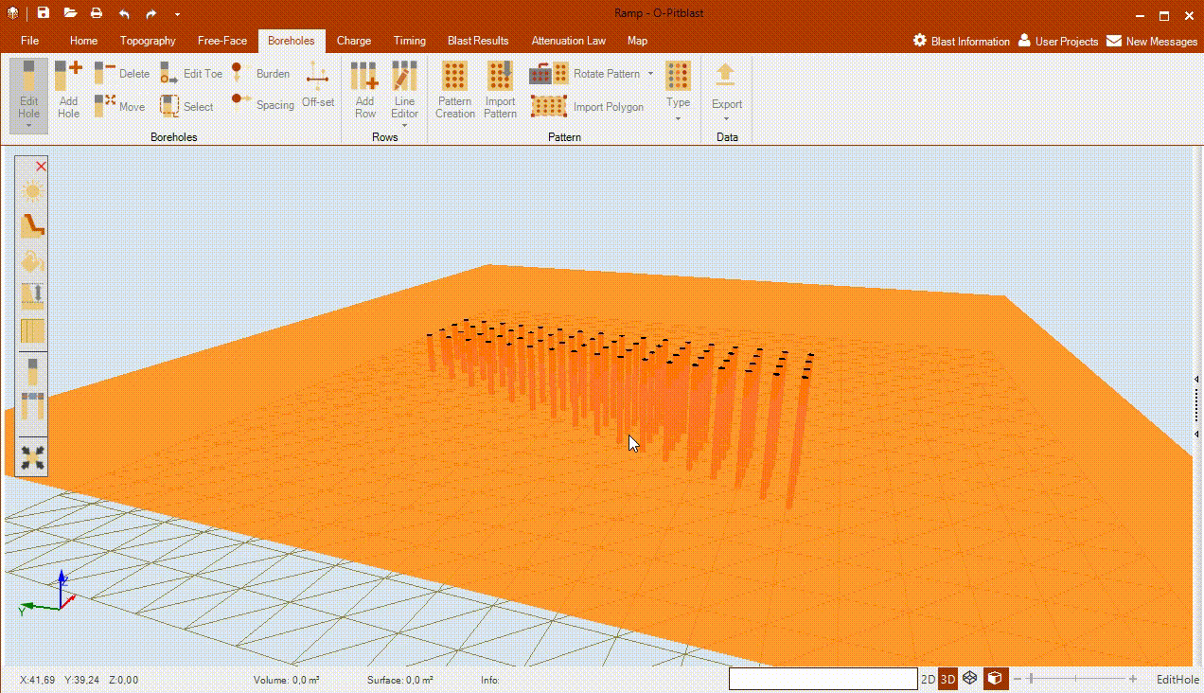
O-Pitblast – Boreholes Module
*.Ramp
Edit Hole

Slide 7
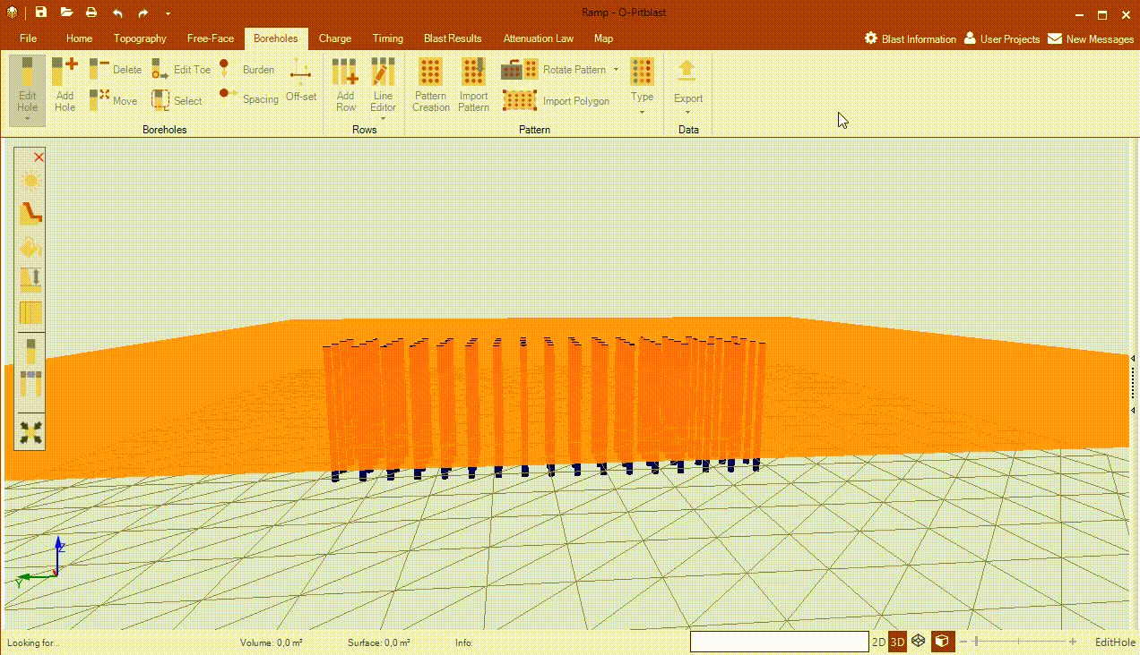
O-Pitblast – Boreholes Module
*.Ramp
Edit Hole

Slide 8
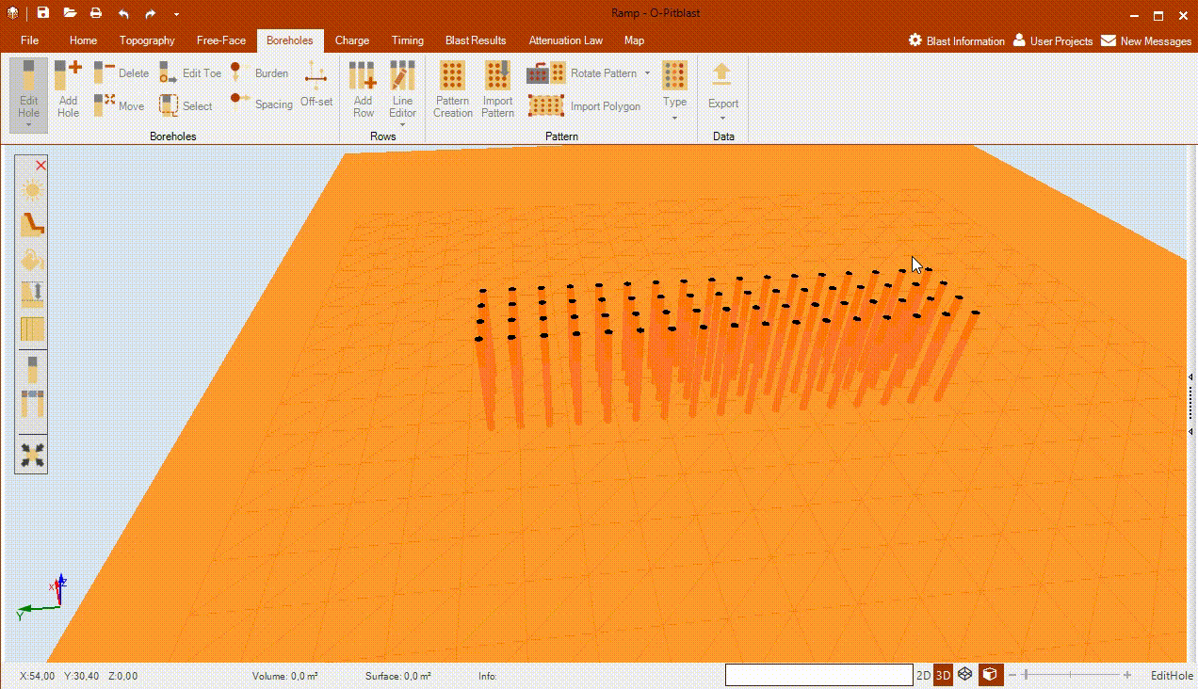
O-Pitblast – Boreholes Module
*.Ramp
Edit Hole

Slide 9
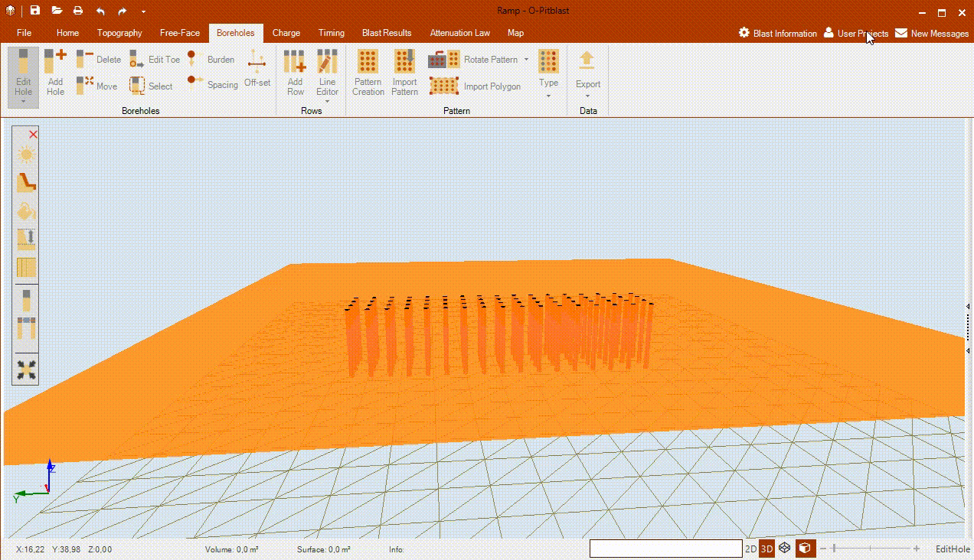
O-Pitblast – Boreholes Module
Edit Hole

Slide 10


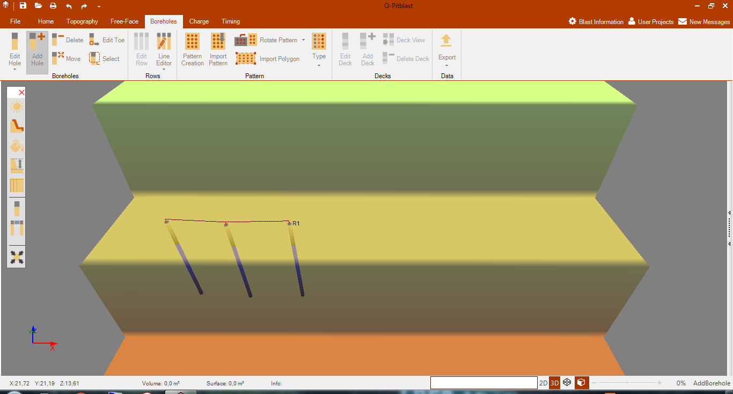

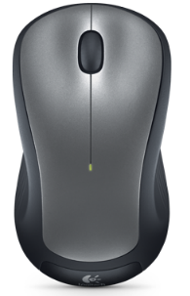
O-Pitblast – Boreholes Module
*.Default Terrain
ctrl+H
Add Hole

Slide 11
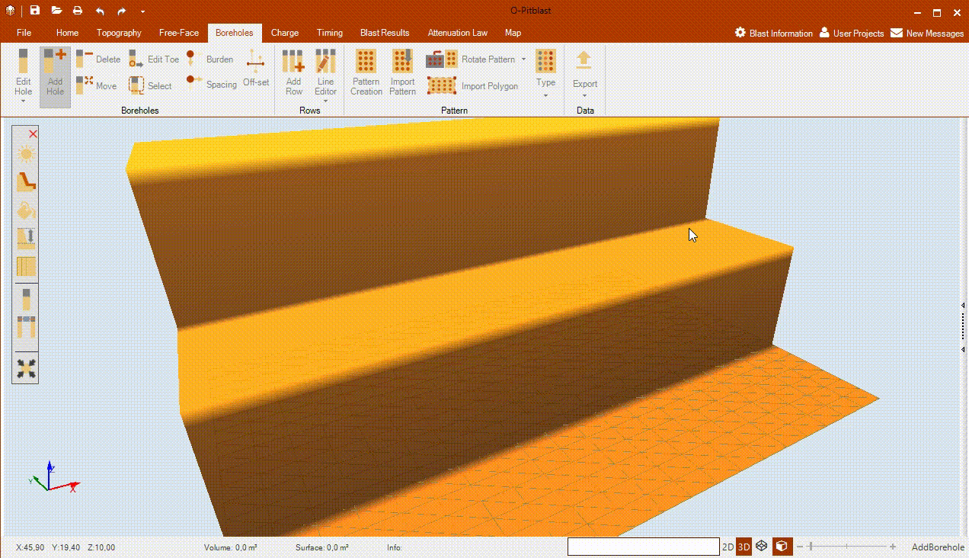
O-Pitblast – Boreholes Module
*.Default Terrain
ctrl+H
Add Hole

Slide 12

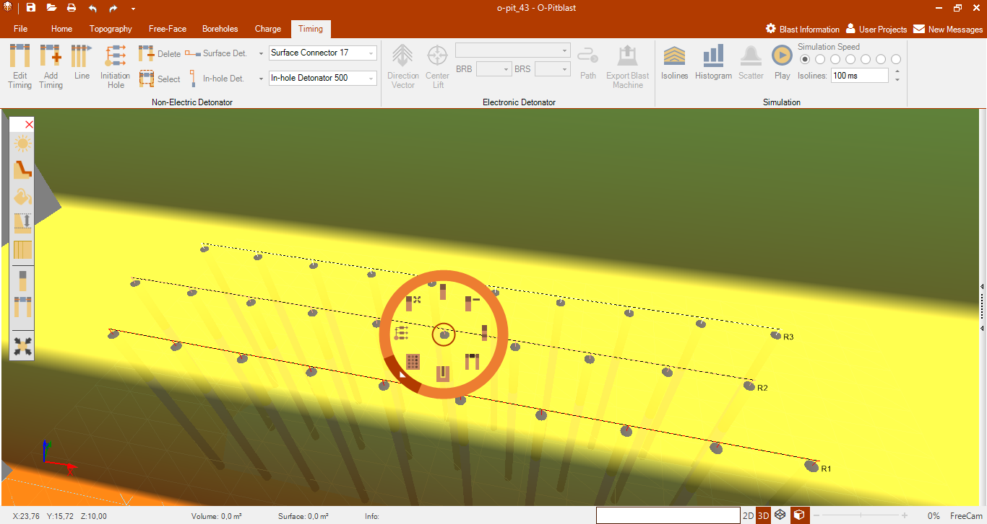

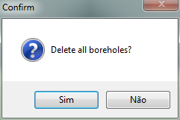
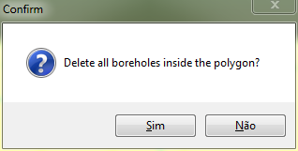
O-Pitblast – Boreholes Module
*.Sample Pattern
ctrl+Del
Delete Hole
Radial Menu

Slide 13
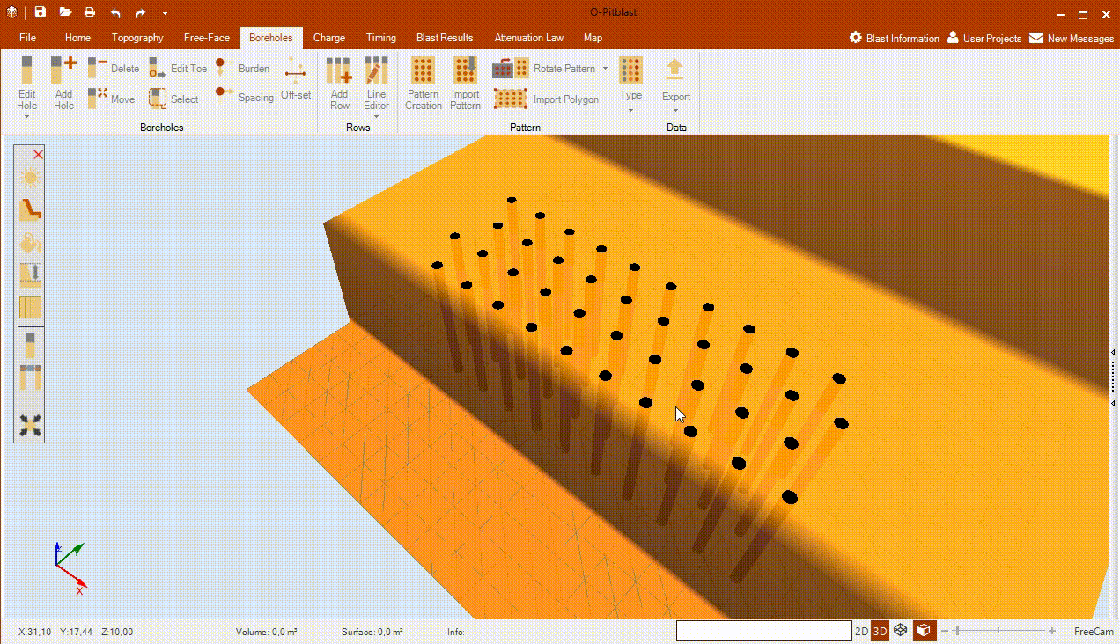
O-Pitblast – Boreholes Module
*.Sample Pattern
Delete Hole

Slide 14

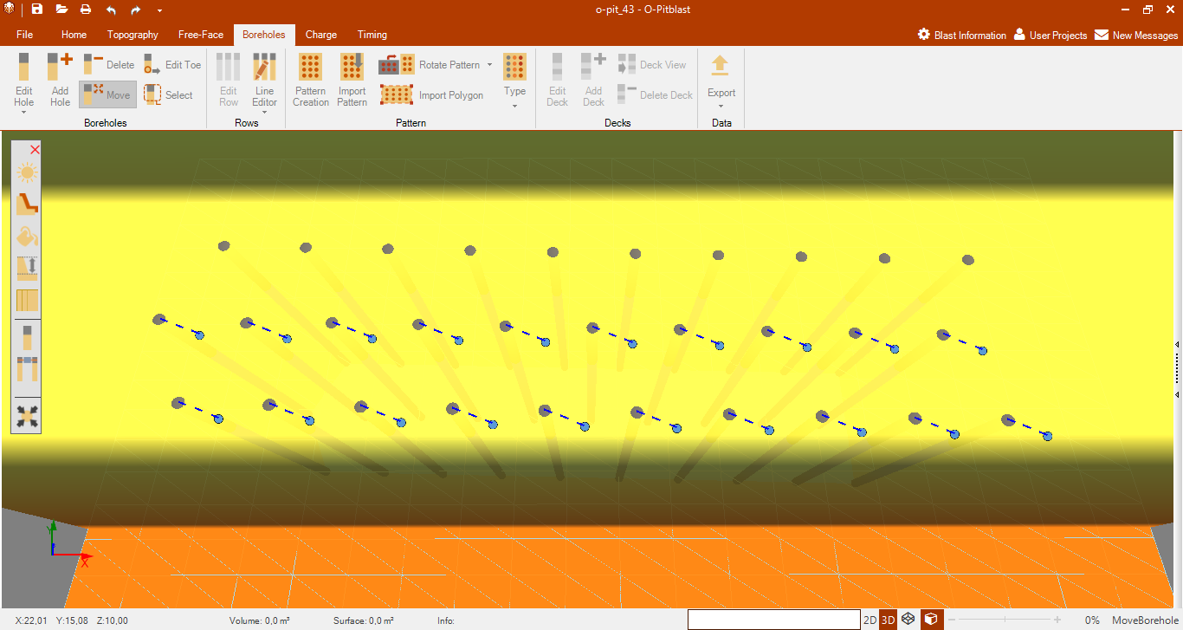
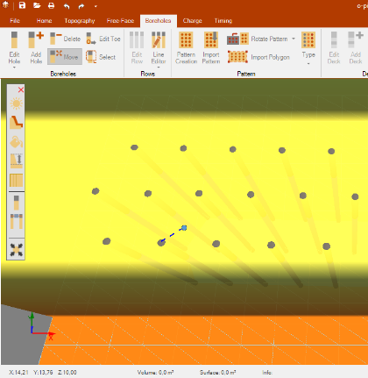

O-Pitblast – Boreholes Module
*.Sample Pattern
ctrl+M
Move Hole
Single Holes
Multiple Holes

Slide 15
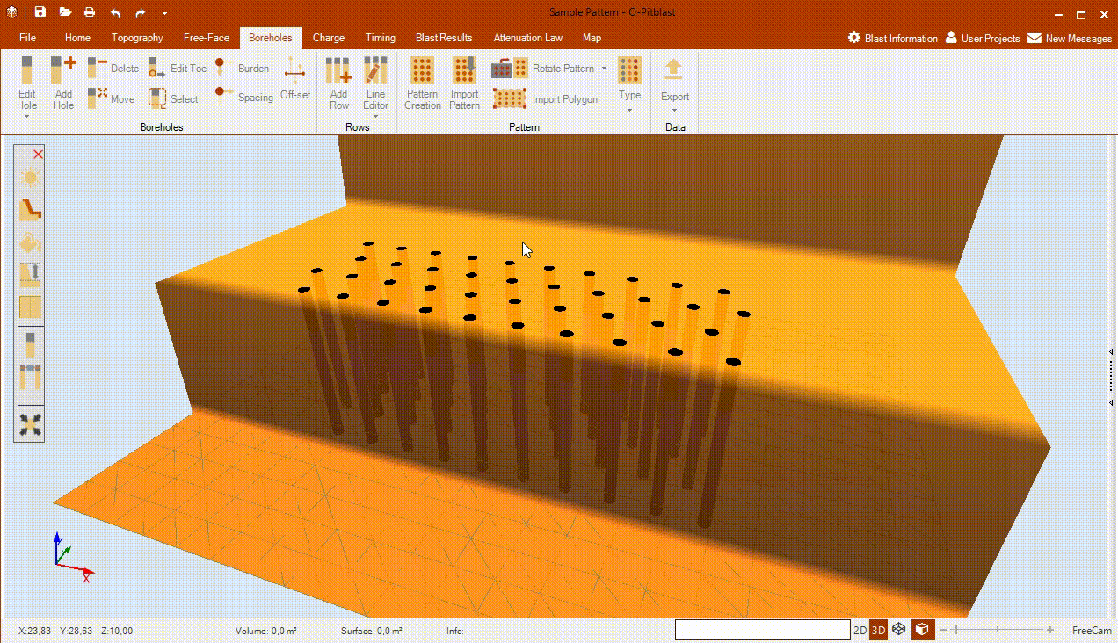
O-Pitblast – Boreholes Module
*.Sample Pattern
Move Hole

Slide 16

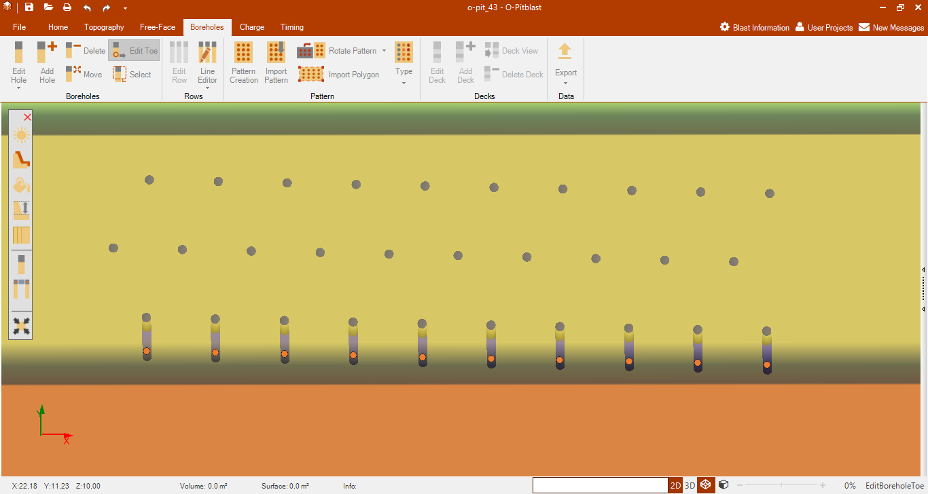
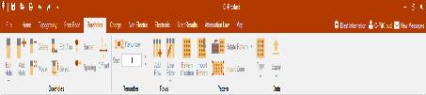
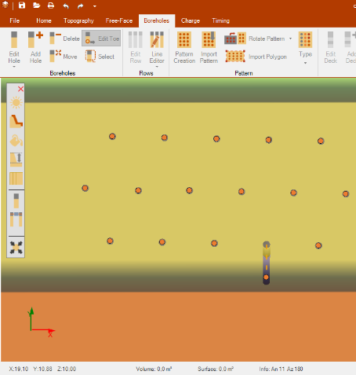
O-Pitblast – Boreholes Module
*.Sample Pattern
ctrl+shift+T
Edit Toe
Single Holes
Multiple Holes

Slide 17
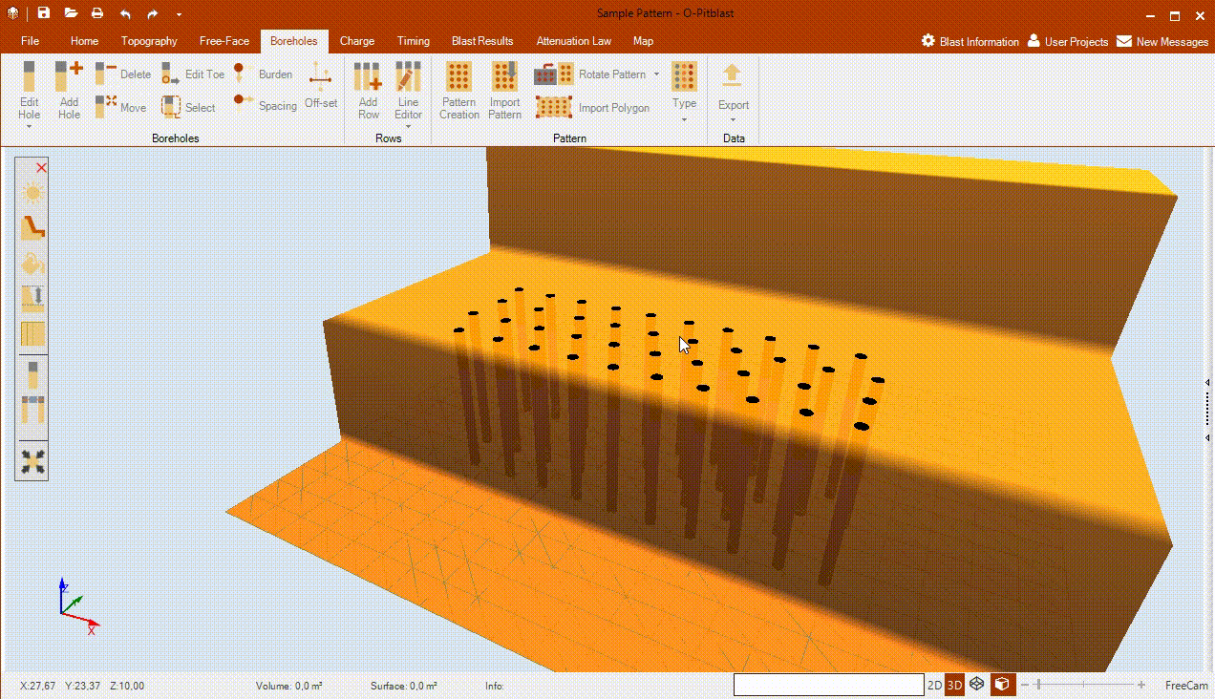
O-Pitblast – Boreholes Module
*.Sample Pattern
Edit Toe

Slide 18
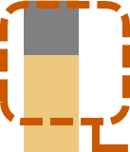
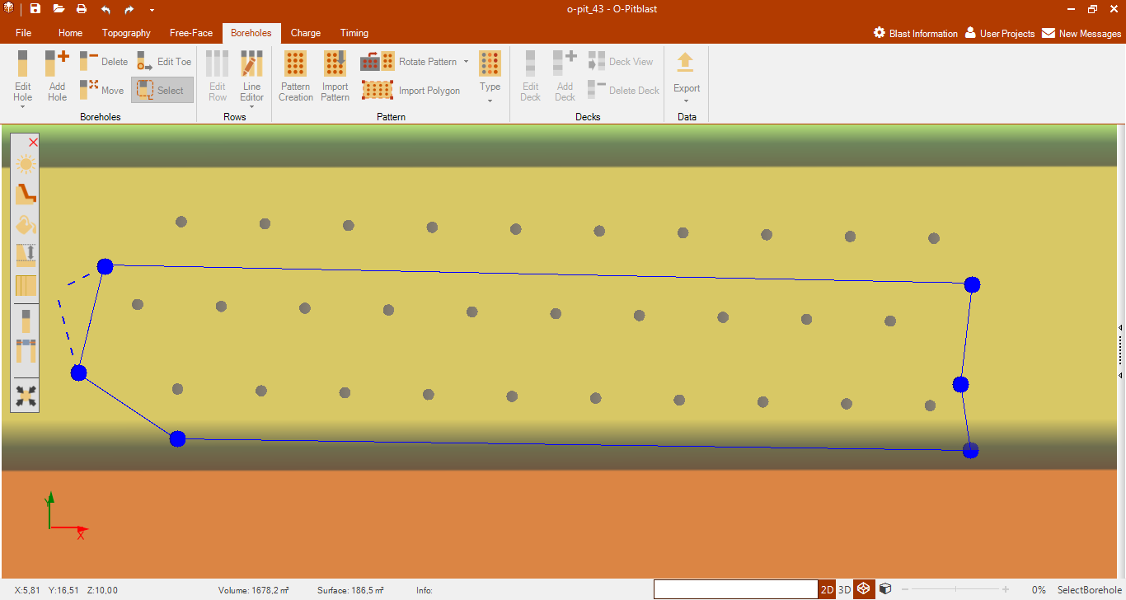
O-Pitblast – Boreholes Module
*.Sample Pattern
ctrl+Q
Select Hole
Create polygon
Close polygon

Slide 19
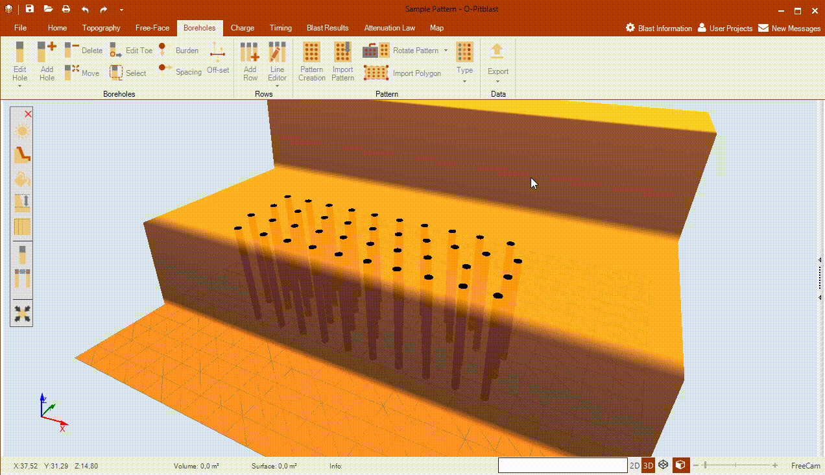
O-Pitblast – Boreholes Module
*.Sample Pattern
Select Hole

