Slide 1
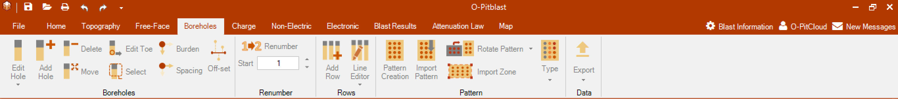

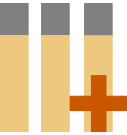
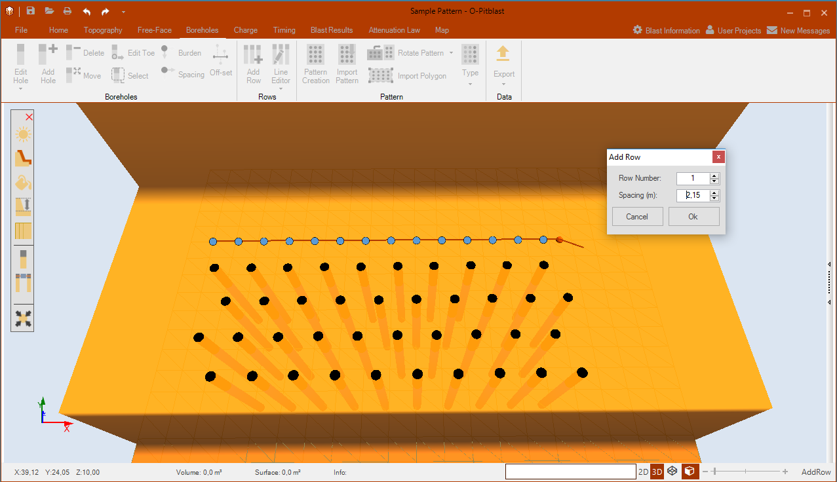
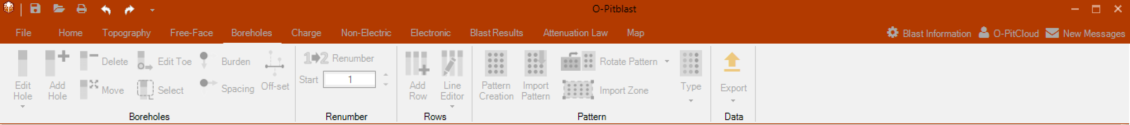
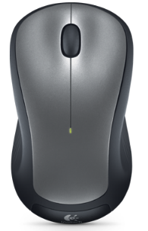
O-Pitblast – Boreholes Module
*.Sample Pattern
ctrl+alt+R
Add Row
Click
Select row and Spacing

Slide 2
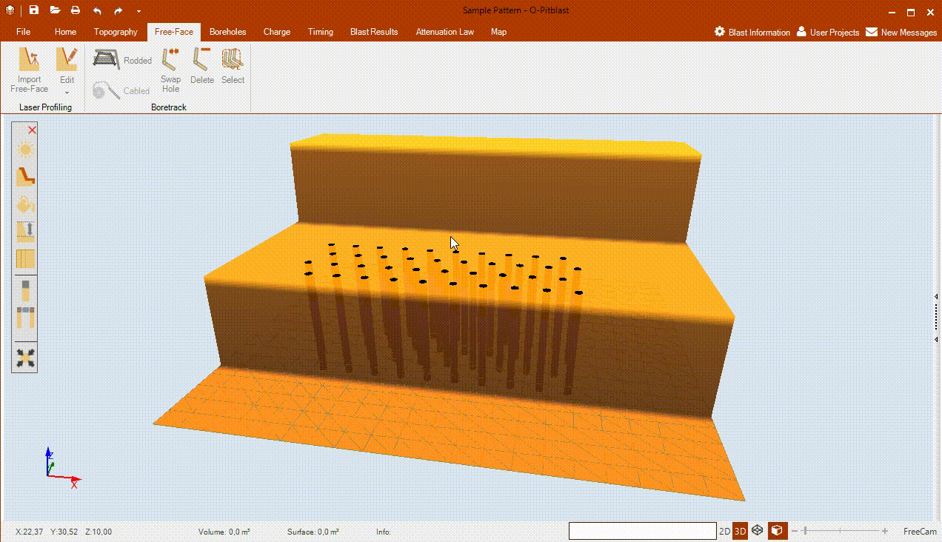
O-Pitblast – Boreholes Module
*.Sample Pattern
Add Row

Slide 3
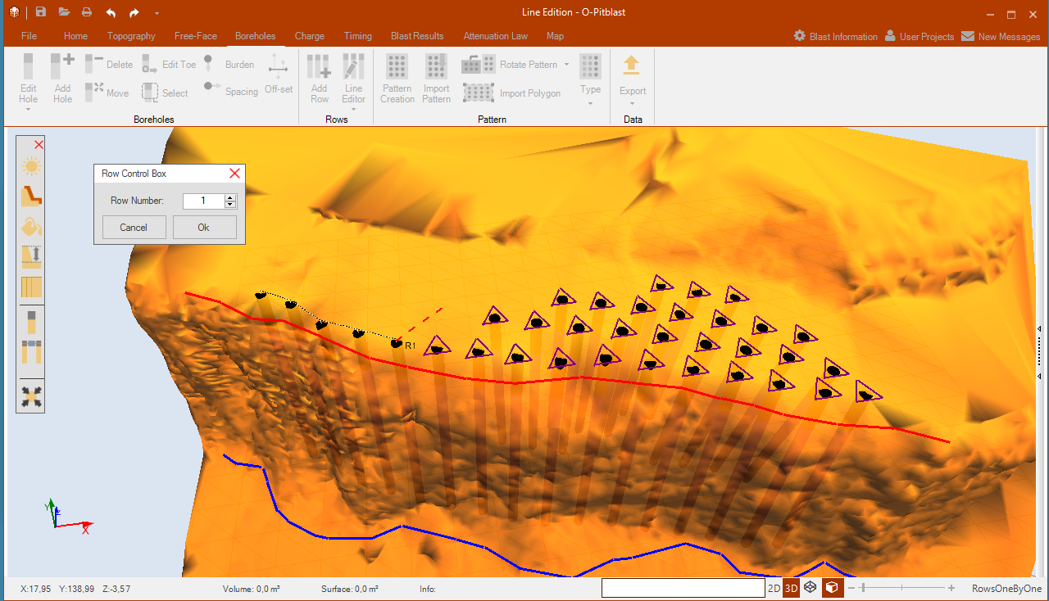
O-Pitblast – Boreholes Module
*.Line Edition
Line Tool

Slide 4
O-Pitblast – Boreholes Module
*.Line Edition
Line Tool

Slide 5
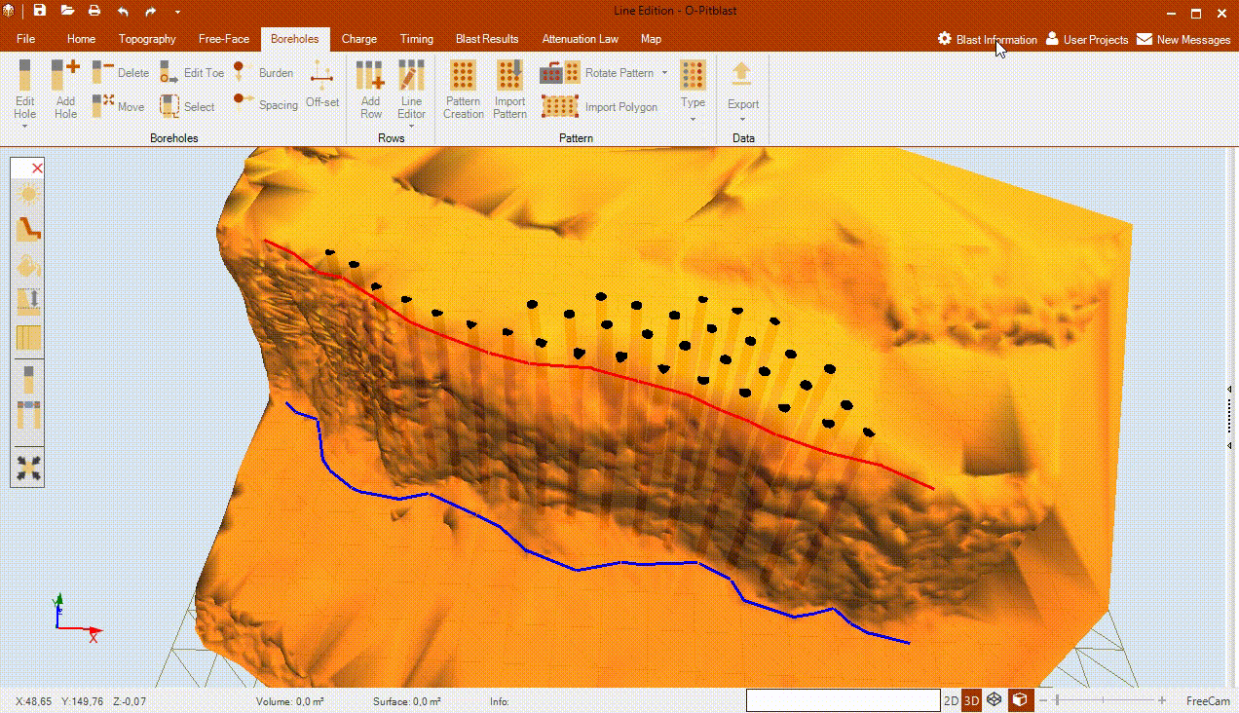
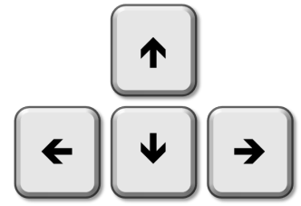
O-Pitblast – Boreholes Module
*.Line Edition
Line Tool
Hole by Hole
Row adjust
+ Drag

Slide 6
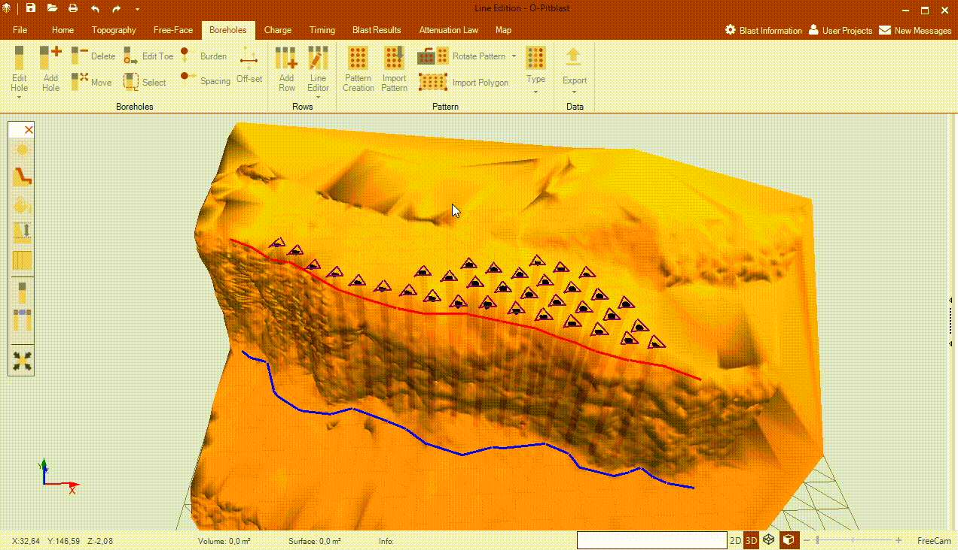
O-Pitblast – Boreholes Module
*.Line Edition
Line Tool
By Line
Row adjust
+ Drag

Slide 7

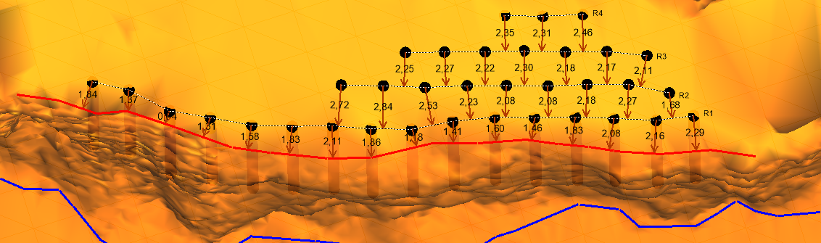
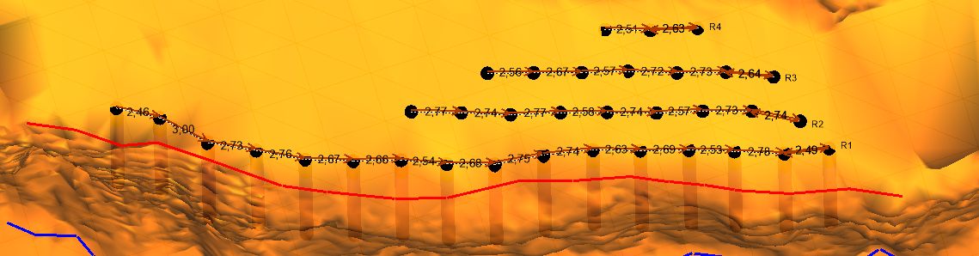
O-Pitblast – Boreholes Module
*.Line Edition
Volume control

Slide 8
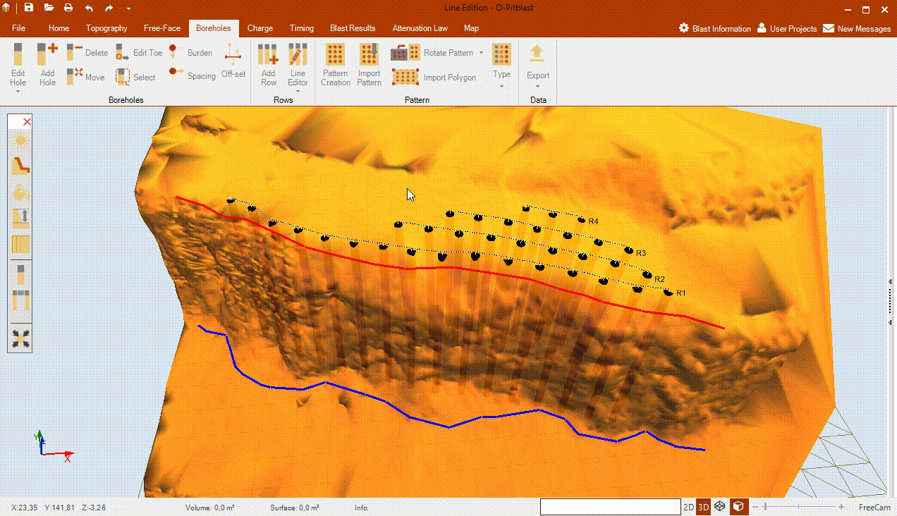
O-Pitblast – Boreholes Module
*.Line Edition
Burden Spacing
Edition
+ Drag

Slide 9

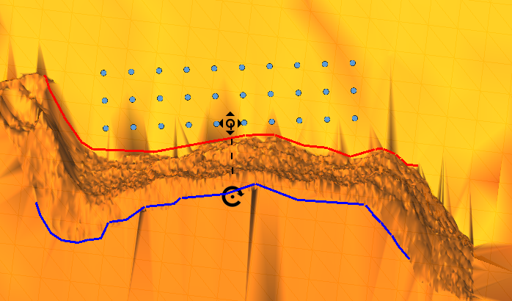
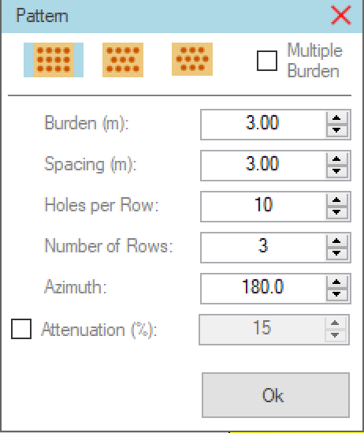
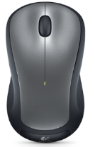
O-Pitblast – Boreholes Module
*.Pattern Creation
ctrl+shift+P
Pattern Creation
+ Drag

Slide 10
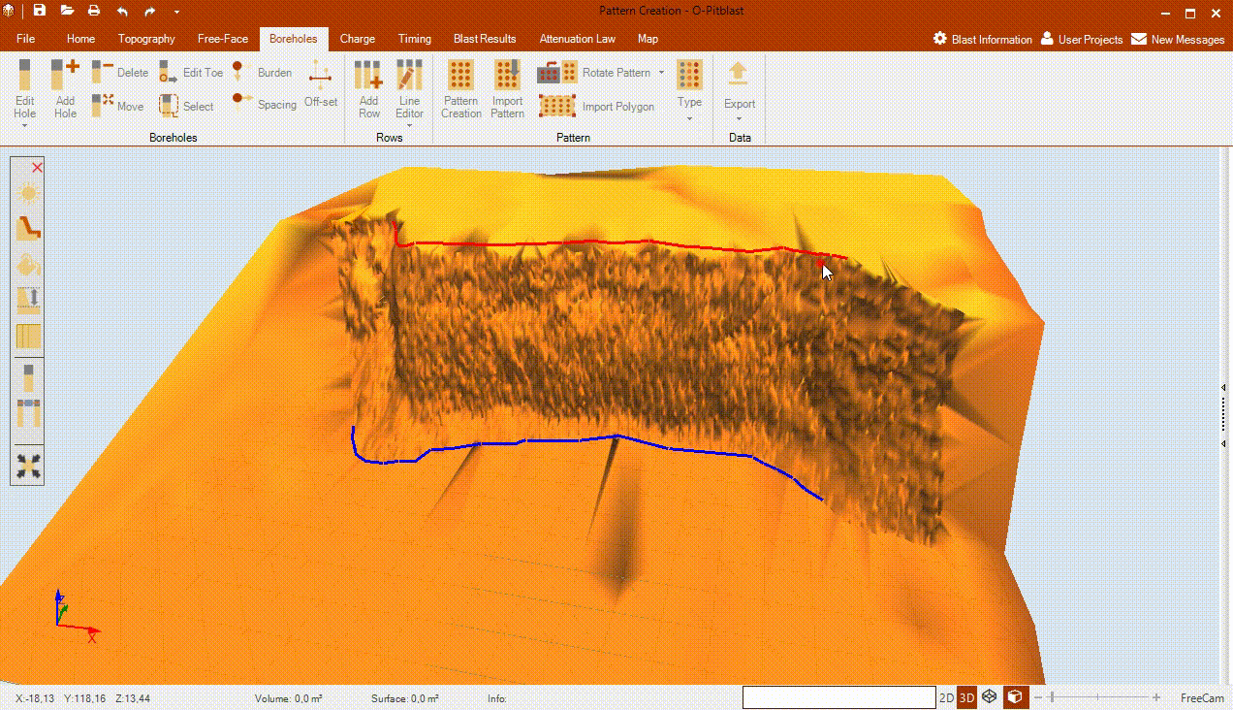
O-Pitblast – Boreholes Module
*.Pattern Creation
Pattern Creation

Slide 11
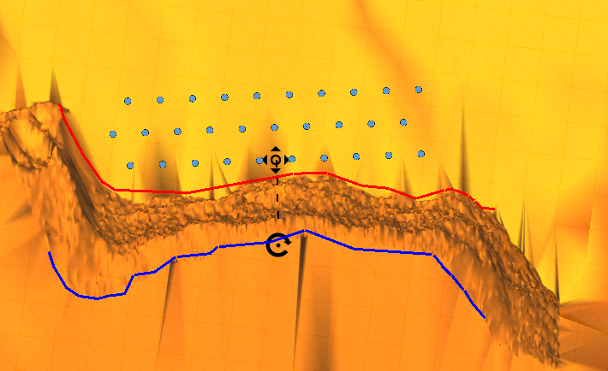
O-Pitblast – Boreholes Module
*.Pattern Creation
Pattern Creation
+ Drag

Slide 12
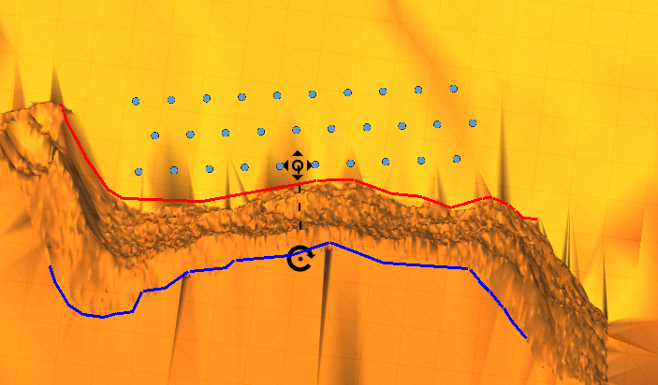
O-Pitblast – Boreholes Module
*.Pattern Creation
Pattern Creation
+ Drag

Slide 13
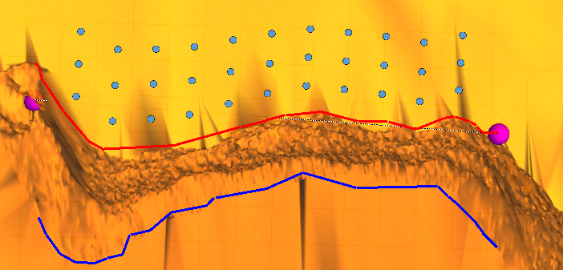
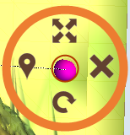
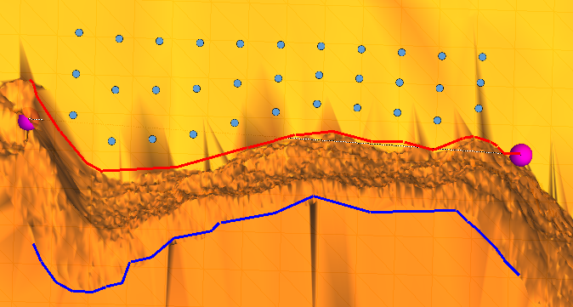
O-Pitblast – Boreholes Module
*.Pattern Creation
Pattern Creation

Slide 14
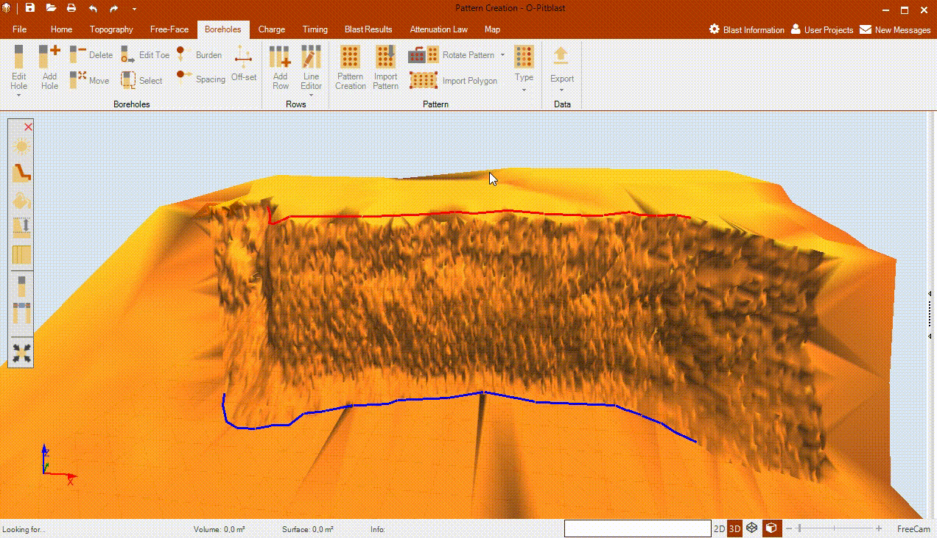
O-Pitblast – Boreholes Module
*.Pattern Creation
Pattern Creation

Slide 15
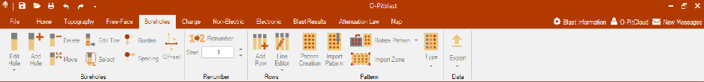

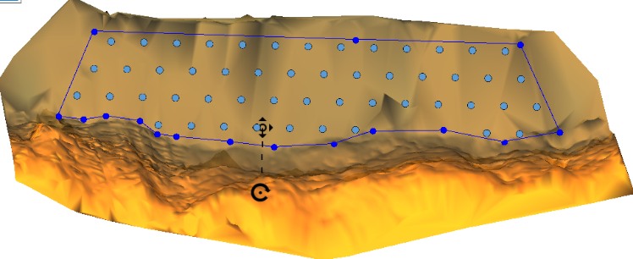
O-Pitblast – Boreholes Module
*.Pattern Creation
Pattern Creation

