Slide 1
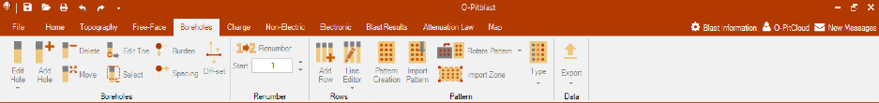


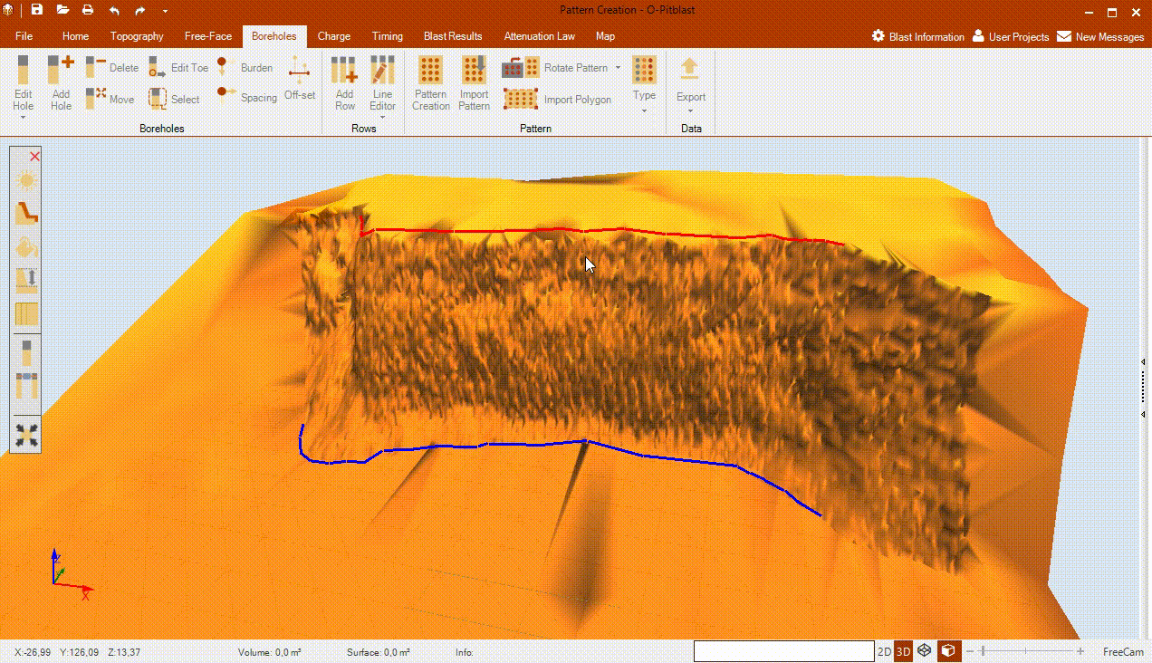
O-Pitblast – Boreholes Module
*.Pattern Creation
*.Pattern Creation
*.Pattern Creation
Pattern Creation

Slide 2
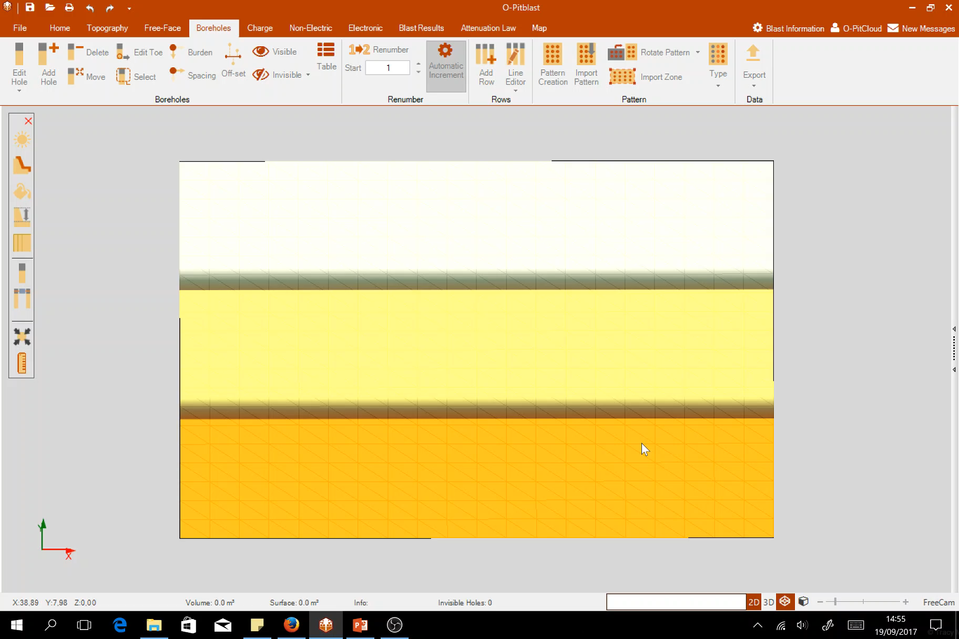
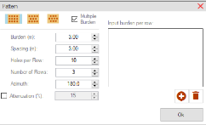
O-Pitblast – Boreholes Module
*.Pattern Creation
*.Pattern Creation
*.Pattern Creation
Pattern Creation: Multiple Burden

Slide 3
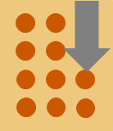
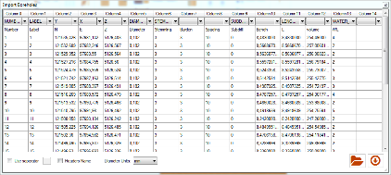
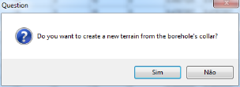
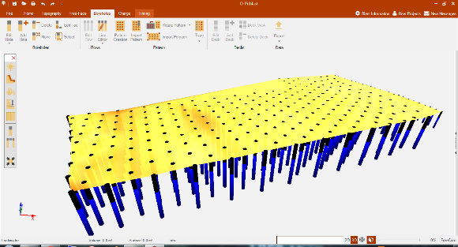

O-Pitblast – Boreholes Module
*. Drill Pattern Full Info
*.Pattern Creation
*.Pattern Creation
Import Pattern
.xlsx
.csv
.txt
.str

Slide 4
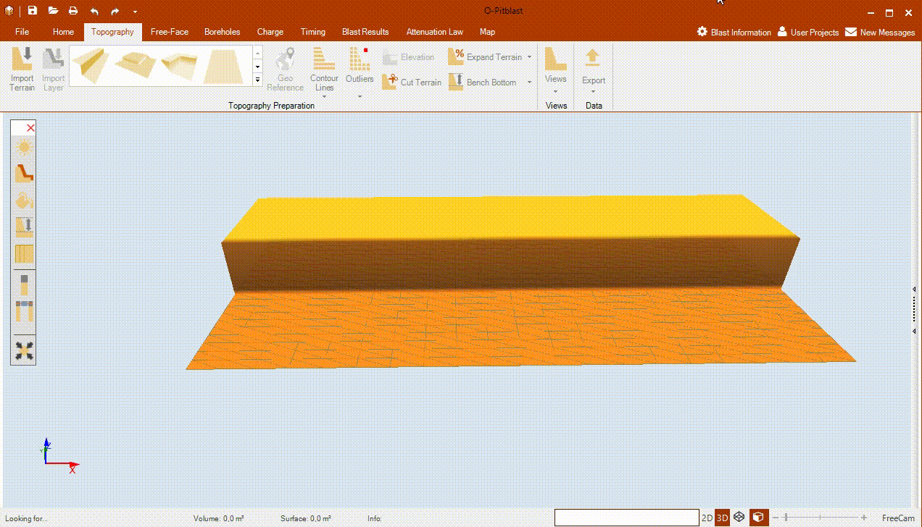
O-Pitblast – Boreholes Module
*. Drill Pattern Full Info
Import Pattern
.xlsx
.csv
.txt
.str

Slide 5

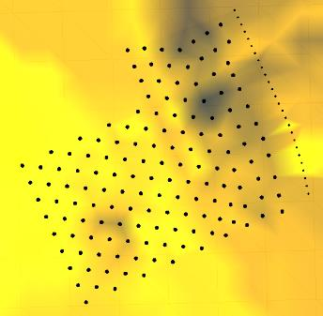
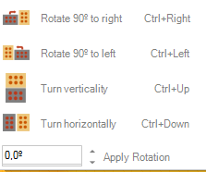
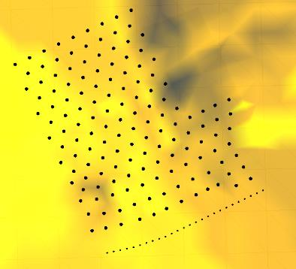
O-Pitblast – Boreholes Module
*. Drill Pattern Full Info
Rotate Pattern

Slide 6
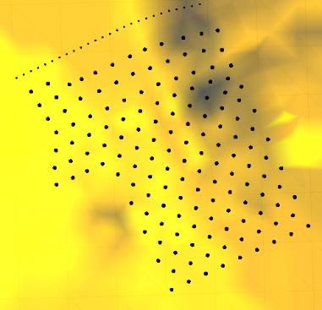
O-Pitblast – Boreholes Module
*. Drill Pattern Full Info
Rotate Pattern

Slide 7
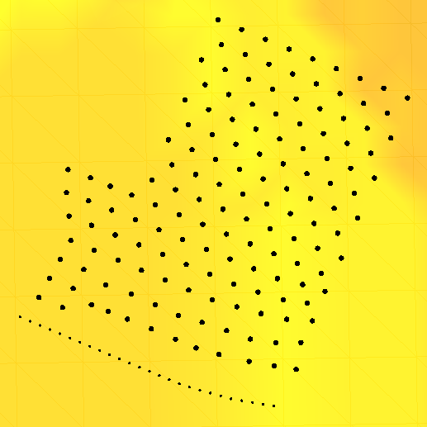
O-Pitblast – Boreholes Module
*. Drill Pattern Full Info
Rotate Pattern

Slide 8
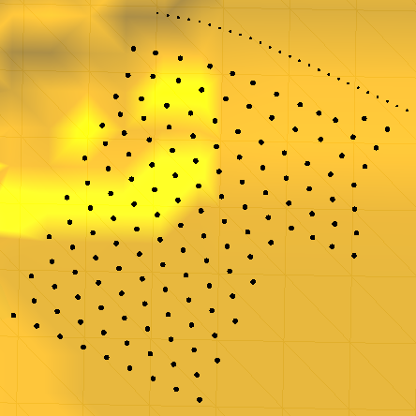
O-Pitblast – Boreholes Module
*. Drill Pattern Full Info
Rotate Pattern

Slide 9
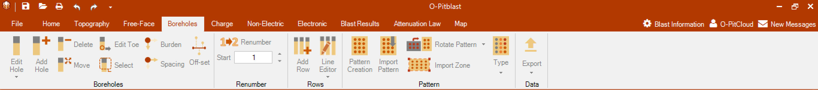
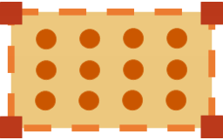

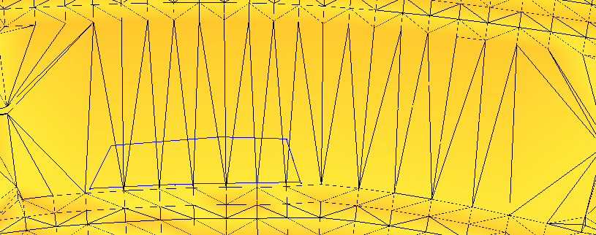
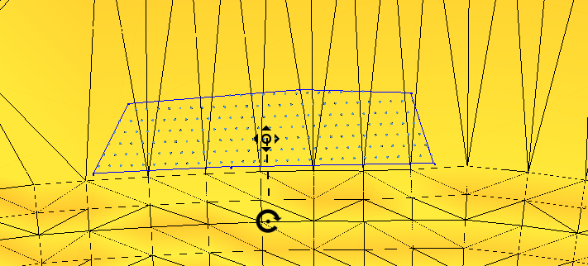
O-Pitblast – Boreholes Module
*. Pit to Polygon
*. Blast Boundaries
Import Polygon

