Slide 1
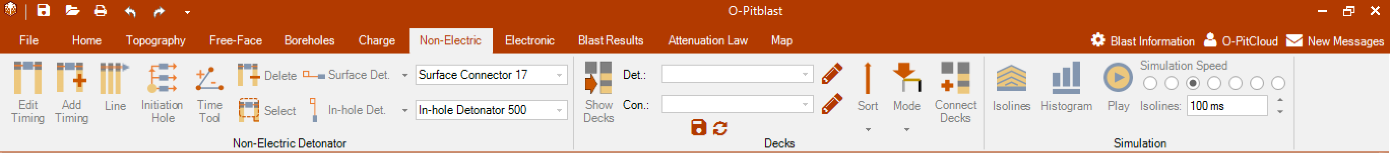

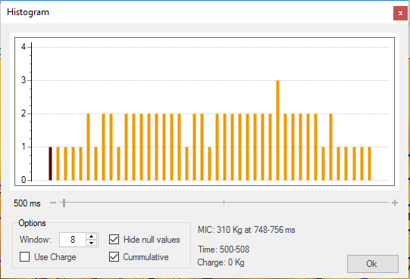
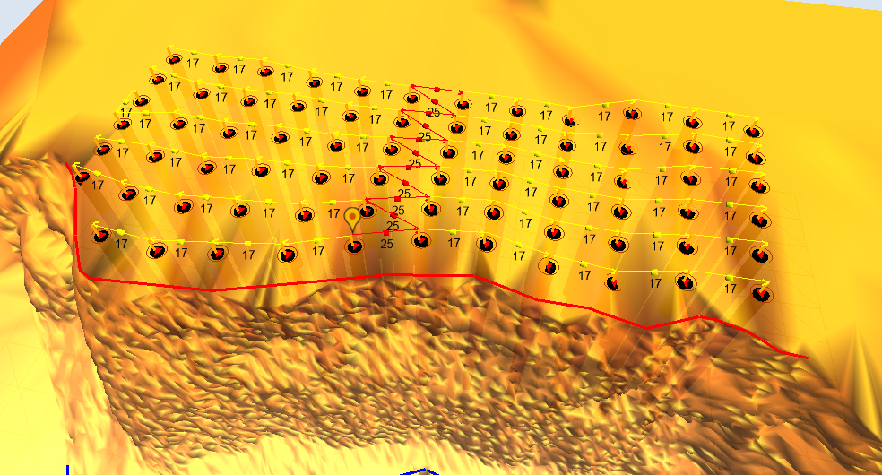
O-Pitblast – Non electronic detonators
*. Pattern Timing_3
Number of holes
Histogram
MIC information
Comulative info

Slide 2
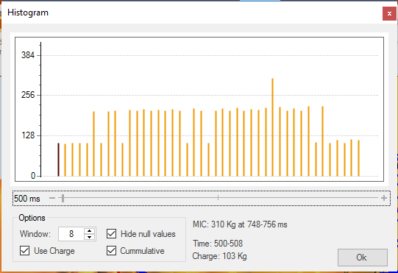
O-Pitblast – Non electronic detonators
*. Pattern Timing_3
kg’s
Histogram
Charge histogram
Time interval without blast

Slide 3
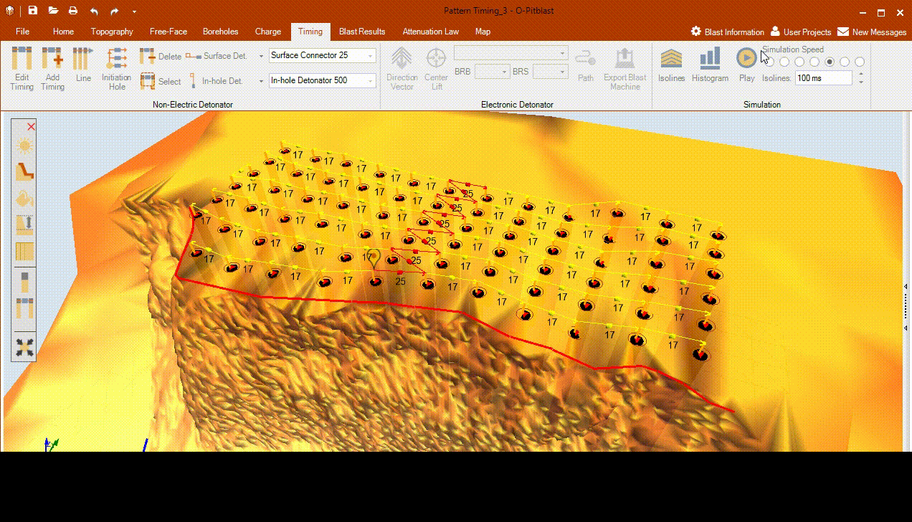
O-Pitblast – Non electronic detonators
*. Pattern Timing_3
Histogram

Slide 4

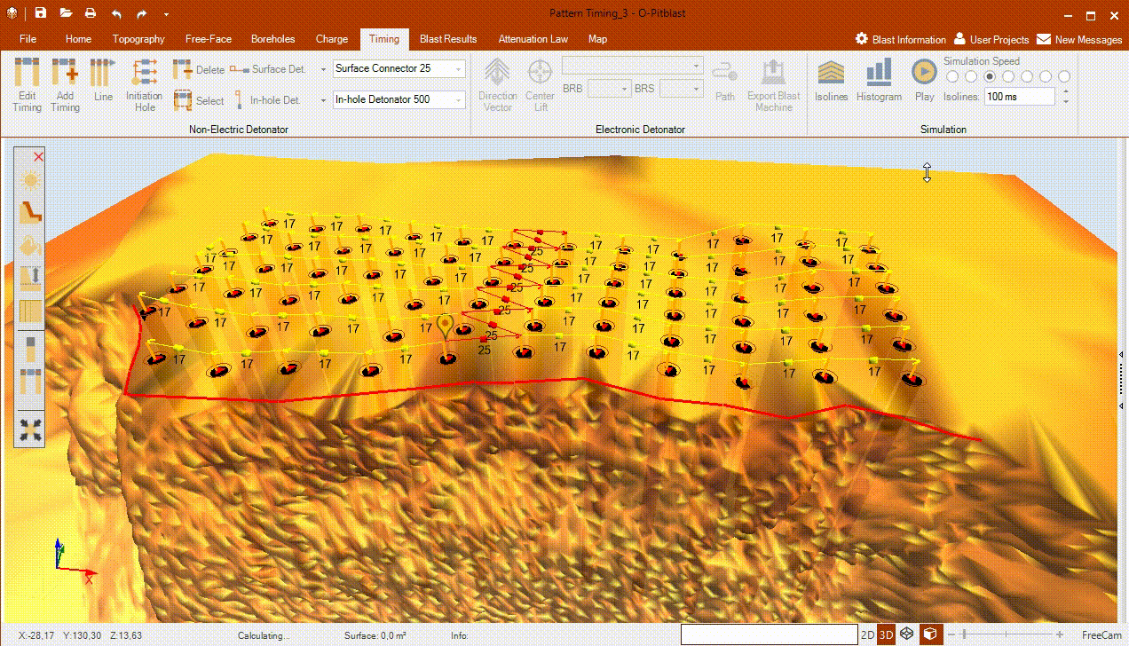
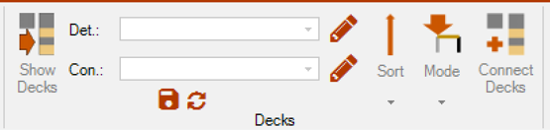
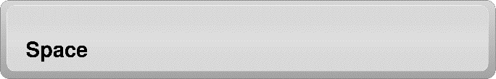
O-Pitblast – Non electronic detonators
*. Pattern Timing_3
Simulation
Play/Pause

Slide 5
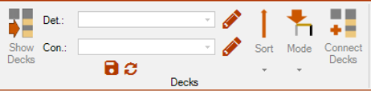

O-Pitblast – Non electronic detonators
*. Pattern Timing_3
Decks
Open the deck design
Det.: Add detonator
Con.: Add connector
Save configuration
Load previous configuration

Slide 6
O-Pitblast – Non electronic detonators
*. Pattern Timing_3
Start connection by the collar
Open the deck design
Connect decks with select configuration

Slide 7

Technical Support
Phone: +351 918 558 879
E-mail: support@o-pitblast.com

