Slide 1
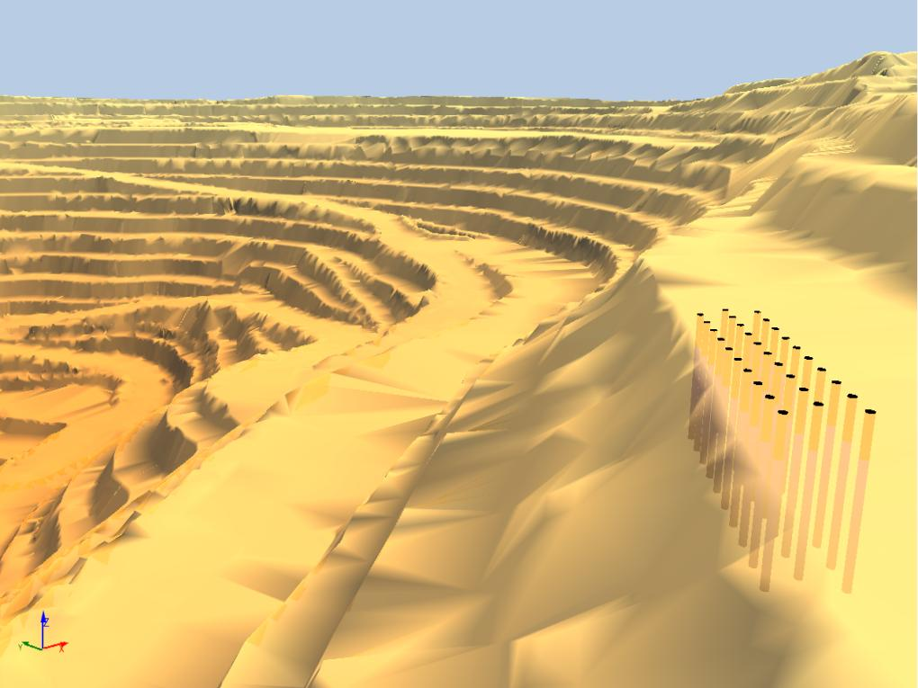

O-Pitblast – Vibration Module

Slide 2
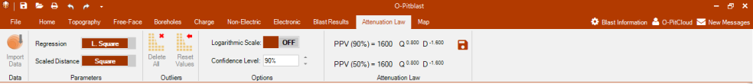
O-Pitblast – Vibration Module

Slide 3
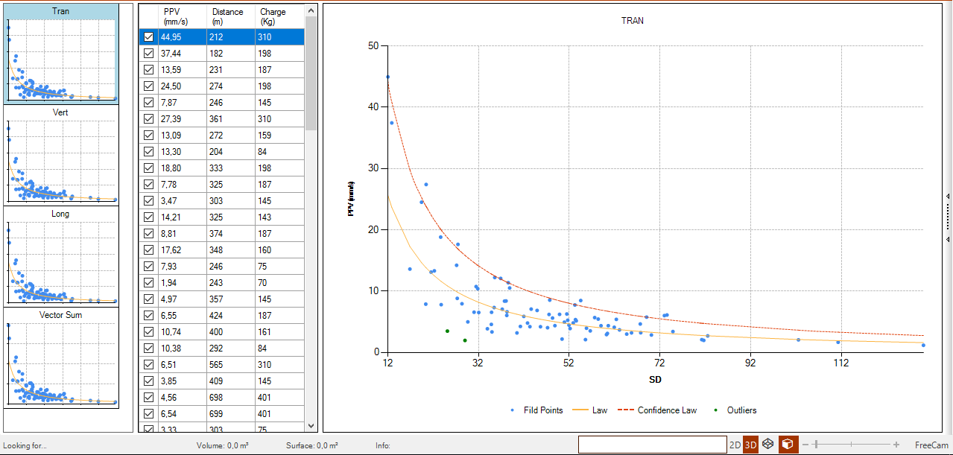
O-Pitblast – Vibration Module
Channel data
Raw data
PPV/SD Graphic

Slide 4
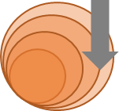
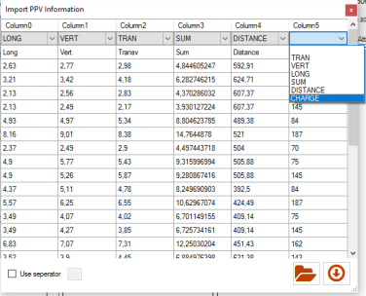
O-Pitblast – Vibration Module
*. Seismography data
Long. PPV
Trans. PPV
Distance
Vert. PPV
Sum. PPV
Charge
Import Vibration Data

Slide 5
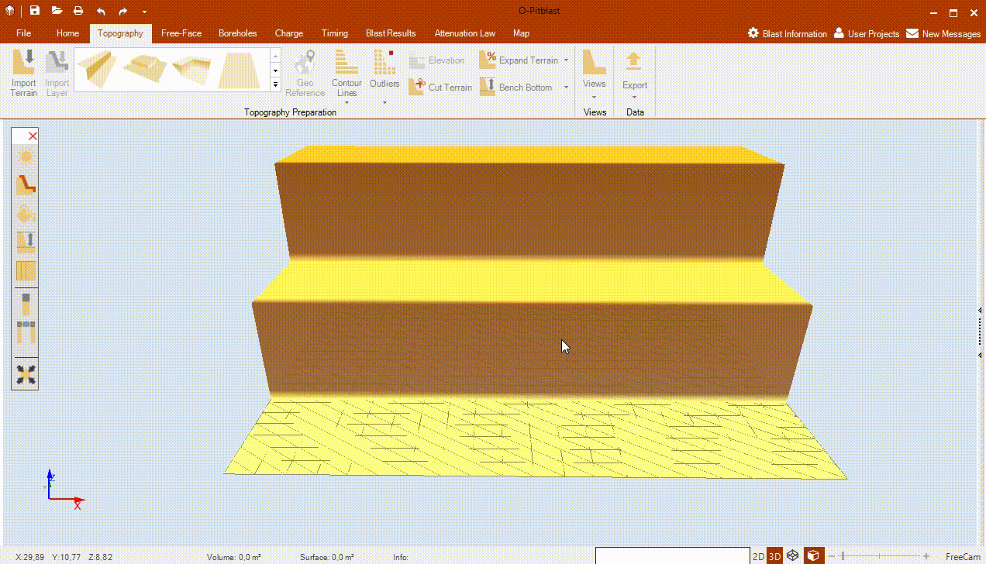
O-Pitblast – Vibration Module
*. Seismography data
Import Vibration Data

Slide 6
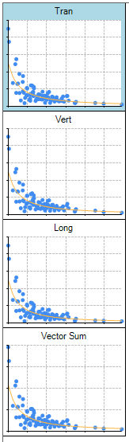
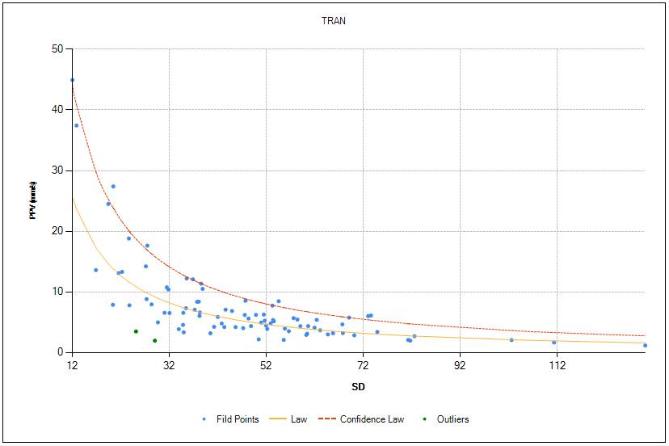
O-Pitblast – Vibration Module
*. Seismography data

Slide 7
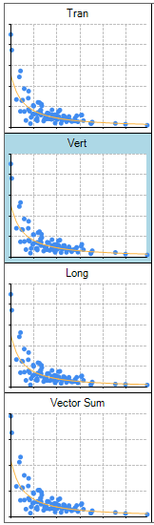
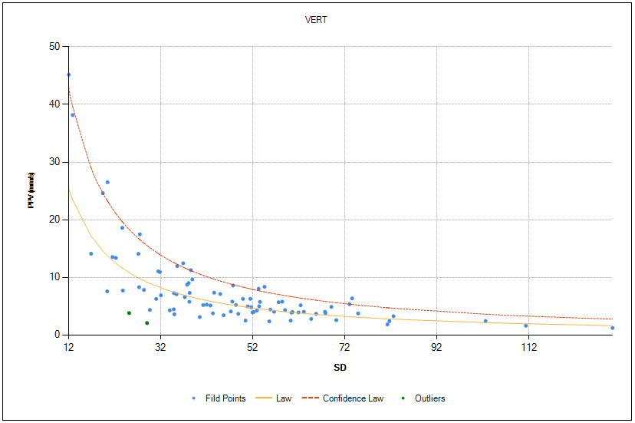
O-Pitblast – Vibration Module
*. Seismography data

Slide 8
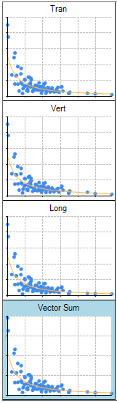
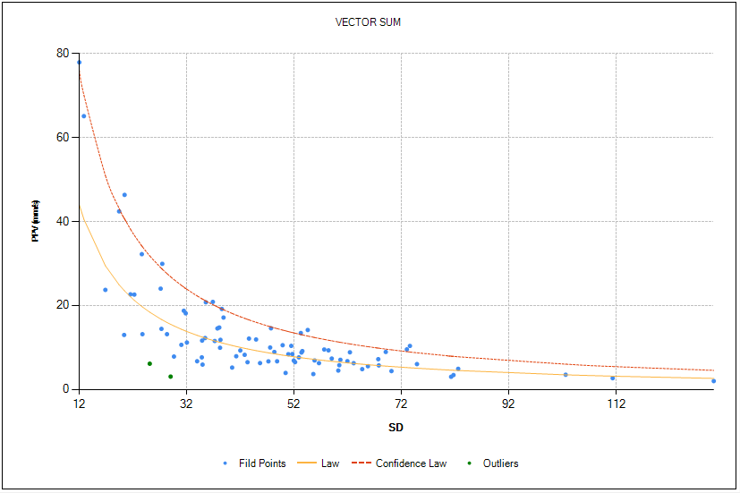
O-Pitblast – Vibration Module
*. Seismography data

Slide 9
O-Pitblast – Vibration Module
*. Seismography data

Slide 10
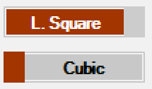
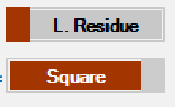
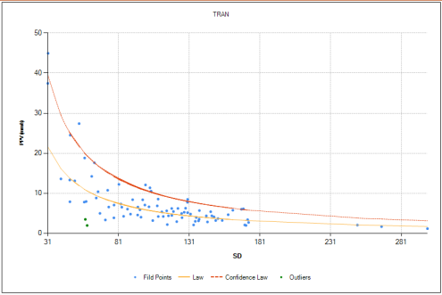
O-Pitblast – Vibration Module
*. Seismography data

Slide 11
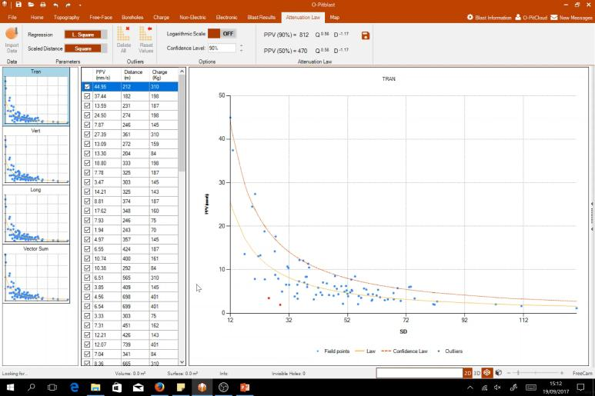
O-Pitblast – Vibration Module
*. Seismography data

Slide 12
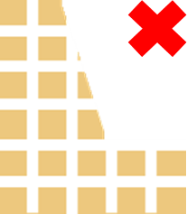
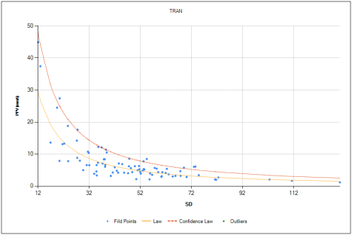
O-Pitblast – Vibration Module
*. Seismography data
Delete Outliers
Outliers
Reset Values

Slide 13
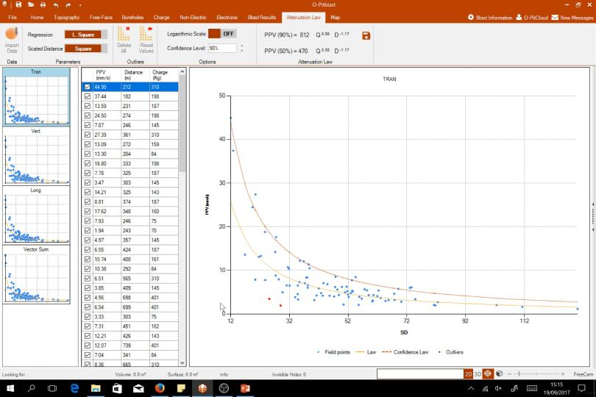
O-Pitblast – Vibration Module
*. Seismography data
Delete Outliers

Slide 14
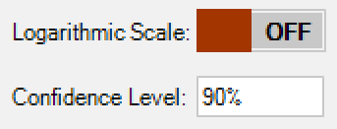
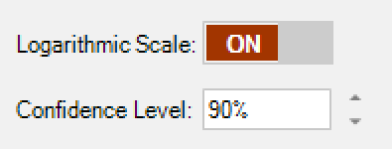
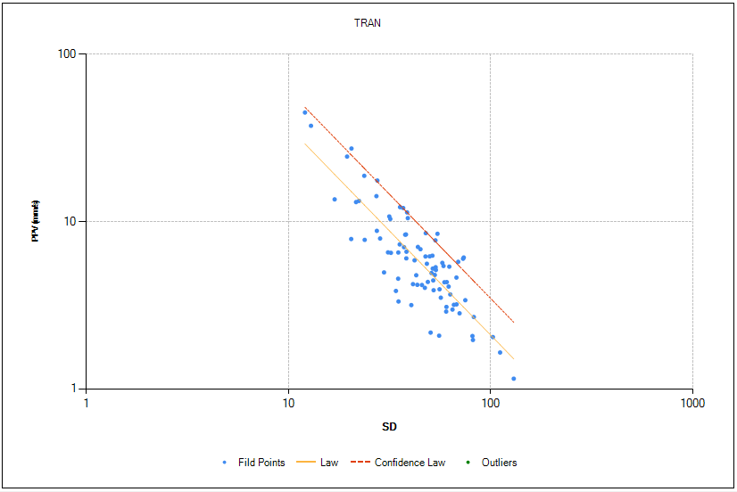
O-Pitblast – Vibration Module
*. Seismography data

Slide 15
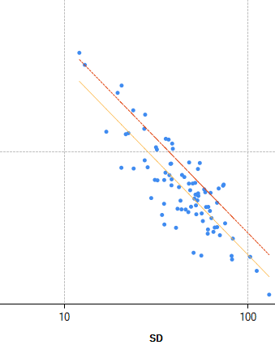
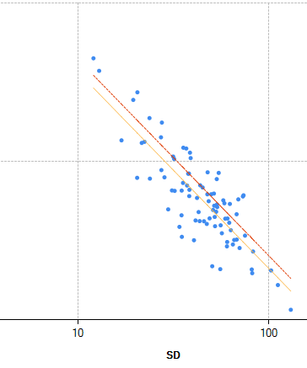
O-Pitblast – Vibration Module
*. Seismography data
90%
85%
70%

Slide 16
O-Pitblast – Vibration Module
*. Seismography data
90%
85%
70%

Slide 17
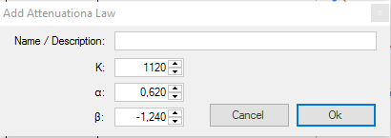
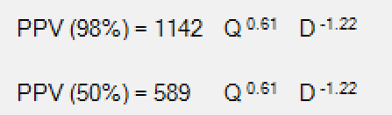
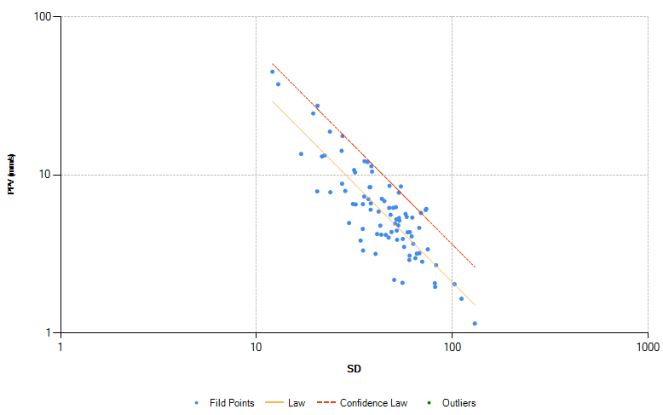
O-Pitblast – Vibration Module
*. Seismography data

Slide 18

O-Pitblast – Vibration Module
*. Seismography data
Save Attenuation Law

Slide 19
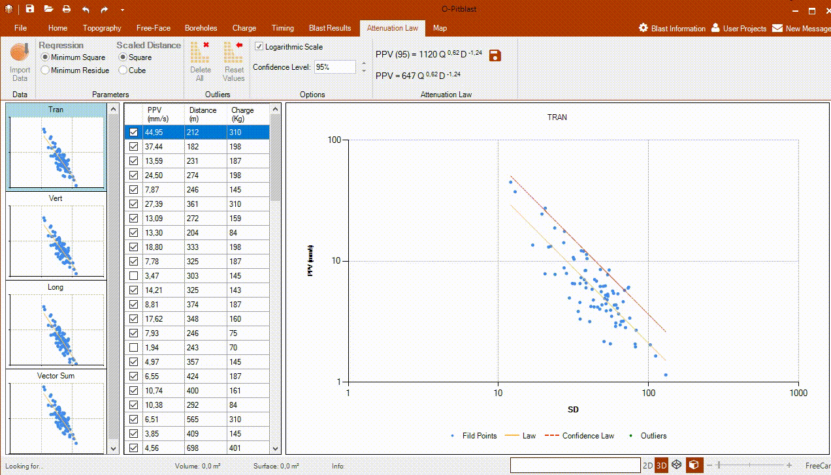
O-Pitblast – Vibration Module
*. Seismography data
Save Attenuation Law

Slide 20
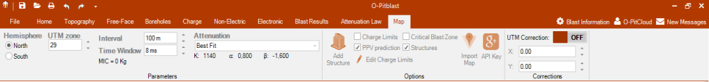

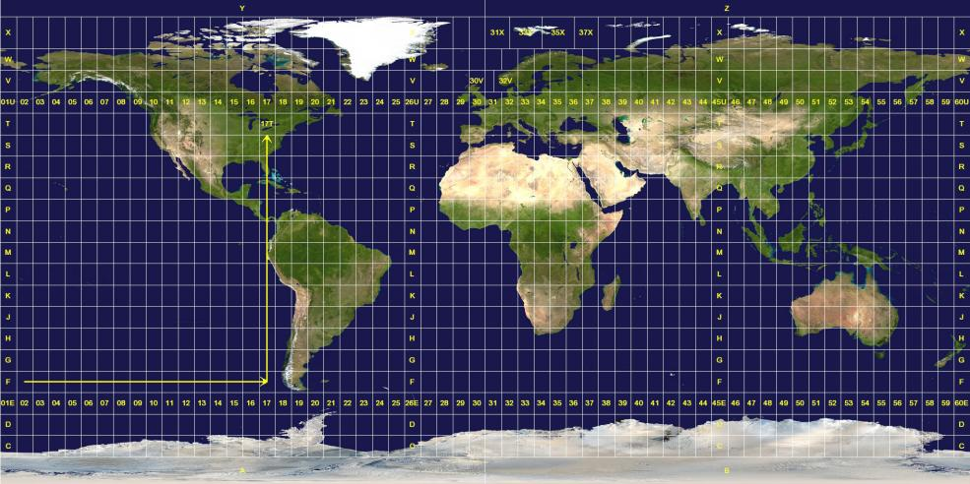
O-Pitblast – Vibration Module
*. PPV Prediction_2
North
North
South

Slide 21
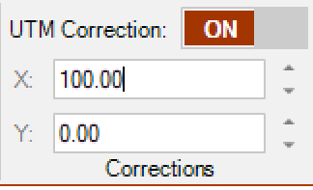
O-Pitblast – Vibration Module
*. PPV Prediction_2
North
North
South
>> Local coordinates to UTM coordinates

Slide 22
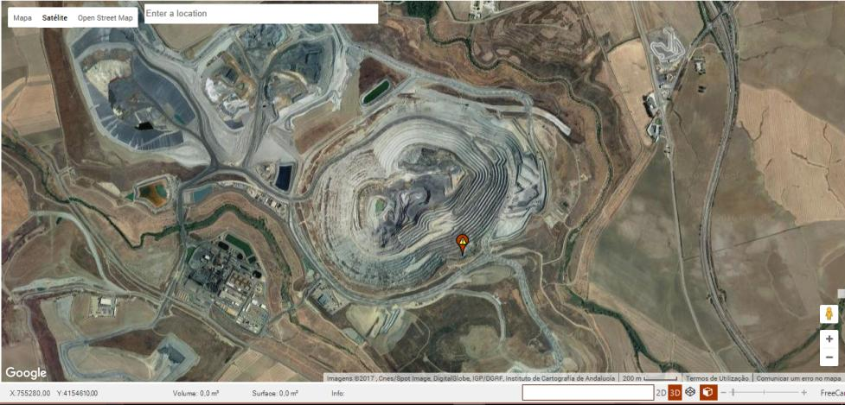
O-Pitblast – Vibration Module
*. PPV Prediction_2
Satelite view

Slide 23
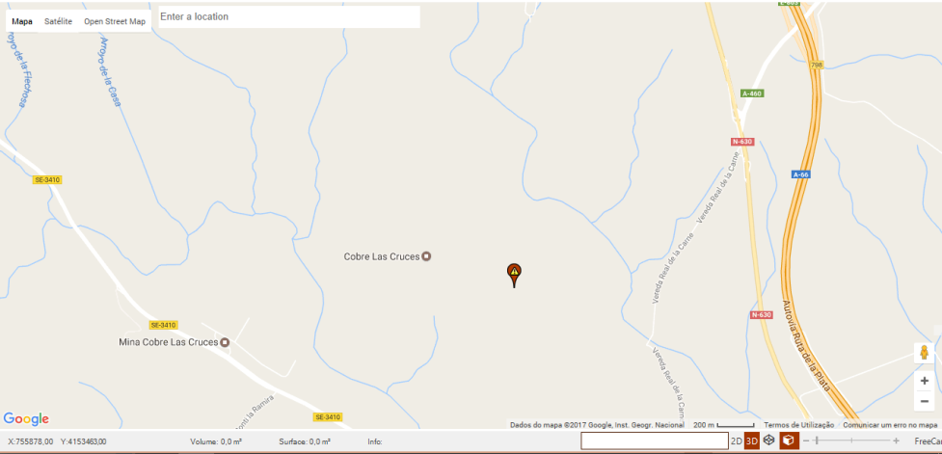
O-Pitblast – Vibration Module
*. PPV Prediction_2
Map view

Slide 24
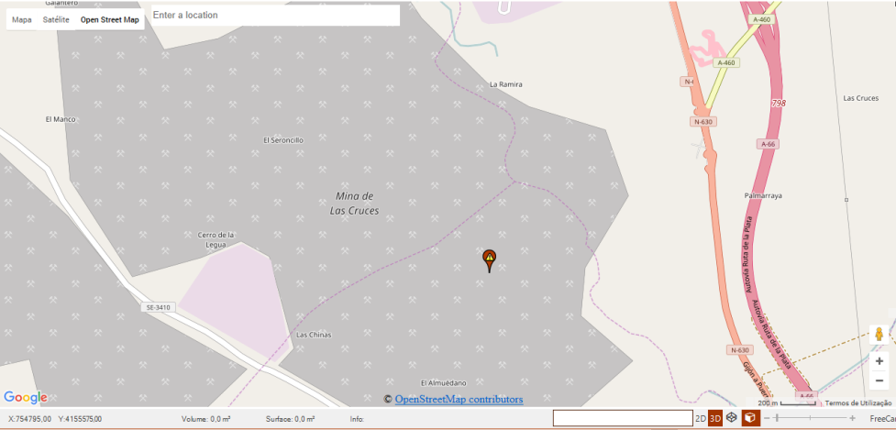
O-Pitblast – Vibration Module
*. PPV Prediction_2
Open Street Map view

Slide 25

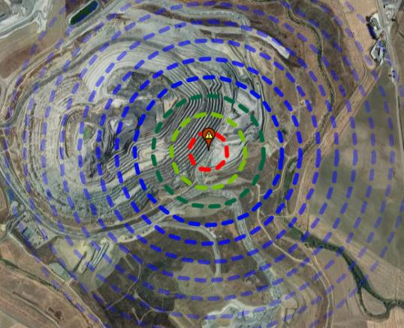

O-Pitblast – Vibration Module
*. PPV Prediction_2
Visualization
PPV countour lines interval
MIC time window

Slide 26
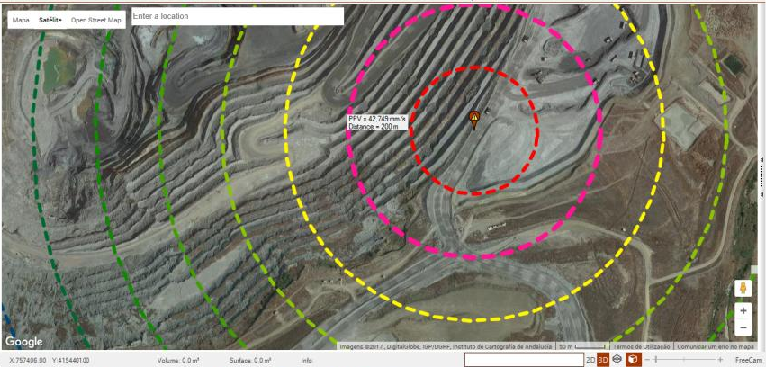
O-Pitblast – Vibration Module
Mouse over

Slide 27
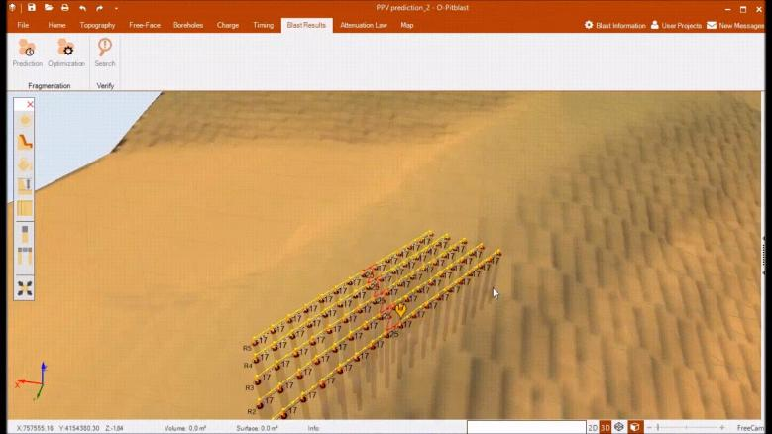
O-Pitblast – Vibration Module
*. PPV Prediction_2

Slide 28

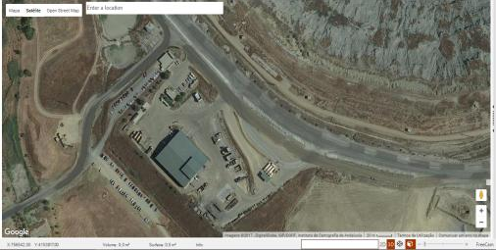
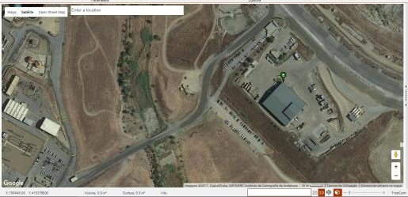
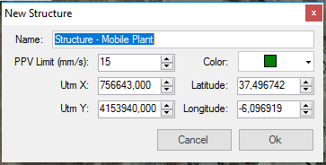
O-Pitblast – Vibration Module
*. PPV Prediction_2
Add Structures
Critical Structure

Slide 29
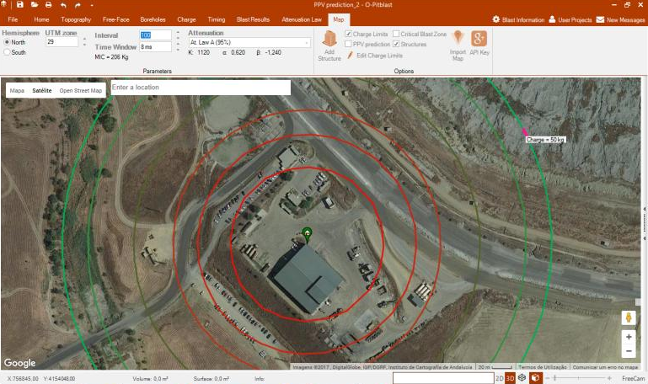

O-Pitblast – Vibration Module
*. PPV Prediction_2
Charge Limits
Add Structures
Charge limits and distances for:
Given Attenuation Law
Structures Limits
Mouse over

Slide 30
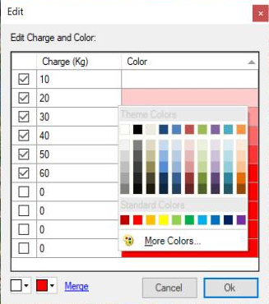
O-Pitblast – Vibration Module
*. PPV Prediction_2
Edit Charge Limits
Add Structures
Edit charge limits
Mouse over

Slide 31
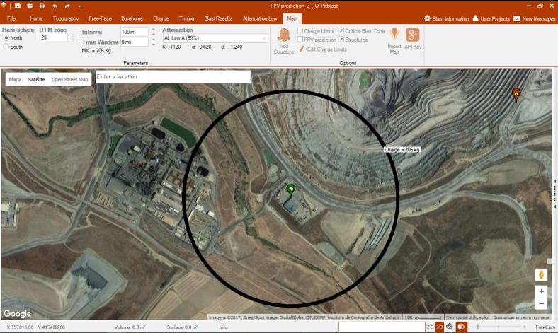
O-Pitblast – Vibration Module
*. PPV Prediction_2
Critical Blast Zone
Critical Blast Zone
Add Structures
Critical Blast Zone for:
Given Attenuation Law
Structures Limits
General Blast MIC
Mouse over

Slide 32
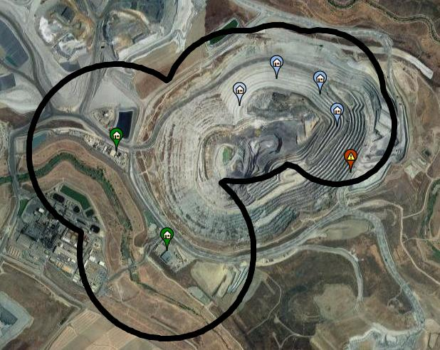
O-Pitblast – Vibration Module
*. PPV Prediction_2
Critical Blast Zone
Add Structures
Multi-Structures
Wall Control Points
Wall Control points
Building/structure
Blast inside Blast Critical Zone
Building/structure

Slide 33
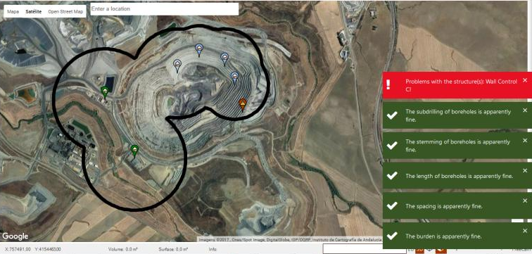
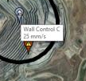

O-Pitblast – Vibration Module
*. PPV Prediction_2
Add Structures
Critical Structure
Search
Affected Structure

