Slide 1
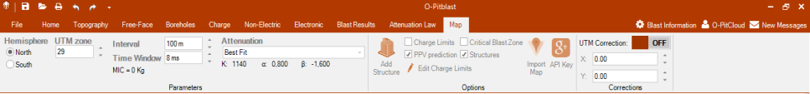

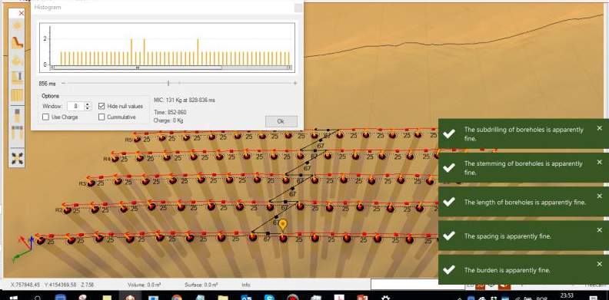

O-Pitblast – Vibration Module
*. PPV Prediction_2
Add Structures
Search
4 hole – 8 ms
Changing Tie-up

Slide 2
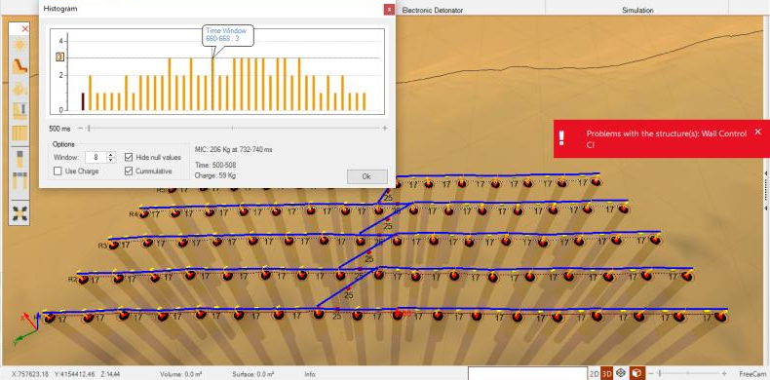
O-Pitblast – Vibration Module
*. PPV Prediction_2
Add Structures
Search
4 hole – 8 ms
Changing Tie-up

Slide 3
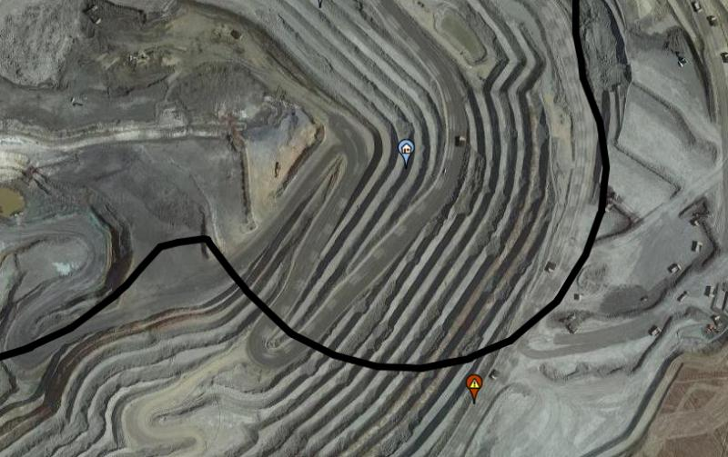
O-Pitblast – Vibration Module
*. PPV Prediction_2
Add Structures
Search
Blast out of Critical Zone
4 hole – 8 ms
Changing Tie-up

Slide 4
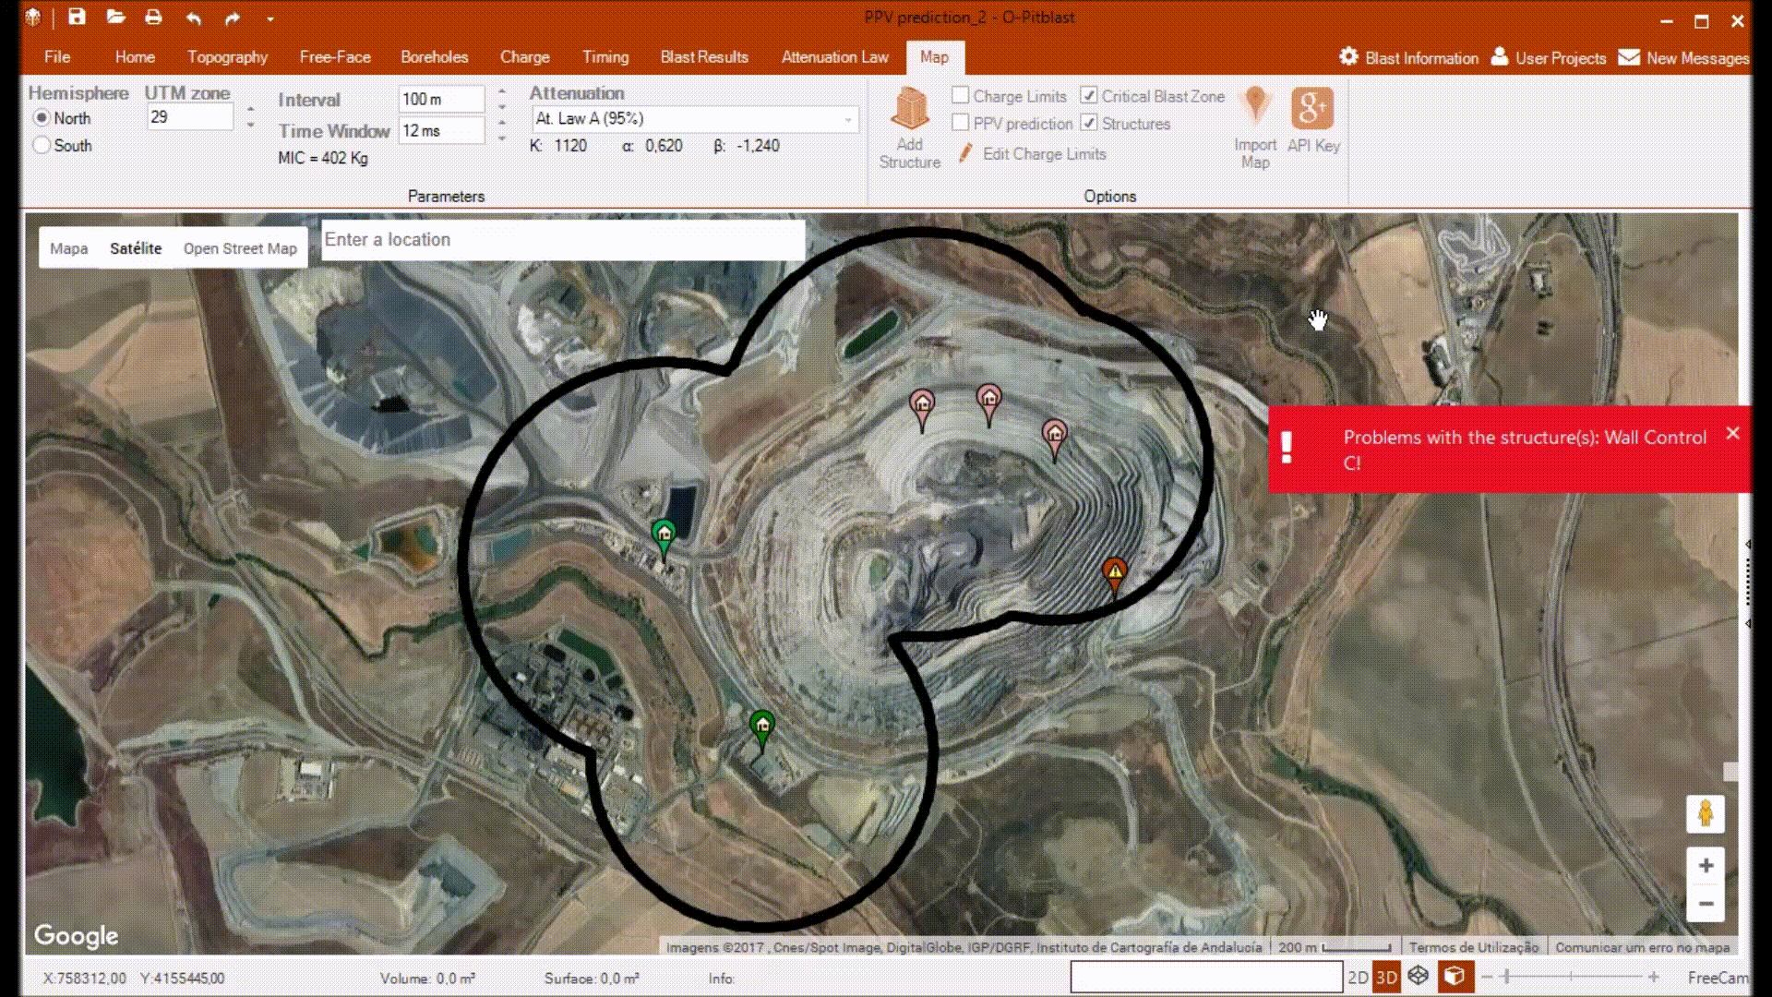
O-Pitblast – Vibration Module
*. PPV Prediction_2
Add Structures
Search

Slide 5


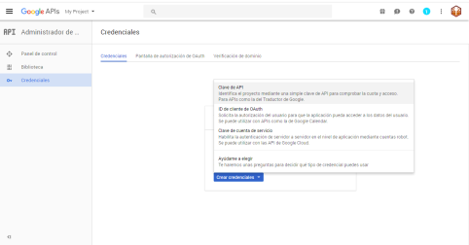
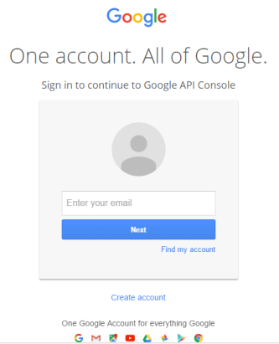
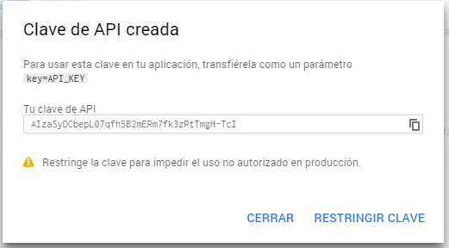
O-Pitblast – Vibration Module
*. PPV Prediction_2
Api Key

Slide 6

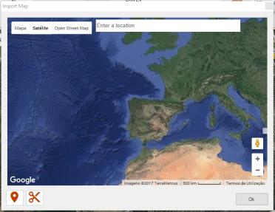
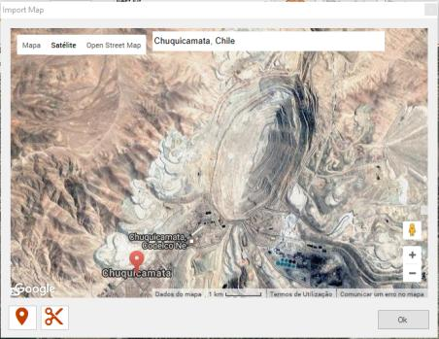
O-Pitblast – Vibration Module
*. PPV Prediction_2
Zoom to place
Import Map
Find location

Slide 7
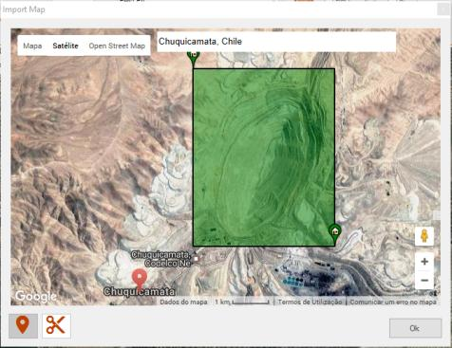
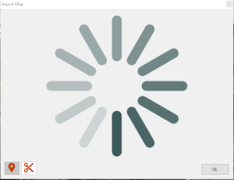
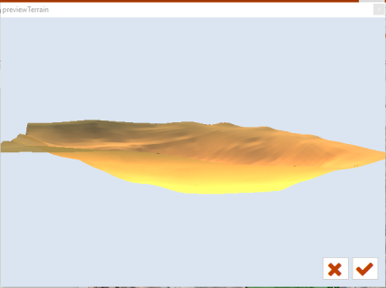
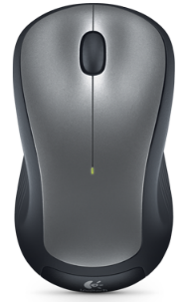
O-Pitblast – Vibration Module
*. PPV Prediction_2
Import Map
Drag +

Slide 8
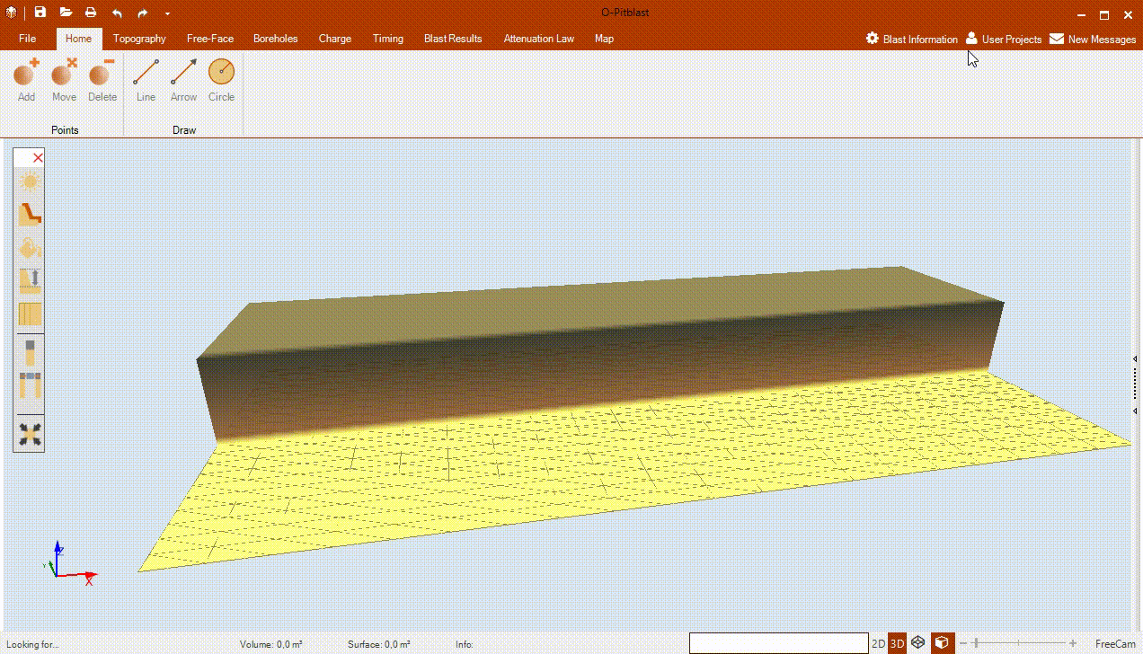
O-Pitblast – Vibration Module
*. PPV Prediction_2
Import Map

Slide 9

Technical Support
Phone: +351 918 558 879
E-mail: support@o-pitblast.com

