Slide 1

O-Pitblast – Coordinate system

Slide 2
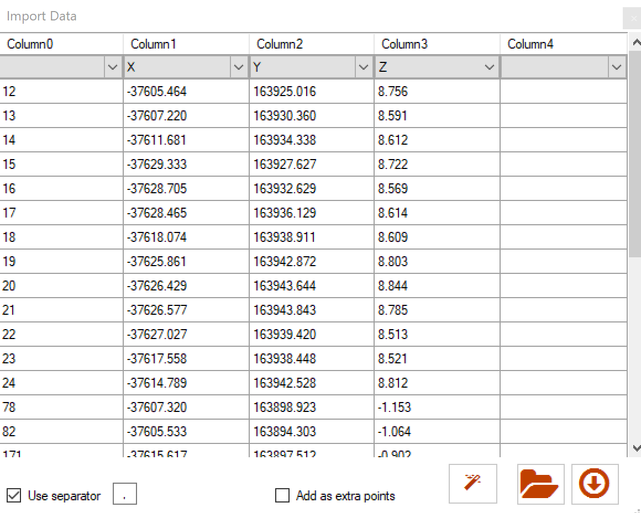
O-Pitblast – Coordinate Sytem
When you import one file in a coordinates system. You can change it inside of O-Pitblast.
Change coordinates system

Slide 3
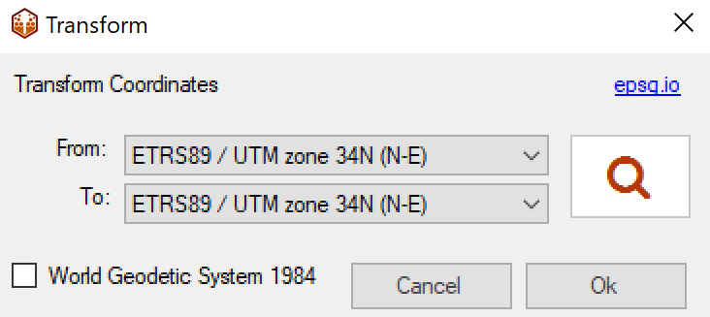
O-Pitblast – Coordinate Sytem
Define your x, y and z
Click on “Coordinate system” symbol
Click on the magnifier glass

Slide 4
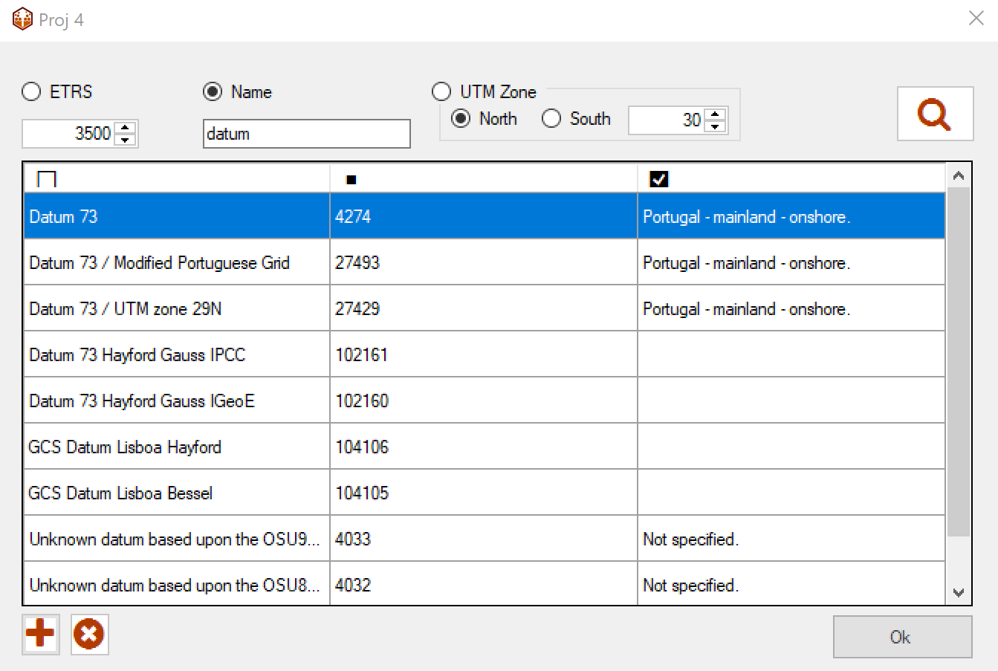
O-Pitblast – Coordinate Sytem
4) Shearch by ETRS; Name or UTM Zone
5) Add your coordinates system clicking on the plus sign
6) Add all coordinates system that you need
Add coordinate system

Slide 5
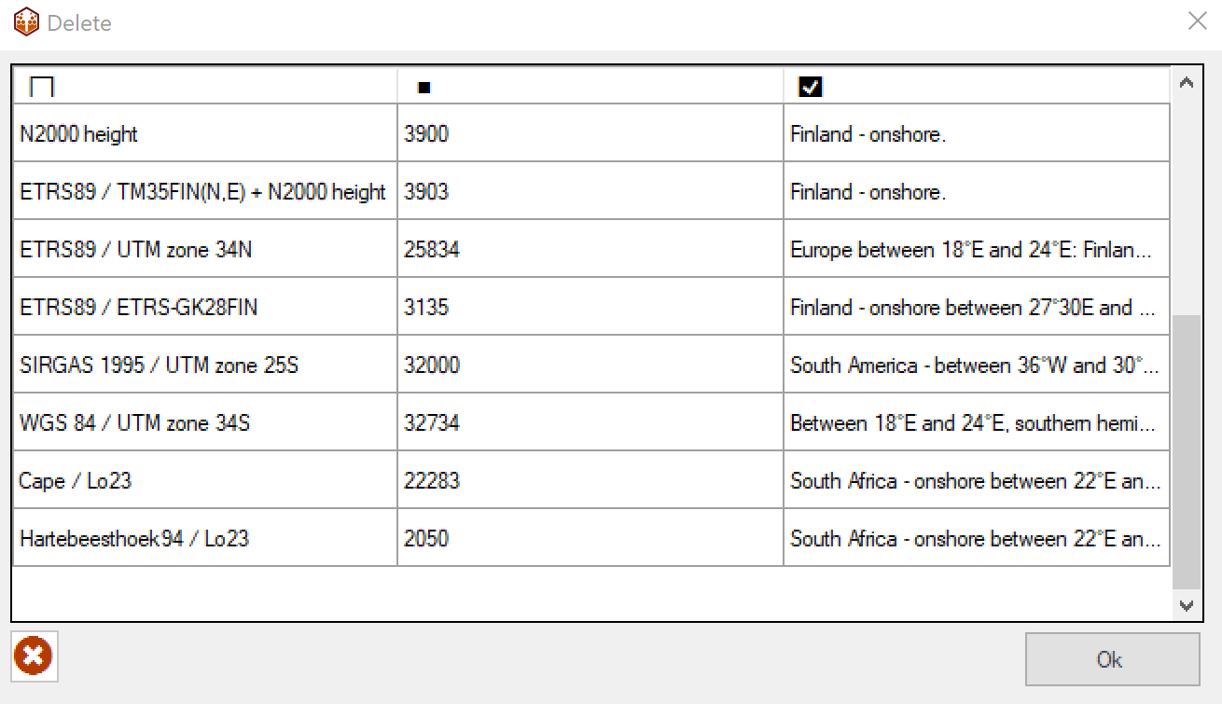
O-Pitblast – Coordinate Sytem
7) To delete click on the “X” icon and choose the ones you want to delete.

Slide 6
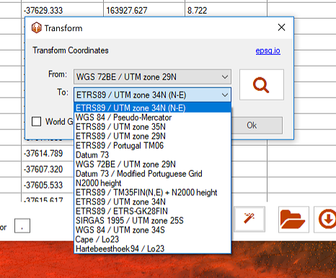
O-Pitblast – Coordinate Sytem
8) When you’re ready choose from/to which coordinates you want do transform the coordinates and press OK. Import the file normally.

Slide 7

O-Pitblast – Coordinate Sytem
NOTE: You can find this tranformation every time you import/export files to O-Pitblast: since laser information, Borehole information, topographic information, etc
Just look for this symbol

Slide 8
Technical Support
Phone: +351 918 558 879
E-mail: support@o-pitblast.com

