Slide 1

O-Pitblast – Charge Module

Slide 2
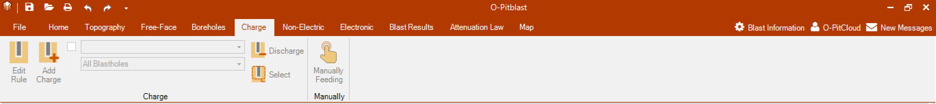
O-Pitblast – Charge Module

Slide 3

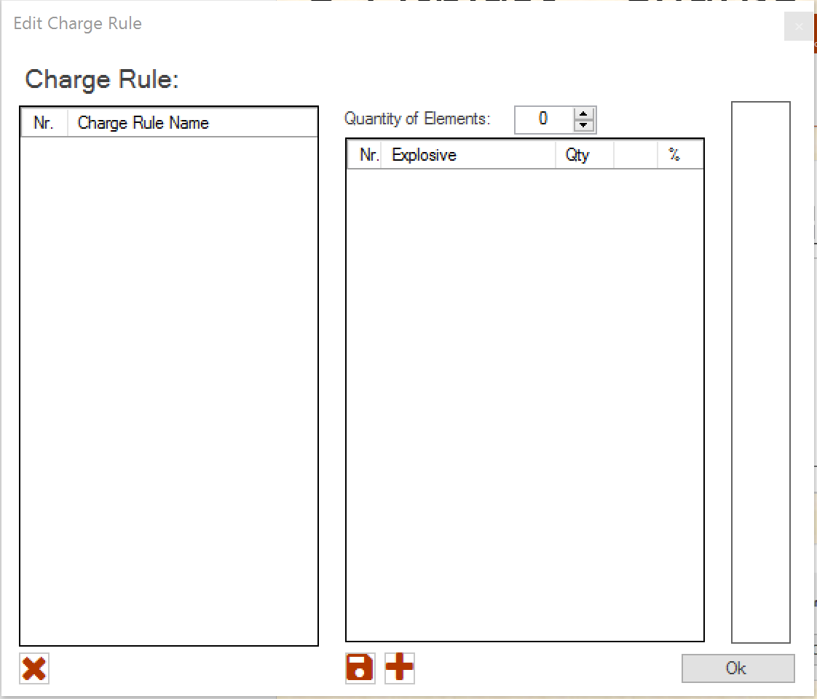
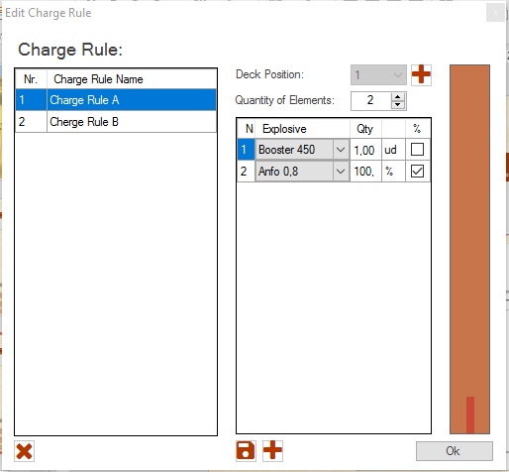
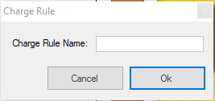
O-Pitblast – Charge Module
Edit Charge Rule
Delete Rule
Update Rule
Add Rule

Slide 4
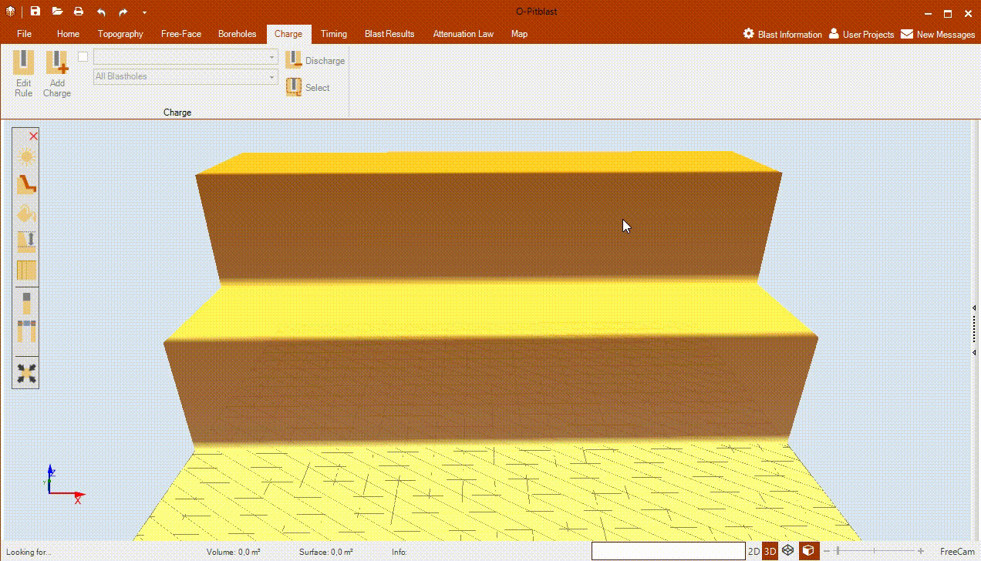
O-Pitblast – Charge Module
Edit Charge Rule
Bulk Explosives

Slide 5
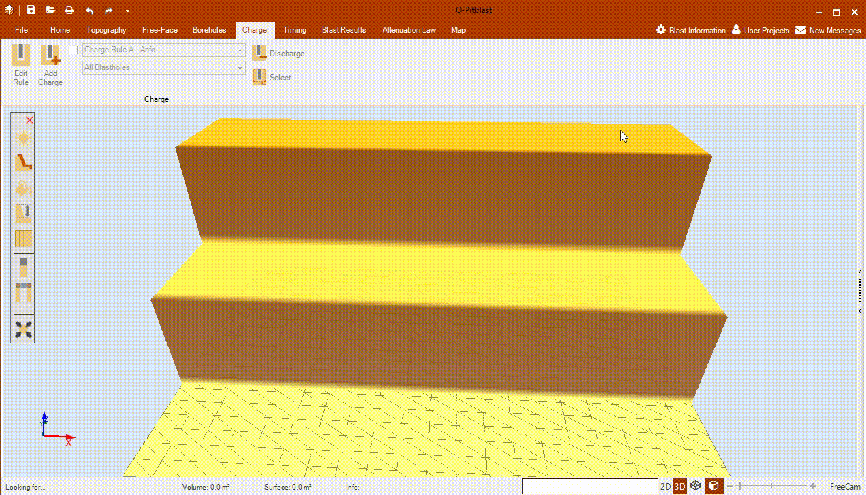
O-Pitblast – Charge Module
Edit Charge Rule
Cartridge Explosives

Slide 6

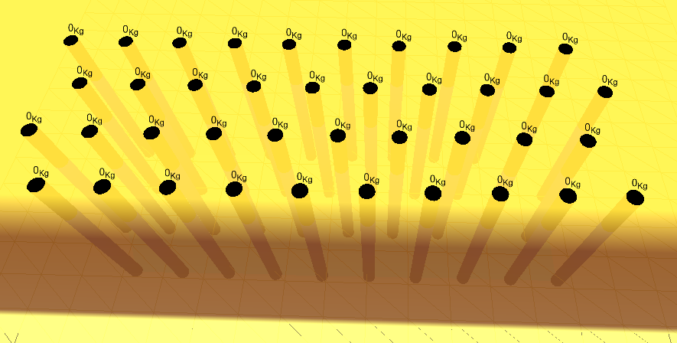
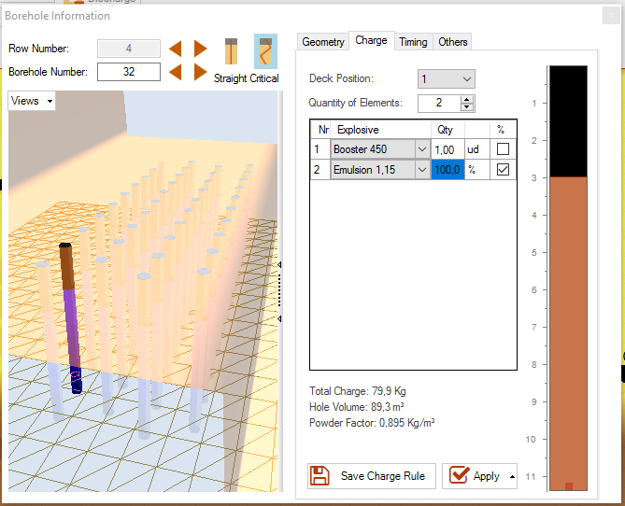

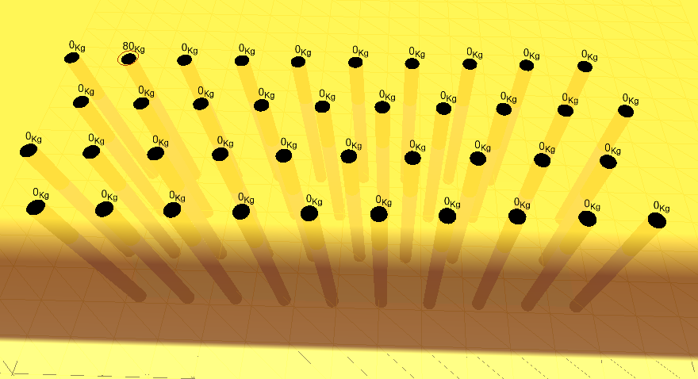
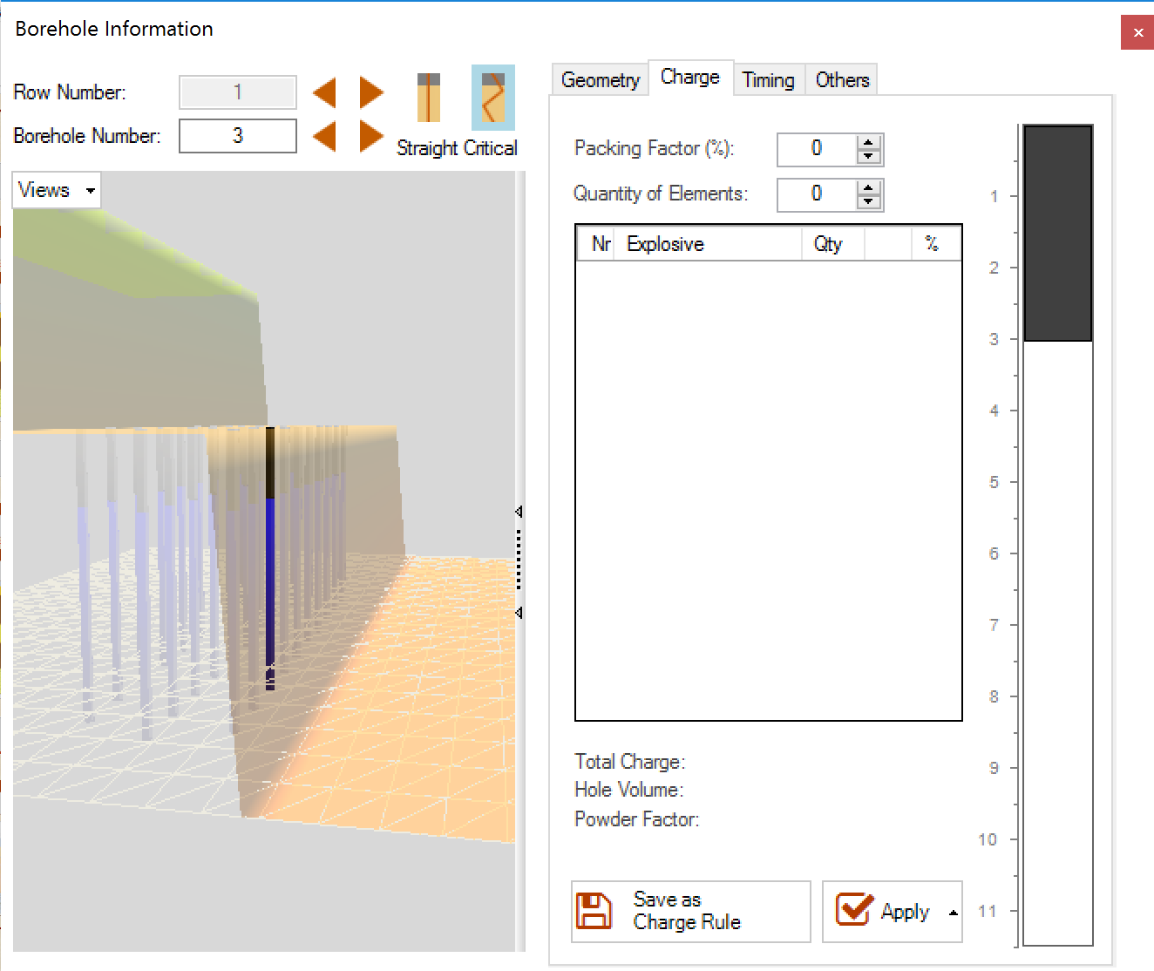
O-Pitblast – Charge Module
*. Sample Pattern
Add Charge

Slide 7
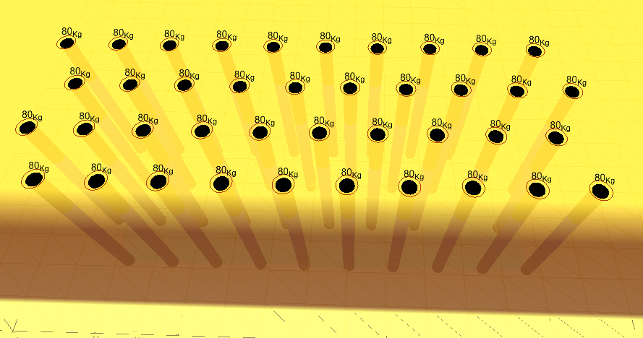
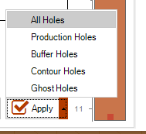
O-Pitblast – Charge Module
*. Sample Pattern
Add Charge

Slide 8
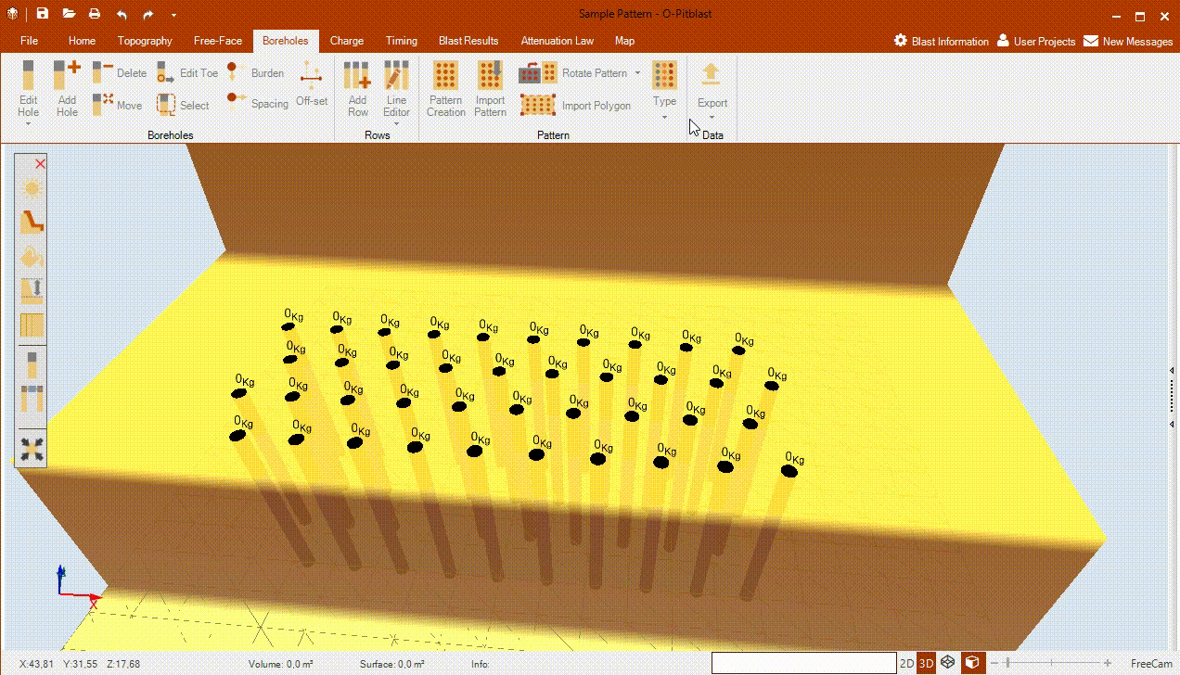
O-Pitblast – Charge Module
*. Sample Pattern
Add Charge

Slide 9
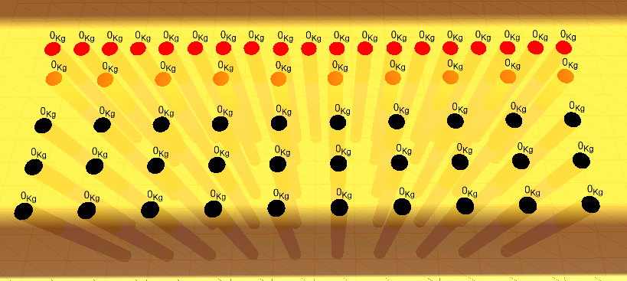

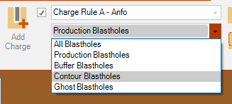
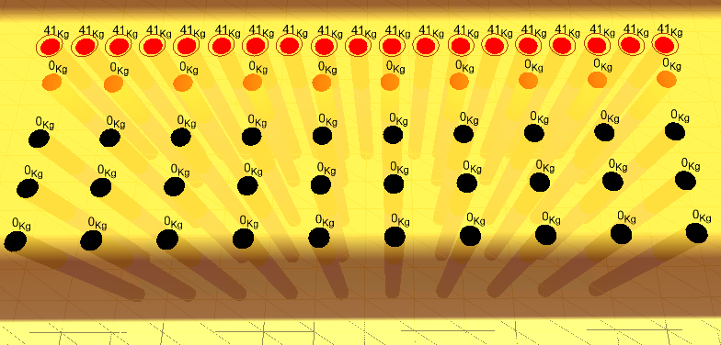
O-Pitblast – Charge Module
*. Holes Type
Add Charge

Slide 10
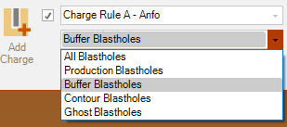
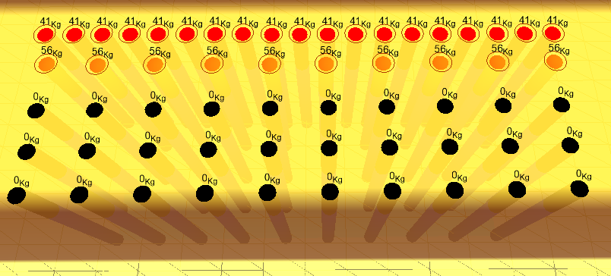
O-Pitblast – Charge Module
*. Holes Type
Add Charge

Slide 11
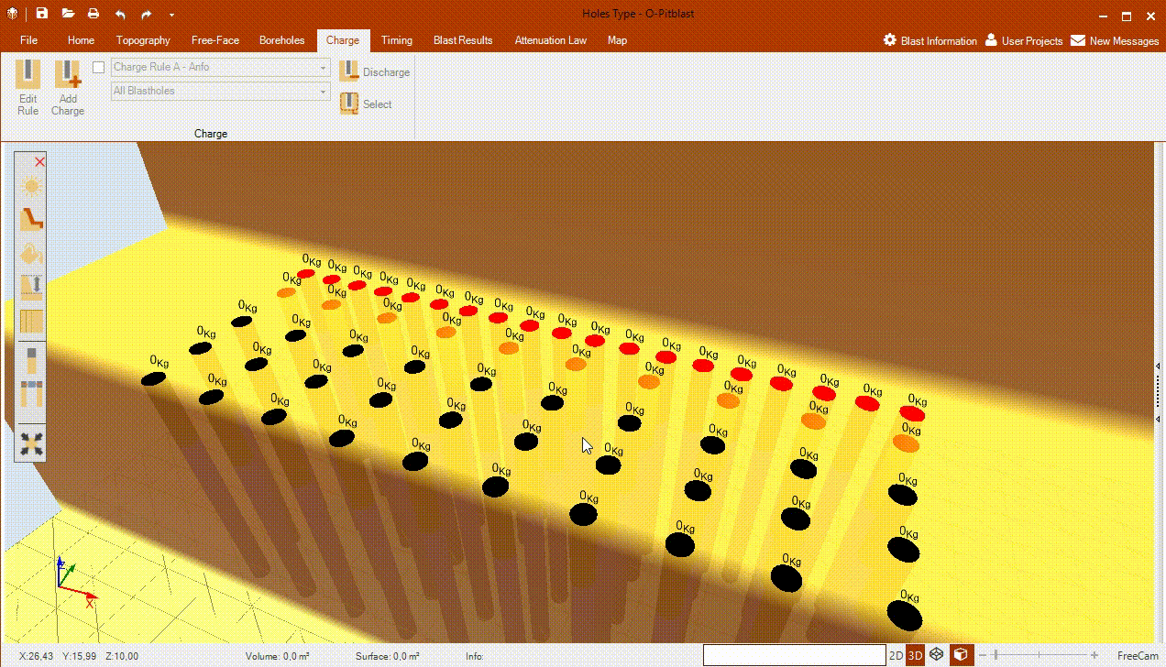
O-Pitblast – Charge Module
*. Holes Type
Add Charge

Slide 12

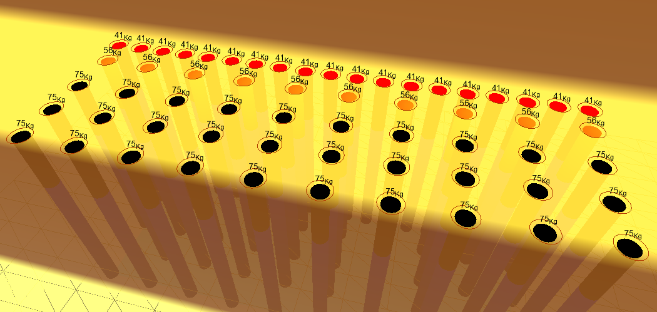

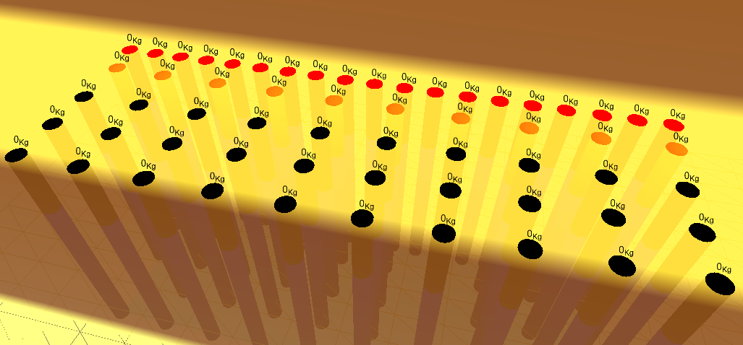
O-Pitblast – Charge Module
*. Sample Pattern
Discharge
Cartridge Explosives

Slide 13

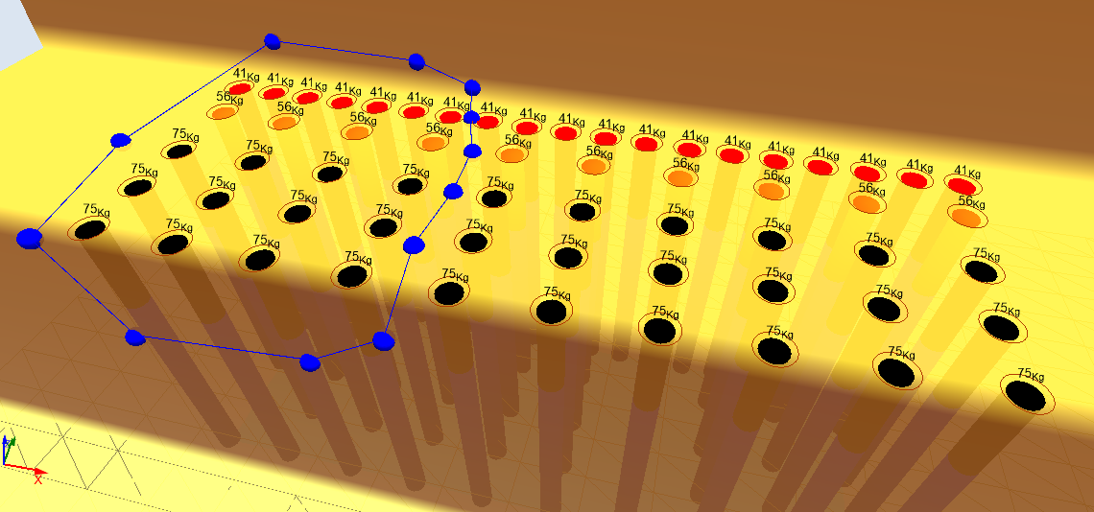
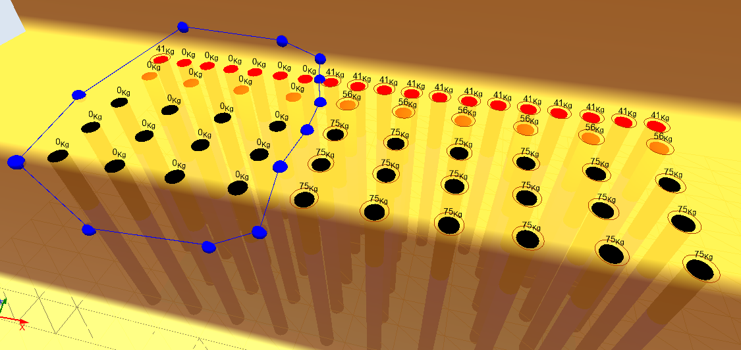

O-Pitblast – Charge Module
*. Sample Pattern
Select Charge

Slide 14
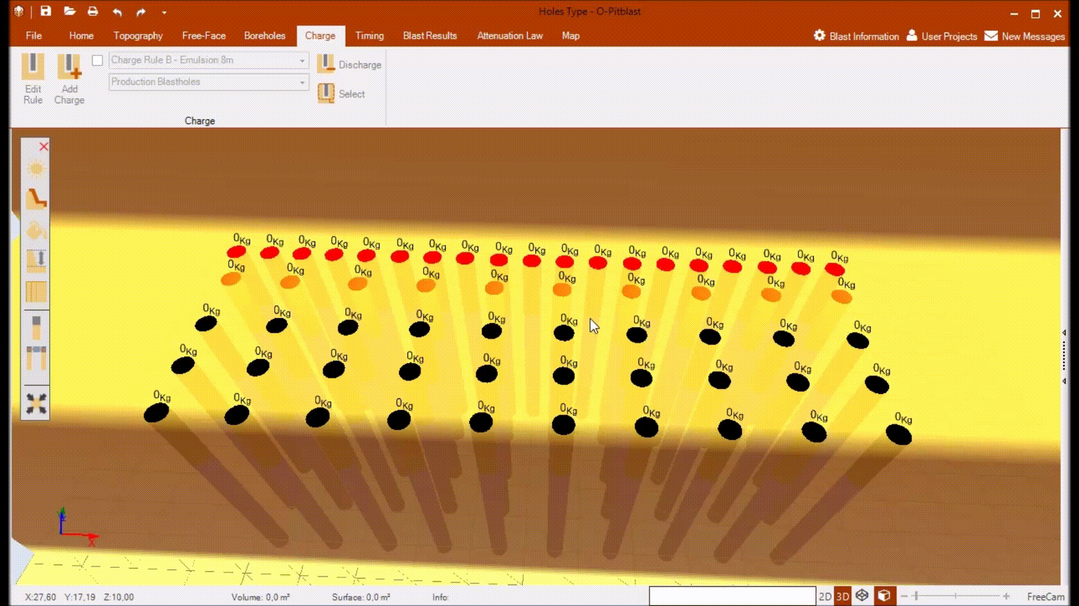
O-Pitblast – Charge Module
*. Sample Pattern
Select Charge

Slide 15
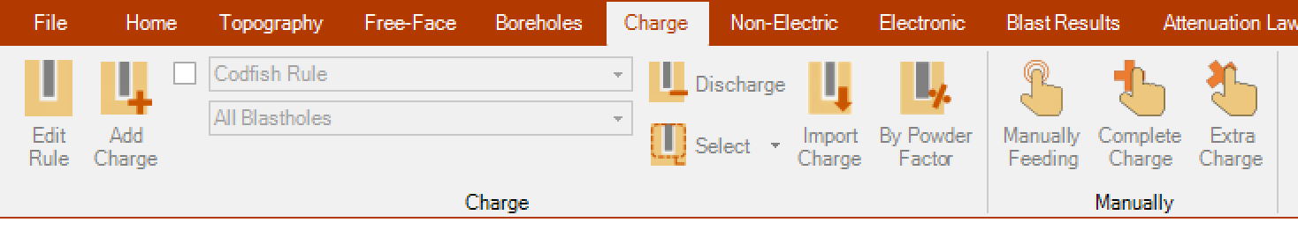
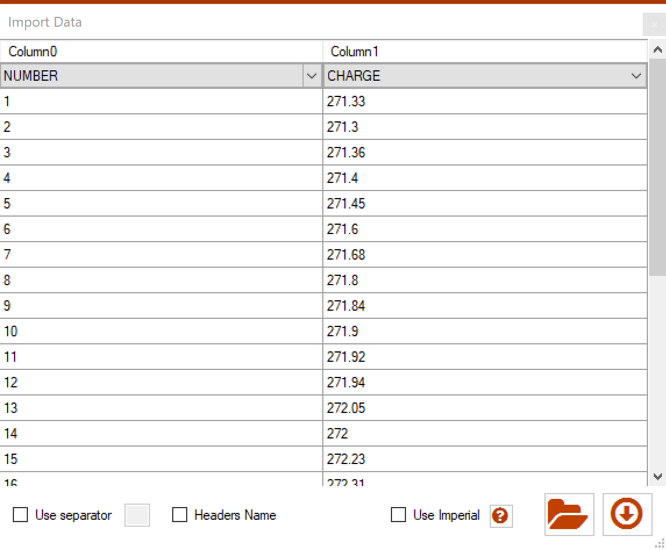
O-Pitblast – Charge Module
You can import a .csv with your charge per hole

Slide 16
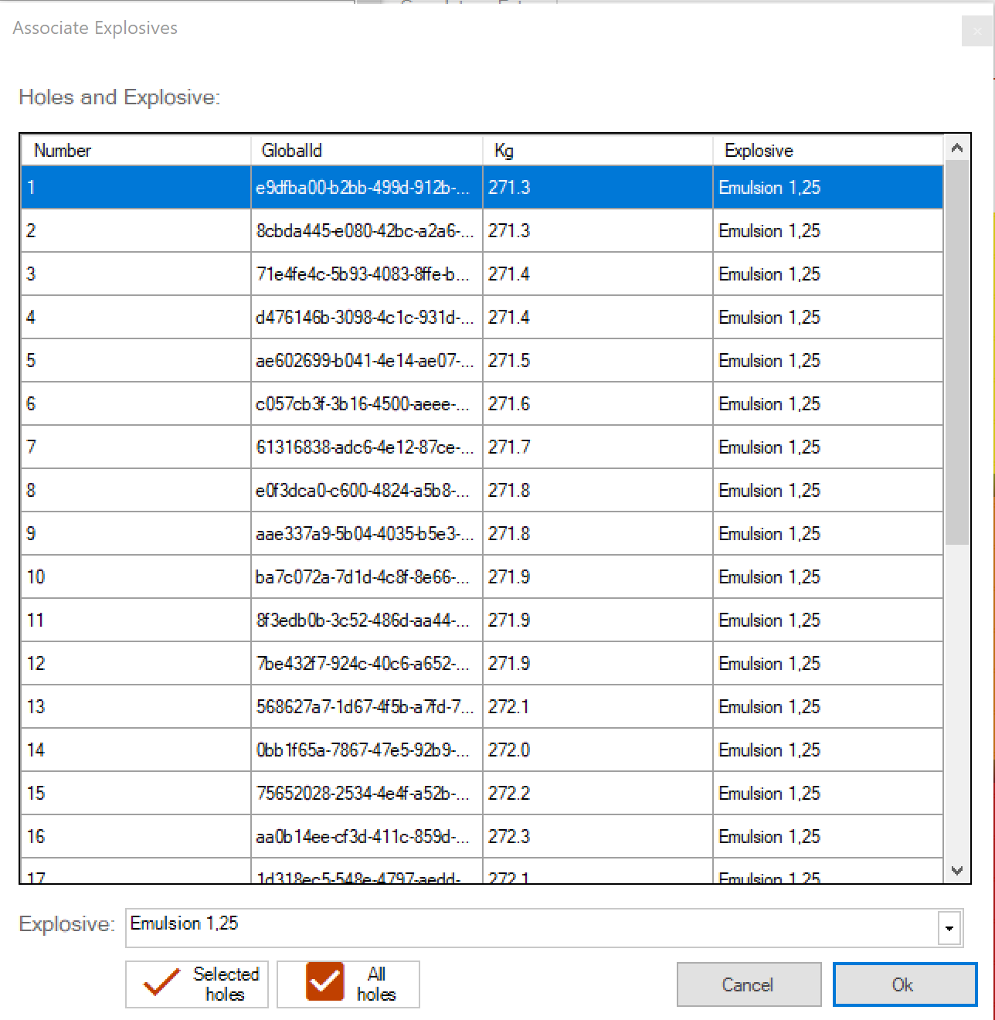
O-Pitblast – Charge Module
Select the type of explosive and and then, select the holes that you want to be charged with that explosive.
Type of explosive

Slide 17
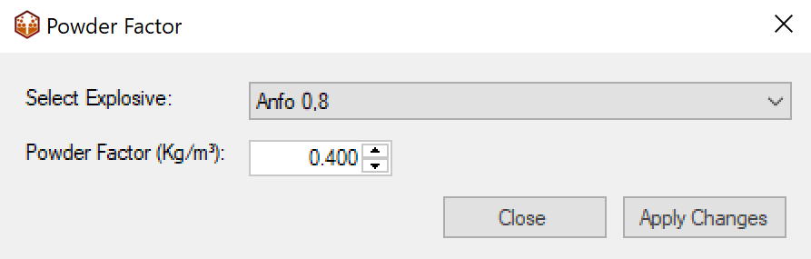
O-Pitblast – Charge Module
Option to charge your Borehole up to a limit (of powder factor)
Choose type of explosive
Define limit of powder factor
Apply changes

Slide 18
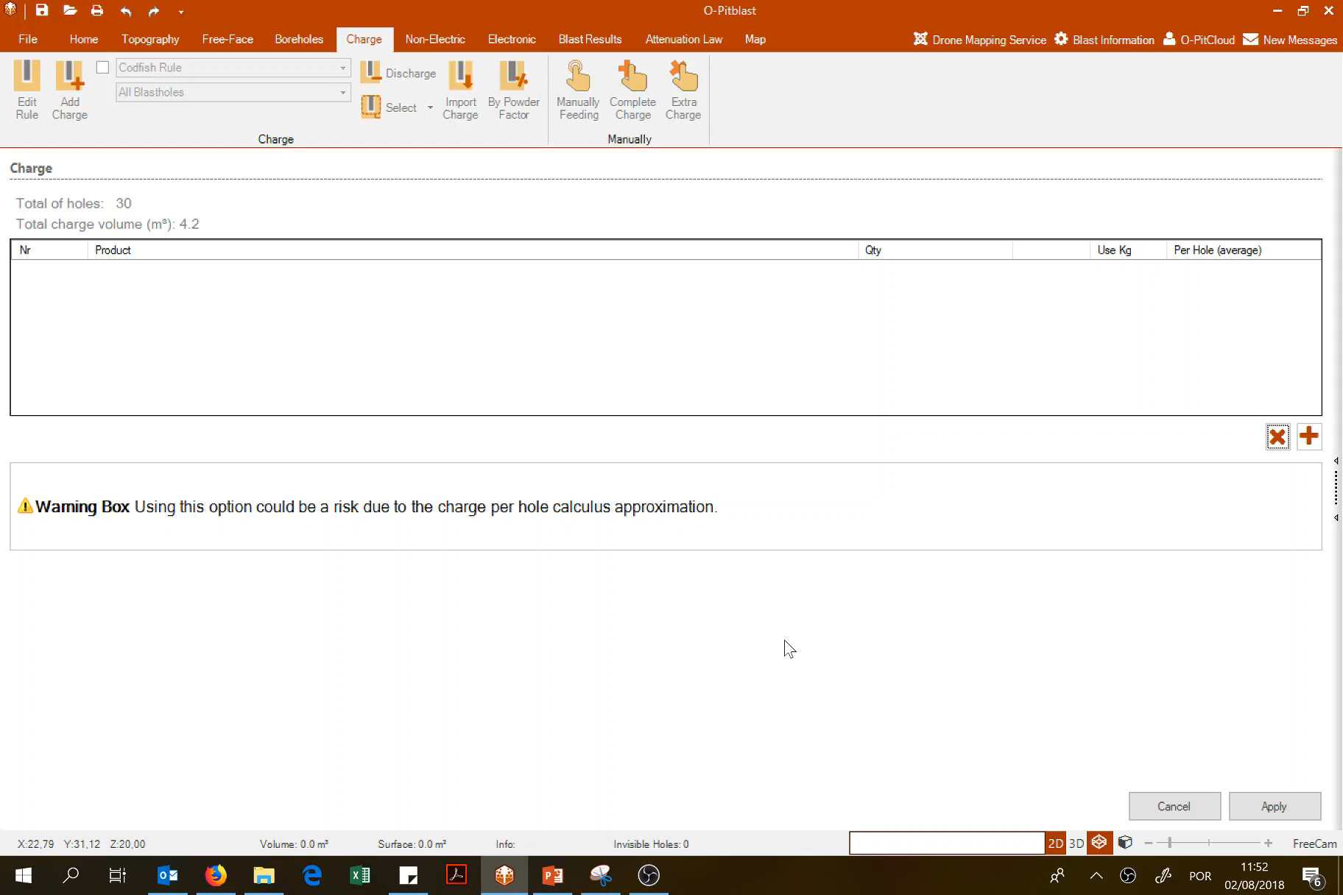
O-Pitblast – Charge Module
Charge your holes manually

Slide 19
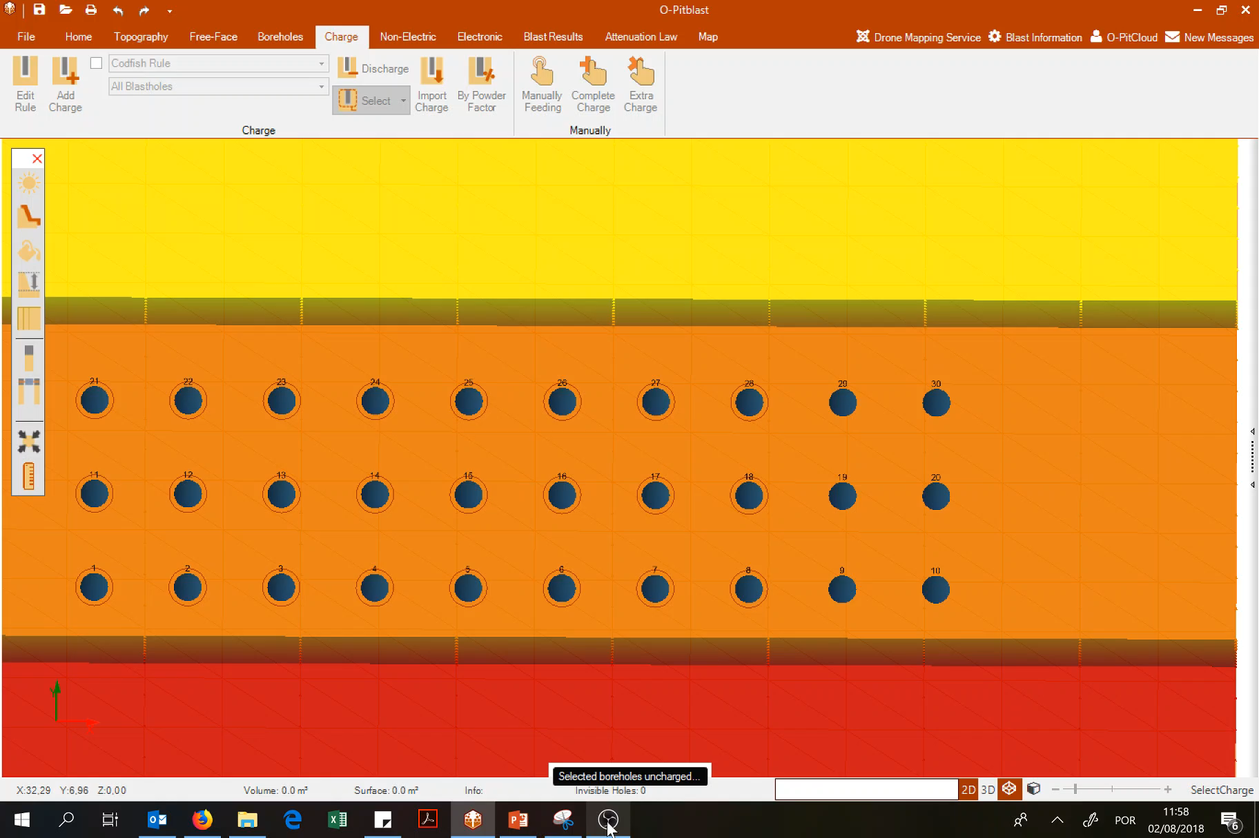
O-Pitblast – Charge Module
If you have some holes to charge, you can complete charge here

Slide 20
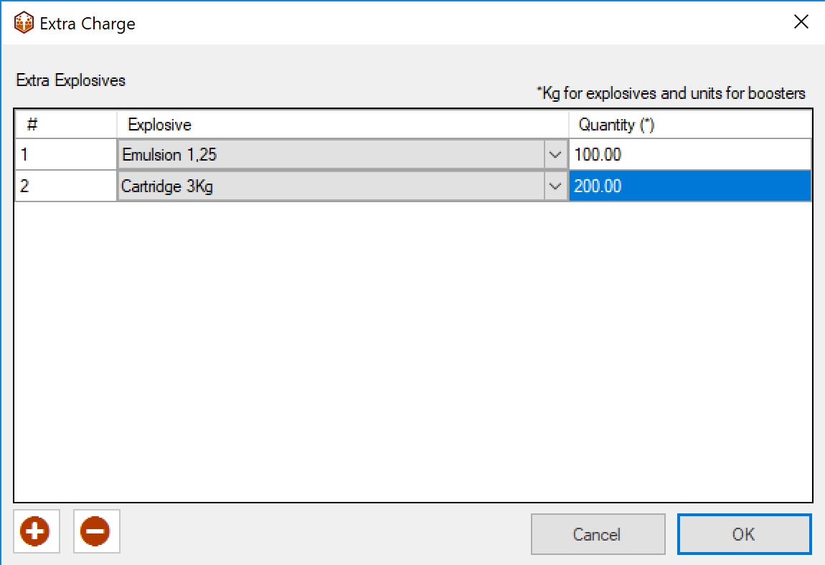
O-Pitblast – Charge Module
In the end, if you want to order extra charge to your suplier, just add it here and it will appear in the report as extra charge.

Slide 21
Technical Support
Phone: +351 918 558 879
E-mail: support@o-pitblast.com

