Slide 1
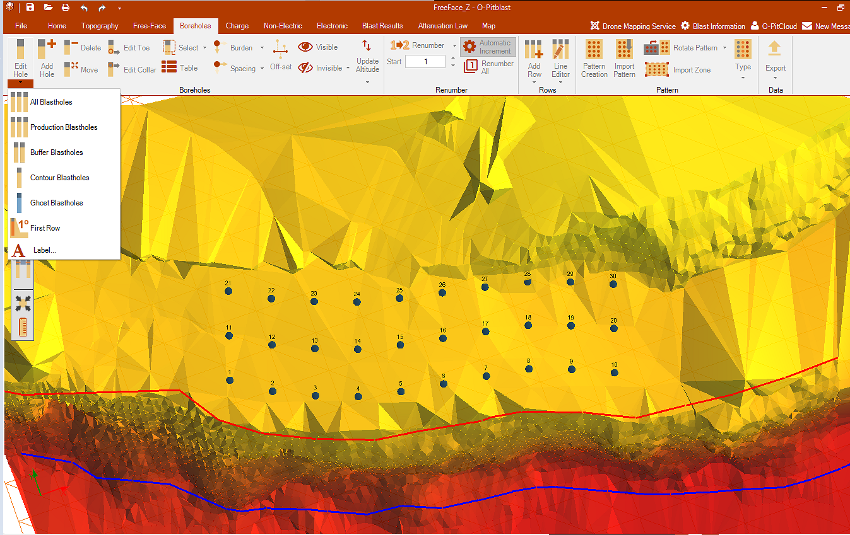
O-Pitblast – Boreholes Module
You can edit your boreholes characteristics according the type. Even boreholes with label.

Slide 2
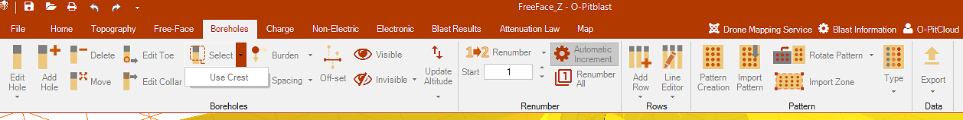
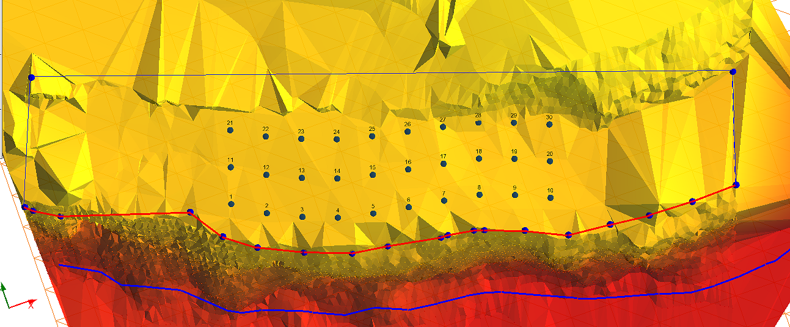
O-Pitblast – Boreholes Module
Same function like that we saw in polygon: use crest (see Design Module)

Slide 3
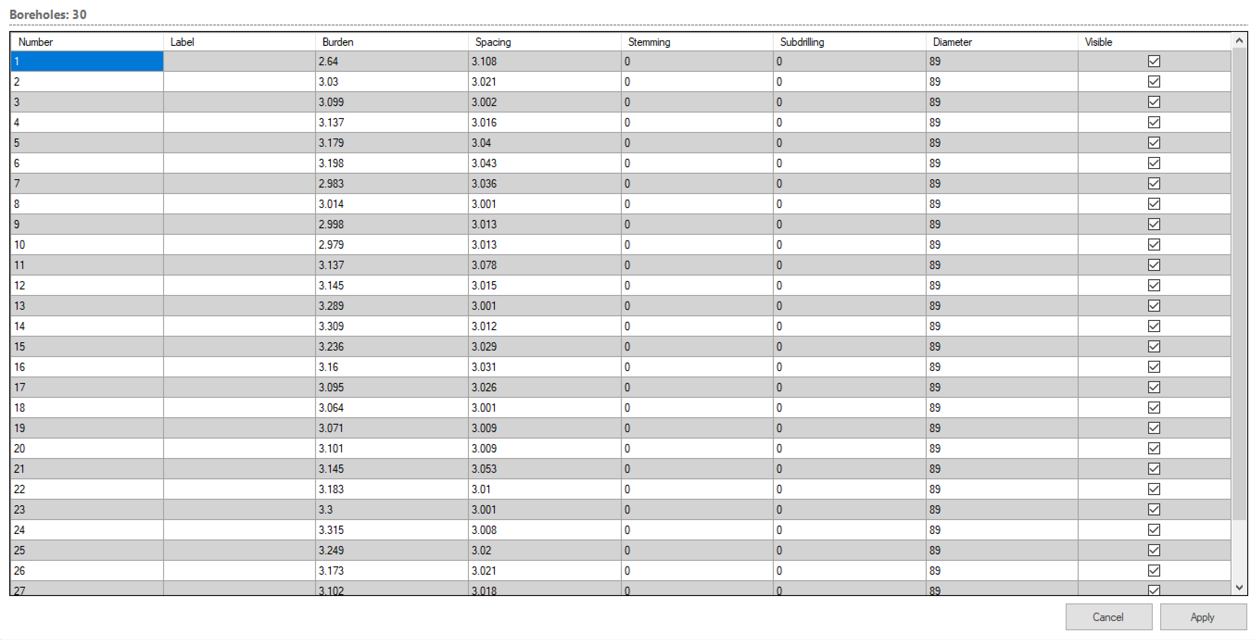
O-Pitblast – Boreholes Module
See a table with your borehole info, and change it one by one.

Slide 4
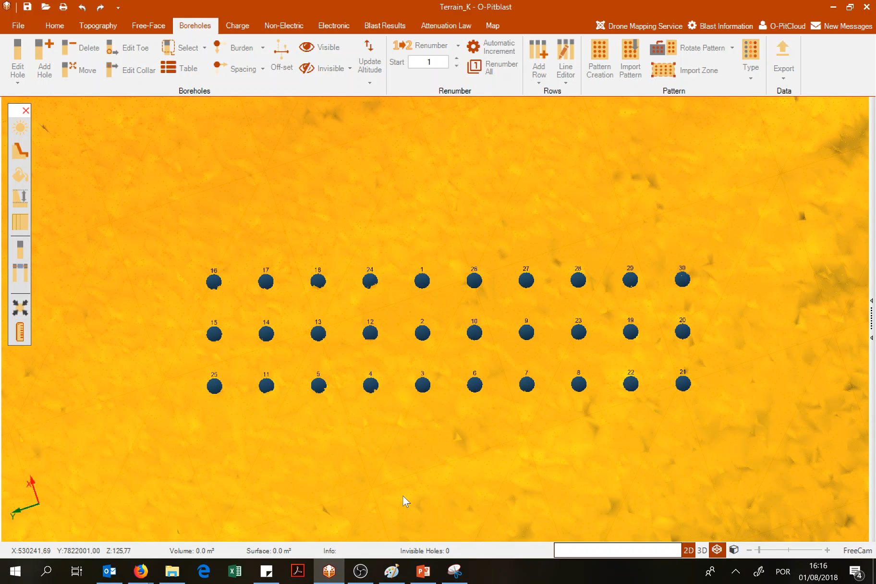
O-Pitblast – Boreholes Module
When renumbering, the increment “Start” will change automatically

Slide 5
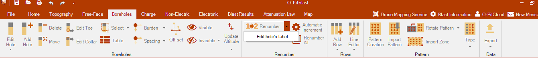
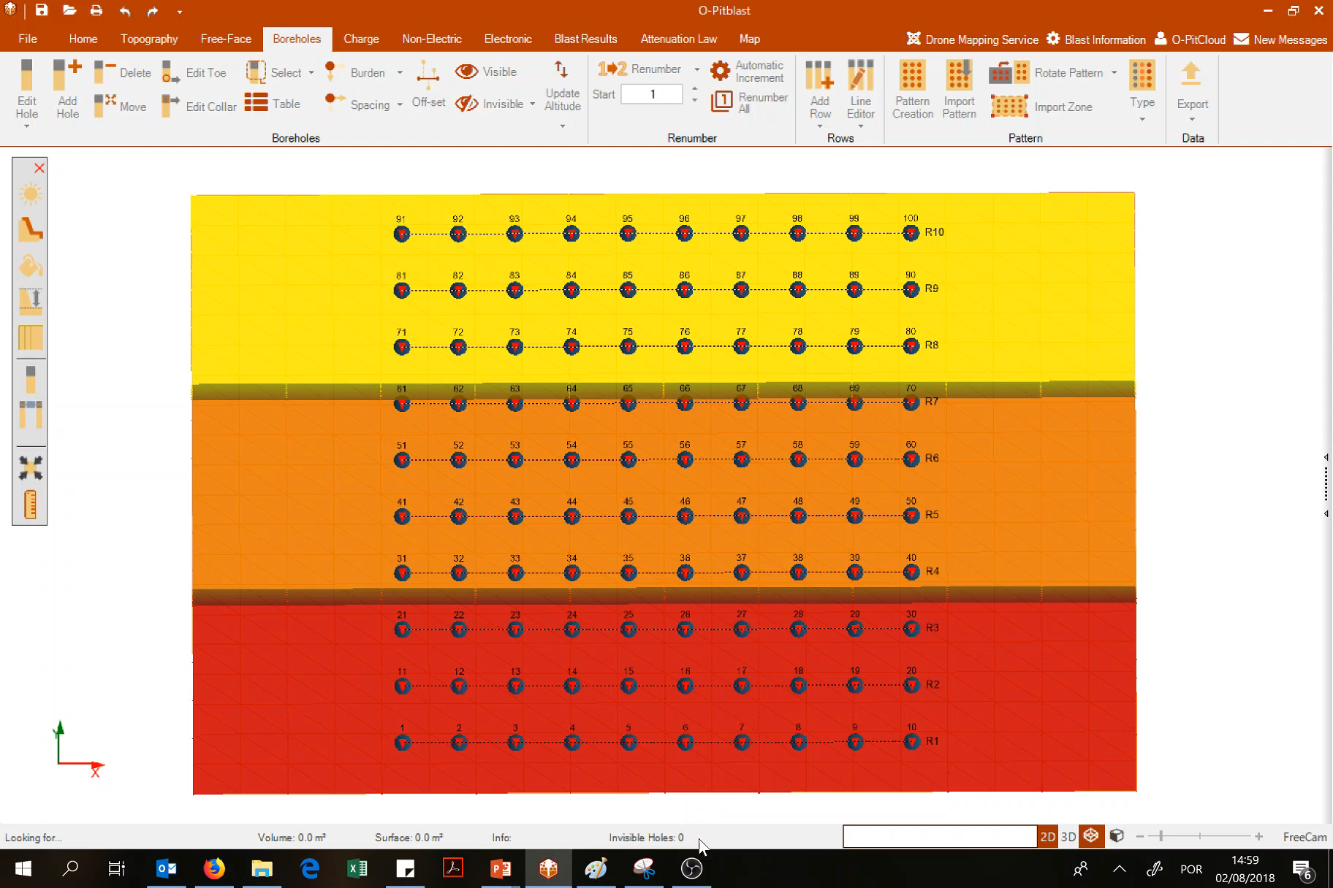
O-Pitblast – Boreholes Module
In “Edit Holes Label” allows you to attached a label to holes: one by one or per row.

Slide 6
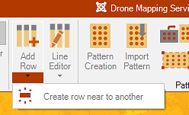
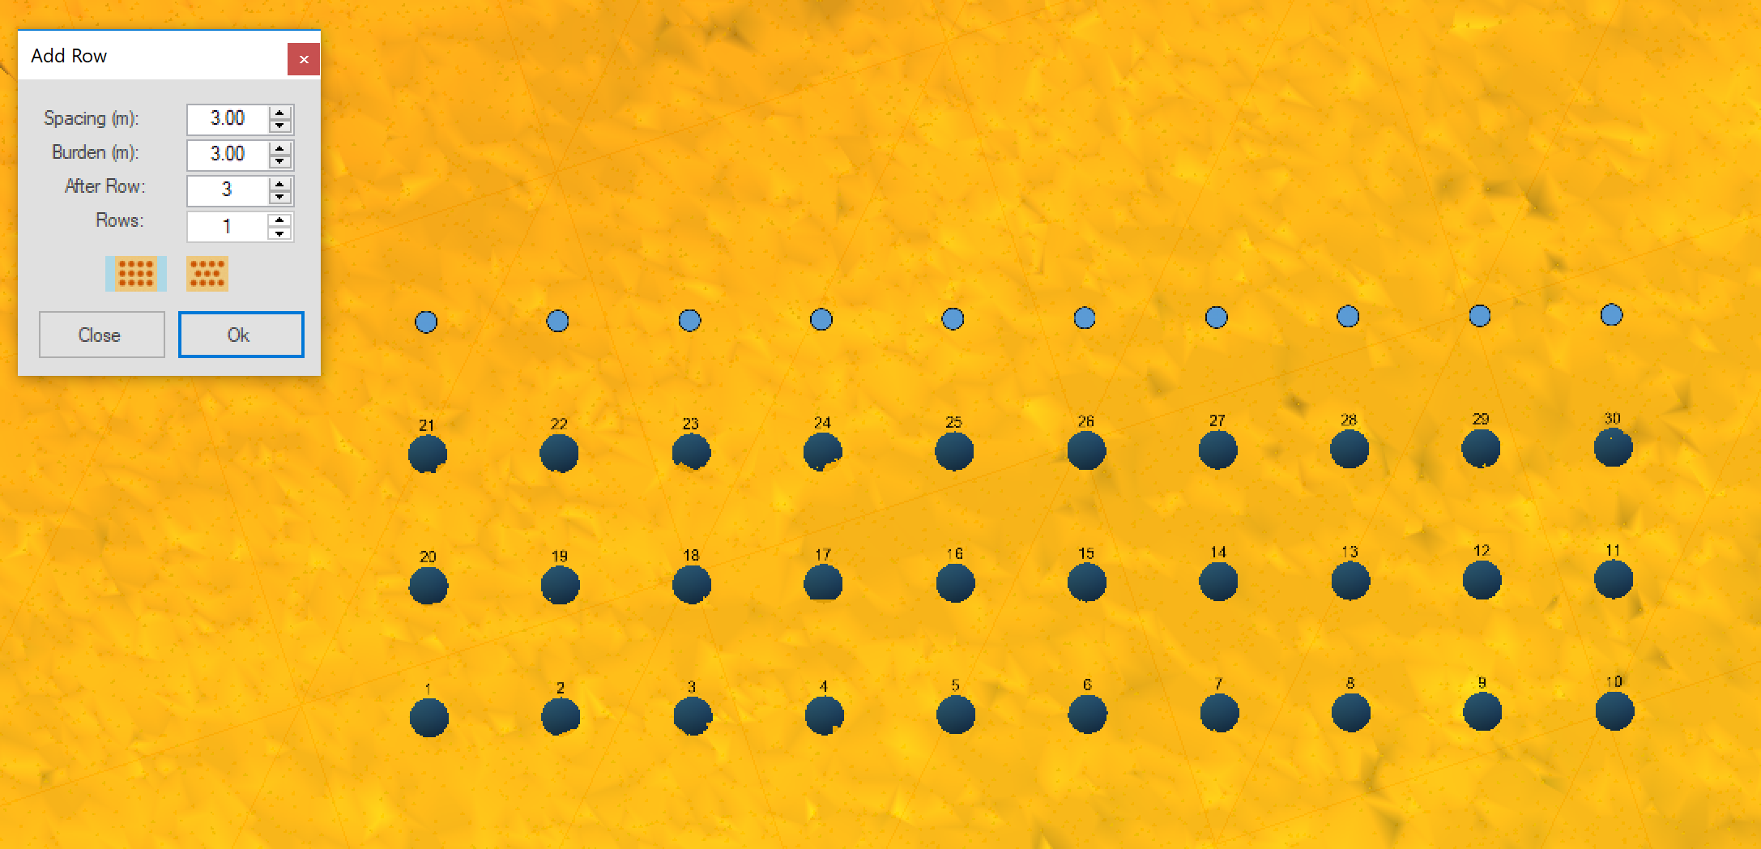
O-Pitblast – Boreholes Module
Create a new row with a new spacing, burden and type of pattern near to another row
New row, near to row 3
Row 3
Row 2
Row 1

Slide 7
O-Pitblast – Boreholes Module
Create a new row with a new spacing, burden and type of pattern near to another row
New row, near to row 3
Row 3
Row 2
Row 1

Slide 8
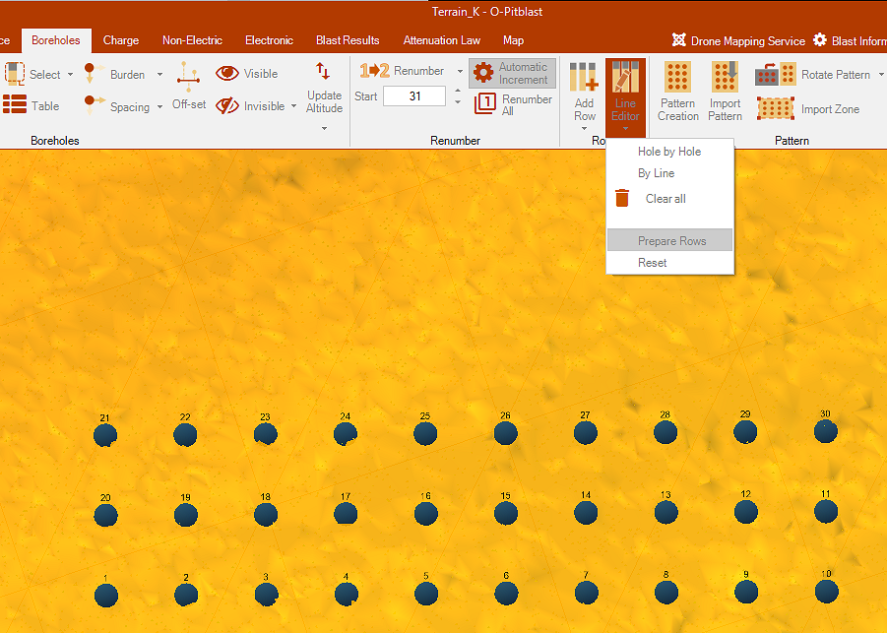
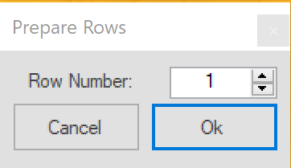
O-Pitblast – Boreholes Module
If select a row or numerous rows (when you click on this option it will open a similar tab when you are define rows) the holes with boretrak will appear all align on the report

Slide 9
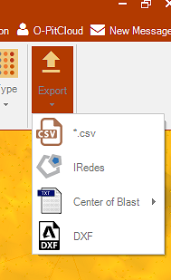
O-Pitblast – Boreholes Module
Export :
Borehole patter in .csv
Borehole patter in IREDES (compatible with automatic drill rigs)
- Center of Blast (coordinates) in txt
Borehole pattern in .DXF

Slide 10
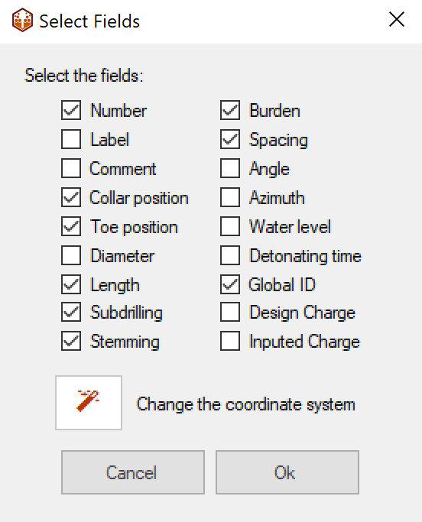
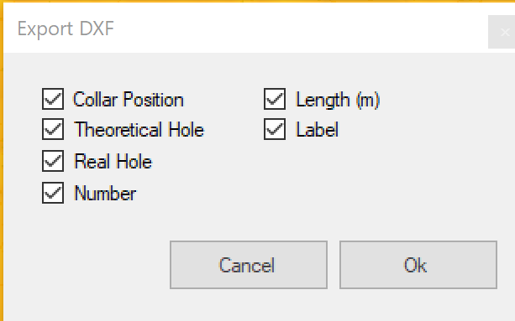
O-Pitblast – Boreholes Module
When exporting your borehole pattern, you can choose between all this fields (that you want in your .csv or dxf)

Slide 11
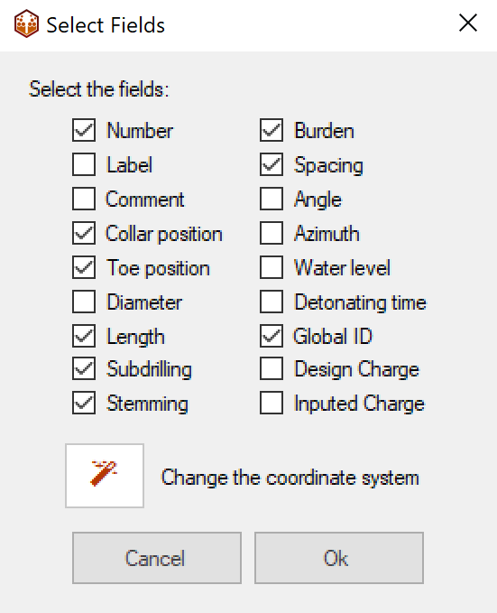
O-Pitblast – Boreholes Module
Also, when importing to .csv you can choose the coordinate system that you want the X, Y and Z of your pattern (see topography module to learn how to use the coordinate system).

Slide 12
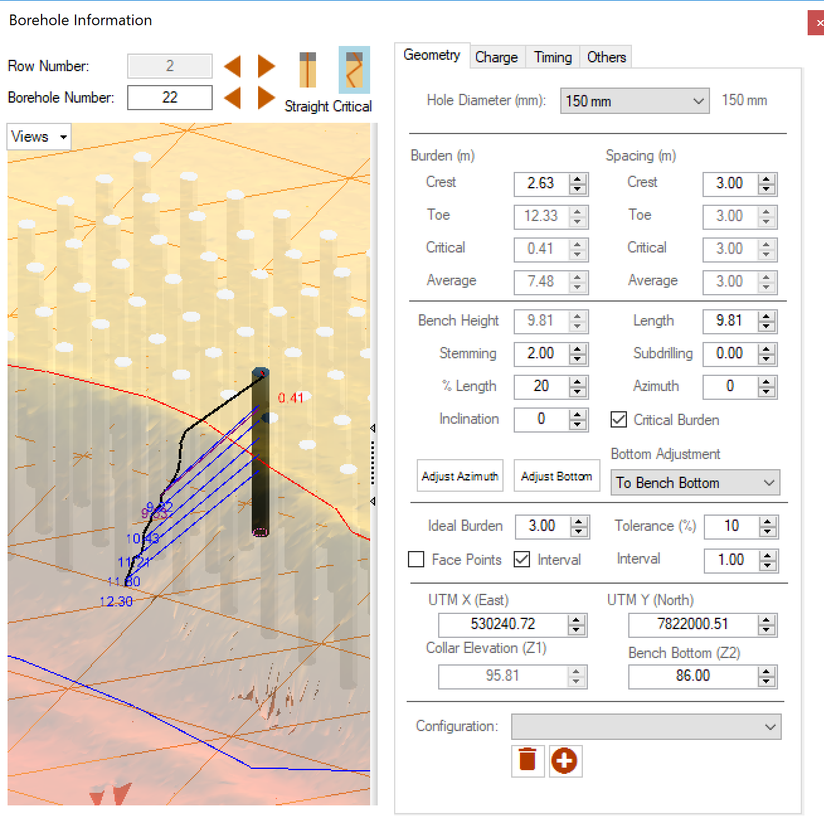
O-Pitblast – Boreholes Module
Critical burden to holes from all rows (not just the first row).

Slide 13

Technical Support
Phone: +351 918 558 879
E-mail: support@o-pitblast.com

