Slide 1
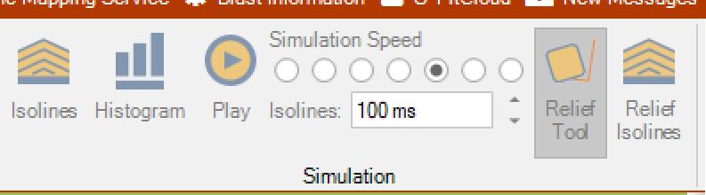
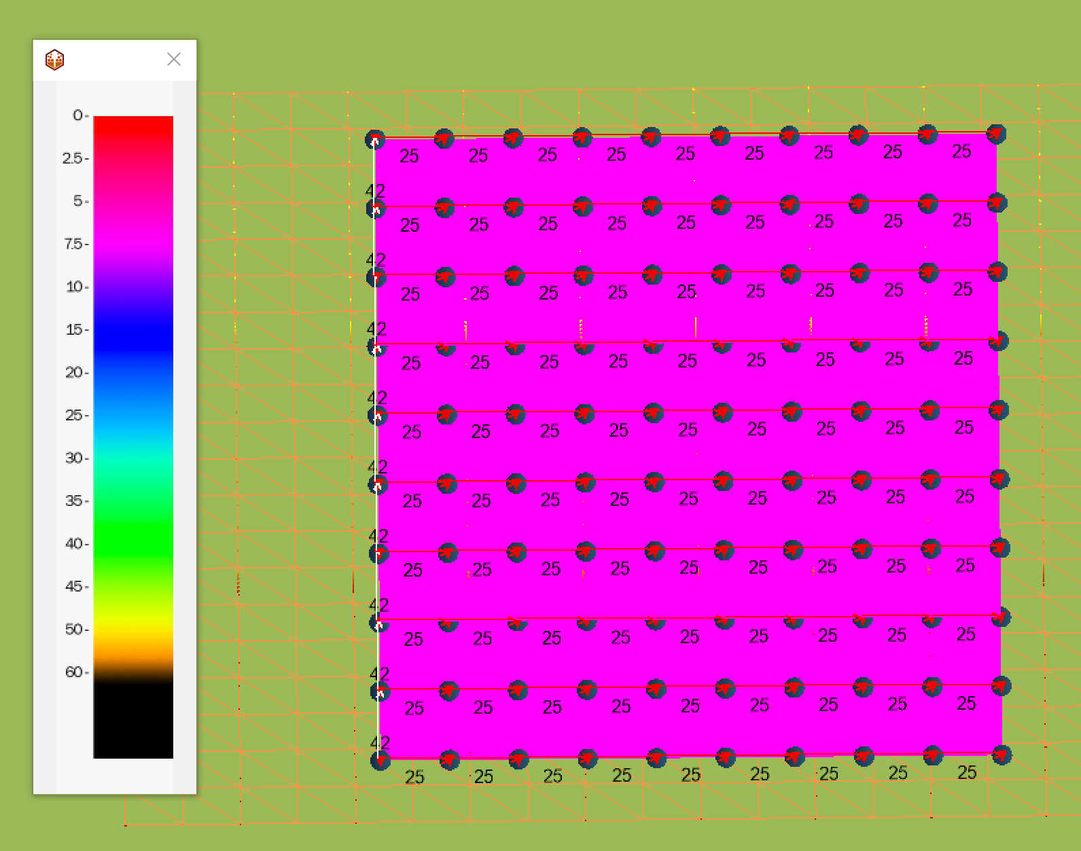
O-Pitblast – Non electronic detonators
The relief tool shows the relative difference of blasting time of each hole in one pattern.
Example: surface connection with 25 ms between holes and 42 ms inter rows.

Slide 2
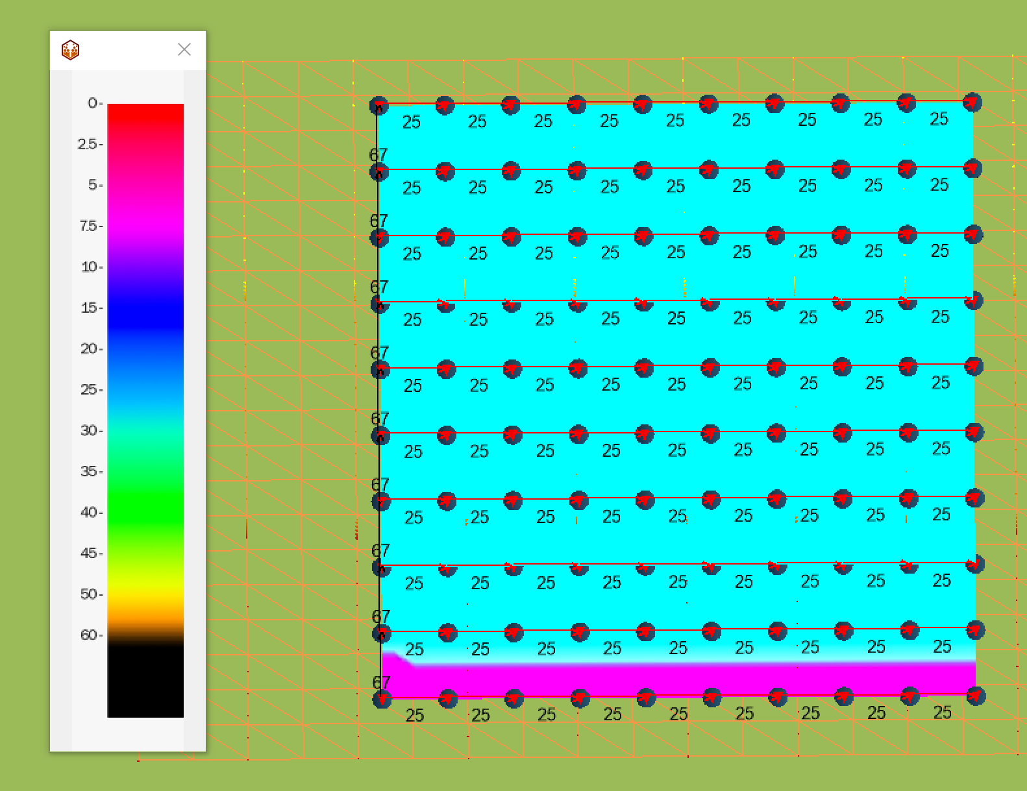
O-Pitblast – Non electronic detonators
The relief tool shows the relative difference of blasting time of each hole in one pattern.
Example: surface connection with 25 ms between holes and 67 ms inter rows.

Slide 3
O-Pitblast – Non electronic detonators

Slide 4
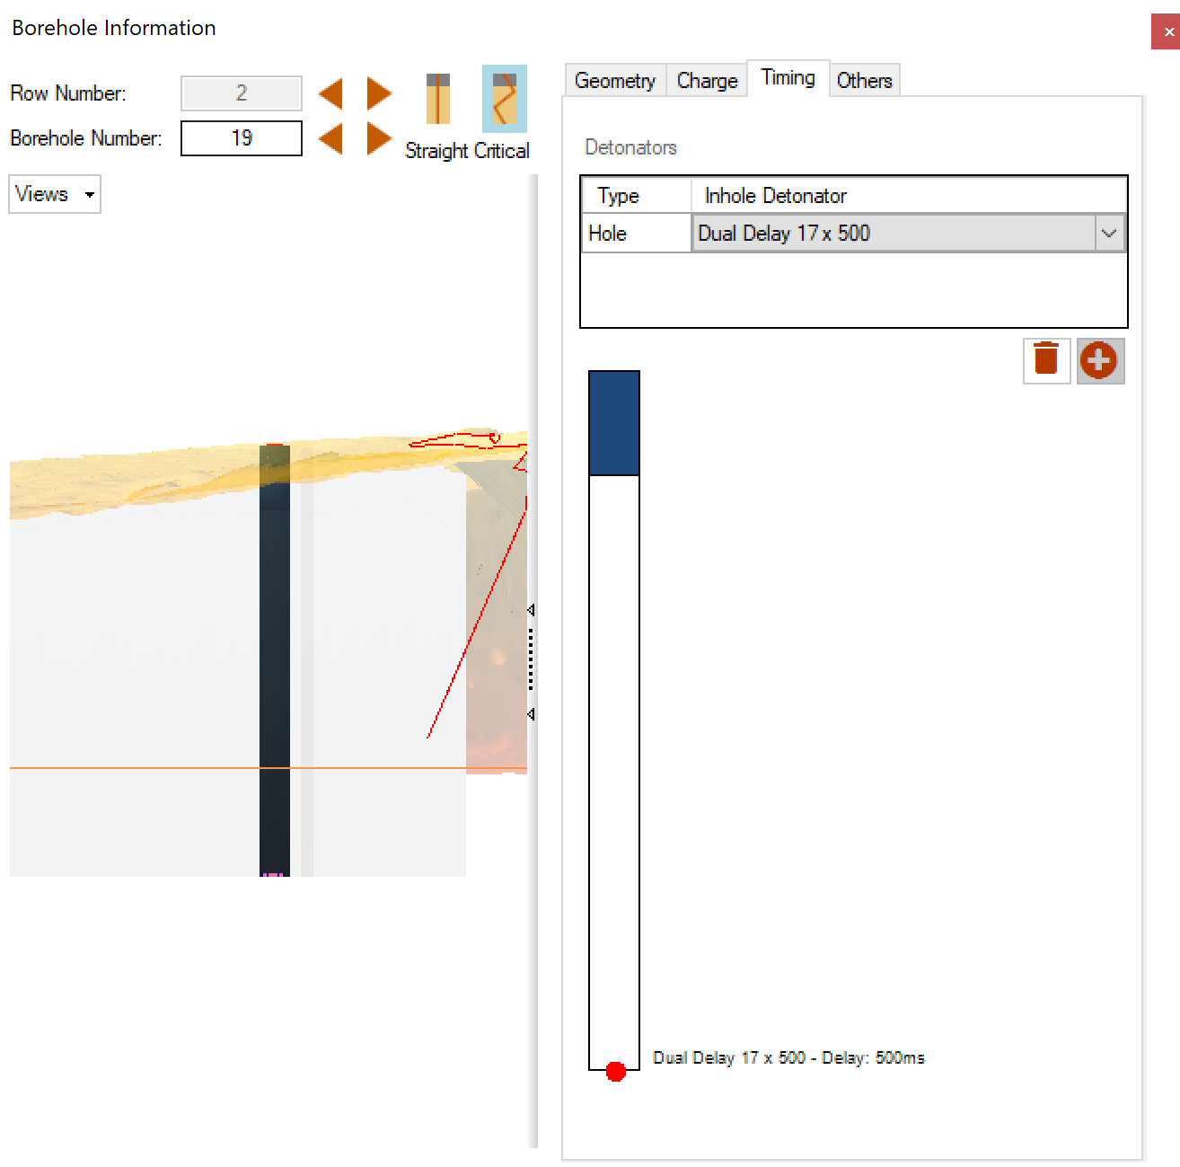
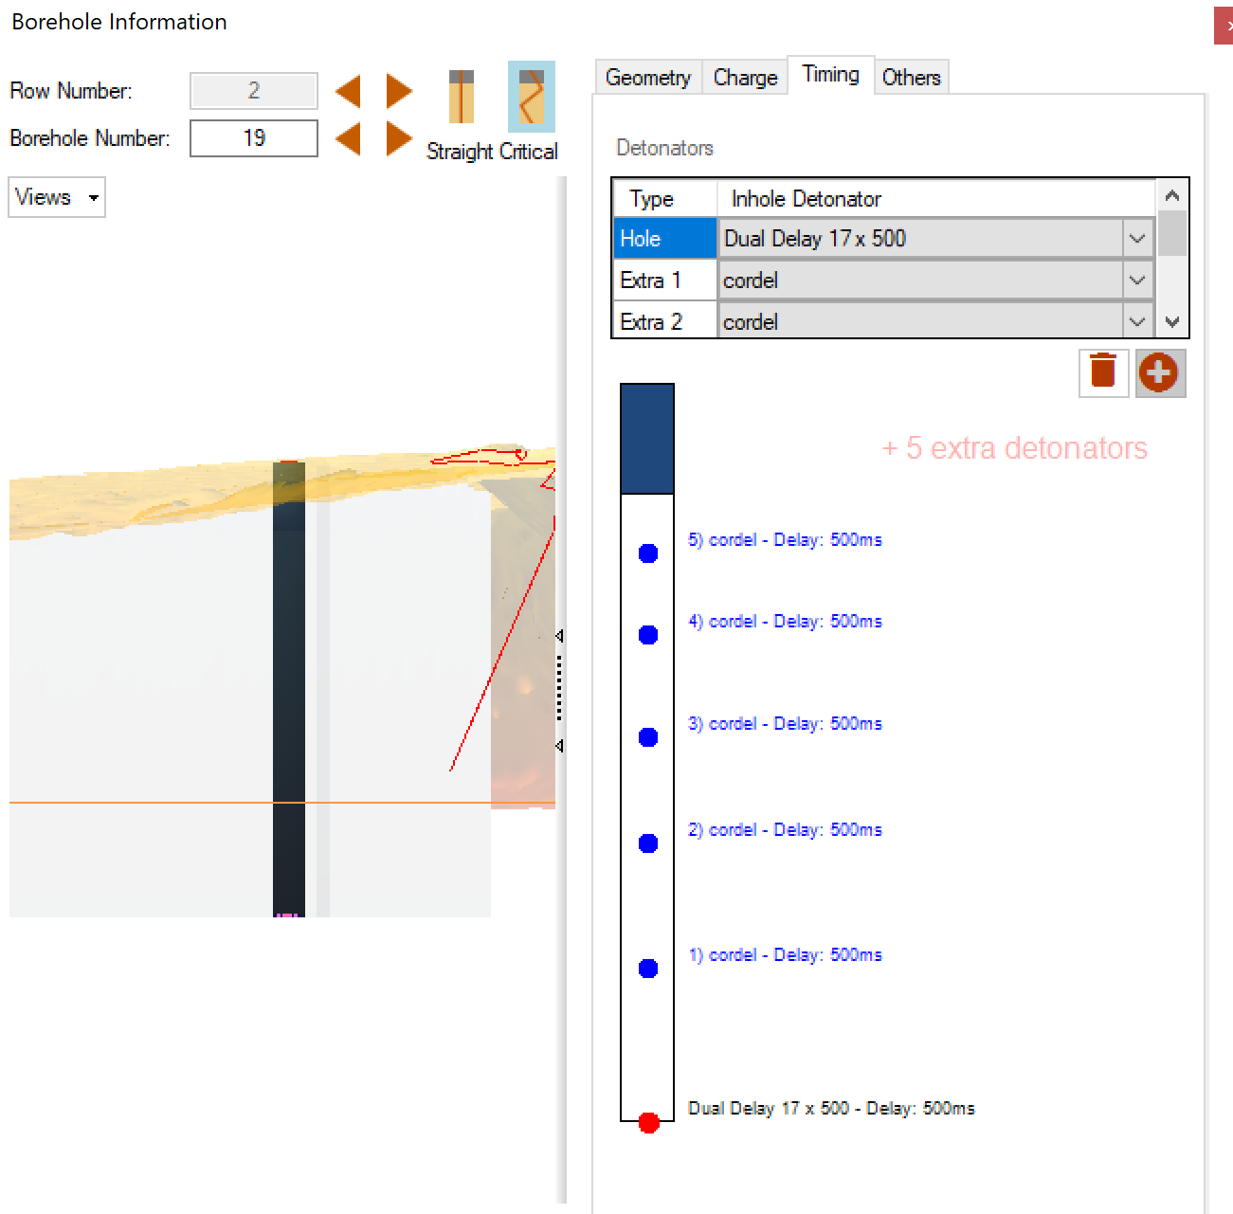
O-Pitblast – Non electronic detonators
Add extra detonators to your hole.
Click on the plus sign an place them along the hole

Slide 5

Technical Support
Phone: +351 918 558 879
E-mail: support@o-pitblast.com

