Slide 1

O-Pitblast –Electronic Detonators

Slide 2
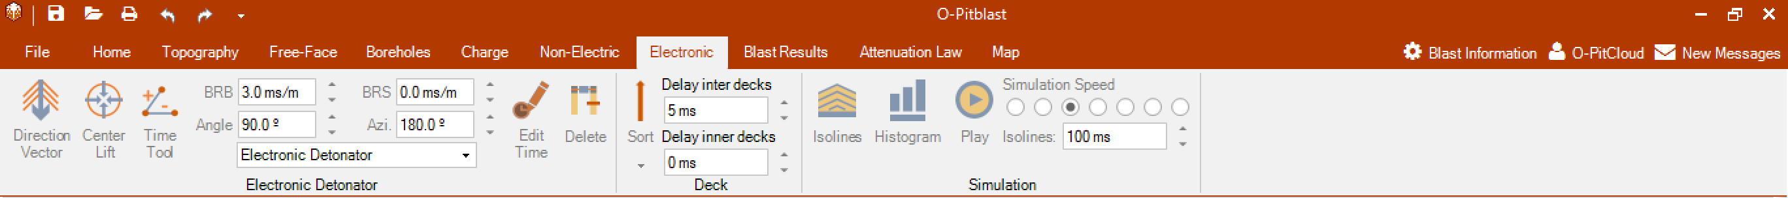
O-Pitblast –Electronic detonators

Slide 3

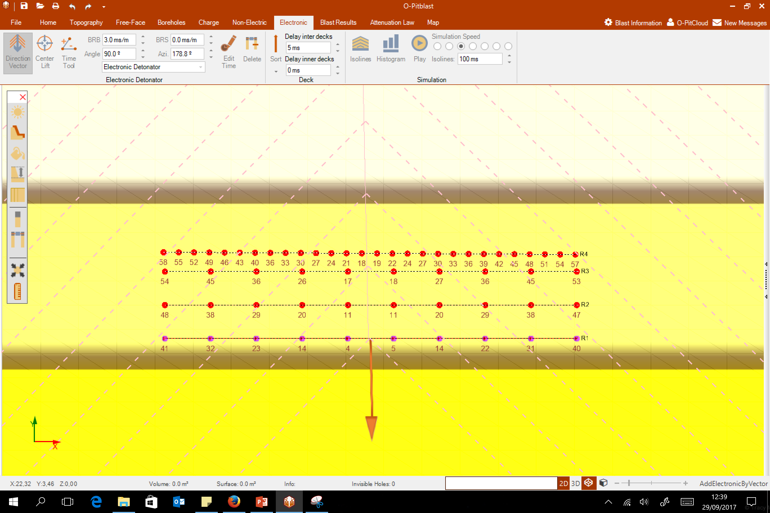
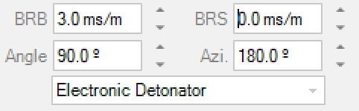
O-Pitblast –Electronic detonators
Direction Vector

Slide 4
O-Pitblast –Electronic detonators
Direction Vector
Burden Relief Burden
Burden Relief Spacing
Angle
Azimuth

Slide 5
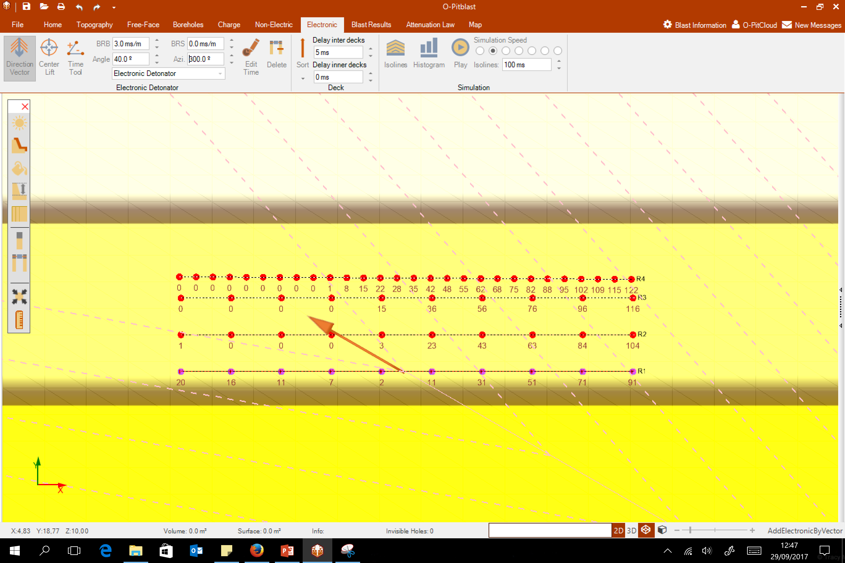
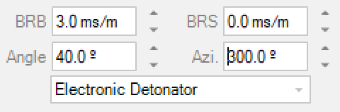
O-Pitblast –Electronic detonators
Direction Vector

Slide 6
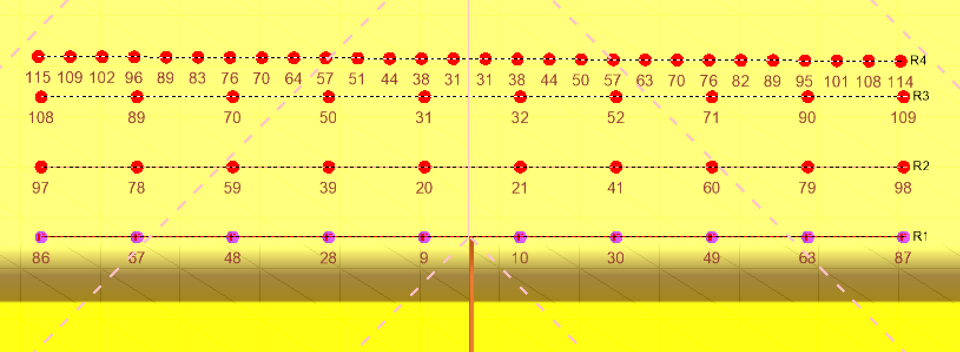
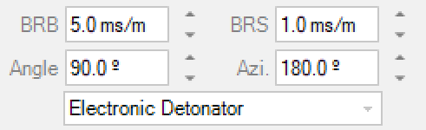
O-Pitblast –Electronic detonators
Direction Vector

Slide 7
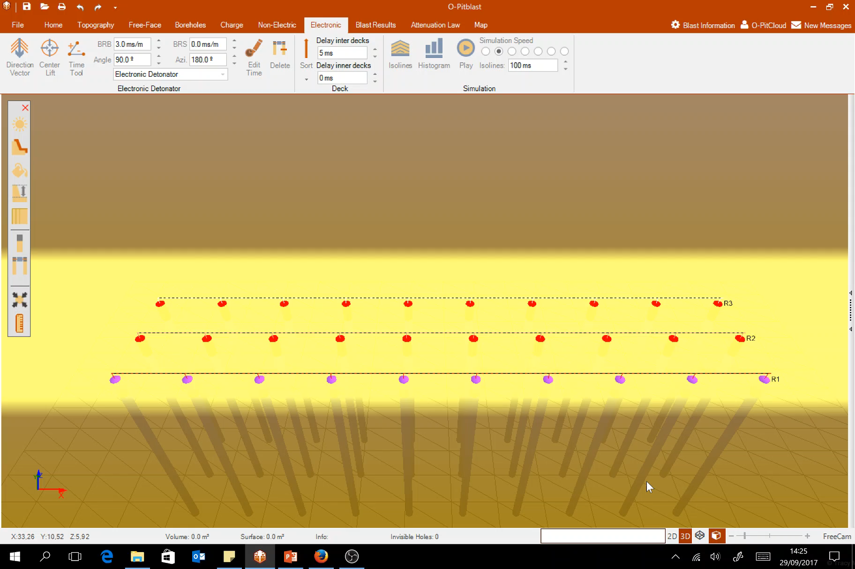
O-Pitblast –Electronic detonators
Direction Vector

Slide 8

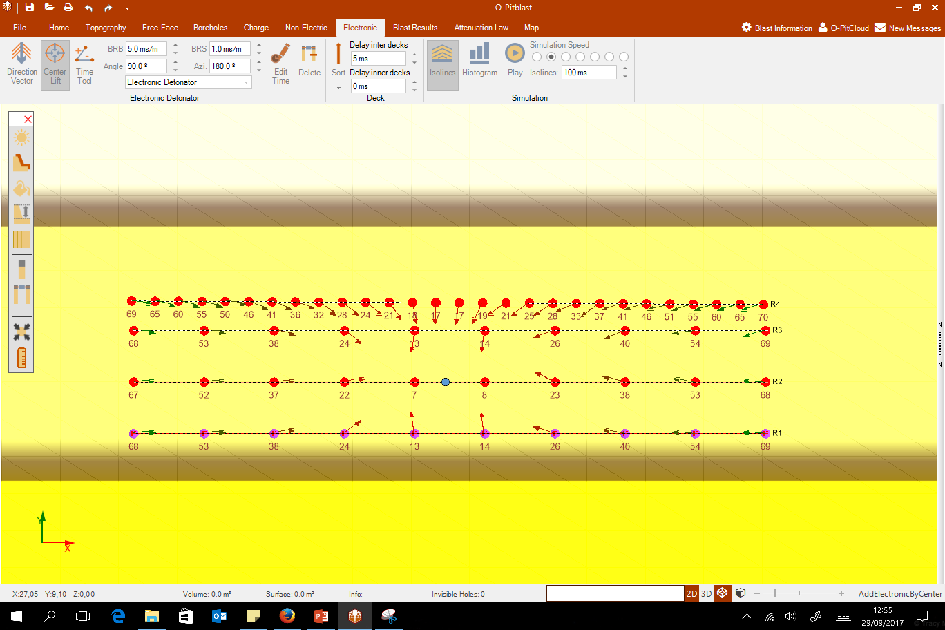
O-Pitblast –Electronic detonators
Center Lift

Slide 9
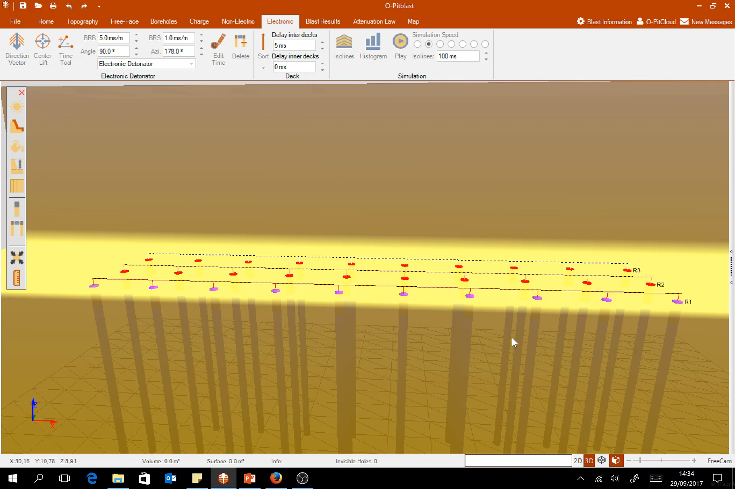
O-Pitblast –Electronic detonators
Center Lift

Slide 10
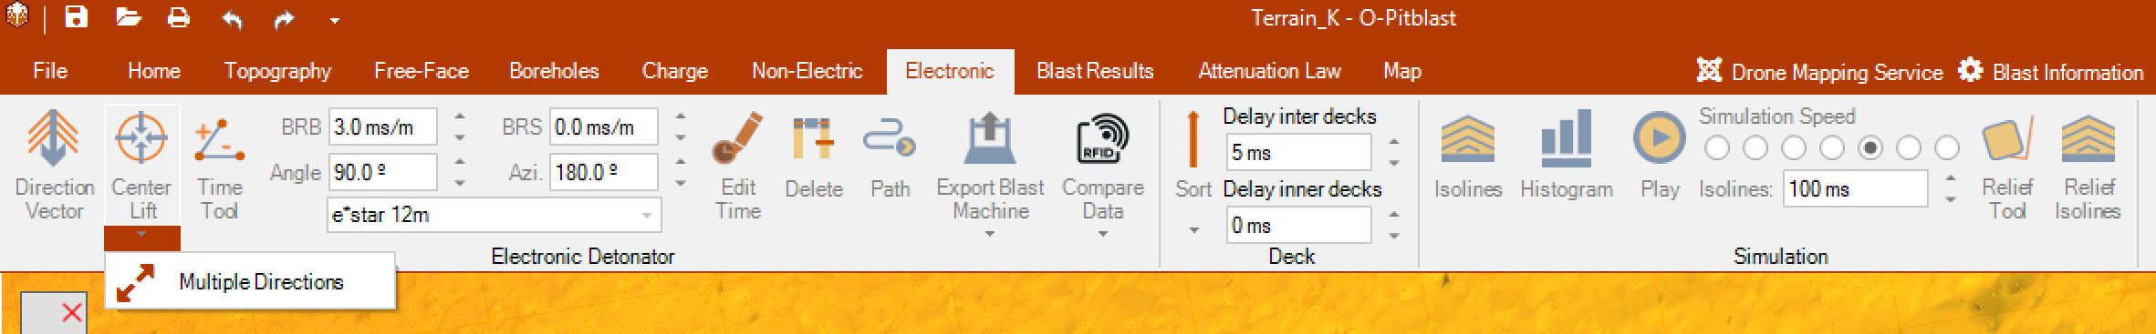
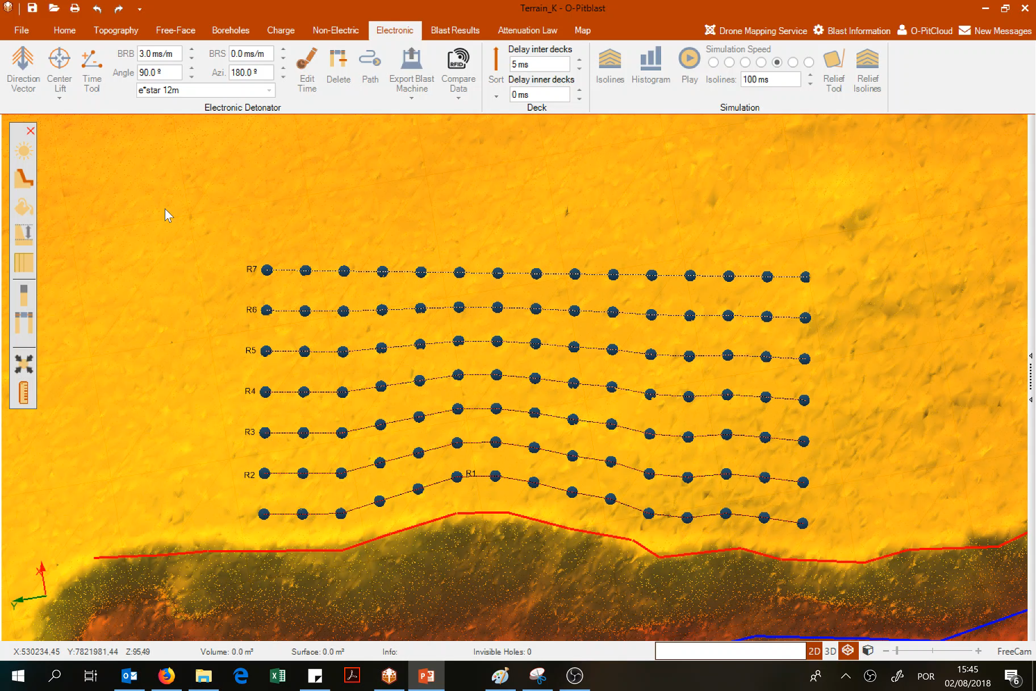
O-Pitblast –Electronic detonators

Slide 11
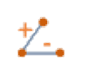
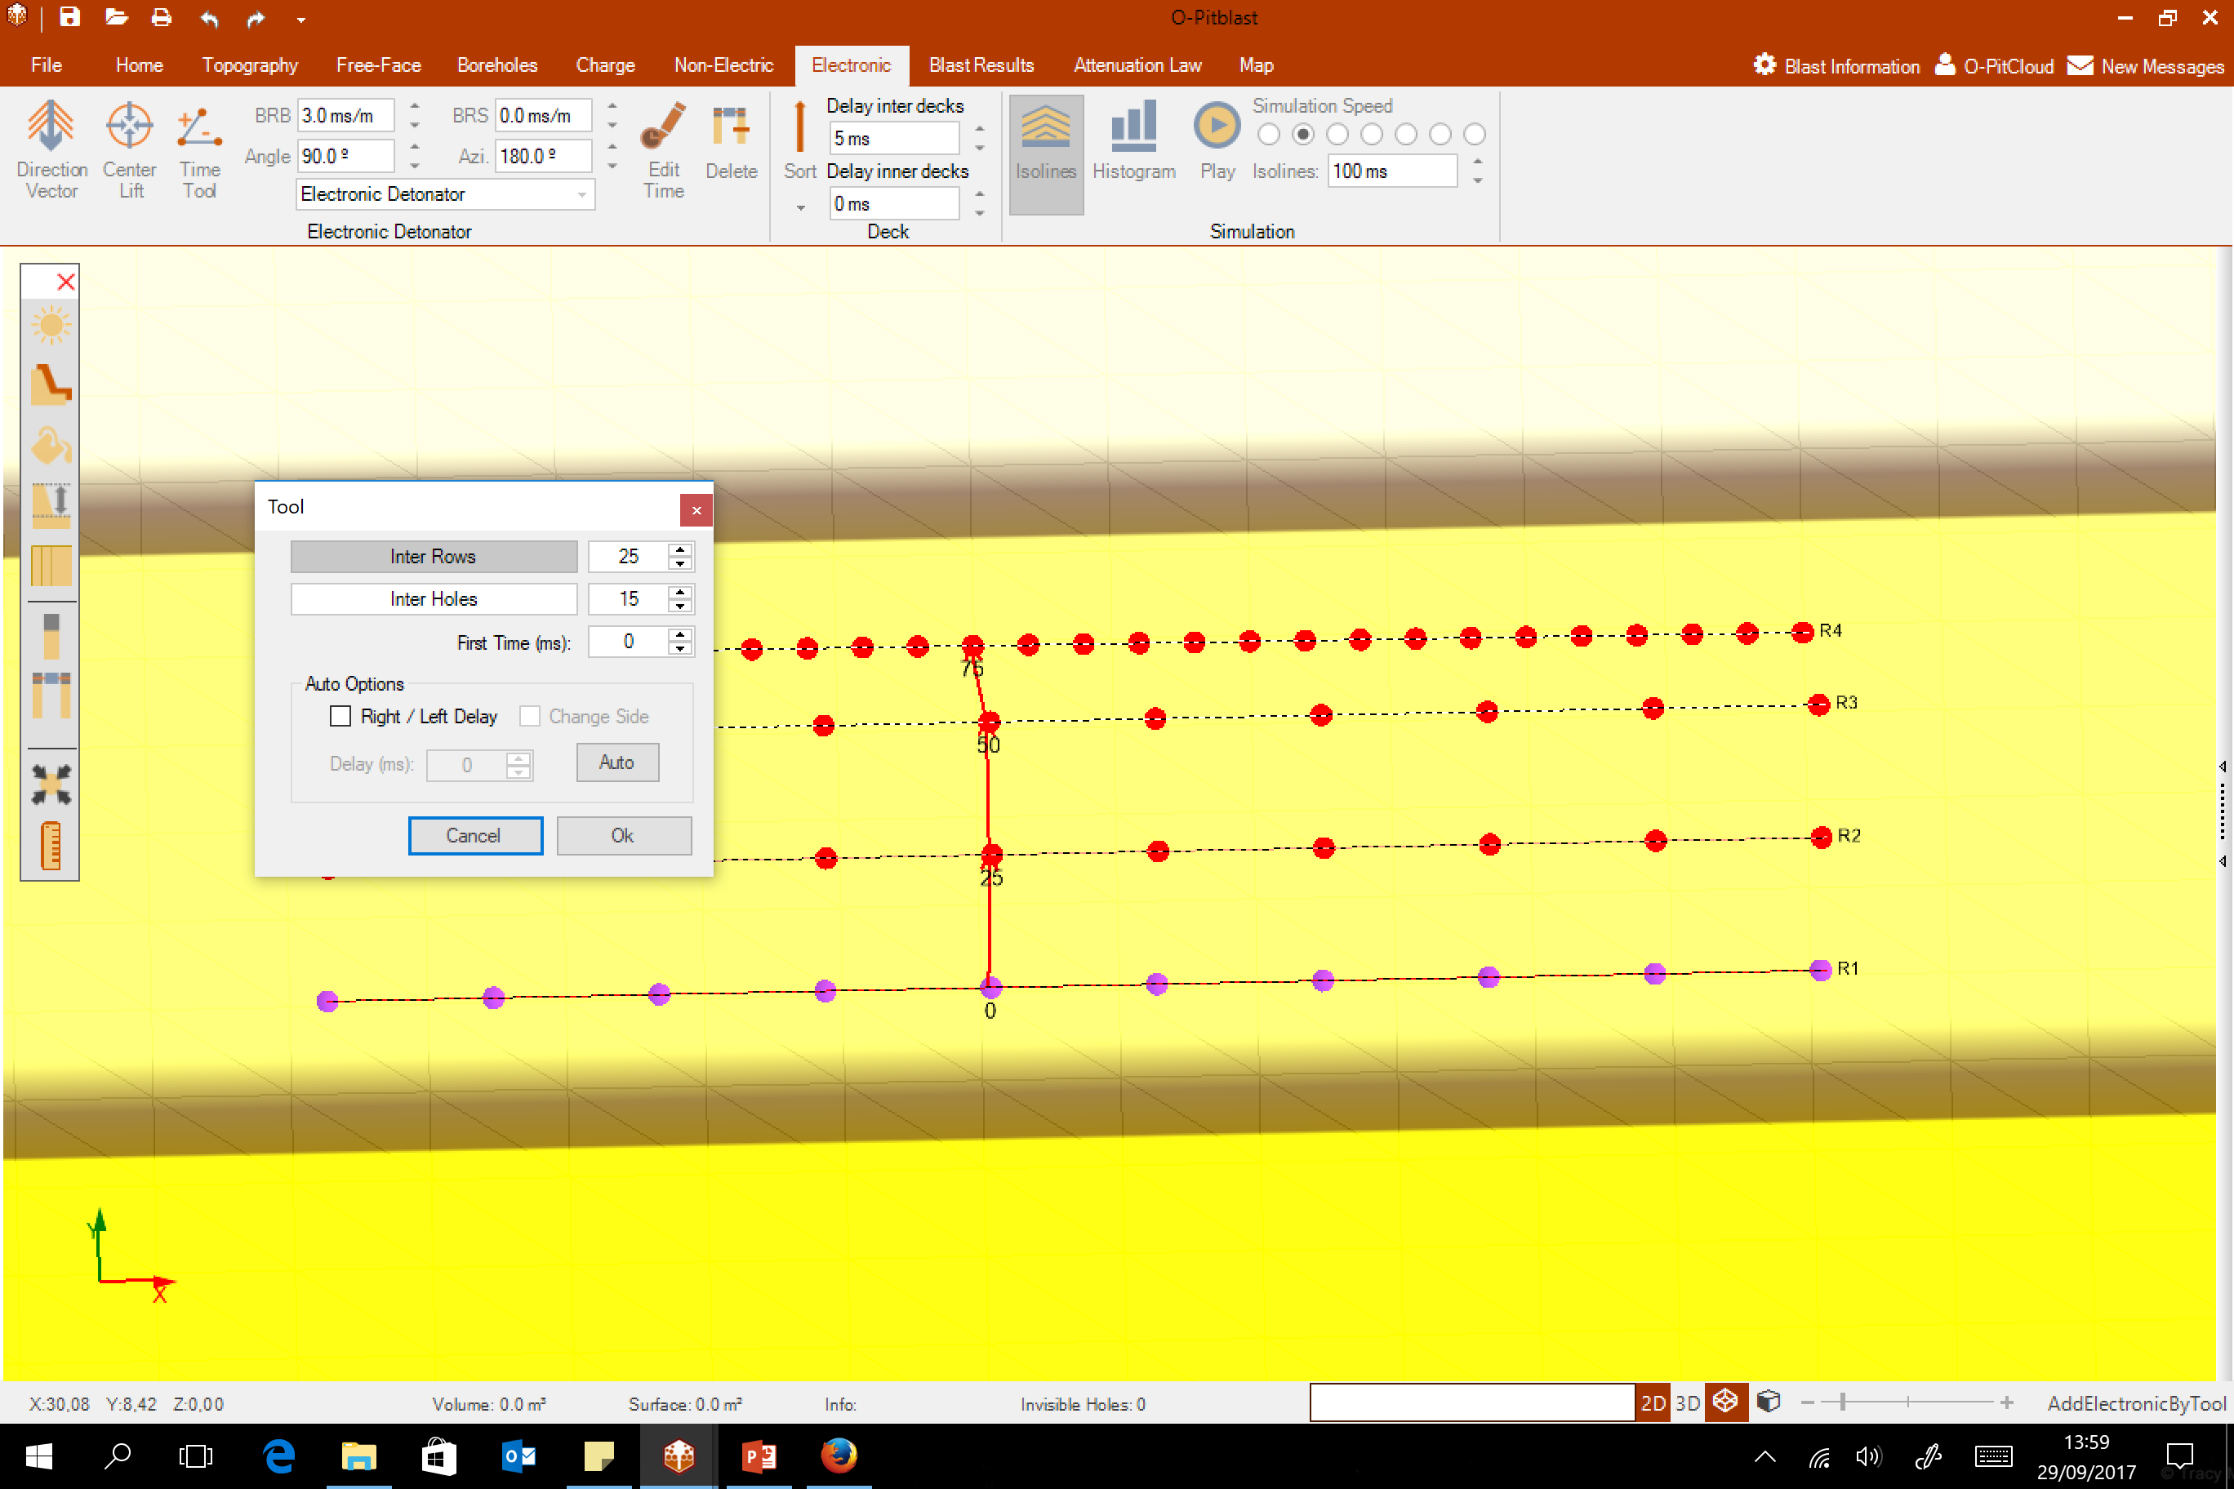
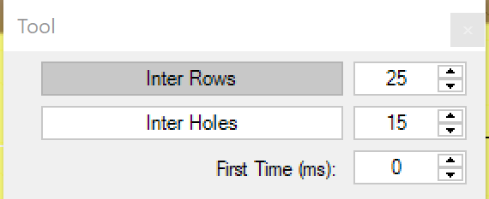
O-Pitblast –Electronic detonators
Time Tool
25 ms
25 ms
25 ms

Slide 12
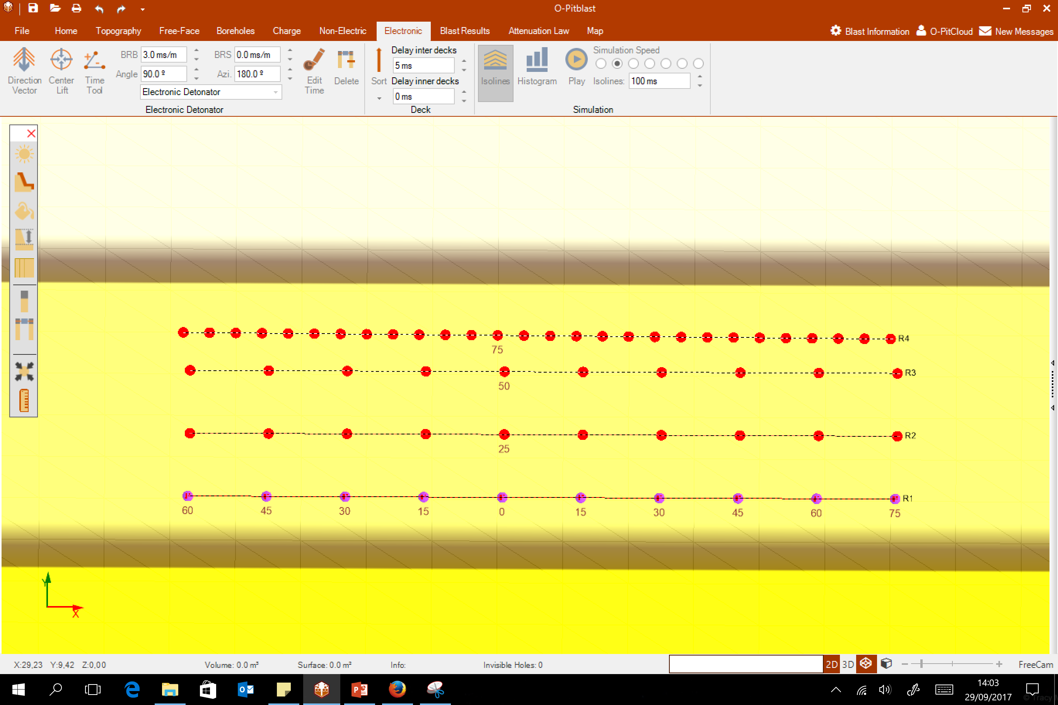
O-Pitblast –Electronic detonators
Time Tool
15 ms
15 ms
15 ms
15 ms
15 ms
15 ms
15 ms
15 ms
15 ms

Slide 13
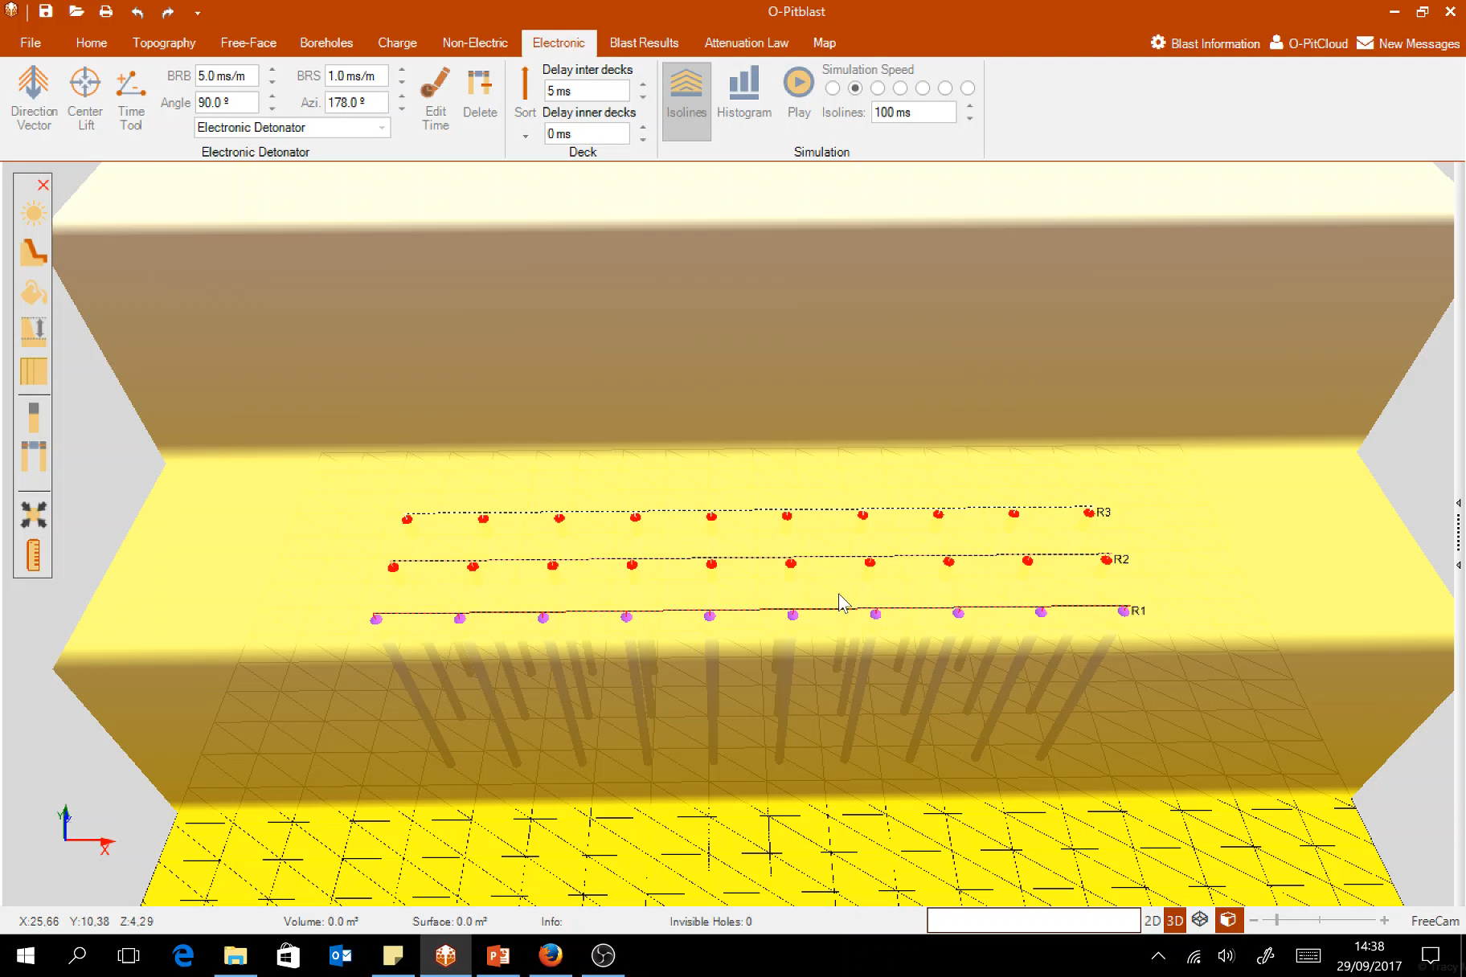
O-Pitblast –Electronic detonators
Time Tool

Slide 14
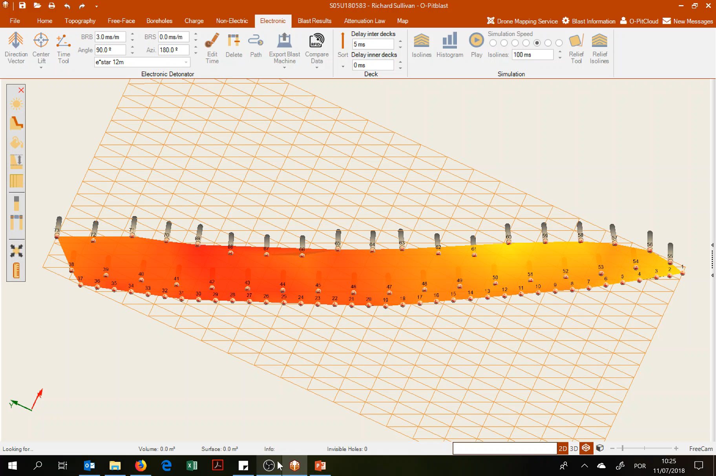
O-Pitblast –Electronic detonators
Time Tool

Slide 15

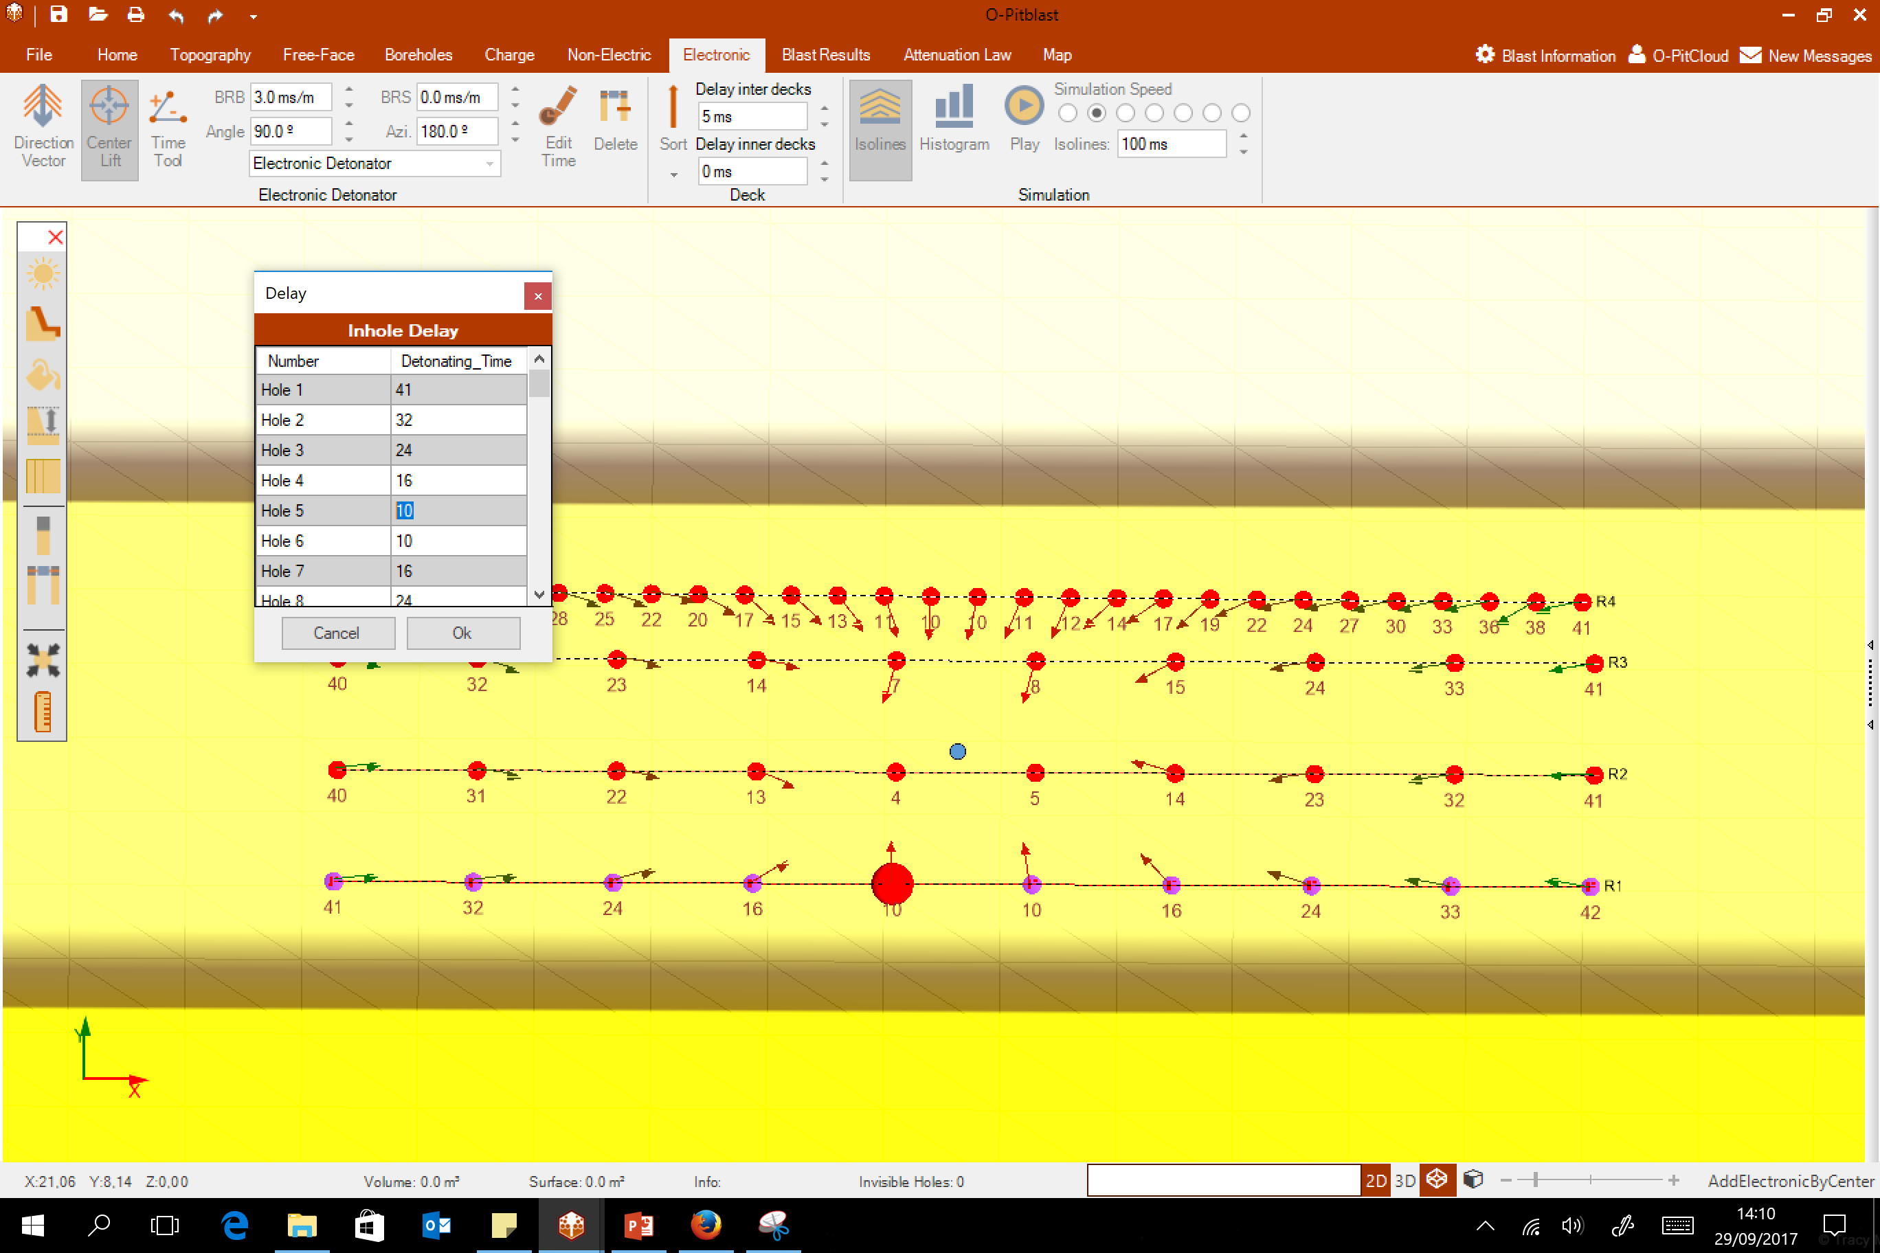
O-Pitblast –Electronic detonators
Edit Time
Change time individually

Slide 16
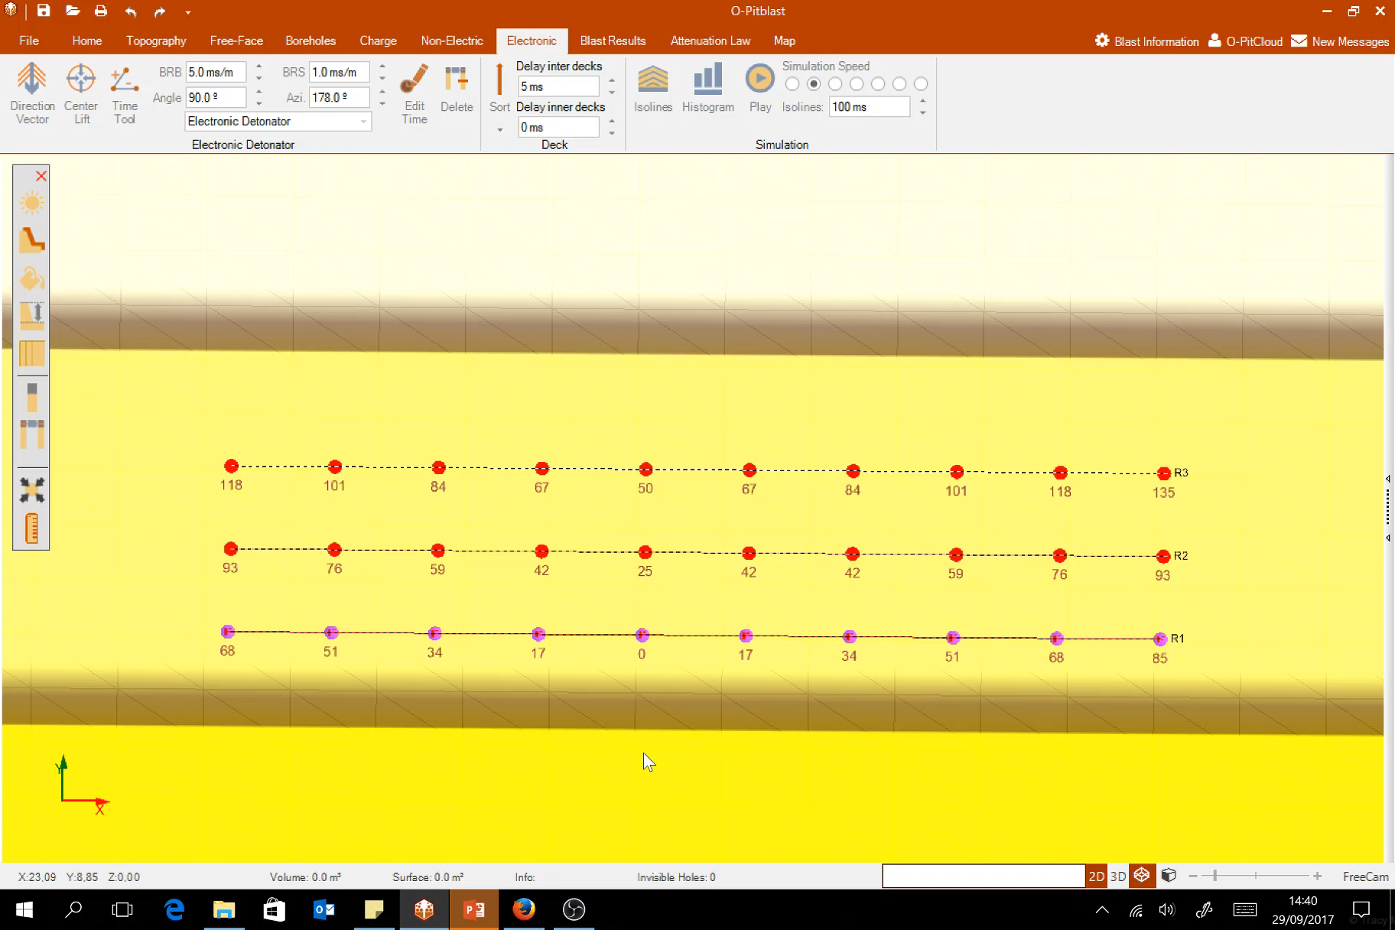
O-Pitblast –Electronic detonators
Edit Time
Change time individualy

Slide 17

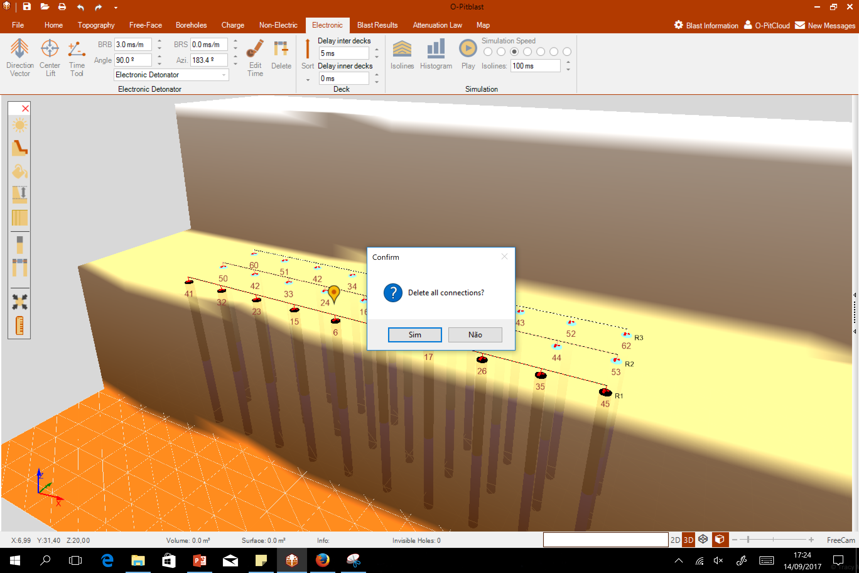
O-Pitblast –Electronic detonators
Delete all connections

Slide 18

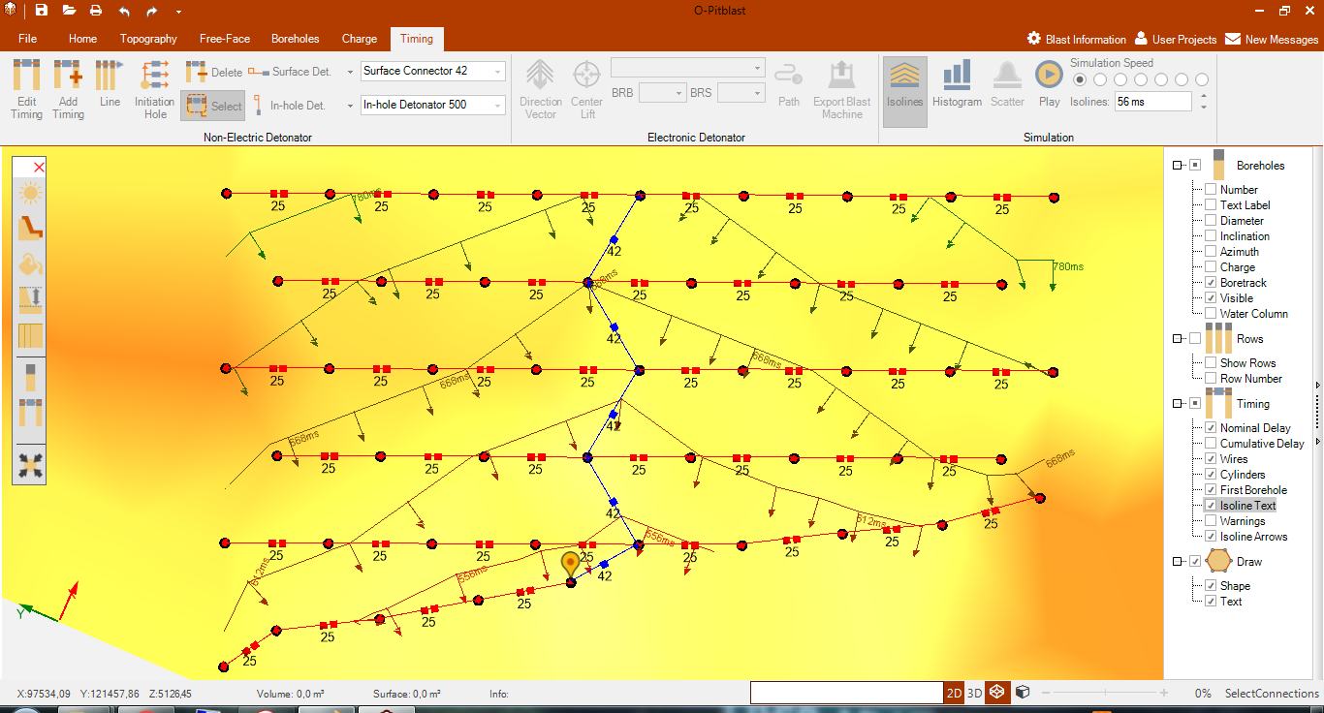

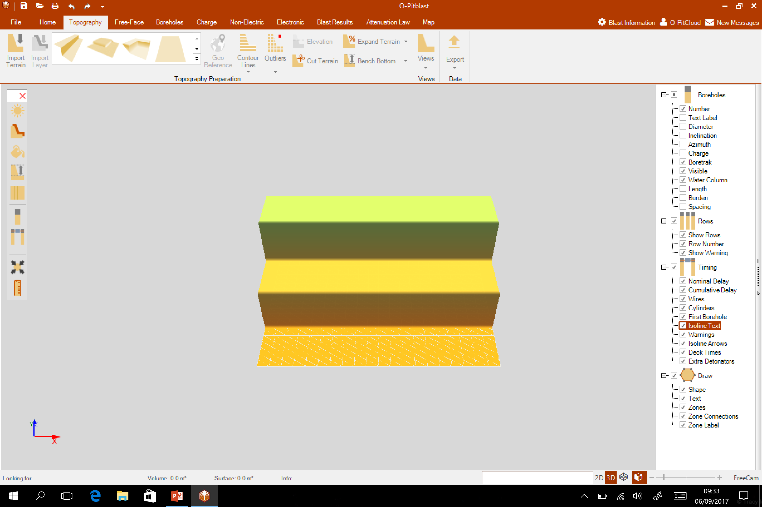
O-Pitblast – Electronic detonators
Isolines

Slide 19
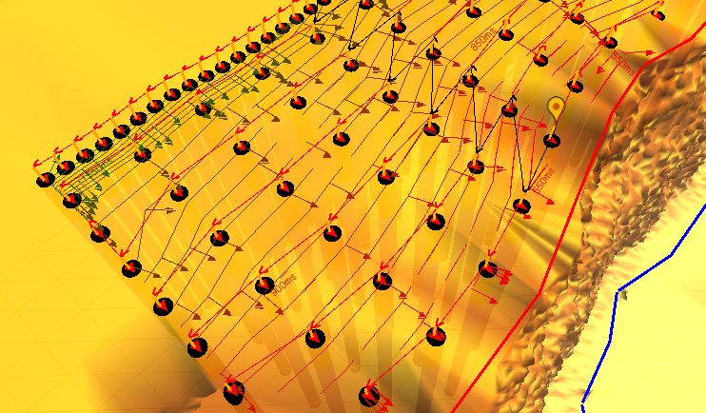
O-Pitblast – Electronic detonators
Isolines
Danger Zone
Cut-Off Zone

Slide 20

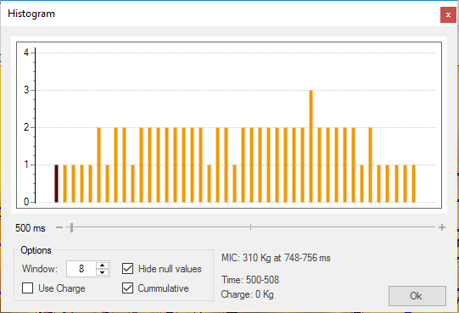
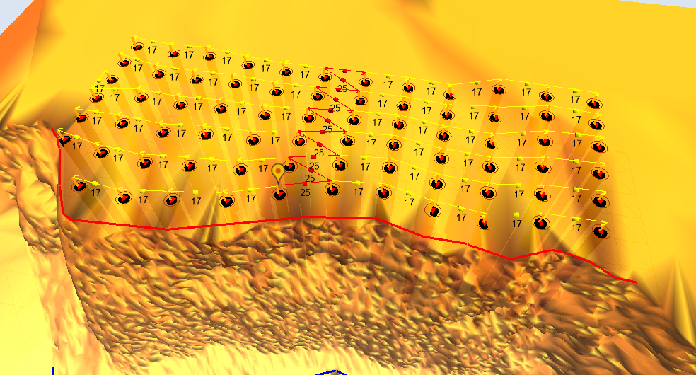
O-Pitblast – Non electronic detonators
Number of holes
Histogram
MIC information
Comulative info

Slide 21
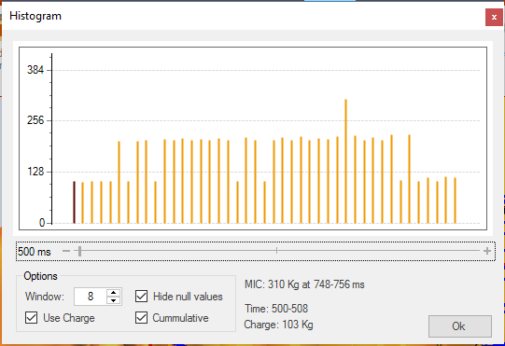
O-Pitblast – Electronic detonators
kg’s
Histogram
Charge histogram
Time interval without blast

Slide 22
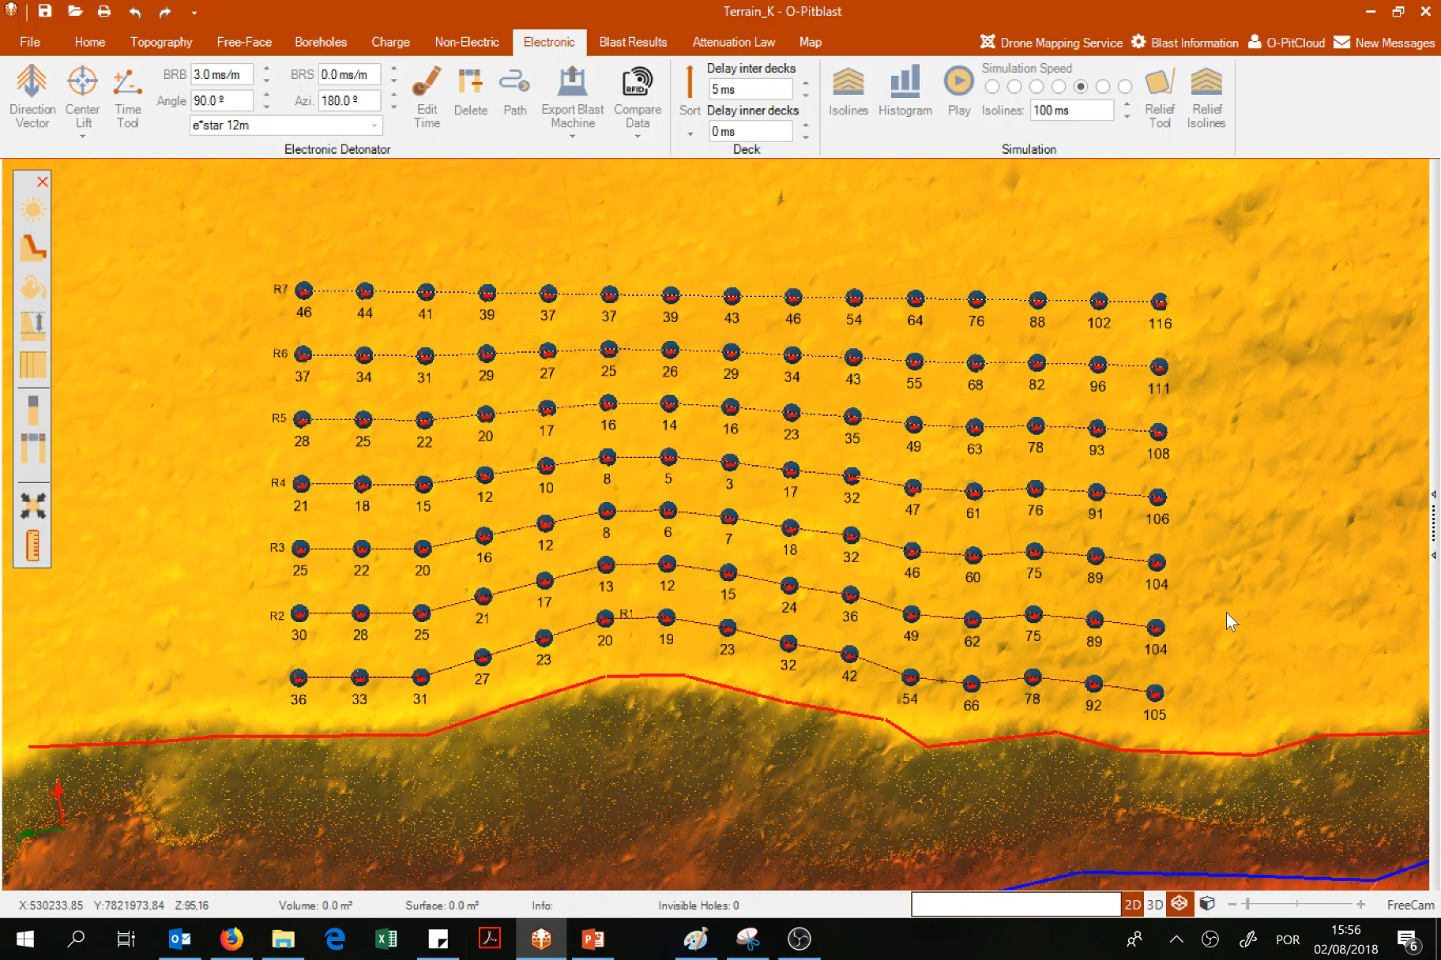
O-Pitblast – Non electronic detonators
Holes Blasting at the same time can be fixed on the option fix. Just choose the interval in ms that you to work.
Histogram

Slide 23
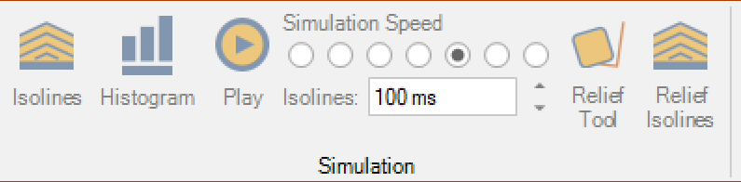
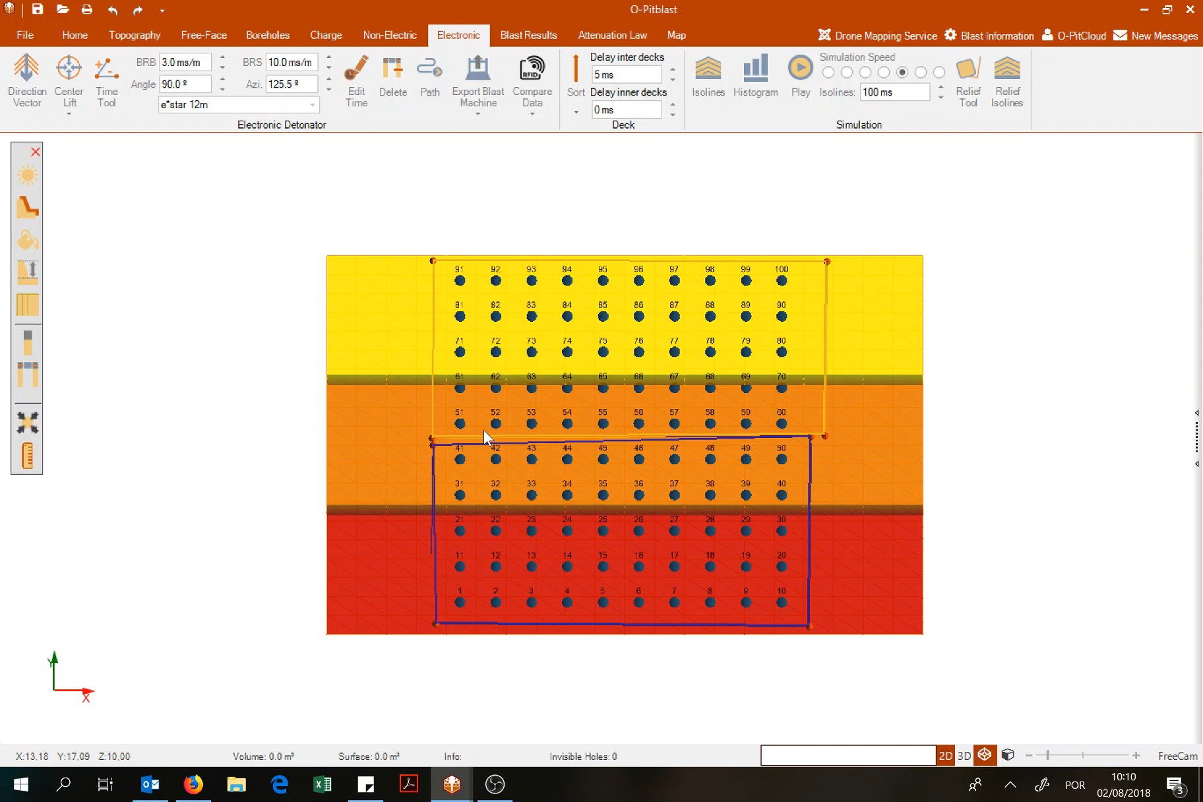
O-Pitblast – Electronic detonators
This options work like the same that we saw in the Non-Electronic module.

Slide 24
Technical Support
Phone: +351 918 558 879
E-mail: support@o-pitblast.com

