Slide 1

O-Pitblast –Electronic Detonators (Davey Bickford)

Slide 2
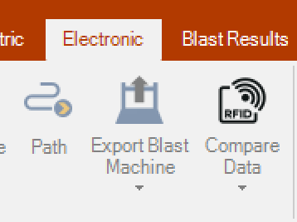
O-Pitblast –Electronic detonators (Davey Bickford)
This option allows the user to prepare the path that it will be made by the PU.
The pattern can have multiple path or just one.
Note: don’t forget to time ALL holes or you won’t be able to export to the blast machine.

Slide 3
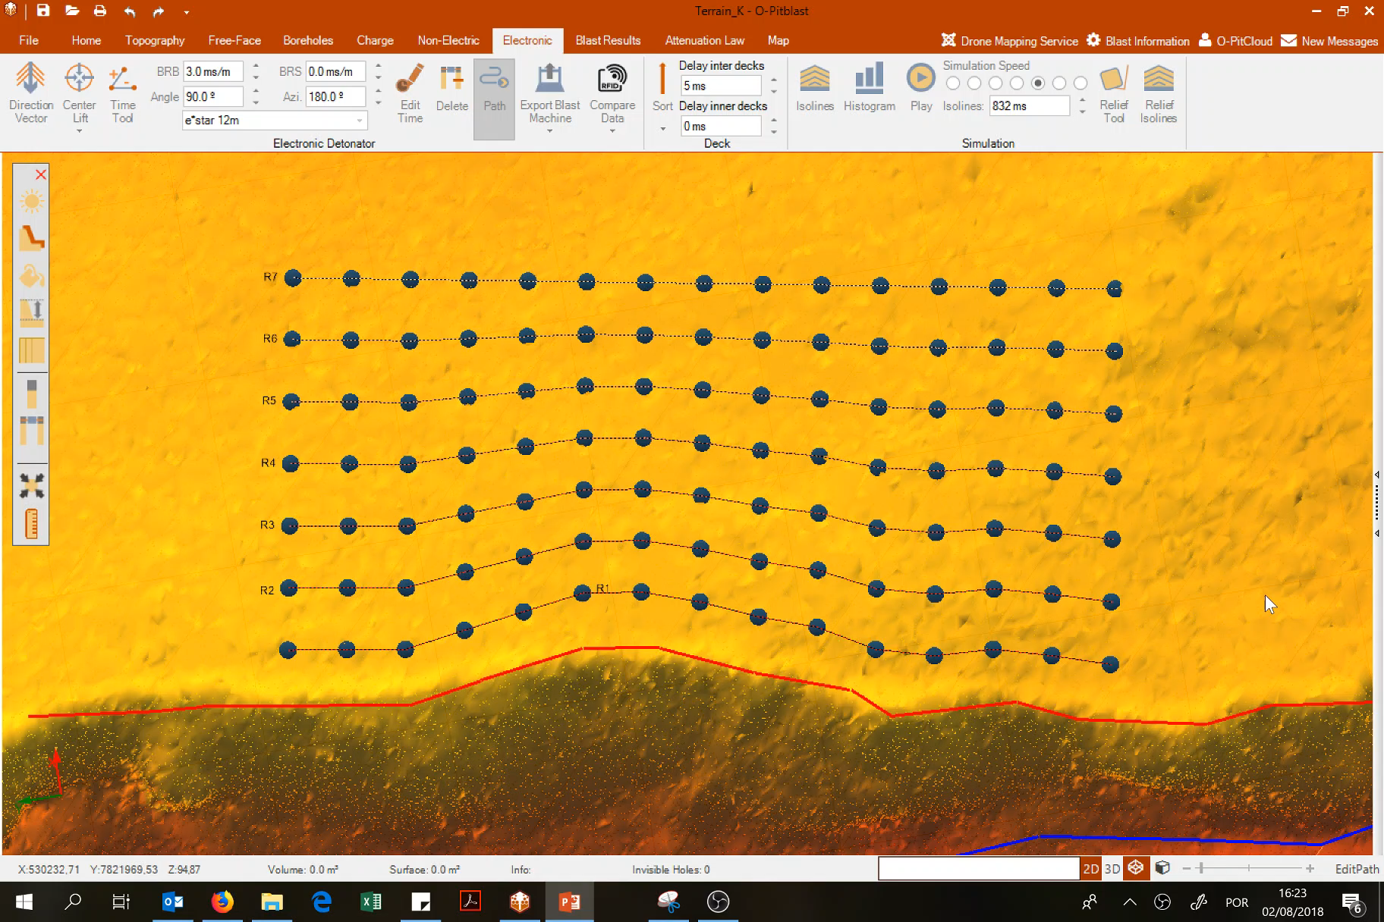
O-Pitblast –Electronic detonators (Davey Bickford)
To delete just right click on the first hole where the path was wrong!

Slide 4
O-Pitblast –Electronic detonators (Davey Bickford)
This option will alllow the user to export the paths to one or more PU’s.
Also it can save .rhd files (blast plan with the path).

Slide 5
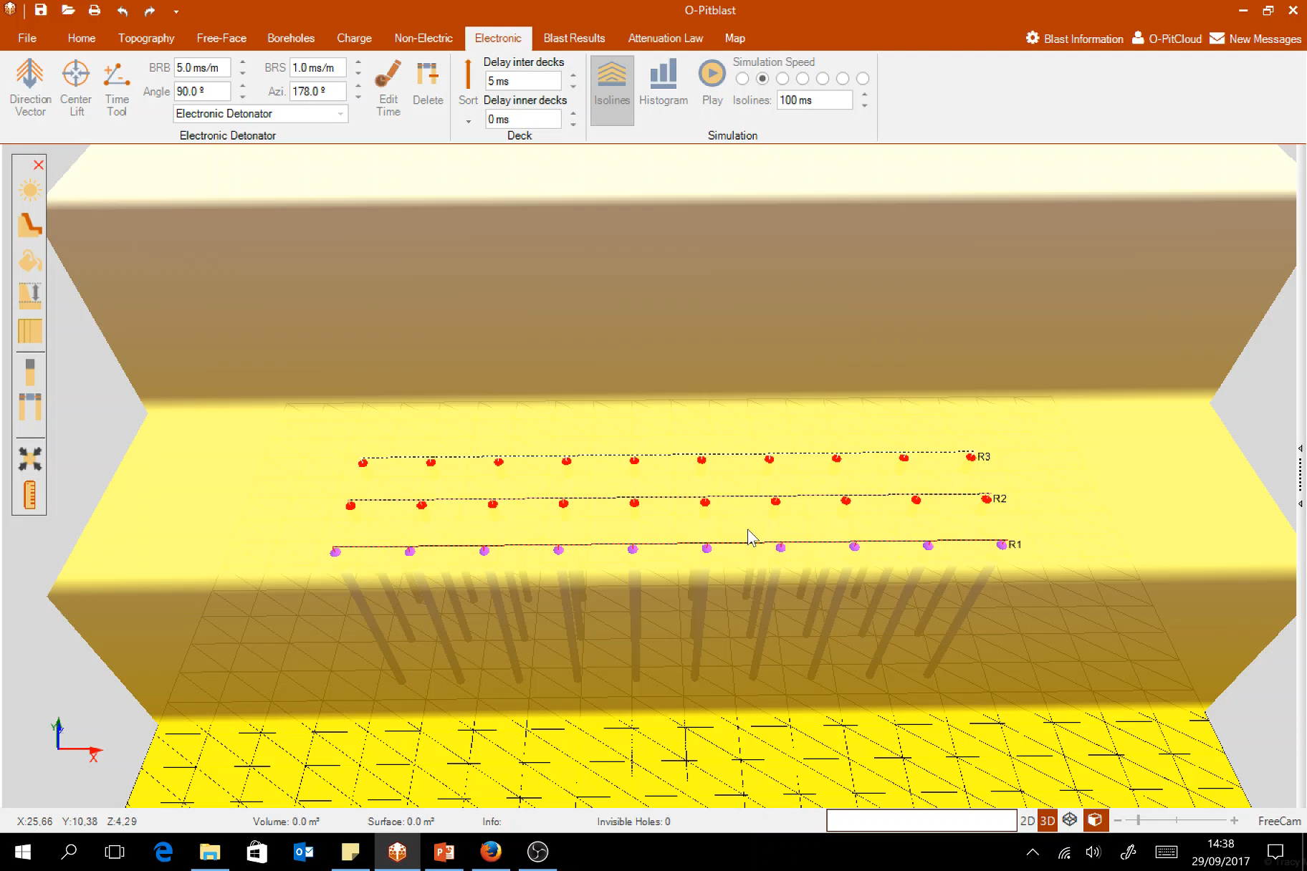
O-Pitblast –Electronic detonators (Davey Bickford)
Export File

Slide 6
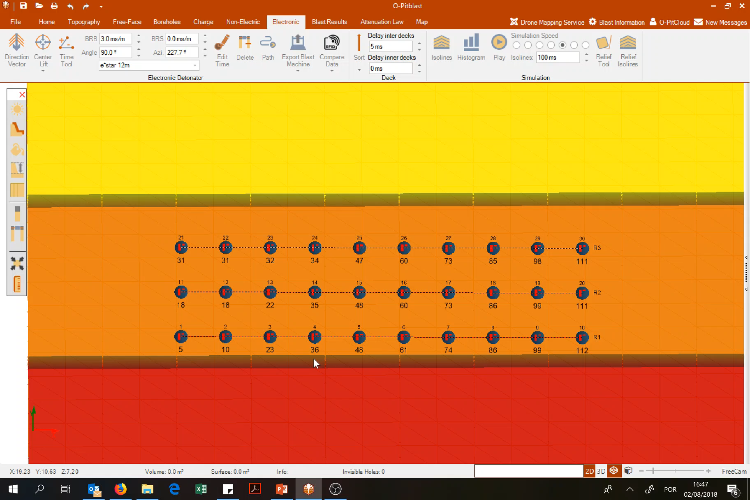
O-Pitblast –Electronic detonators (Davey Bickford)
Export to PU (don’t Forget to connect your PU)

Slide 7
O-Pitblast –Electronic detonators (Davey Bickford)
This option allows the user to:
Transfer the timing inside PU to the timing on O-Pitblast
Transfer the timing on O-Pitblast and Update the timing in the PU

Slide 8
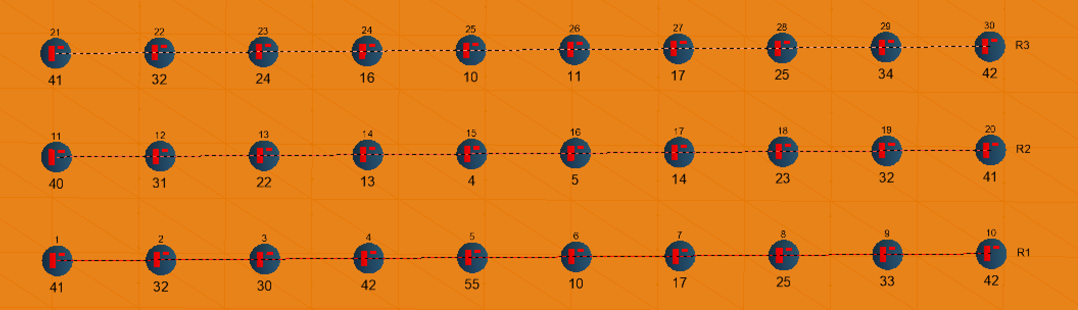
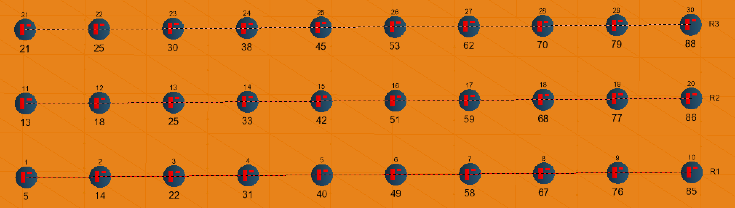
O-Pitblast –Electronic detonators (Davey Bickford)
PU TO COMPUTER
Inside of the PU you have the previous information
Click on the button “PU to computer” to transfer the timing of the PU to O-Pitbast
Timing inside of PU
Timing on O-Pitblast that you want to transfer to the PU

Slide 9
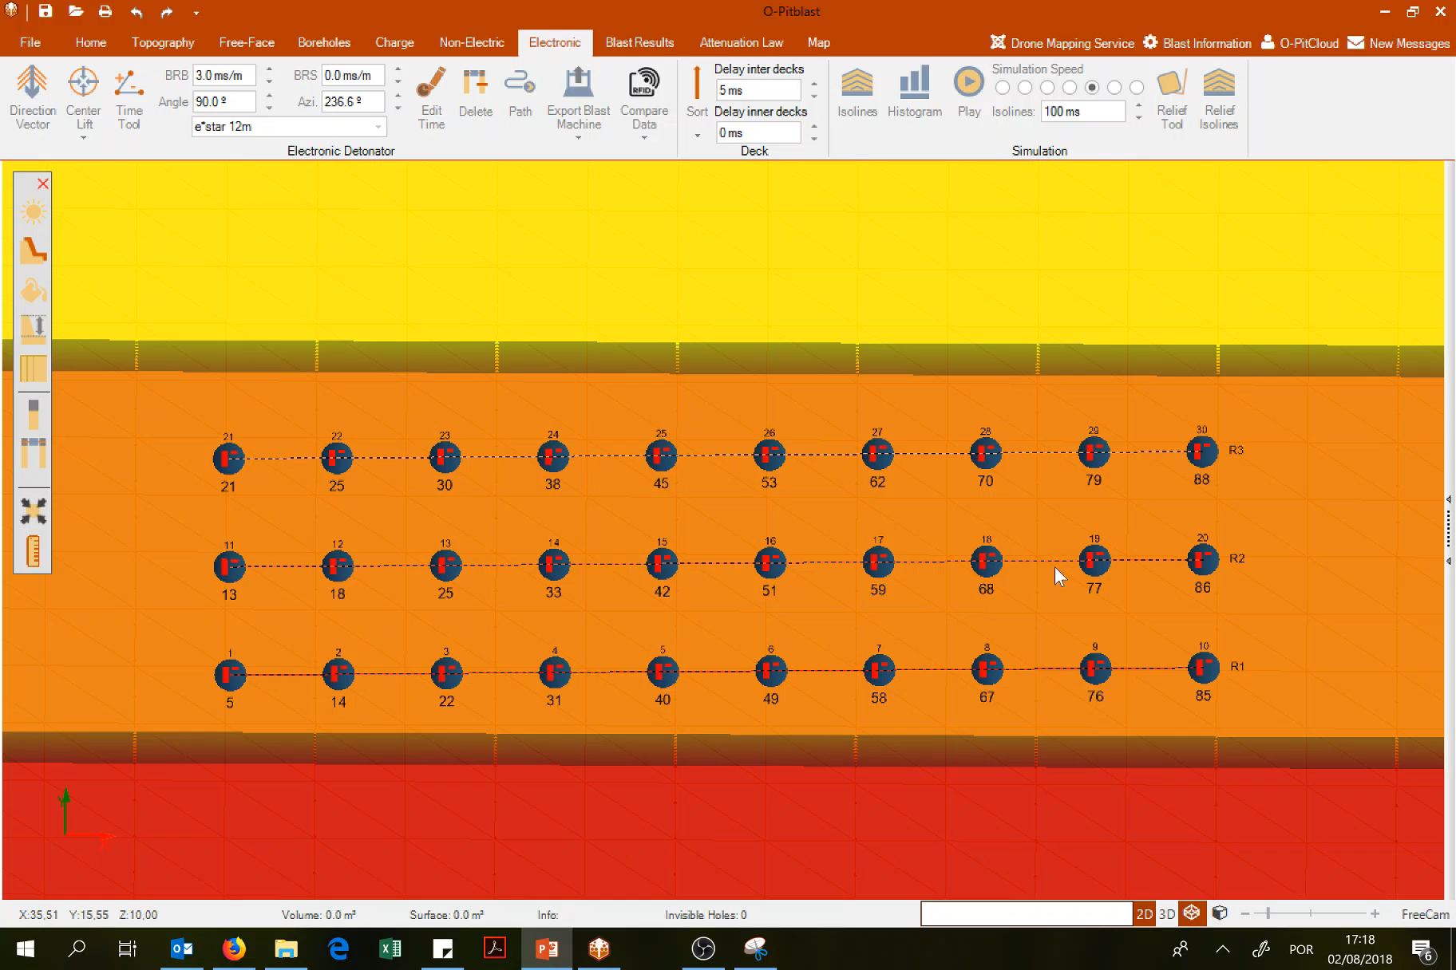
O-Pitblast –Electronic detonators (Davey Bickford)
PU TO COMPUTER

Slide 10
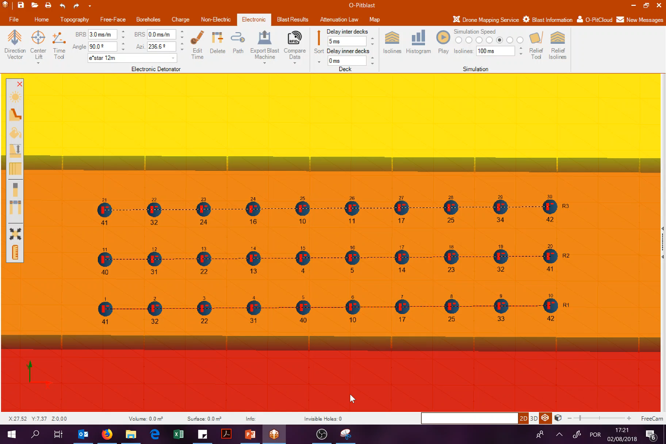
O-Pitblast –Electronic detonators (Davey Bickford)
Update timing in the PU after it’s programmed
Click on the button ”Intented to be programed”
Click on the button “Update PU”

Slide 11
Technical Support
Phone: +351 918 558 879
E-mail: support@o-pitblast.com

