Slide 1

O-Pitblast – Blast Results Module

Slide 2
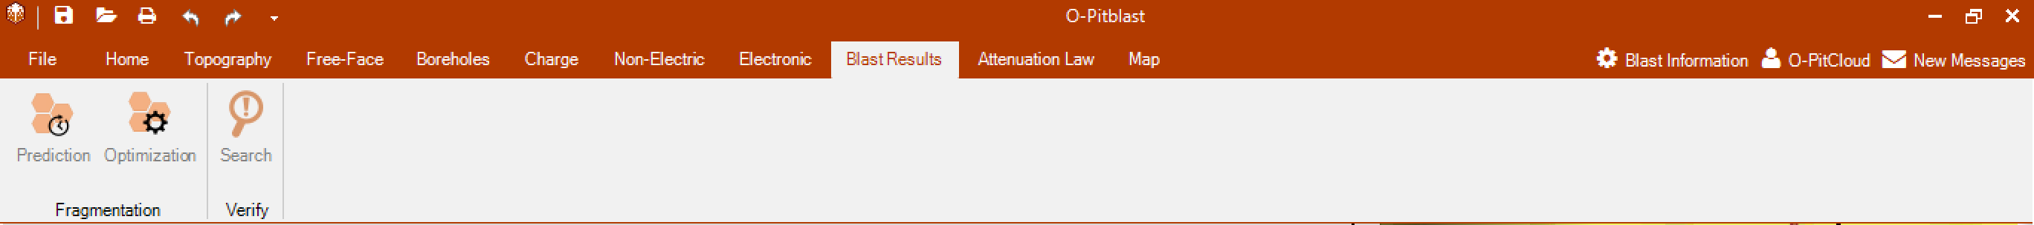
O-Pitblast – Blast Results Module

Slide 3

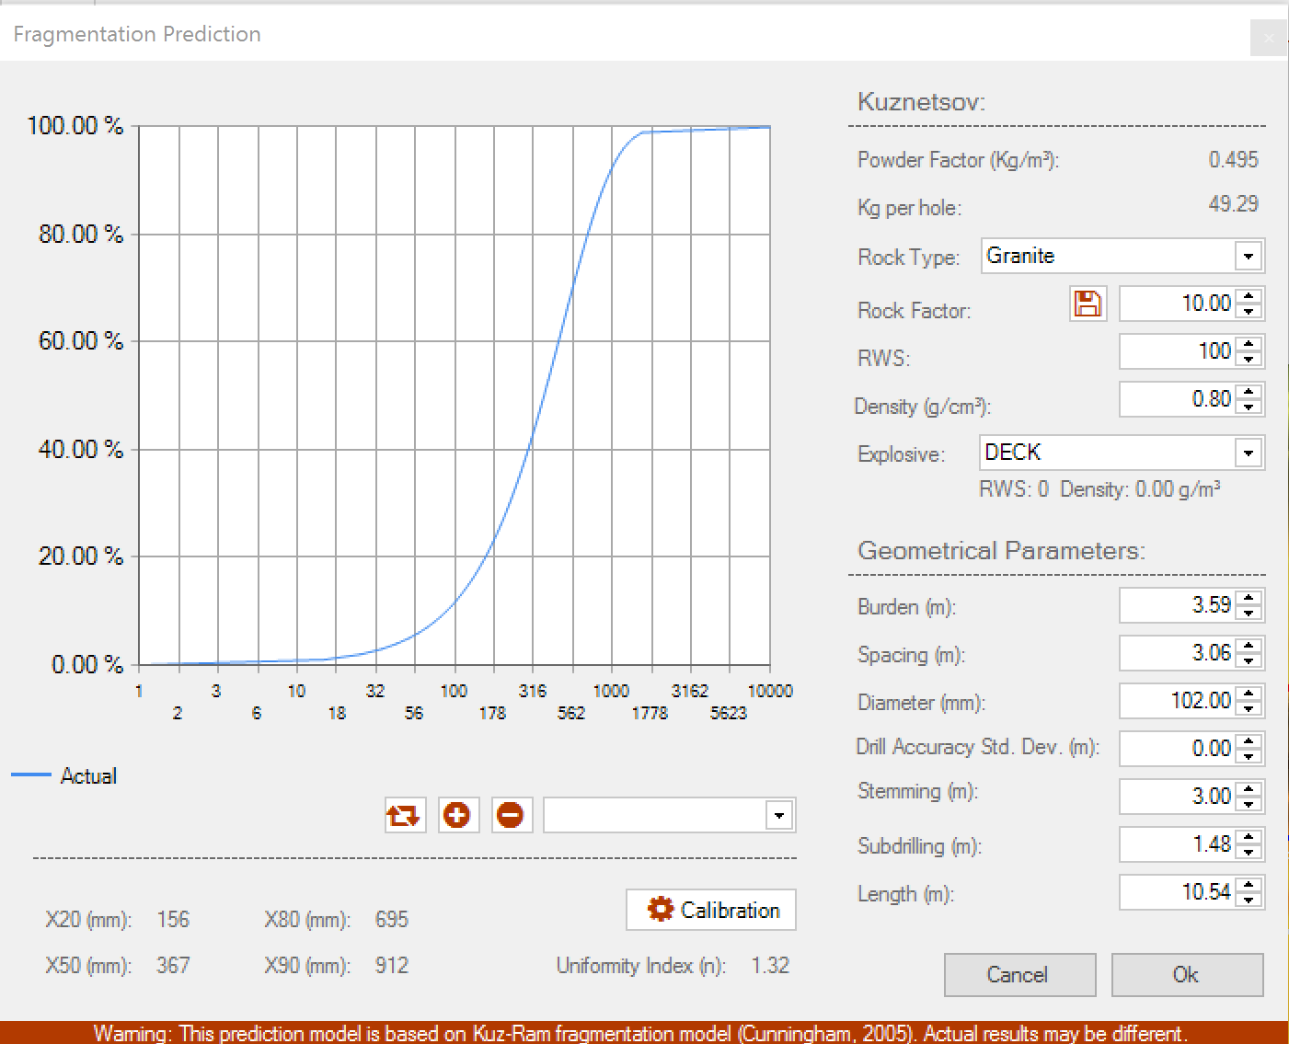
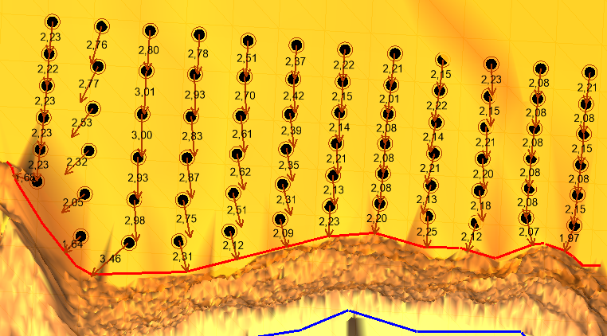
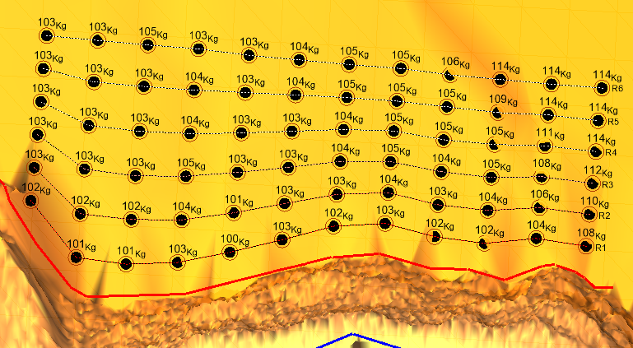
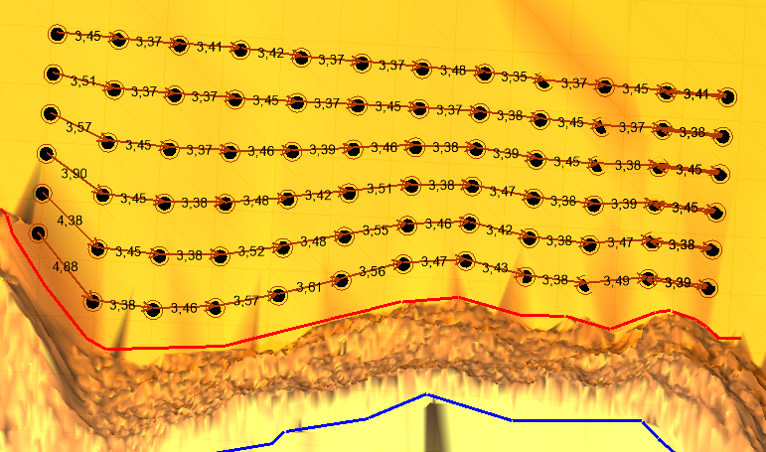
O-Pitblast – Blast Results Module
*. Pattern Timing_3
Critical Fuctions:
Charge
- Line definition
Prediction

Slide 4
O-Pitblast – Blast Results Module
*. Pattern Timing_3
Prediction
Actual/Selected fragmentation curve results

Slide 5
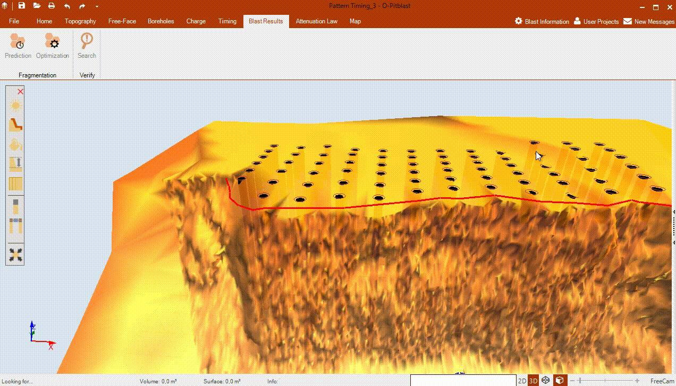
O-Pitblast – Blast Results Module
*. Pattern Timing_3
Prediction

Slide 6
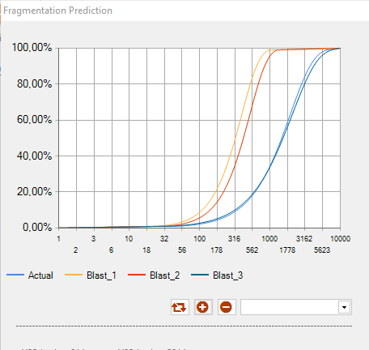
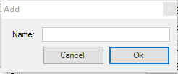
O-Pitblast – Blast Results Module
*. Pattern Timing_3
Adjustable Values
Reset Values:
Average of the actual data from project
Prediction
Reset
Add

Slide 7
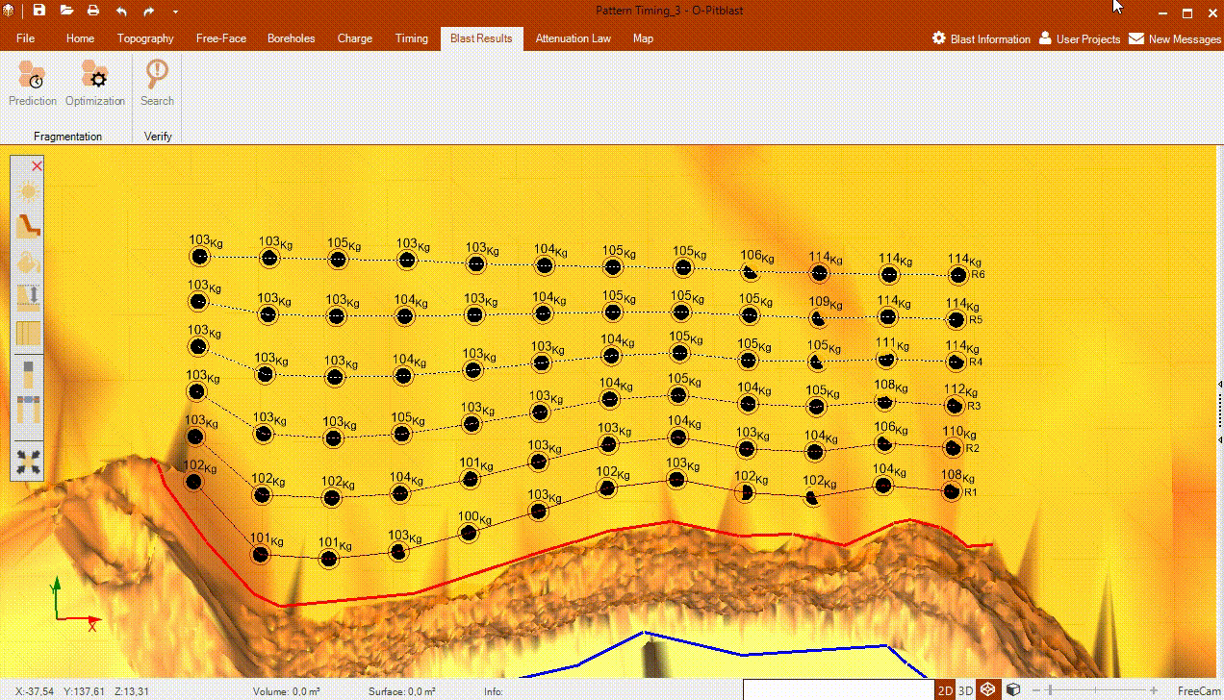
O-Pitblast – Blast Results Module
*. Pattern Timing_3
Prediction

Slide 8

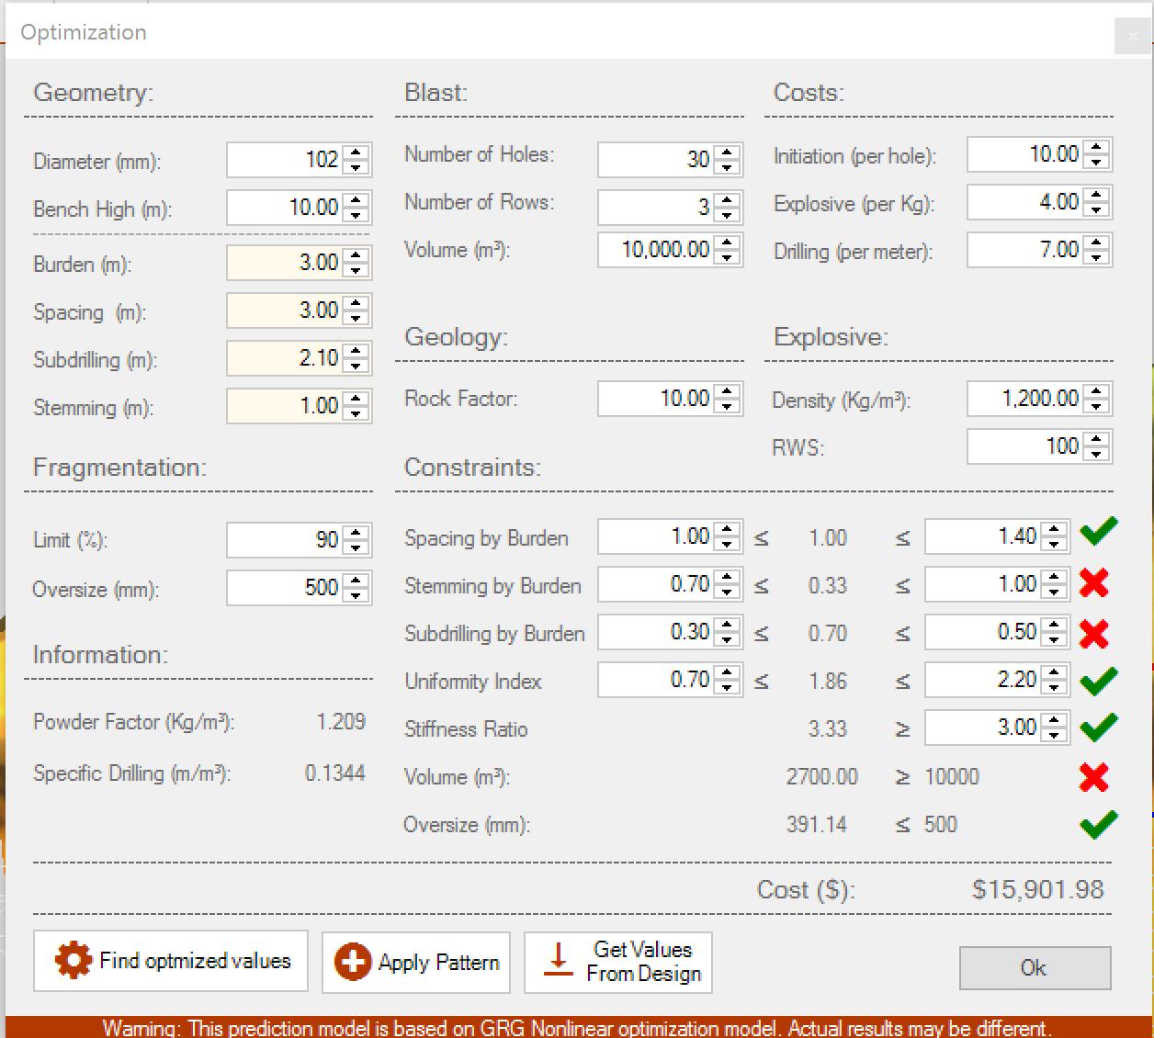
O-Pitblast – Blast Results Module
*. Pattern Timing_3
Optimization
Input Information
Project Data
Fragmentation Constraints
Geometry Constraints
Addcional information
Cost Information

Slide 9
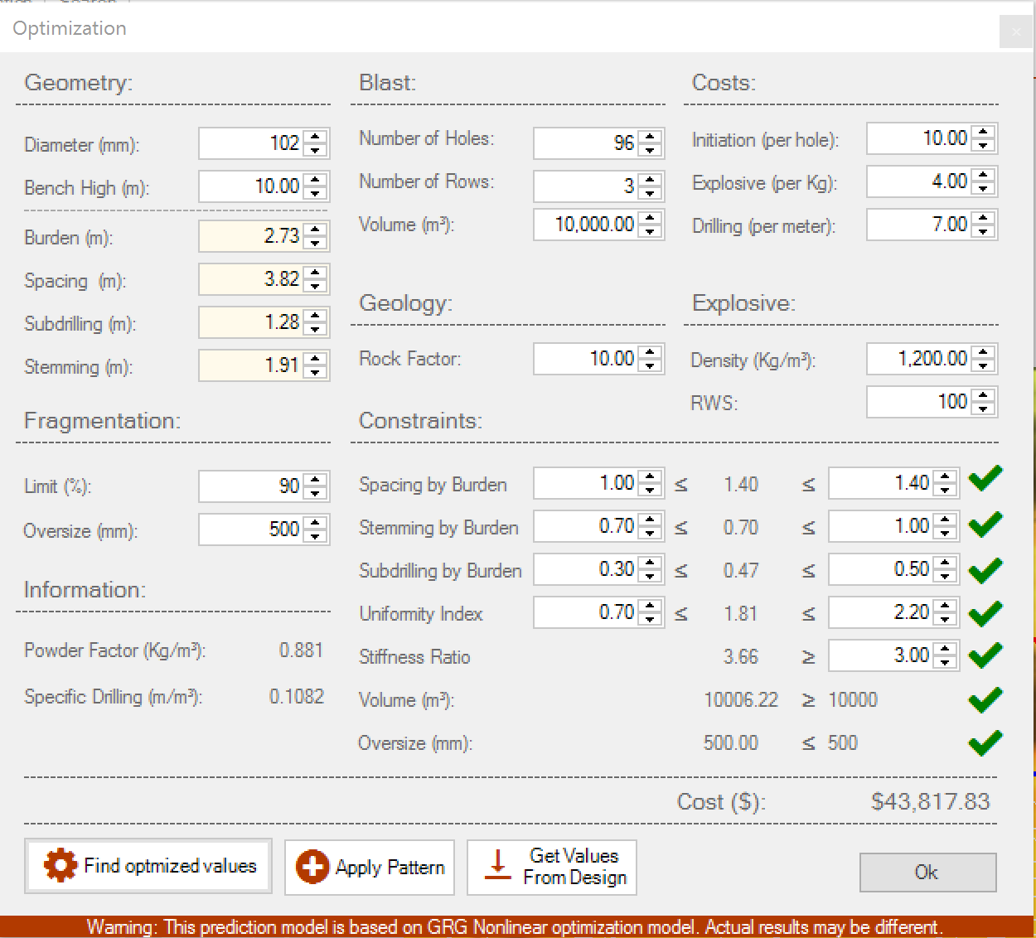
O-Pitblast – Blast Results Module
*. Pattern Timing_3
Optimization

Slide 10
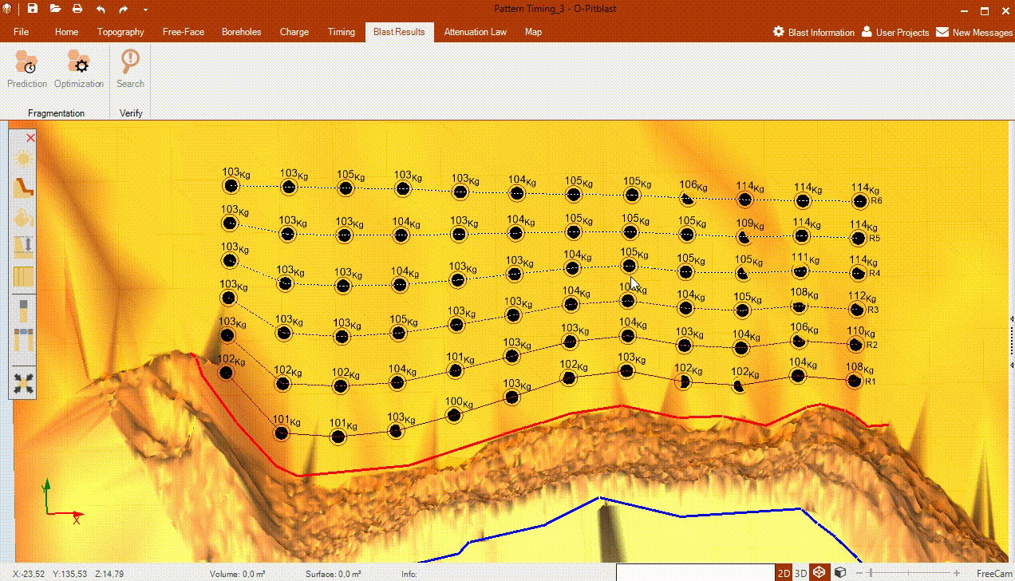
O-Pitblast – Blast Results Module
*. Pattern Timing_3
Optimization

Slide 11
O-Pitblast – Blast Results Module
*. Pattern Timing_3

Slide 12
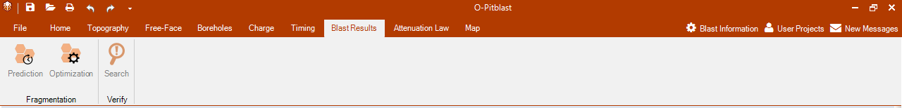
O-Pitblast – Blast Results Module
*. Pattern Timing_3
Analyse Blast Geometry (average data control)
Geology data
Explosive usage

Slide 13
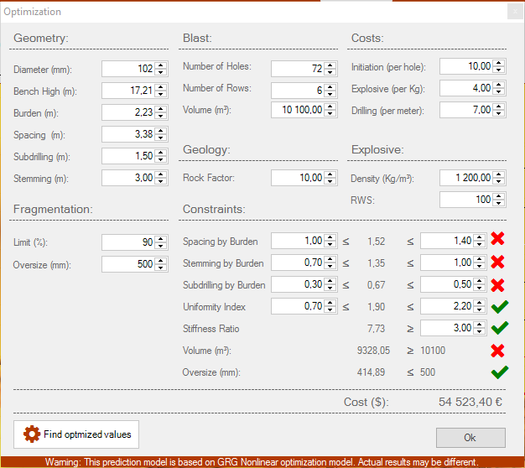
O-Pitblast – Blast Results Module
*. Pattern Timing_3
Define P(X)
Define size

Slide 14
O-Pitblast – Blast Results Module
*. Pattern Timing_3
Blast Design abnormal
Fragmentation under the oversize limit

Slide 15
O-Pitblast – Blast Results Module
*. Pattern Timing_3
Cost Information

Slide 16
O-Pitblast – Blast Results Module
*. Pattern Timing_3

Slide 17
O-Pitblast – Blast Results Module
*. Pattern Timing_3
Reset the inicial values
Applys new patter with the new values
Compare Information

Slide 18
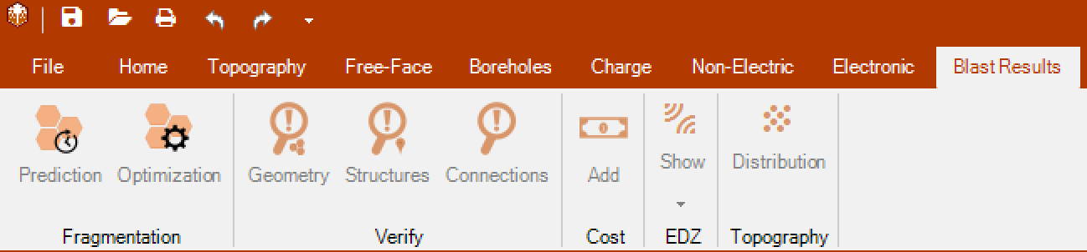

O-Pitblast – Blast Results Module
You can search for:
Geometry problems: burden, spacing, subdrilling, steming, etc;
Structures problems: Vibration problems, high MIC influencing the PVV, etc;
Connection problems: lenght of the conector, type of conector, etc

Slide 19

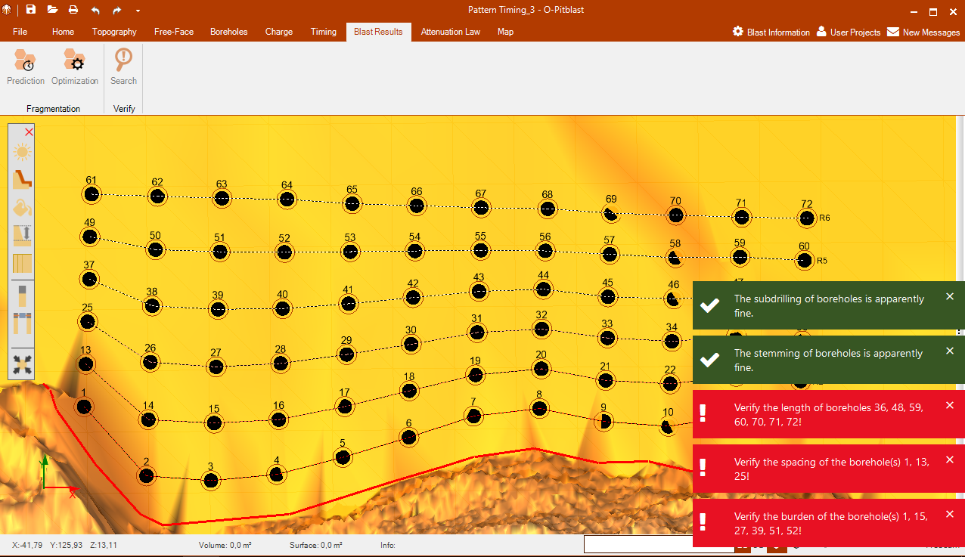

O-Pitblast – Blast Results Module
*. Pattern Timing_3
Search

Slide 20
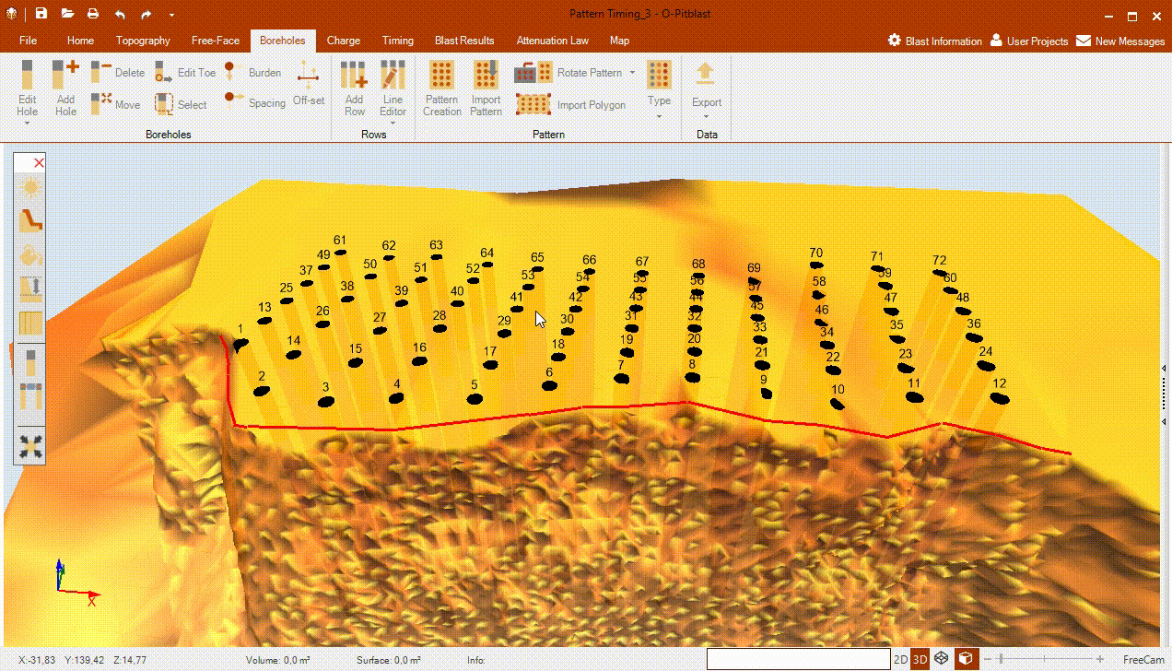
O-Pitblast – Blast Results Module
*. Pattern Timing_3
Search

Slide 21
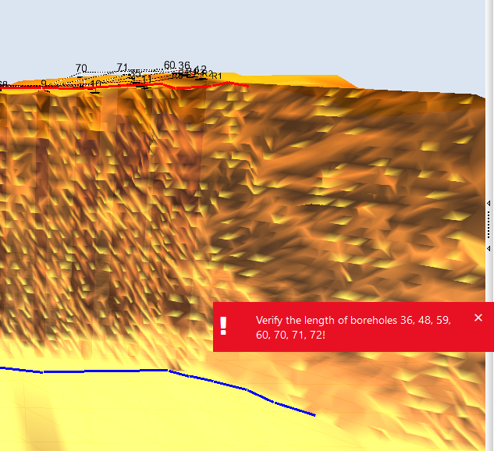
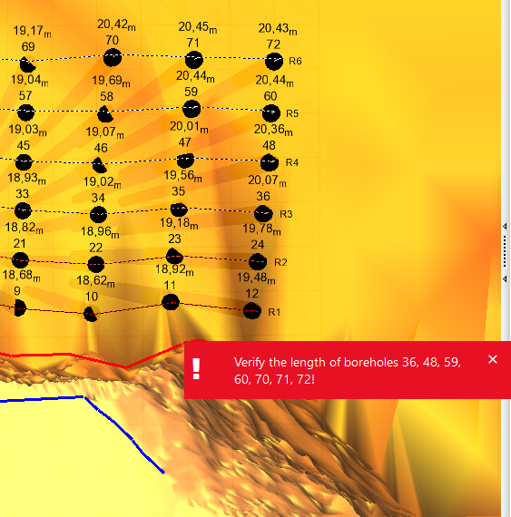
O-Pitblast – Blast Results Module
*. Pattern Timing_3
Search

Slide 22
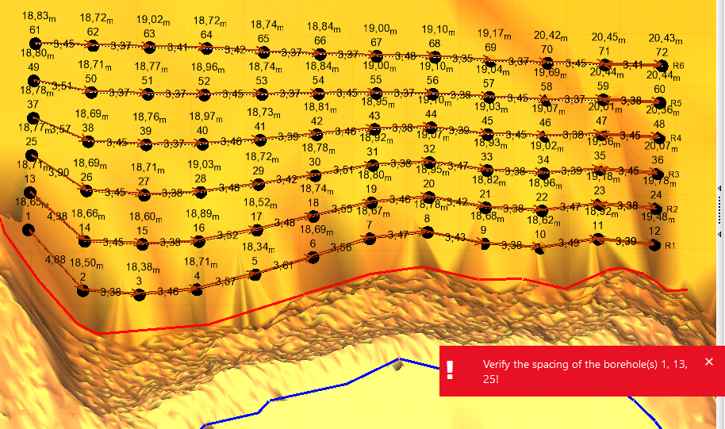
O-Pitblast – Blast Results Module
*. Pattern Timing_3
Search

Slide 23
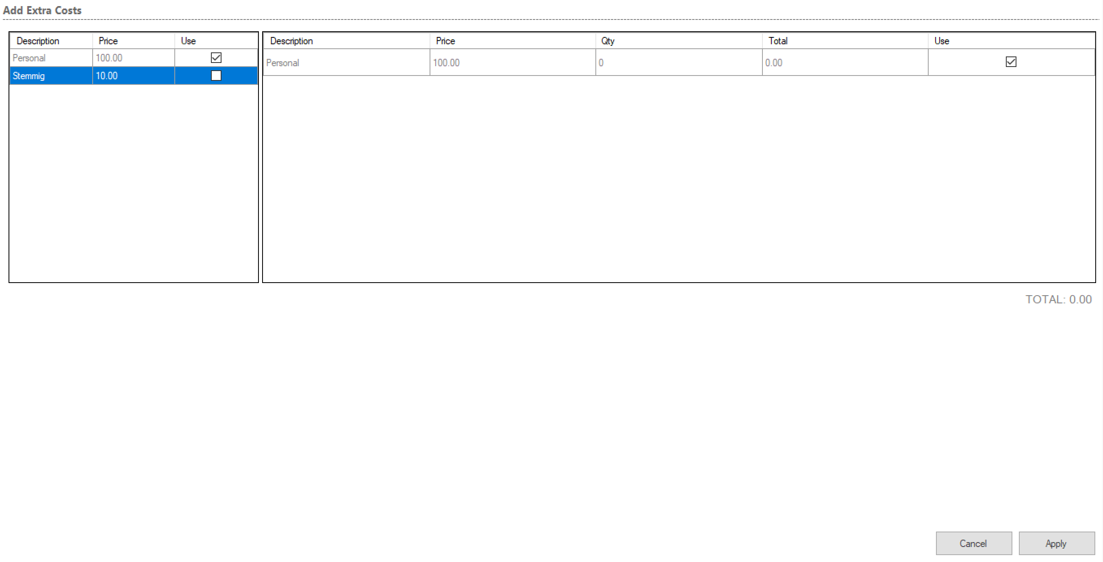
O-Pitblast – Blast Results Module
You can add extra costs to your blast here.
Choose the quantity that you want to add1
Choose the costs you want to add
And apply changes

Slide 24
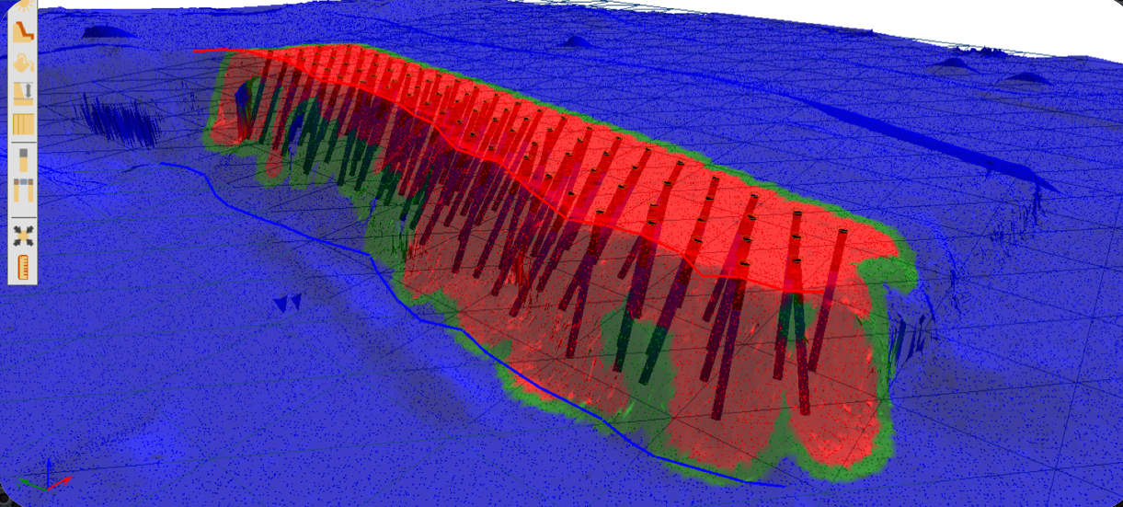
O-Pitblast – Blast Results Module
This option allows you to see your pattern geometry distribution. The red part tell us that you have a bad distribution (inclination of the holes, burden, stemming, etc.)

Slide 25
Technical Support
Phone: +351 918 558 879
E-mail: support@o-pitblast.com

