Slide 1

O-Pitblast – General Information Module

Slide 2
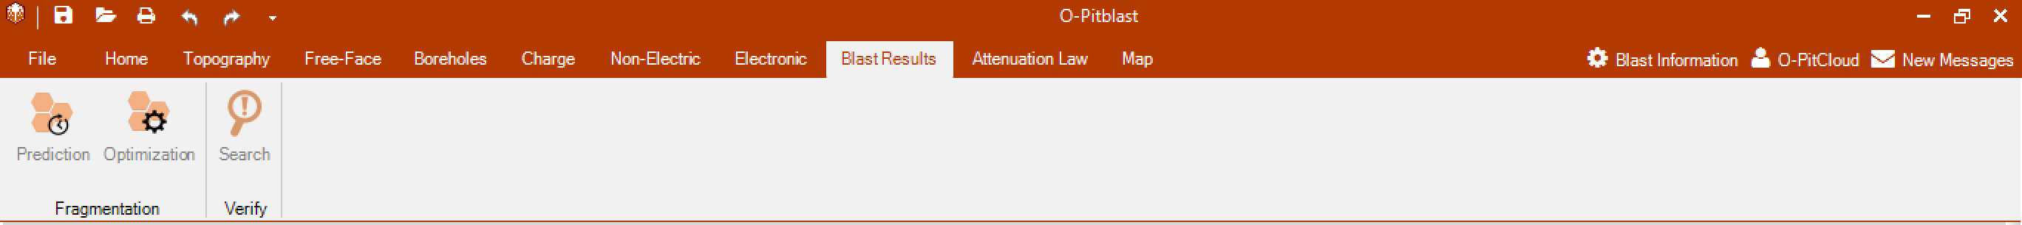
O-Pitblast – Vibration Module

Slide 3
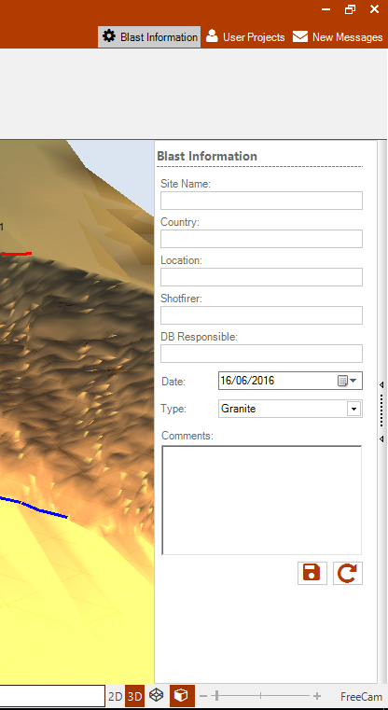
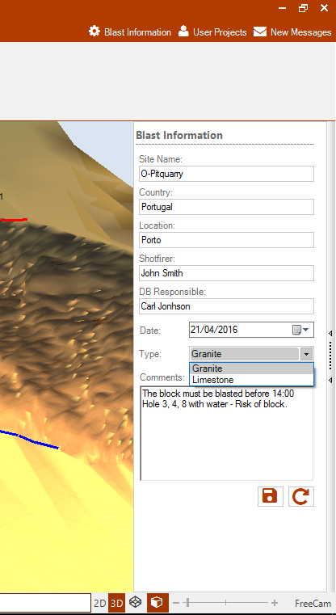
O-Pitblast – Blast Information
Save Information
Reset Information

Slide 4
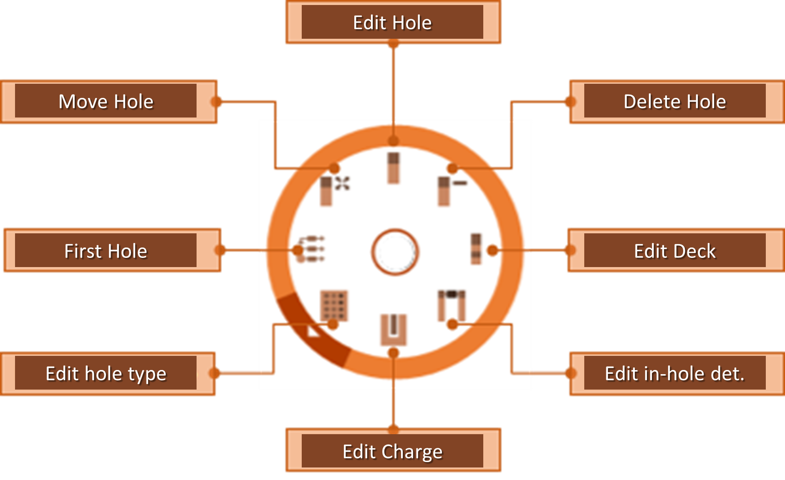

O-Pitblast – Radial Menu
+ Hole

Slide 5
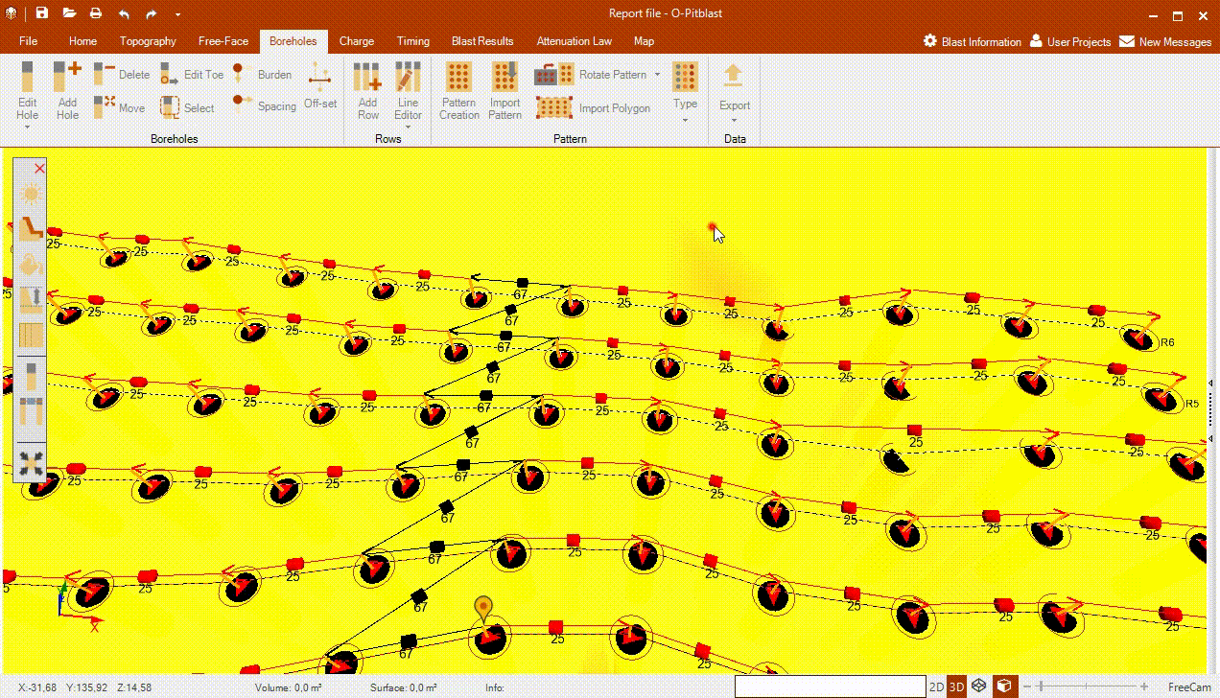
O-Pitblast – Radial Menu
+ Hole

Slide 6

O-Pitblast – File Section

Slide 7
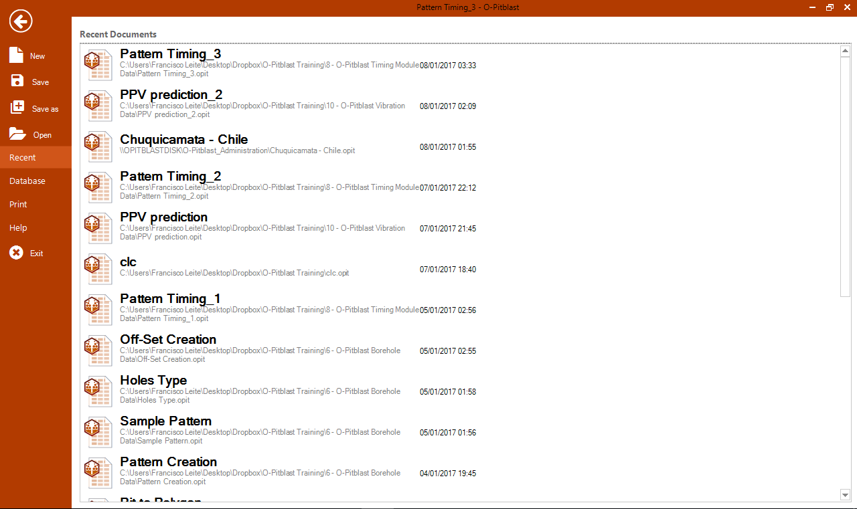
O-Pitblast – File Section
Open recent files
Save Information
Reset Information

Slide 8
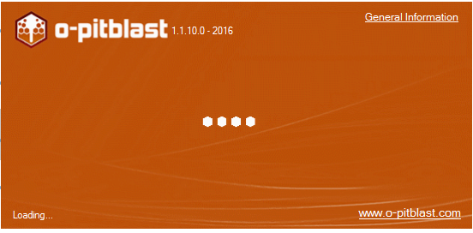
O-Pitblast – File Section
New O-Pitblast session

Slide 9
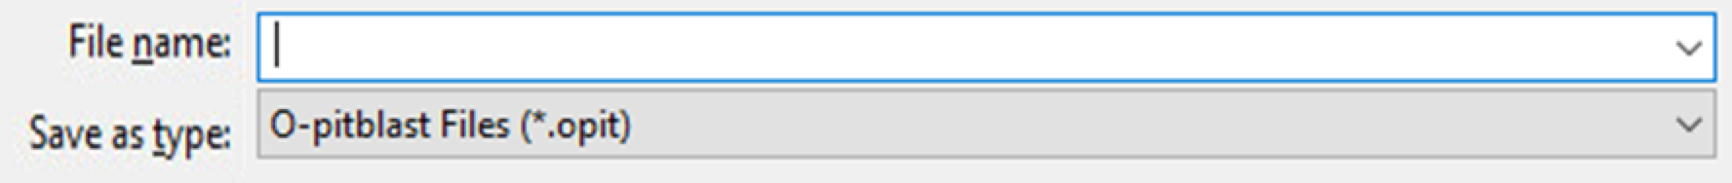

O-Pitblast – File Section
Save/Save as
Open .opit file
Exit O-Pitblast

Slide 10
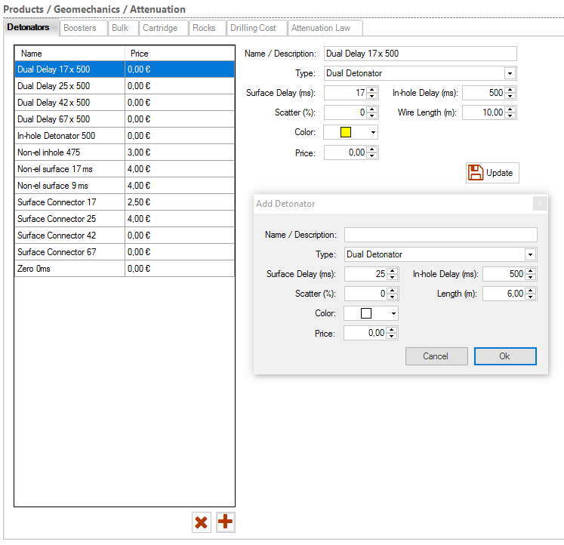
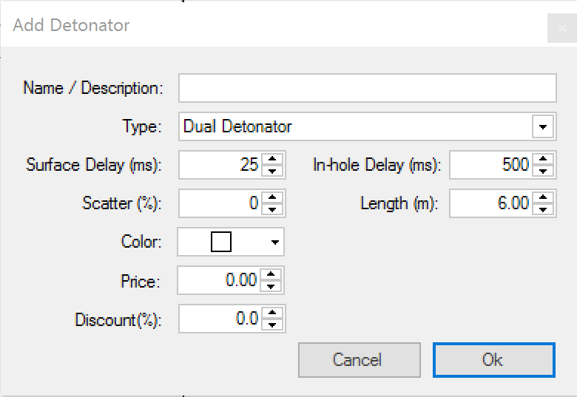
O-Pitblast – File Section
Update an existing Element
Delete Element
Add Element

Slide 11
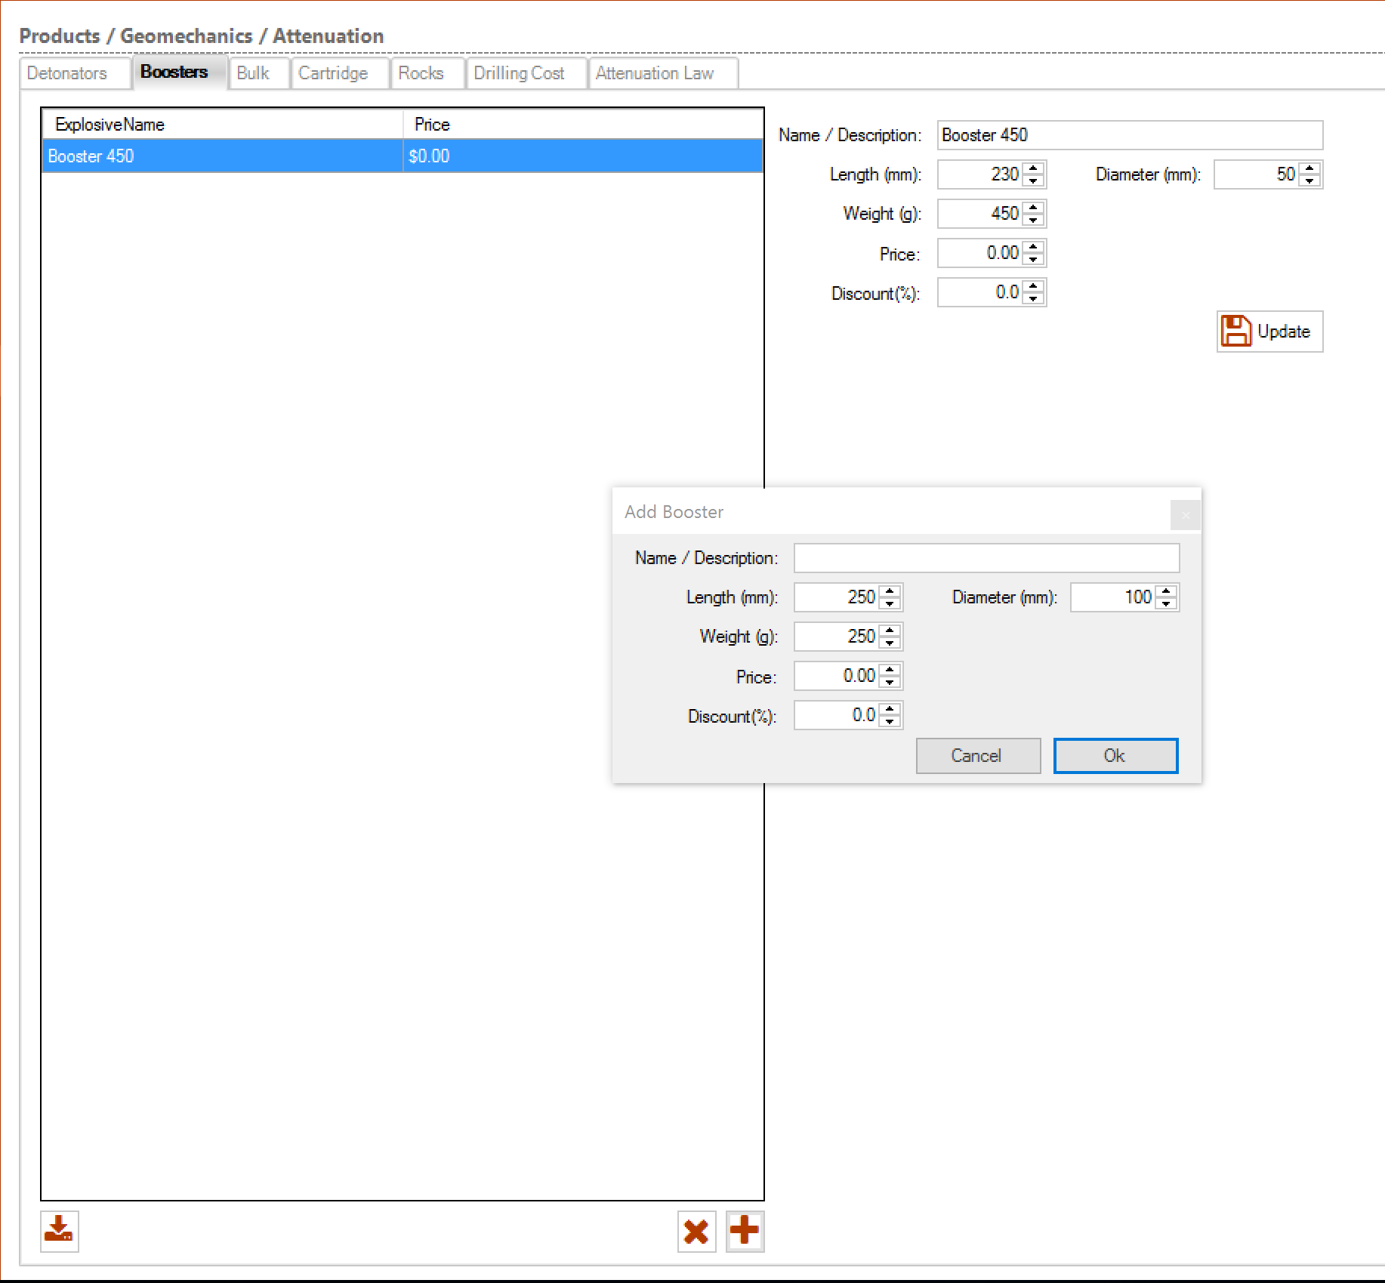
O-Pitblast – File Section
Update an existing Element
Delete Element
Add Element

Slide 12
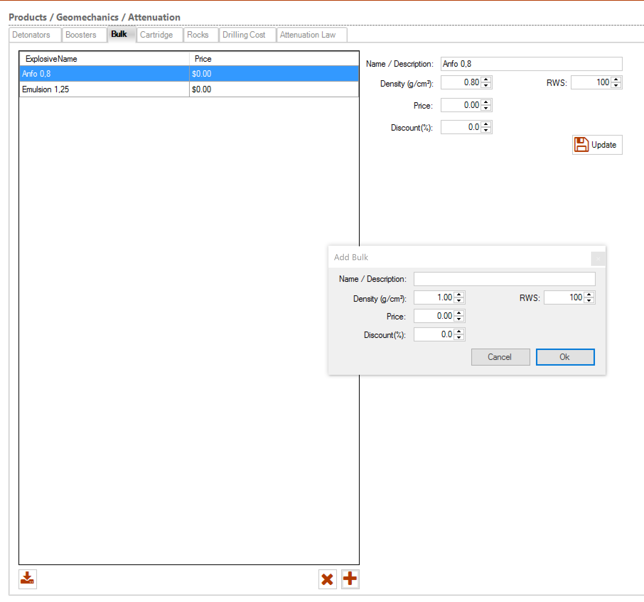
O-Pitblast – File Section
Update an existing Element
Delete Element
Add Element

Slide 13
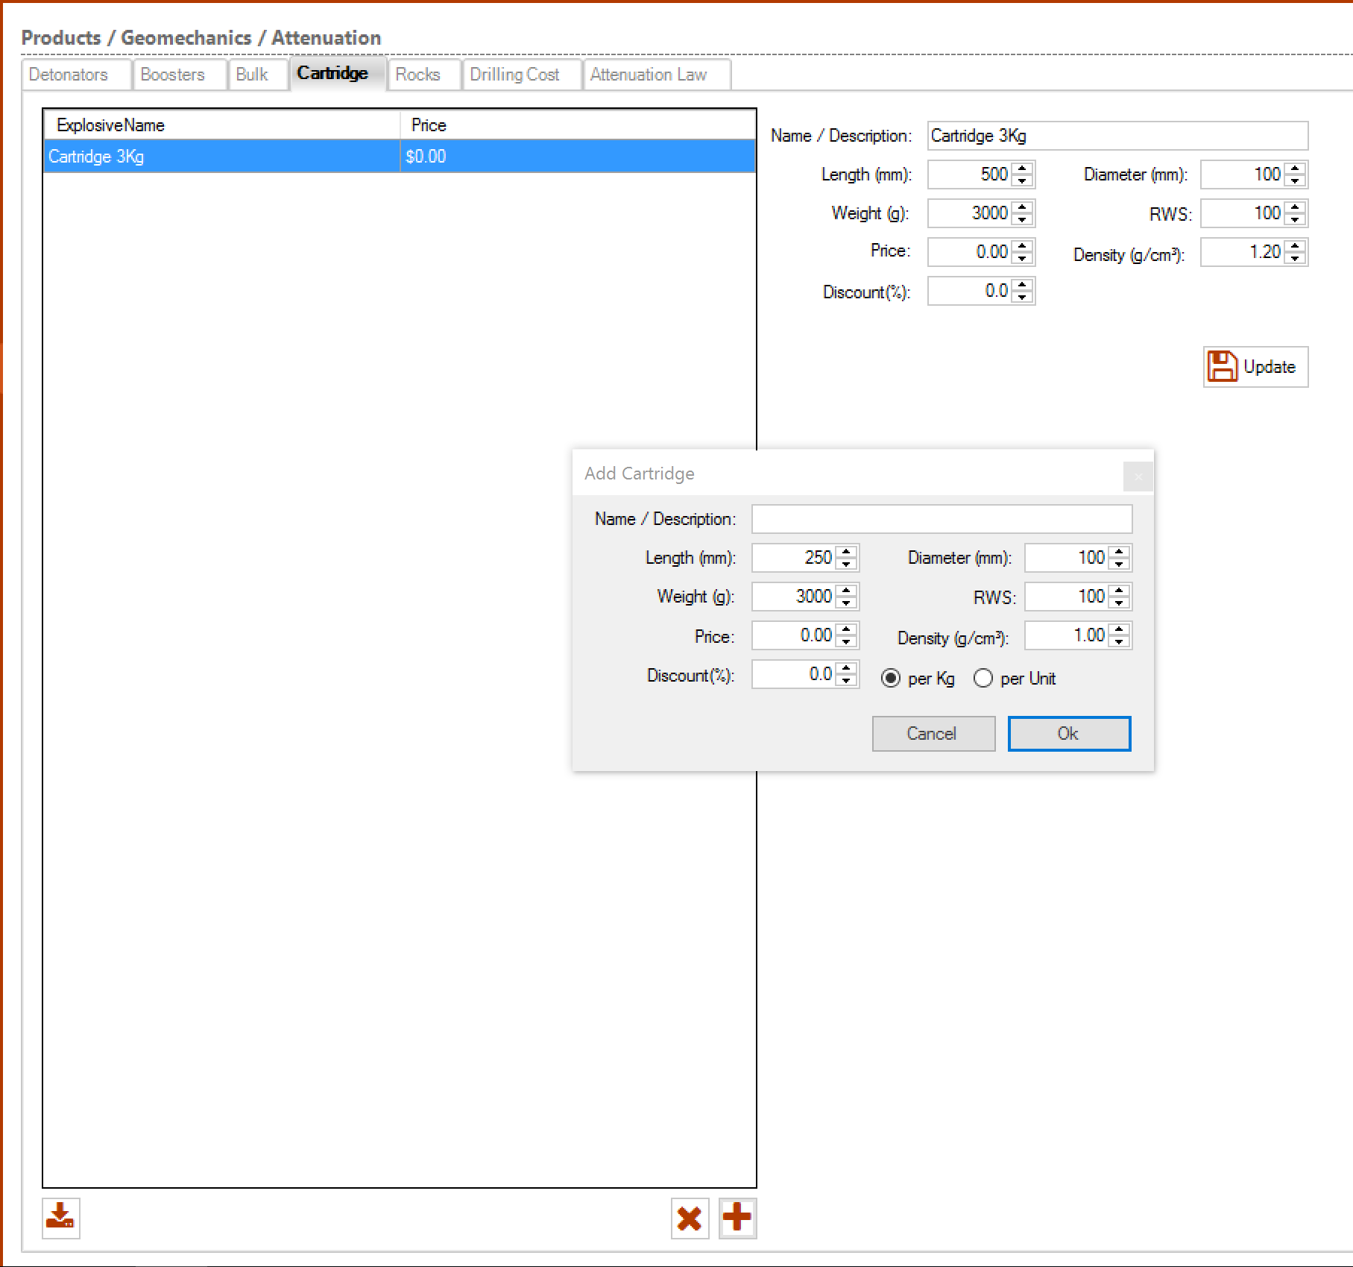
O-Pitblast – File Section
Update an existing Element
Delete Element
Add Element

Slide 14
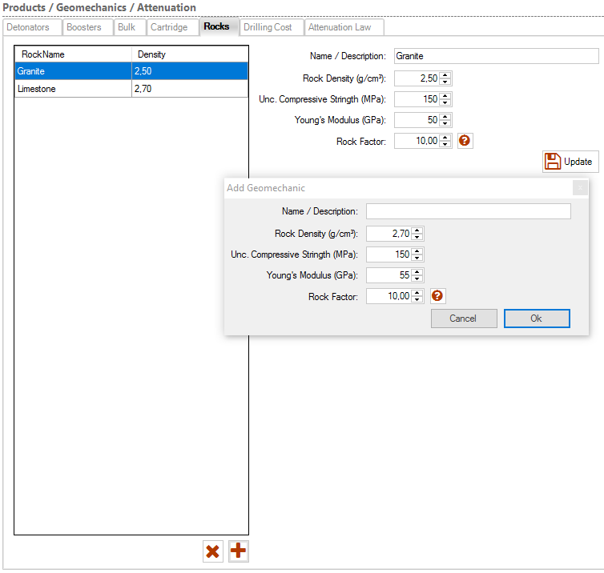
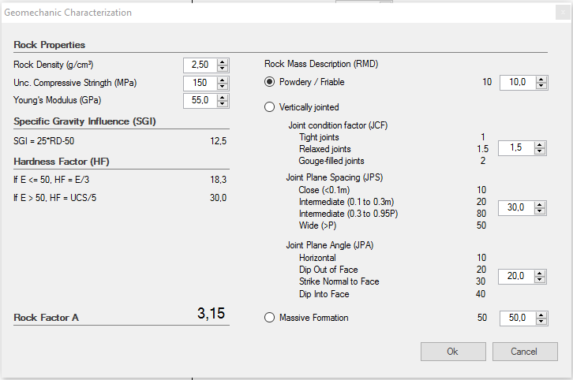
O-Pitblast – File Section
Update an existing Element
Geomechanic Characterization
Delete Element
Add Element

Slide 15
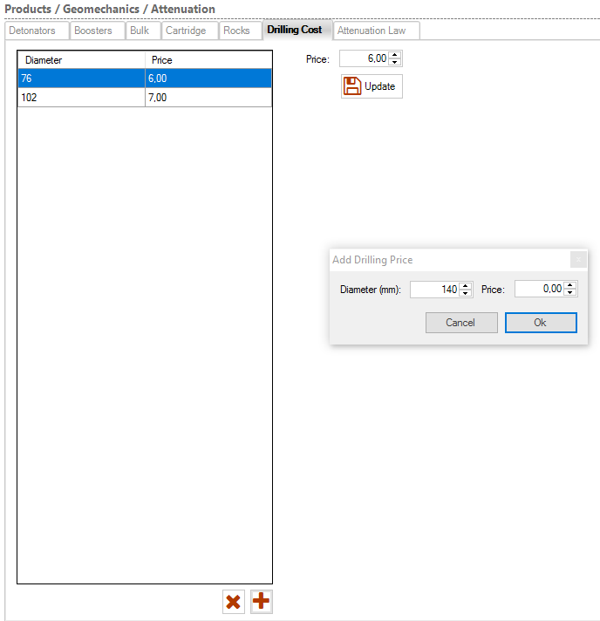
O-Pitblast – File Section
Update an existing Element
Delete Element
Add Element

Slide 16
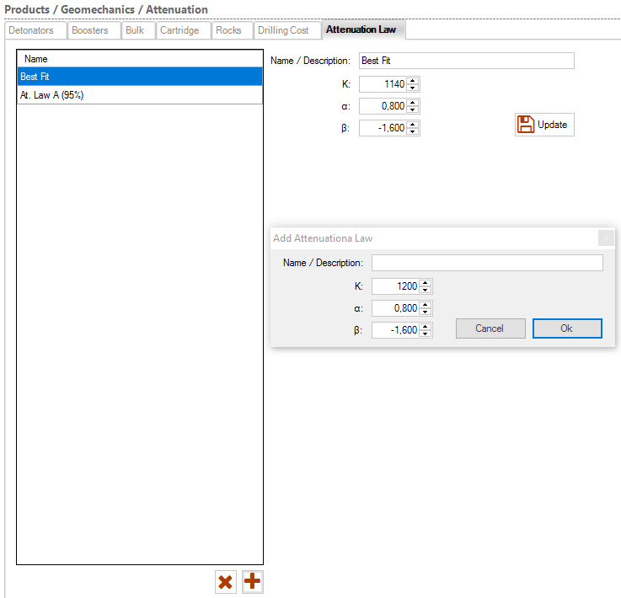
O-Pitblast – File Section
Update an existing Element
Delete Element
Add Element

Slide 17
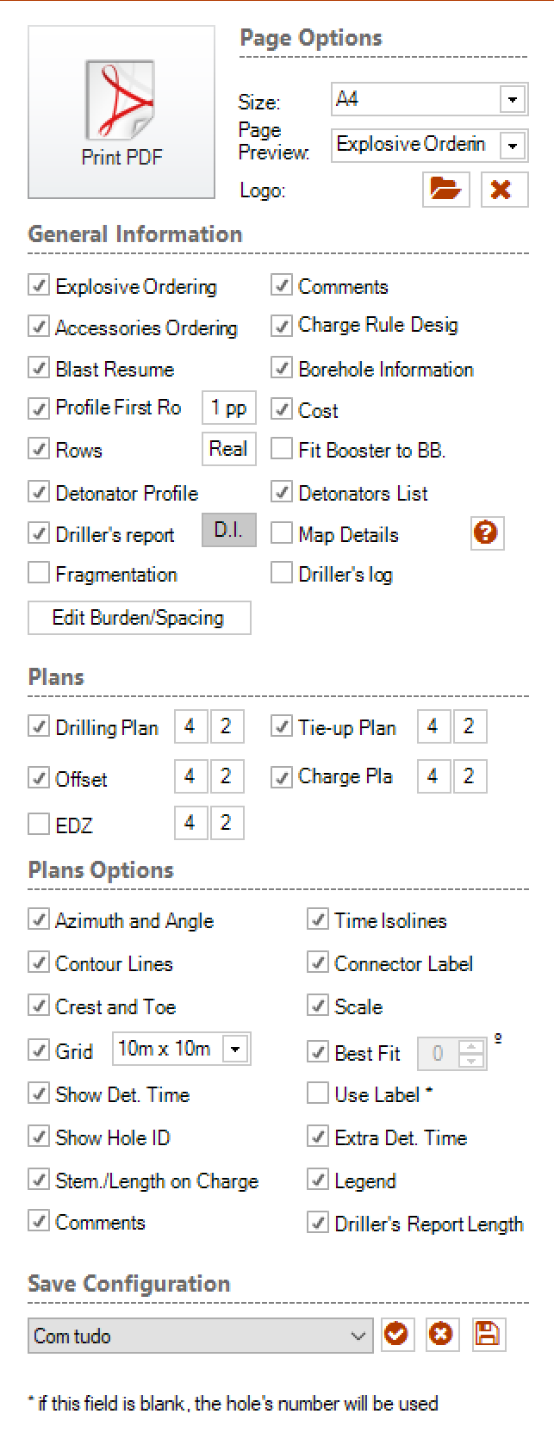
O-Pitblast – File Section
Select page Size
Preview page
Company Logo
Selection of General Information
Selection of Plan Information
Selection of Plan Options
Save your configuration to use in the future

Slide 18
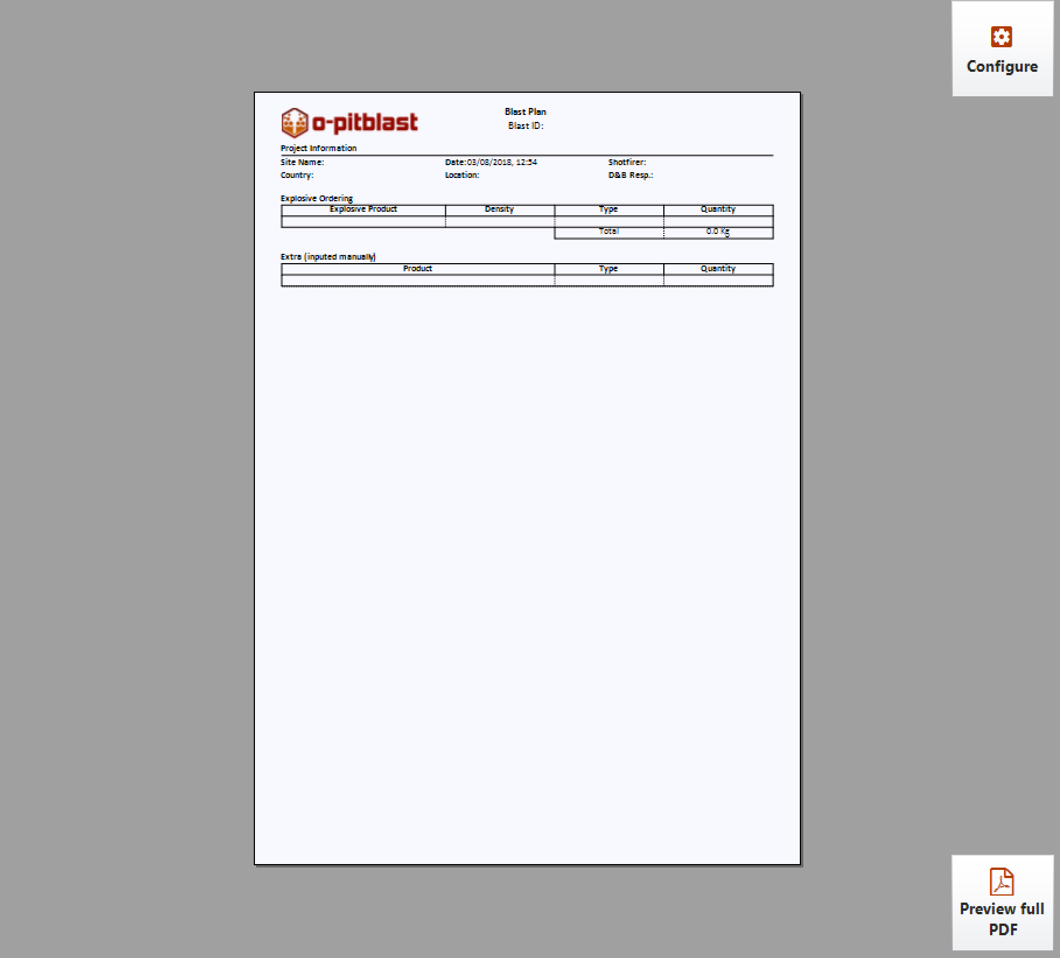
O-Pitblast – File Section
Preview full report

Slide 19
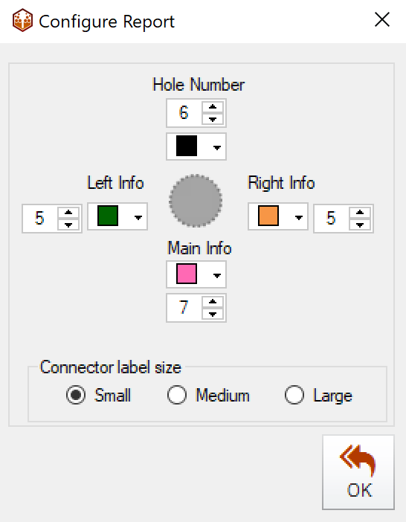
O-Pitblast – File Section
Configure your report

Slide 20
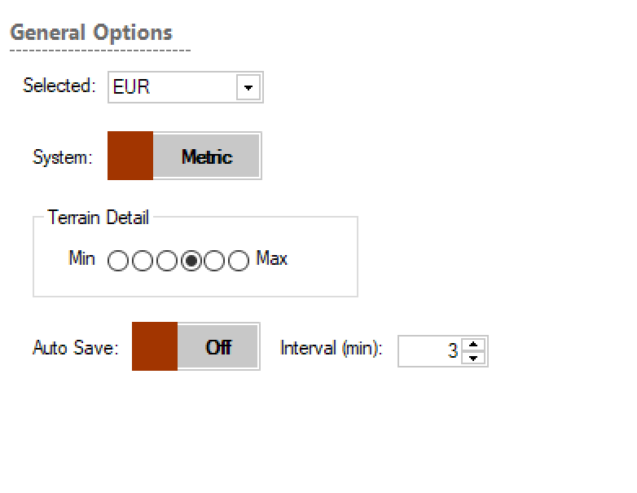
O-Pitblast – File Section
If you don’t want to see all modules you can hide them in “Visible Options”
Change currency
Change metric to imperial and vice-versus
Change the number of points that your terrain will be build
AUTO-SAVE option: if it’s on it will save your work automatically in the interval that the you define

Slide 21
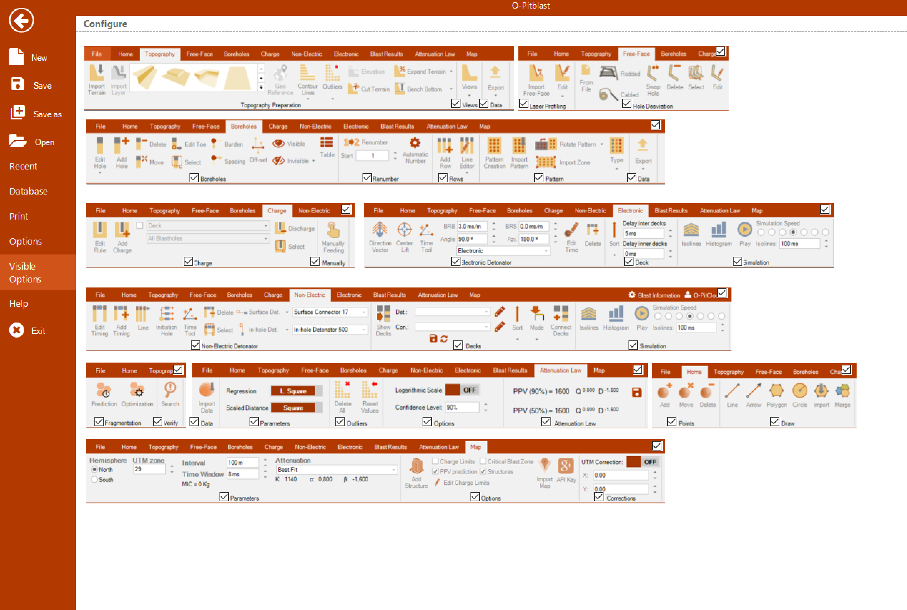
O-Pitblast – File Section
If you don’t want to see all modules you can hide them in “Visible Options”

Slide 22
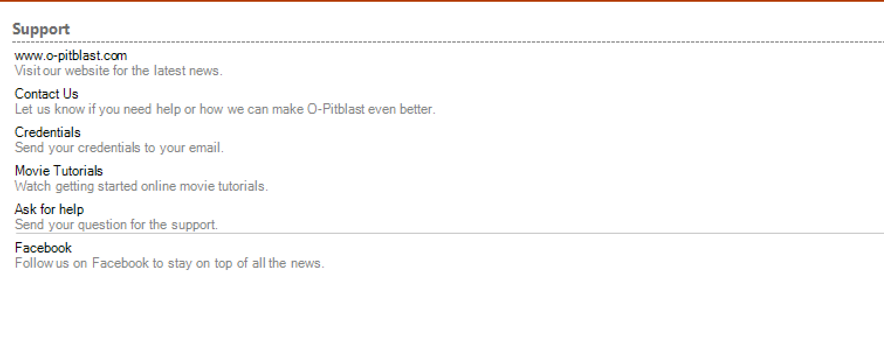
O-Pitblast – File Section
Here you can:
See our website
Contact us
Send your credentials of O-Pitblast to your e-mail
Go to our Youtube page
Ask for help: if O-Pitblast is having any problem just ask for help in this button and attached description and images
Go to our Facebook

Slide 23
Technical Support
Phone: +351 918 558 879
E-mail: support@o-pitblast.com

