Slide 1

O-Pitblast – O-Pitcloud Module

Slide 2
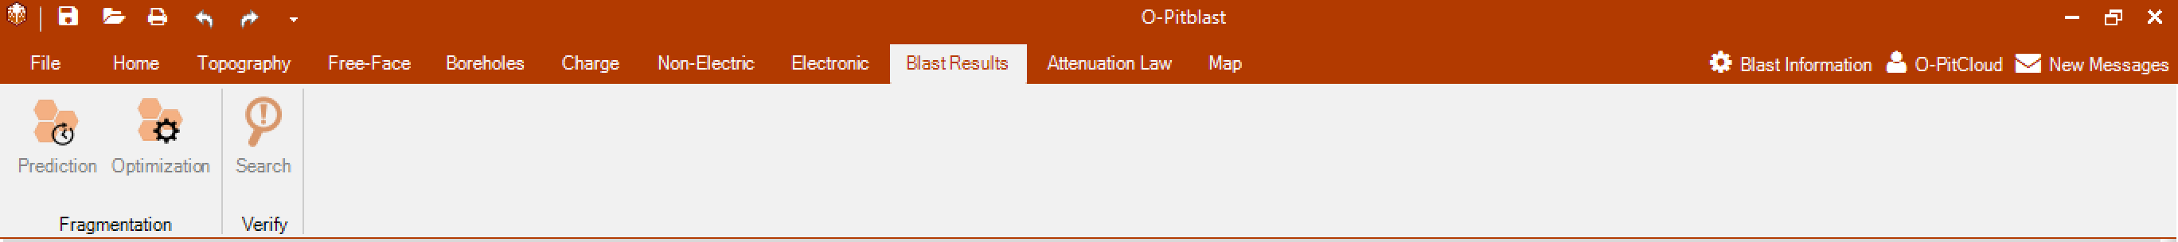
O-Pitblast – O-Pitcloud Module

Slide 3
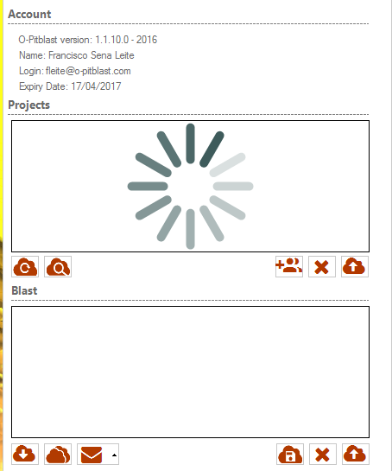

O-Pitblast – O-Pitcloud Module
User Projects
User Account
User Projects
User Blast

Slide 4
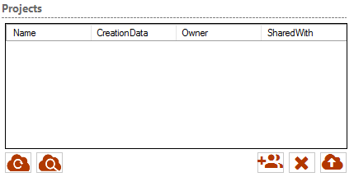
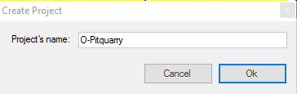
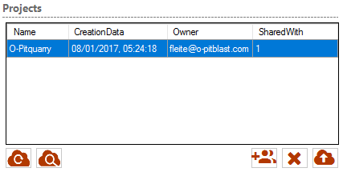
O-Pitblast – O-Pitcloud Module
User Projects
Reload Project List
Creat Project

Slide 5
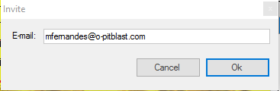
O-Pitblast – O-Pitcloud Module
User Projects
Invite users

Slide 6
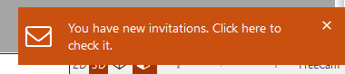
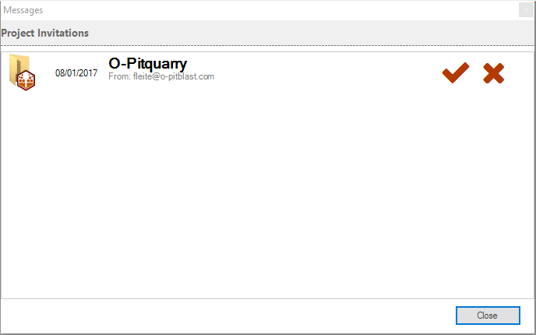
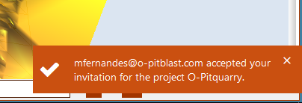
O-Pitblast – O-Pitcloud Module
User A
User B
+ Email

Slide 7
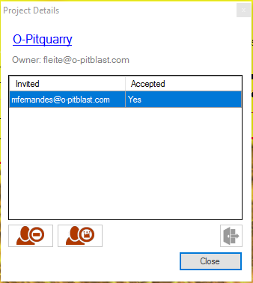
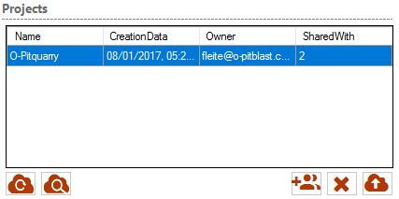
O-Pitblast – O-Pitcloud Module
User Projects
Change Name
Leave project
View Project Details
Exclude participant
Transfer ownership

Slide 8
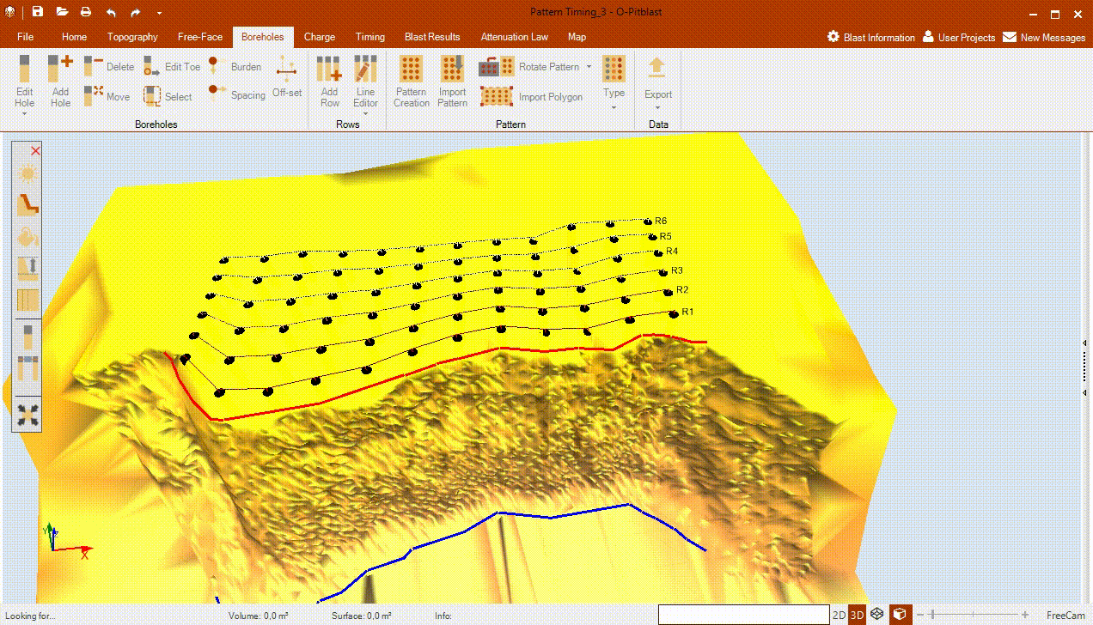
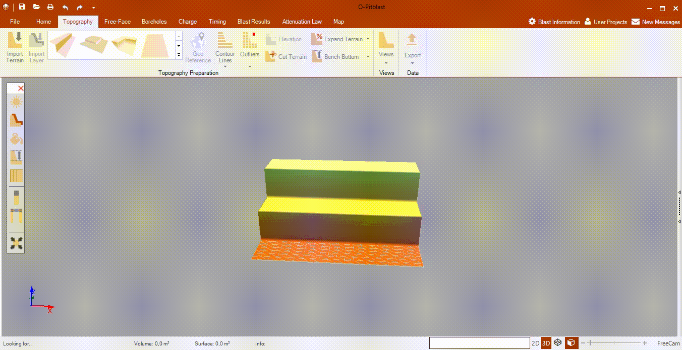
O-Pitblast – O-Pitcloud Module
User A
User B

Slide 9
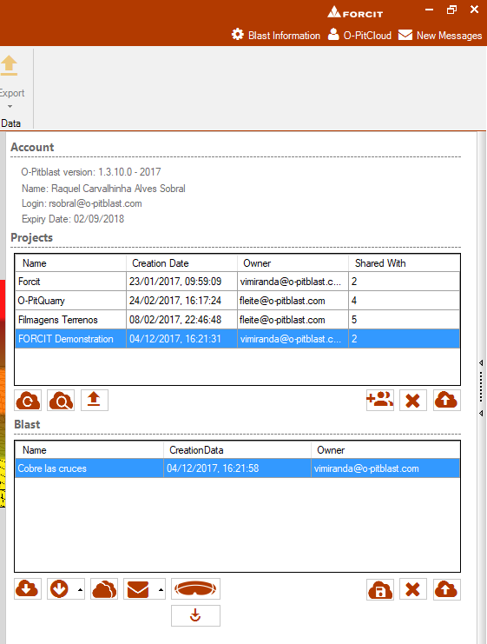
Upload information
Upload information

Slide 10
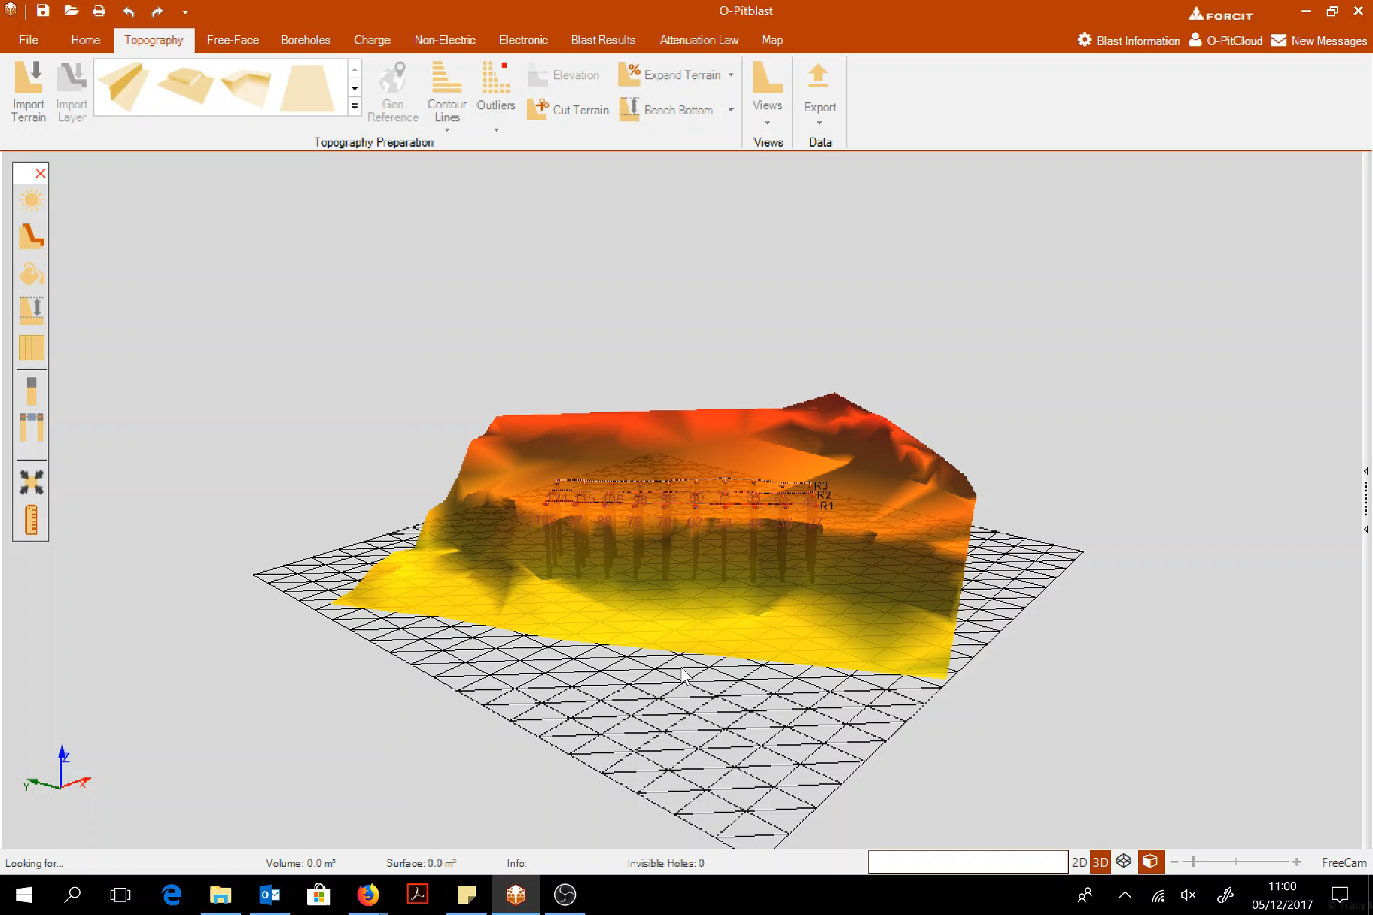
Upload information

Slide 11
Close window

Slide 12
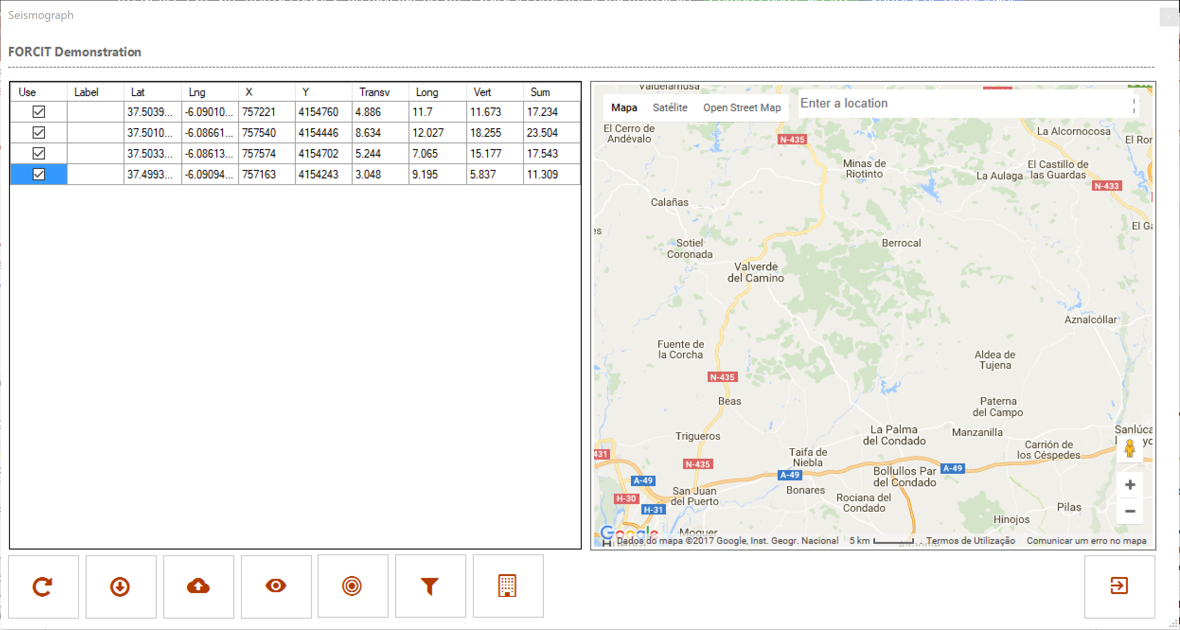
Seismograph window
Uncheck all no visibles
Load file
Filter
Reload
Update information on server
Create Attenuation law
Create Strutures

Slide 13
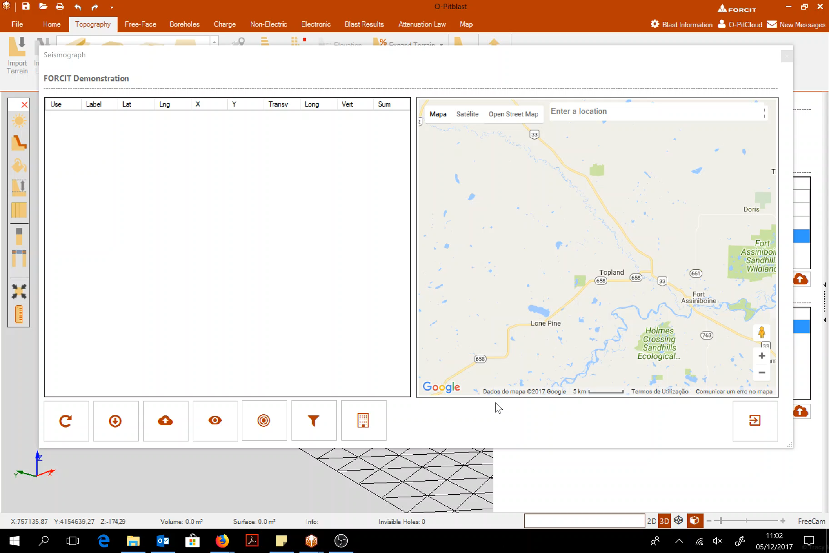
Load file

Slide 14
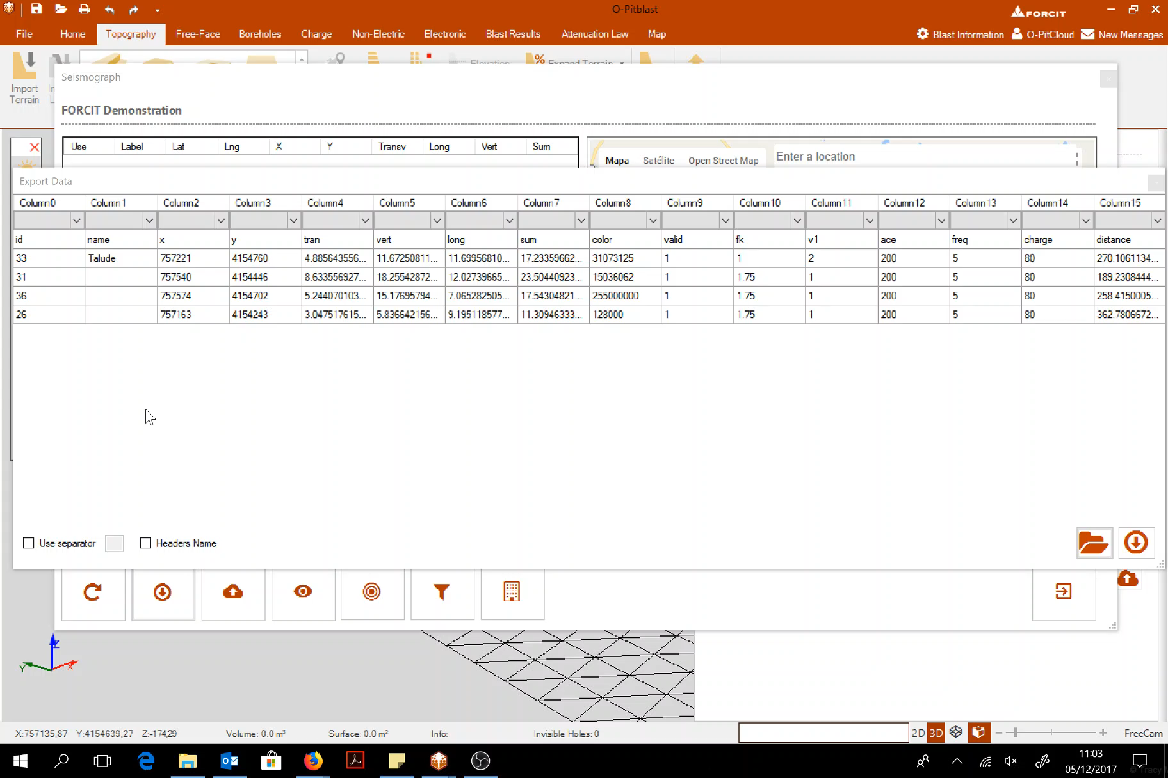
Export data (PPV [Finland] information)

Slide 15
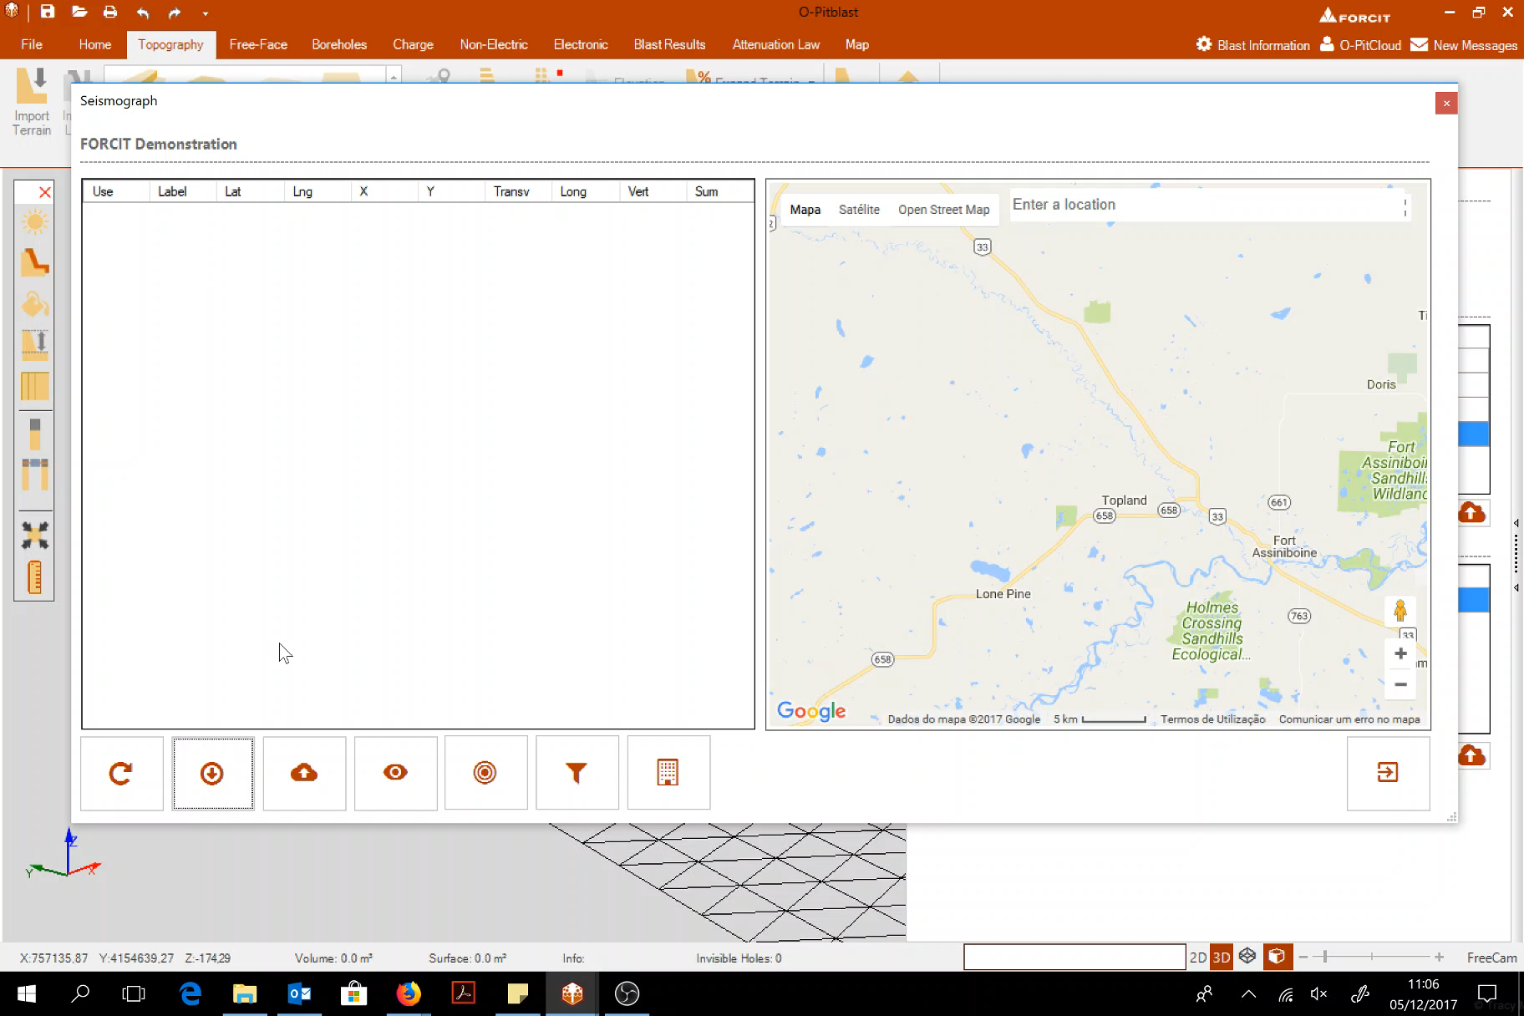
Export data

Slide 16
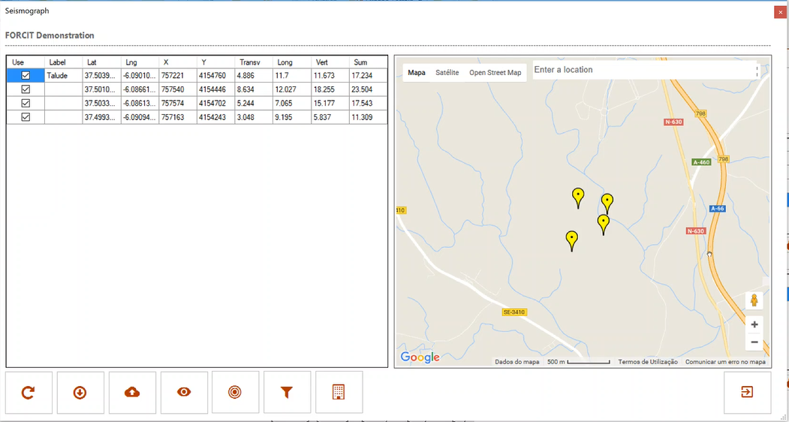
Export data
When the sismograph data is yellow it means that the data is NOT on the server yet.

Slide 17
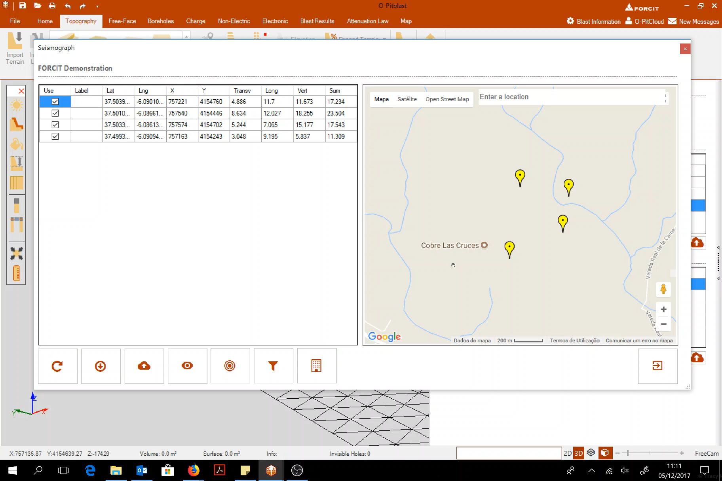
Upload to server

Slide 18
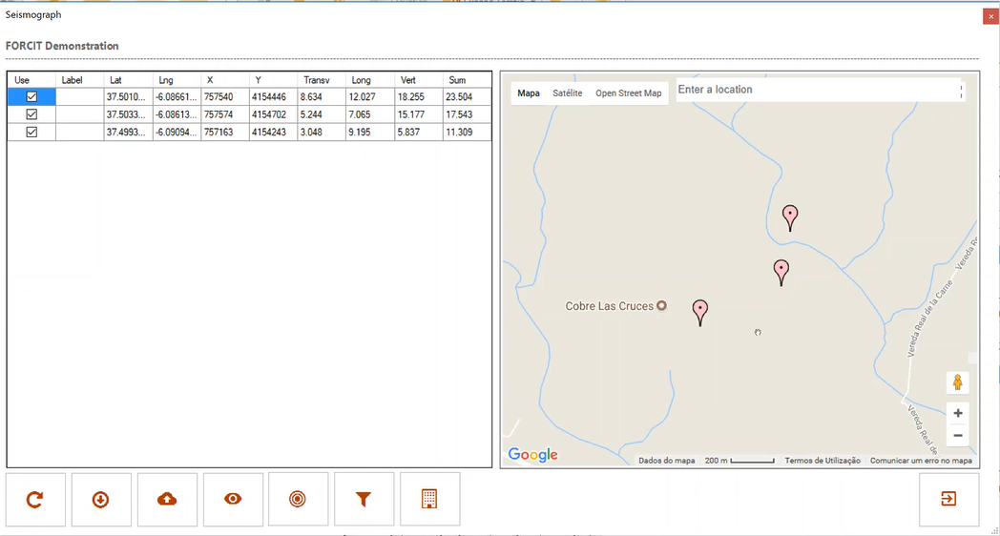
Upload to server
When the sismograph data is pink it means that the data is now on the serve.

Slide 19
Technical Support
Phone: +351 918 558 879
E-mail: support@o-pitblast.com

