Slide 1

O-Pitblast – O-Pitcloud Module

Slide 2
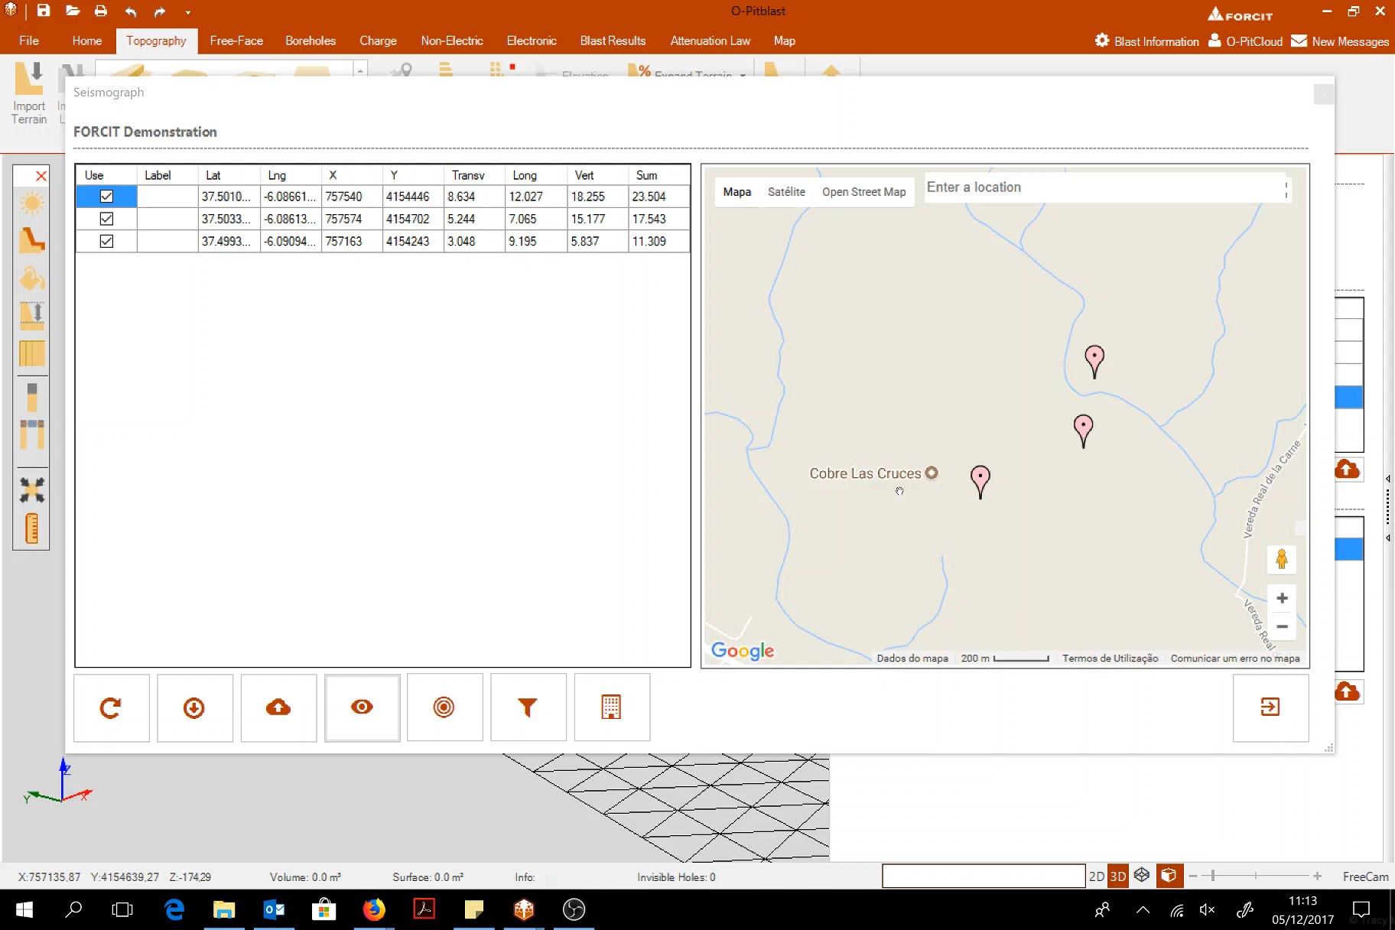
Check and uncheck (no visibles)

Slide 3
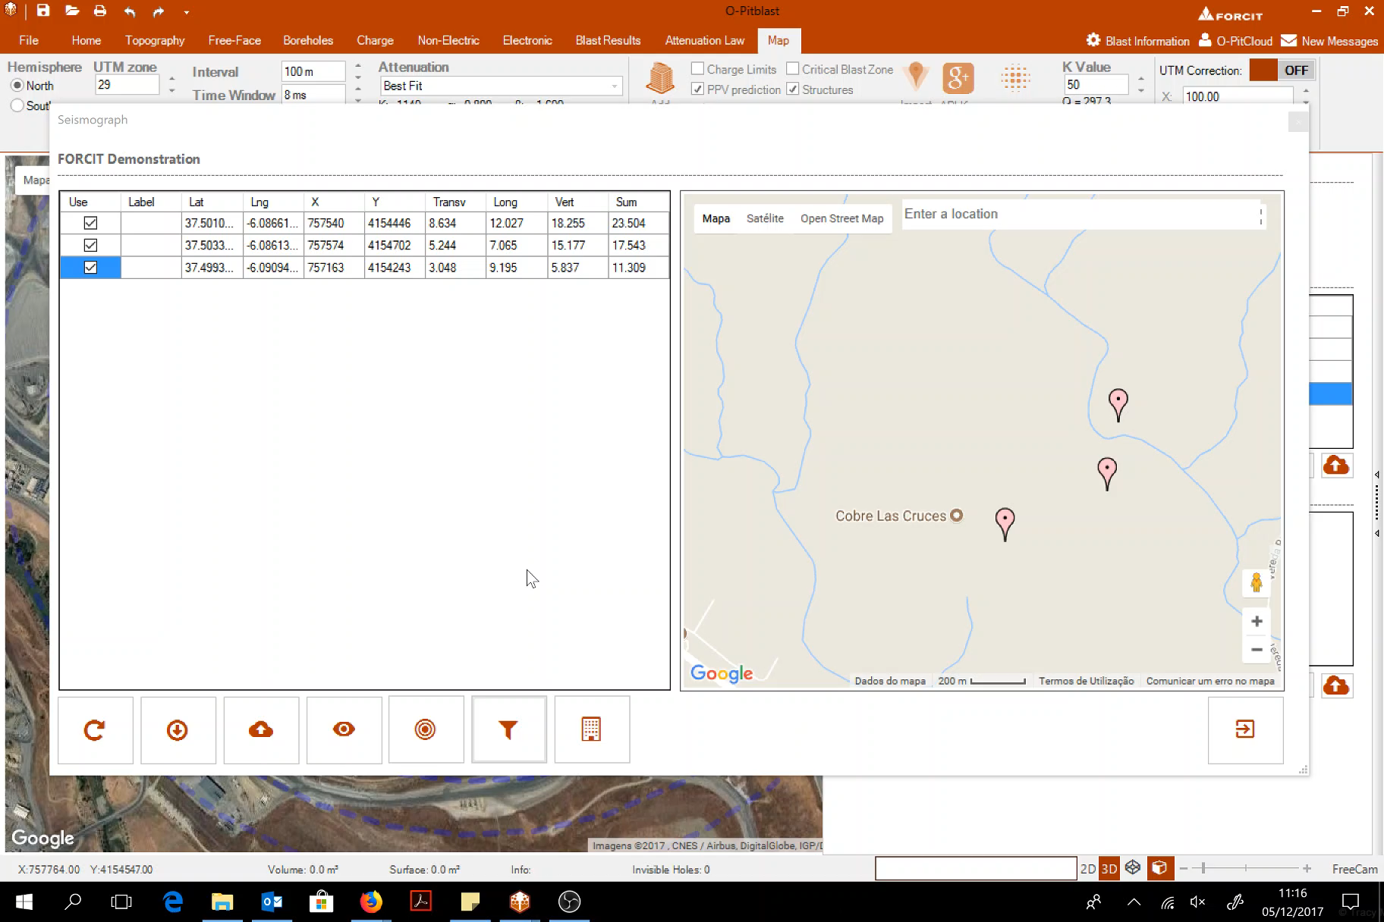
Filter data

Slide 4

Create attenuation law (new information)

Slide 5
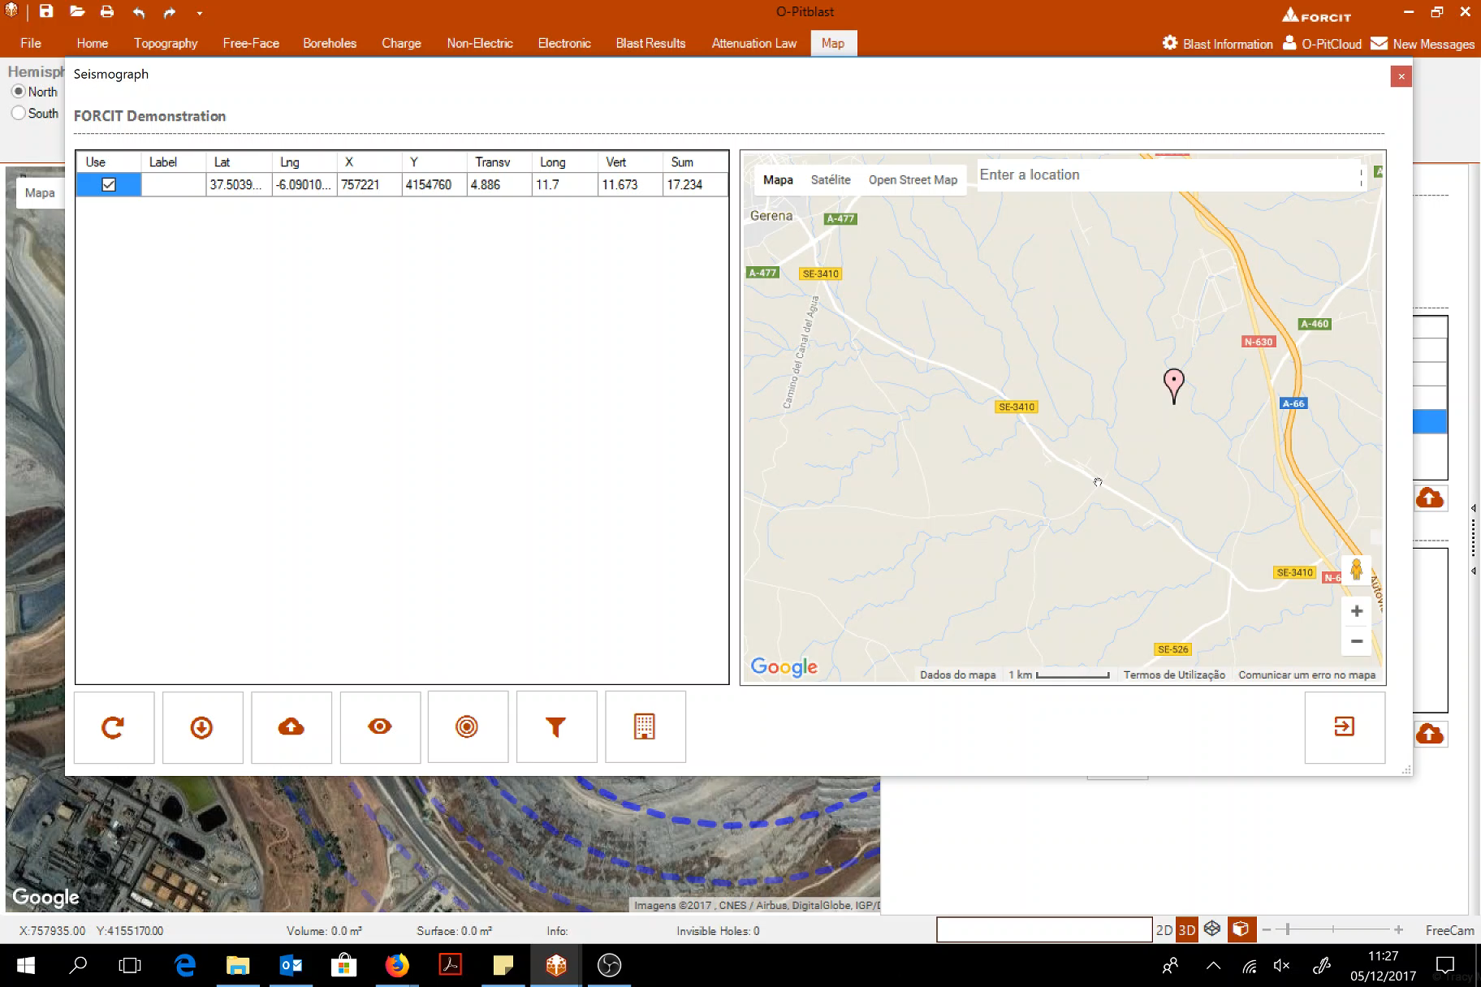
Create attenuation law (add information)

Slide 6
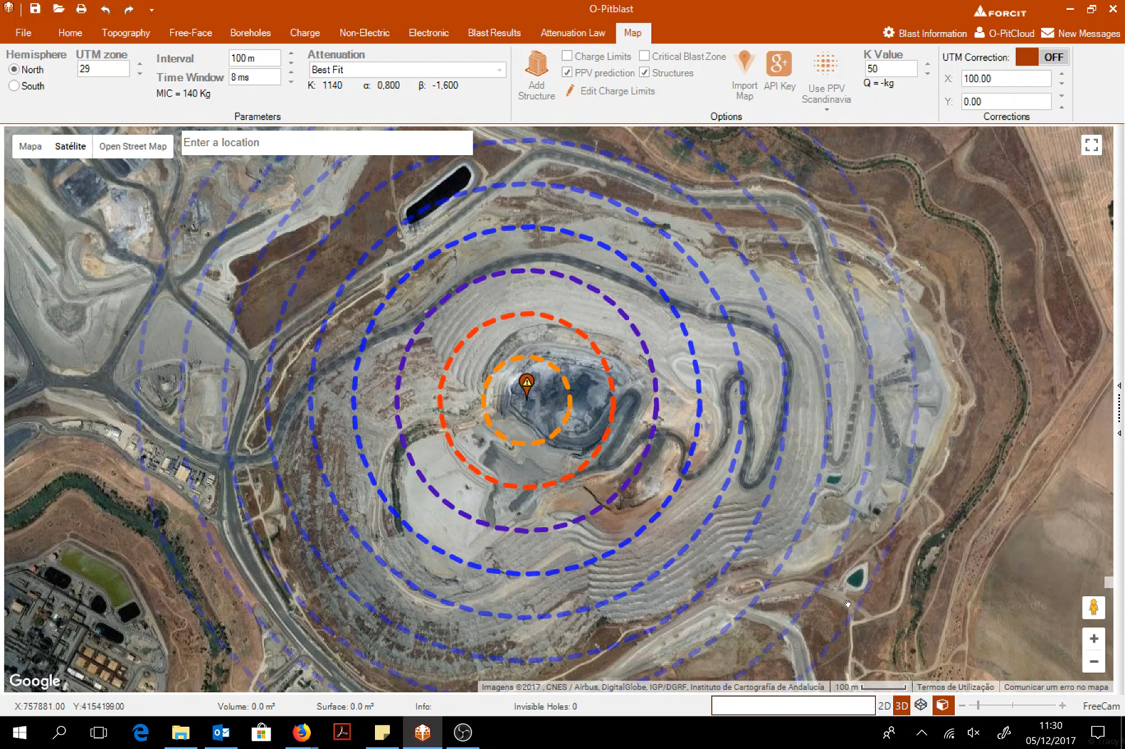
Add structure

Slide 7
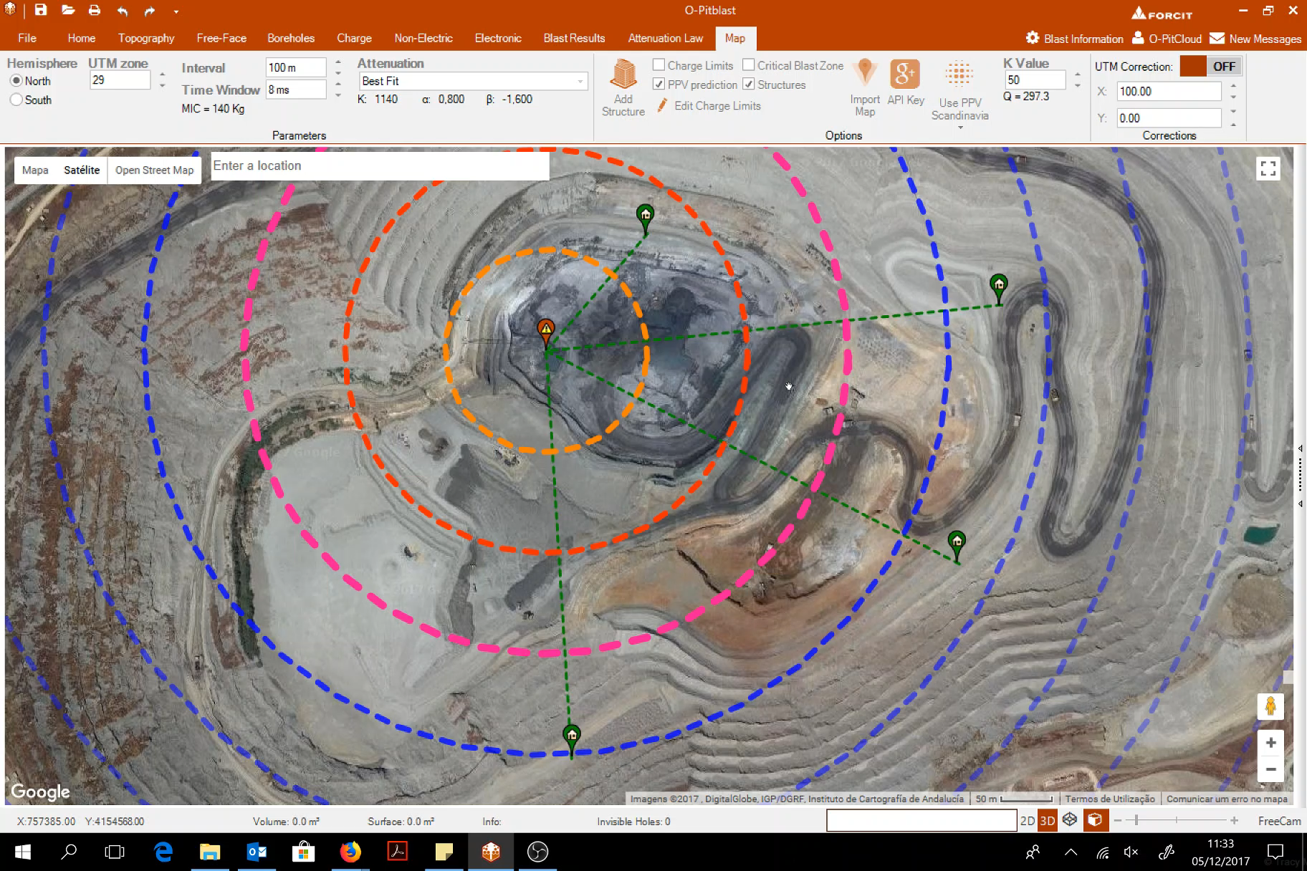
Add “repeated” structure

Slide 8
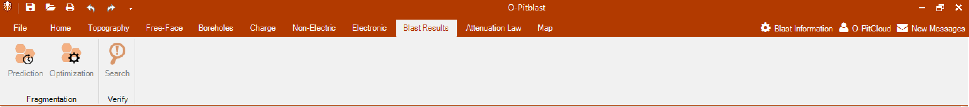
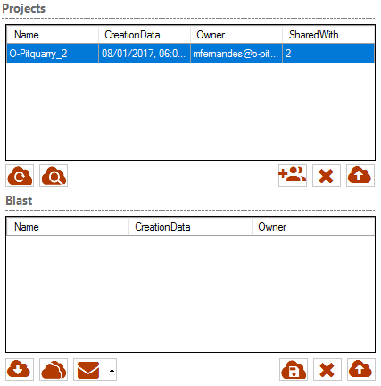
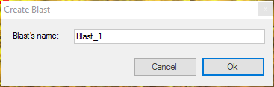
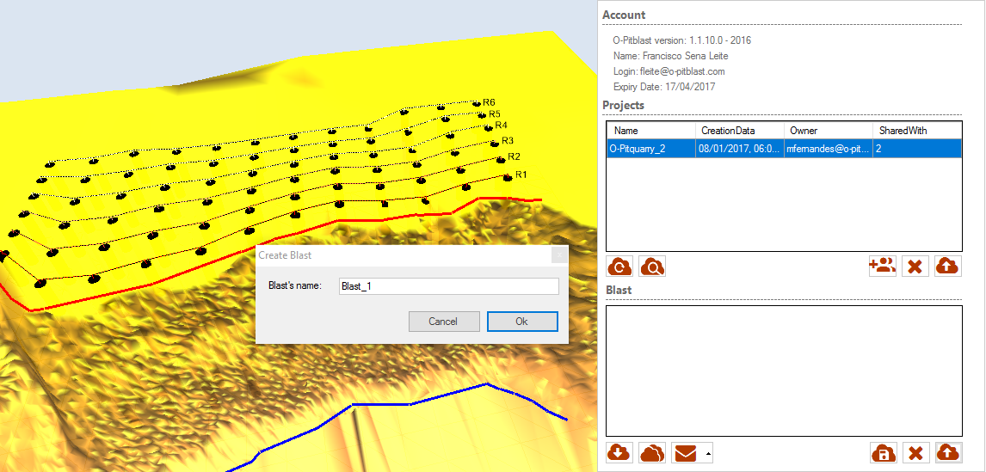
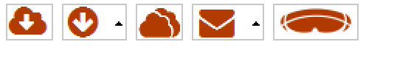
O-Pitblast – O-Pitcloud Module
User Blasts
Upload Blast

Slide 9
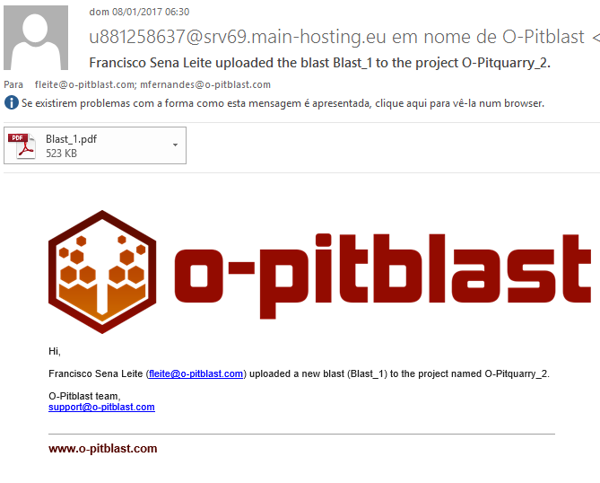
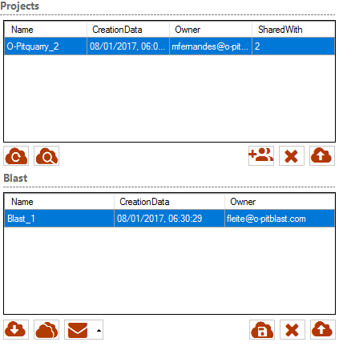
O-Pitblast – O-Pitcloud Module
User A
User B

Slide 10
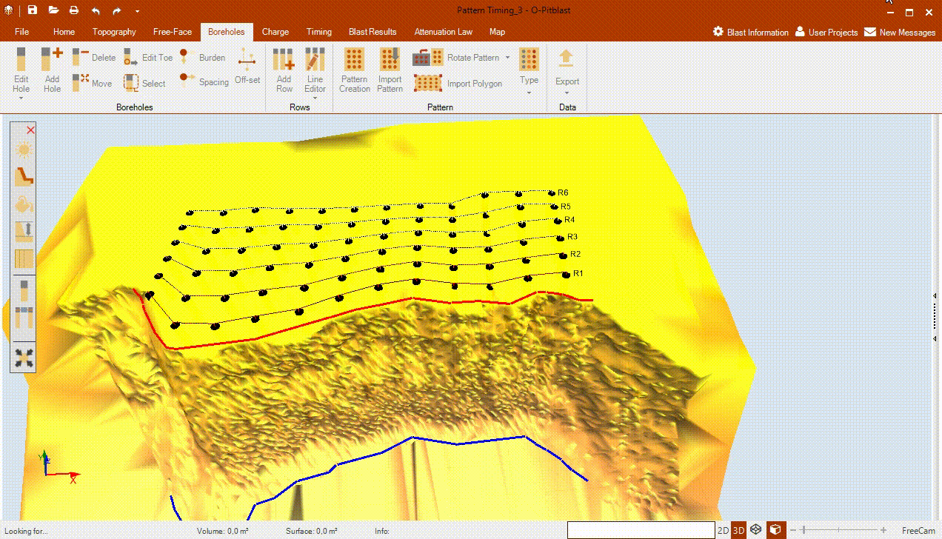
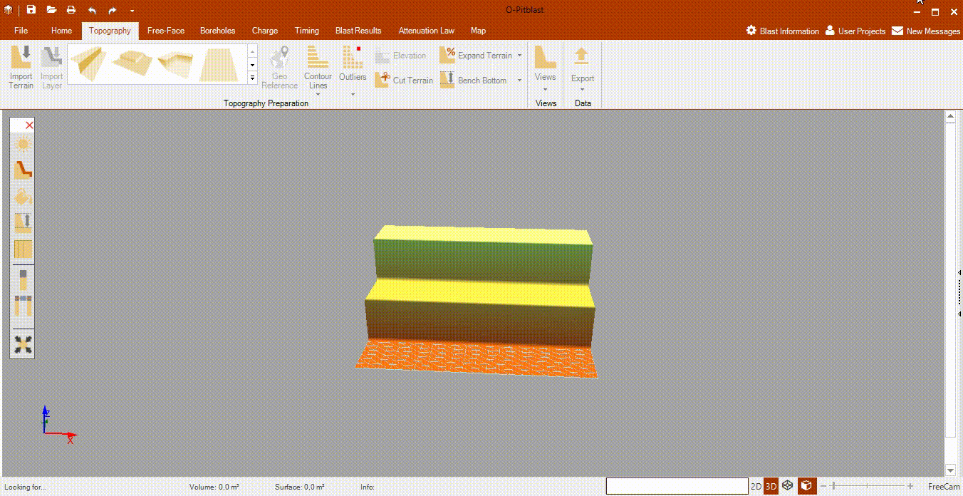
O-Pitblast – O-Pitcloud Module
User A
User B

Slide 11
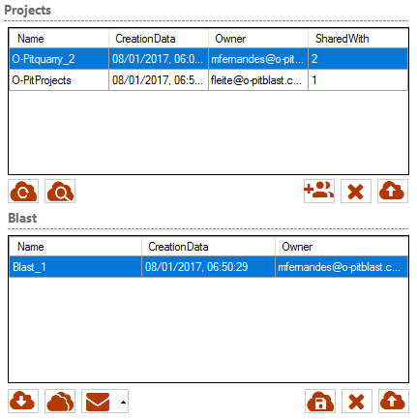
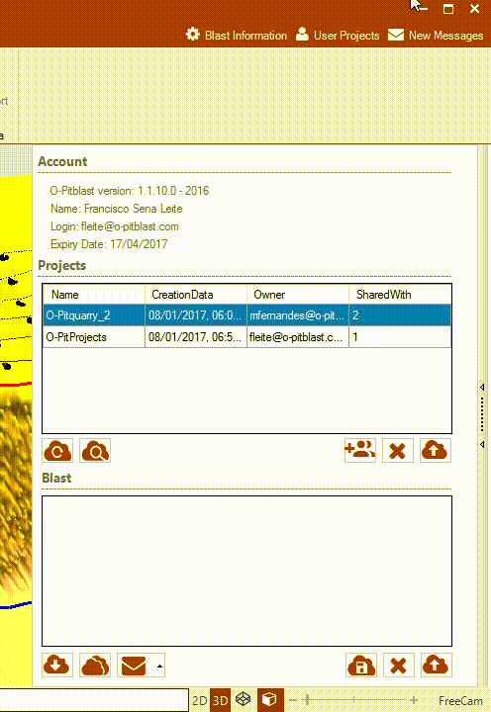
O-Pitblast – O-Pitcloud Module
Clone Blasts
Clone Blast

Slide 12
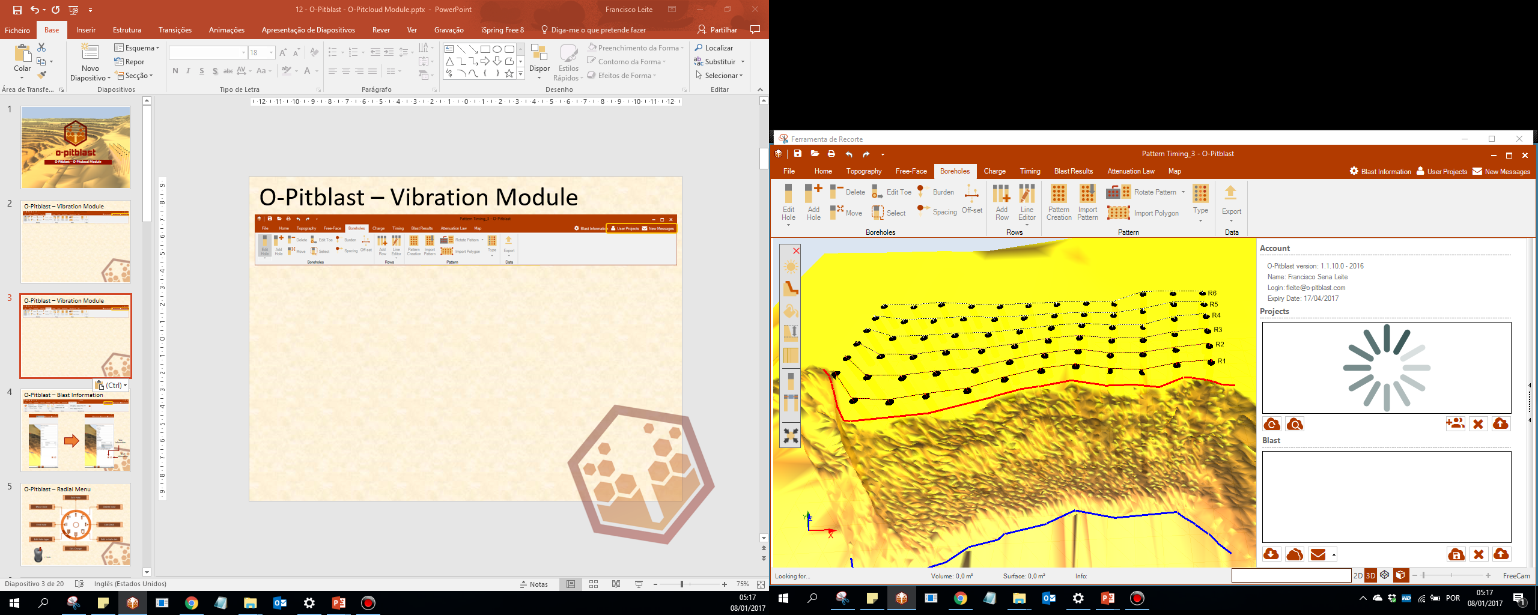
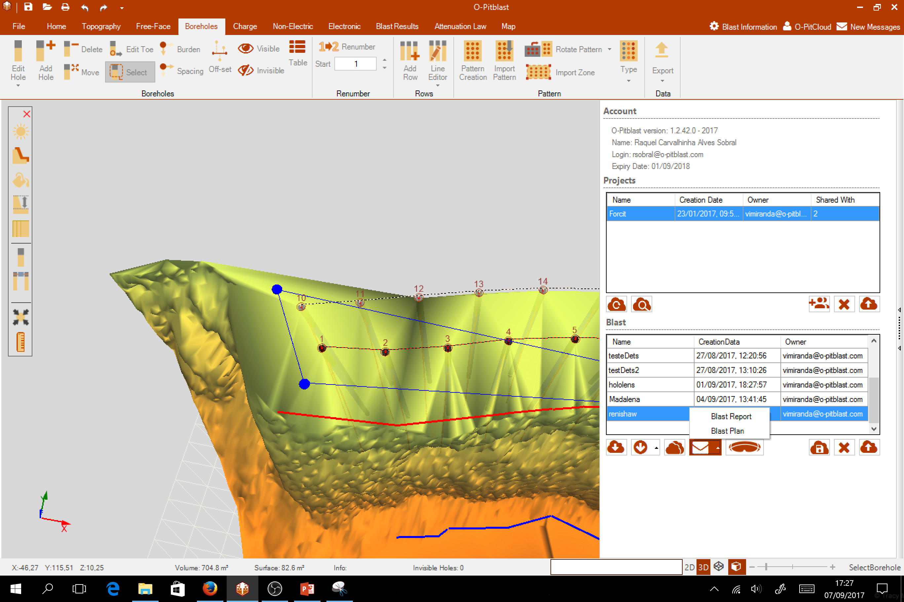
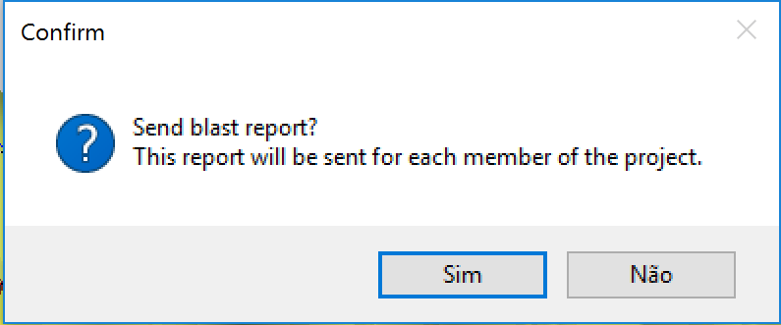
O-Pitblast – O-Pitcloud Module
Plan and report by e-mail

Slide 13
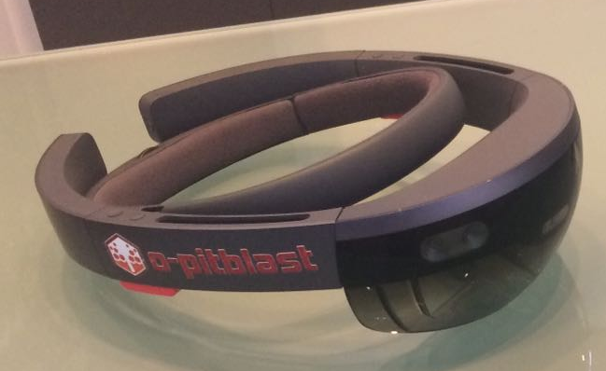
O-Pitblast – O-Pitcloud Module
Upload Hololens Information
Upload your blast to hololens

Slide 14
Technical Support
Phone: +351 918 558 879
E-mail: support@o-pitblast.com

