Slide 1
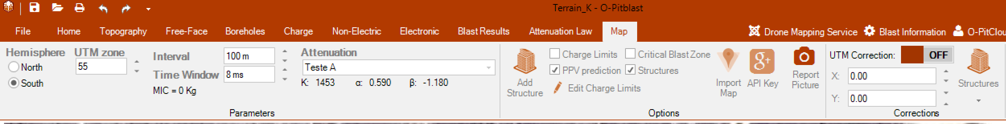
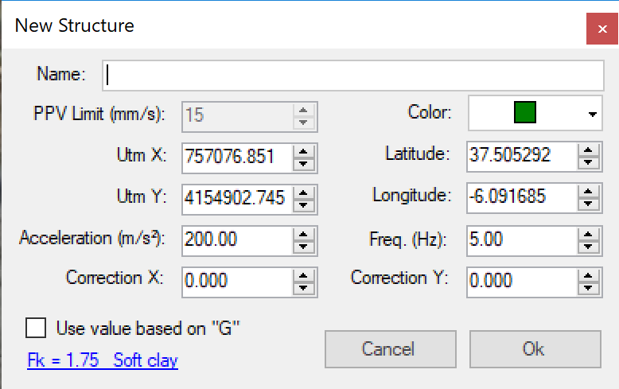
O-Pitblast – Vibration Module
You now can PPV or accelaration
Correction X
Correction Y

Slide 2
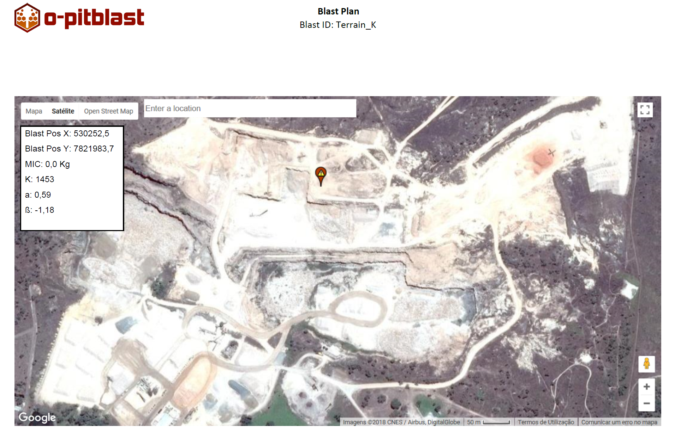
O-Pitblast – Vibration Module
Click on “Report Picture” to add a picture of your map and structures to your Plan.

Slide 3
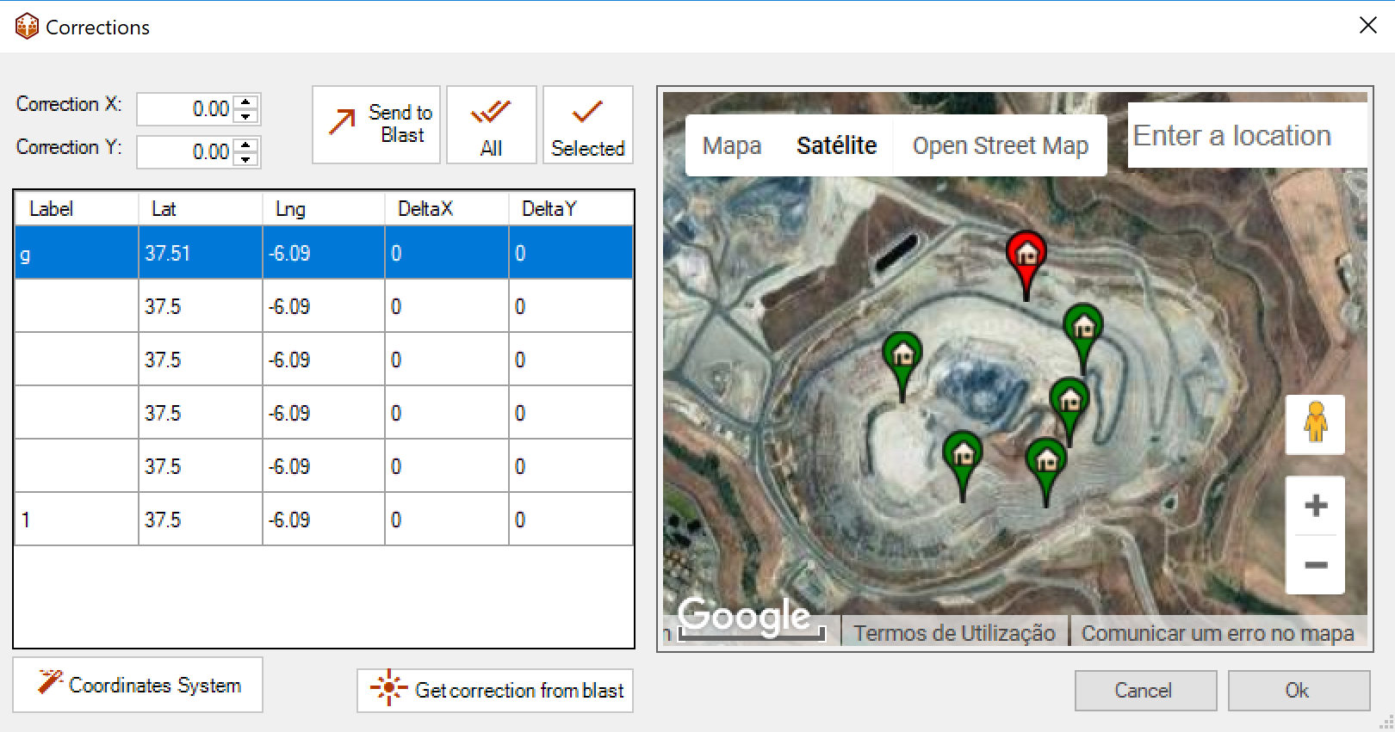
O-Pitblast – Vibration Module
Apply corrections to your structures
Apply X and Y corrections
Apply correction to the selected structures or all
Send correction to the blast
Change your blast position manually, and get the correction from the blast

Slide 4
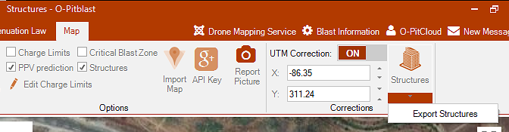
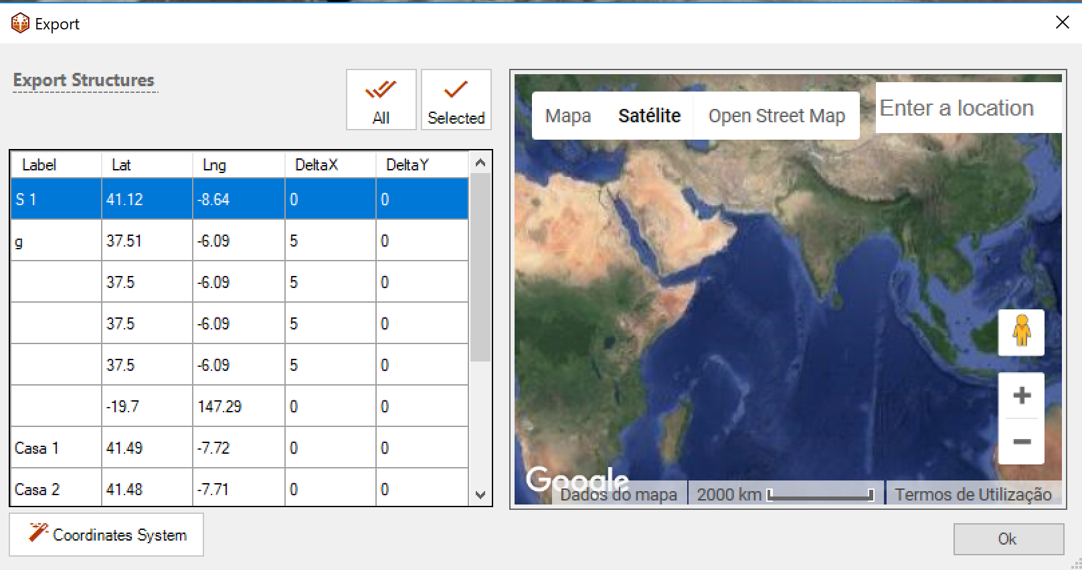
O-Pitblast – Vibration Module
  You can export structures (all of just the selected ones). And, if needed, you can change the coordinates system before you export.

Slide 5

Technical Support
Phone: +351 918 558 879
E-mail: support@o-pitblast.com

